Slide 1
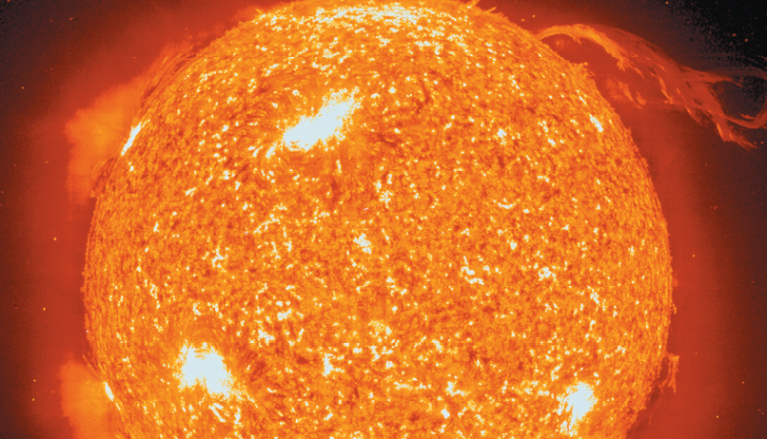
Chapter 18
Nuclear Chemistry
The energy of the sun comes from nuclear reactions. Solar flares are an indication of fusion reactions occurring at a temperature of millions of degrees.
Introduction to General, Organic, and Biochemistry 10e
John Wiley & Sons, Inc
Morris Hein, Scott Pattison, and Susan Arena

Slide 2
Chapter Outline
18.1 Discovery of Radioactivity 18.2 Natural Radioactivity 18.3 Alpha Particles, Beta Particles and Gamma Rays 18.4 Radioactive Disintegration Series 18.5 Transmutation of Elements 18.6 Artificial Radioactivity 18.7 Measurement of Radioactivity | 18.8 Nuclear Fission 18.9 Nuclear Power 18.10 The Atomic Bomb 18.11 Nuclear Fusion 18.12 Mass-Energy Relationship in Nuclear Reactions 18.13 Transuranium Elements 18.14 Biological Effects of Radiation

Slide 3
Radioactivity
Radioactivity is the spontaneous emission of particles and/or energy from an unstable nucleus of an atom.
Nucleons are the protons and neutrons in the nucleus of an atom.
Nuclide is how we refer to any isotope of an atom.
Radioactive nuclides are unstable nuclides that spontaneously emit radiation.
Stable nuclides are considered stable because they are not radioactive.

Slide 4
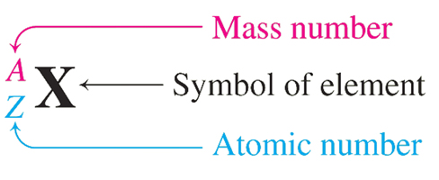
Isotopic Notation - Review
Mass number – 238
Atomic number – 92
Uranium-238 has 238 nucleons (92 protons and 146 neutrons).
Lead-210 has 210 nucleons (82 protons and 128 neutrons).

Slide 5
Your Turn!
How many protons, neutrons and nucleons are found in the nuclide:
83 protons, 127 neutrons and 210 nucleons
210 protons, 83 neutrons and 127 nucleons
127 protons, 83 neutrons and 210 nucleons

Slide 6
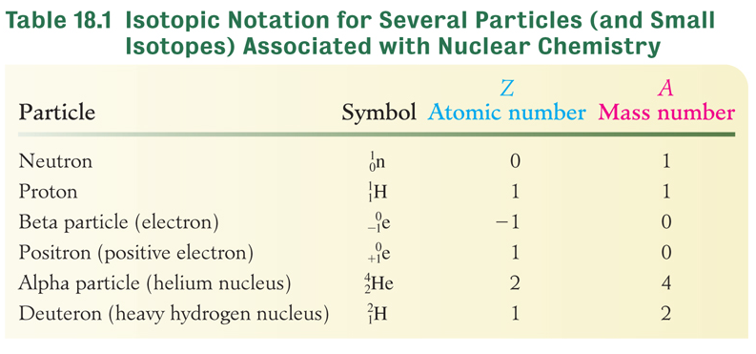
Types of Radiation

Slide 7
Natural Radioactivity
Radioactive decay is the continuous disintegration of radioactive nuclides.
The rate of decay is independent of temperature, pressure or the chemical or physical state of the nuclide.
Every radioactive nuclide has a characteristic half-life (t_{½}).
The half-life is the time required for one-half of a specific amount of a radioactive nuclide to disintegrate.

Slide 8
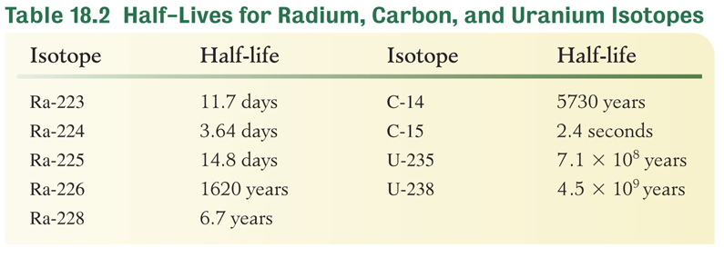
Half-Life
We can use the half-life of a radioactive nuclide to predict the amount remaining after a particular length of time.

Slide 9
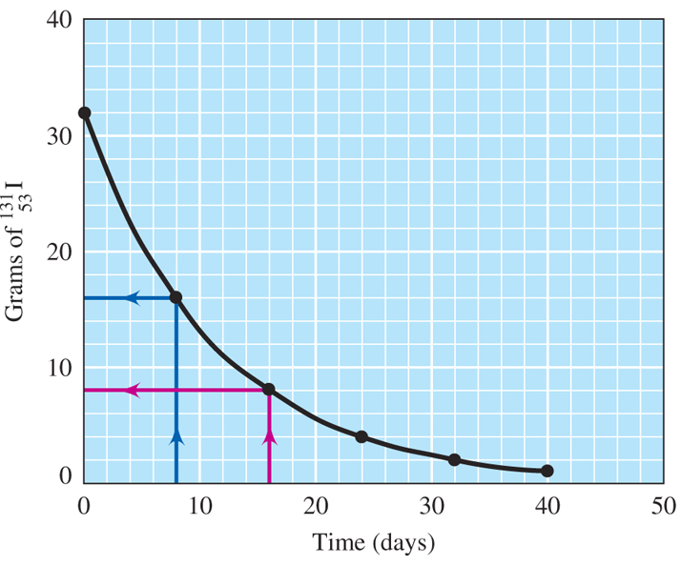
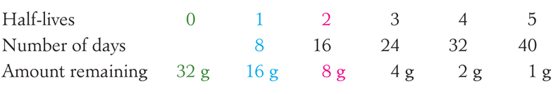
Half-Life of I-131
The half-life of I-131 is 8 days. How much I-131 from a 32-g sample remains after 5 half-lives?

Slide 10
Half-Life of C-14
The relative amount of radioactive carbon-14 is stable in living organisms, but the amount decreases after the organisms death. How many half-lives must elapse so that less than 1.0% of the radioactivity remains?
It takes almost 7 half-lives to get below 1.0%.
t_{½} = 5730 years How many years is 7 half-lives?
5730 years/half-life x 7 half-lives = over 40,000 years!

Slide 11
Your Turn!
A 4.0 g sample of Ra-226 decays to 1.0 g. If the half-life of Ra-226 is 1620 years, how much time has elapsed?
540 years
810 years
3240 years
4860 years

Slide 12
Your Turn!
The half-life of Au-198 is 2.7 days. What mass of Au-198 will remain unchanged if a 12.0 g sample decays for 13.5 days?
12.0 g
0.750 g
384 g
0.375 g

Slide 13
Your Turn!
As the temperature of a solid radioisotope increases, its half-life
Increases
Decreases
Remains the same

Slide 14
Stable Neutron to Proton Ratio
Radioactivity is the result of an unstable ratio of neutrons to protons in the nucleus.
Elements 1-20 are stable with 1 to 1 neutron to proton ratio.
In elements 21-83, the ratio of neutrons to protons needed gradually increases, until there is a 1.5 to 1 neutron to proton ratio in a stable isotope of Bi (83).
If the neutron to proton ratio is too high or too low, the nucleus emits particles to achieve a more stable nucleus.
All elements after 83 are radioactive.

Slide 15
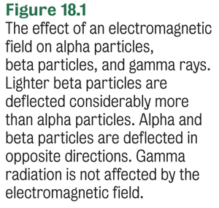
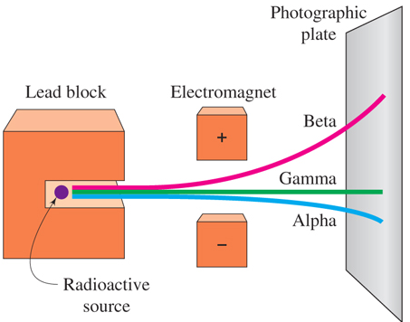
Alpha, Beta and Gamma Rays

Slide 16
Alpha Particles
Alpha particles () consist of 2 protons and 2 neutrons, with a mass of 4 amu and a charge of +2.
Loss of an alpha particle from the nucleus results in
a loss of 4 in the mass number (A)
a loss of 2 in the atomic number (Z)
The alpha decay of U-238 can be written two ways:
or

Slide 17
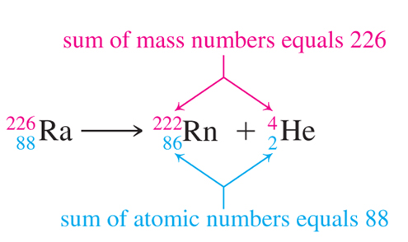
Balancing Nuclear Equations
Balance mass – sum of mass numbers of products must equal sum of mass numbers of reactants
Balance charge – sum of atomic numbers of products must equal sum of atomic numbers of reactants

Slide 18
Your Turn!
Bismuth-210 decays by alpha decay to produce
Tl-206
Tl-214
Au-206
Au-208
Au-214

Slide 19
Beta Particles
Beta particles () are identical in mass and charge to an electron.
Loss of a beta particle from the nucleus result in
no change in the mass number (A)
an increase of 1 in the atomic number (Z)
The beta decay of Th-234 can be written two ways:
or

Slide 20
Your Turn!
Carbon-14 is a beta emitter. What new nuclide is formed from the decay?
B-14
N-14
Be-10

Slide 21
Gamma Rays
Gamma rays ( ) are photons of energy (higher than x-rays).
Loss of a gamma ray results in no change in mass number or atomic number.
Boron-11 is a gamma emitter.

Slide 22
Your Turn!
Polonium-210 is both an alpha emitter and a gamma emitter. What is nuclide that forms as a result of this decay?
Lead-206
Lead-214
Radon-206
Radon-214

Slide 23
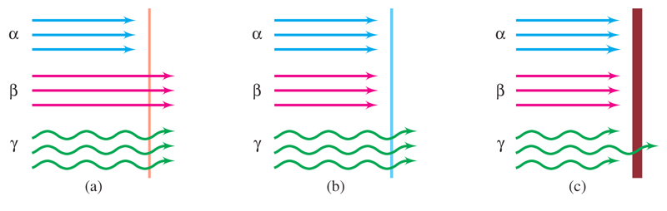
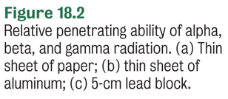
Penetrating Power
Sheet of
paper
Sheet of
aluminum
5-cm
Pb block

Slide 24
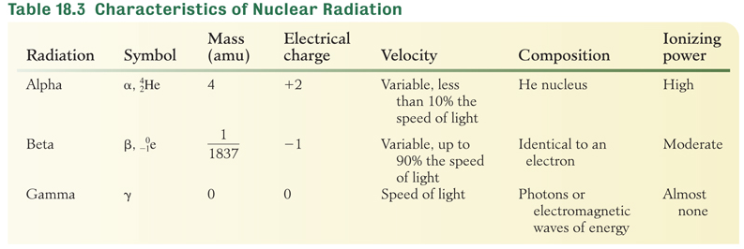
Characteristics of Nuclear Radiation

Slide 25
Your Turn!
Which form of nuclear emission requires the greatest amount of shielding to provide protection from radiation injury?
Alpha
Beta
Gamma

Slide 26
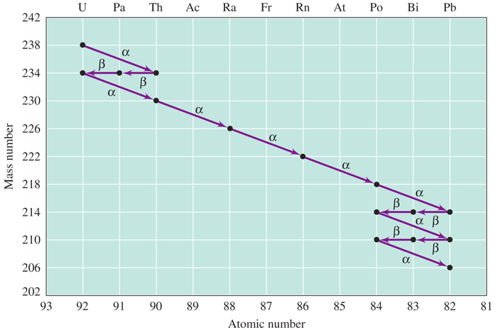
Uranium Disintegration Series
Figure 18.3 decays by a series of emissions to form the
stable nuclide

Slide 27
Your Turn!
What nuclide is formed when U-238 undergoes one alpha decay and two beta decays?
U-238
U-234
Th-230

Slide 28
Transmutation of Elements
Transmutation is the conversion of one element into another by either natural or artificial means.
Transmutation occurs spontaneously in natural radiation.
The first artificial transmutation was done in 1919 in Ernest Rutherford’s lab:

Slide 29
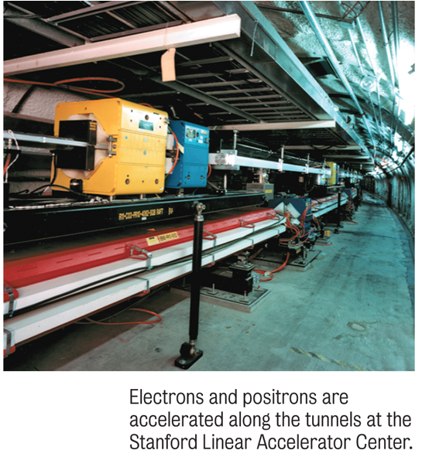
Transmutation
Many elements have been made using particle accelerators.
Californium:
Roentgenium:

Slide 30
Artificial Radioactivity
Irene and Frederick Joliot-Curie discovered that the bombardment of aluminum-27 with alpha particles resulted in the emission of neutrons and positrons:
First phosphorus-30 is produced along with a neutron:
Then silicon 30 is produced along with a positron:

Slide 31
Artificial Radioactivity
The radioactivity of nuclides produced by bombarding stable isotopes with small particles like neutrons or alpha particles is known as artificial radioactivity or induced radioactivity.
The Joliot-Curies received the Nobel Prize in chemistry in 1935 for the discovery of artificial, or induced, radioactivity.

Slide 32
Your Turn!
In an artificial transmutation process, a nucleus of Be-9 absorbs a proton, emits a particle, and is converted into Li-6. What was the particle emitted?
A proton
A neutron
An electron
An alpha particle

Slide 33
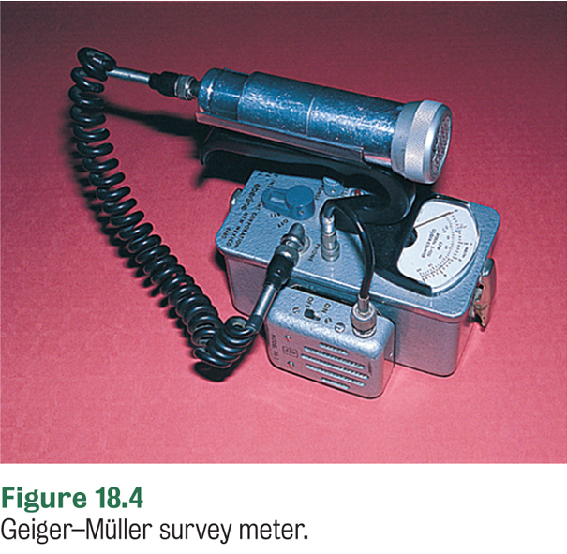
Measurement of Radioactivity with a Geiger Counter
Ionizing radiation is high energy radiation that causes atoms or molecules to become ionized.
  If ionizing radiation enters the Geiger counter tube, argon in the tube is ionized and an electric current passes between two electrodes.
  Radiation is measured in counts/min or counts/s.

Slide 34
Curie:
A Unit for Measuring Radioactivity
The curie is the unit used to express the amount of radioactivity produced by an element.
One curie (Ci) = 3.7 x 10¹⁰ disintegrations per second.
This definition came from the element radium, which has an activity of 1Ci/g
Because a curie is so large the millicurie (one thousandth of a curie) and the microcurie (one millionth of a curie) are more commonly used.

Slide 35
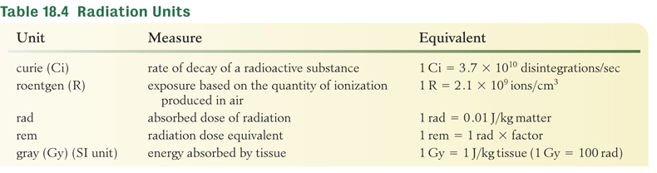
Other Units of Radiation
The rem takes into account the degree of biological effect caused by the type of radiation exposure. For example, alpha particles are 10 times more ionizing than beta particles so the factor is 10 for an alpha particle and a 1 for a beta particle.

Slide 36
Nuclear Fission
In nuclear fission a heavy nuclide struck by a neutron splits into two or more intermediate-sized fragments.
Characteristics of nuclear fission:
Upon absorption of a neutron, a heavy nuclide splits into one or more smaller nuclides (fission products).
The mass of the nuclides ranges from abut 70-160 amu.

Slide 37
Nuclear Fission
Two or more neutrons are produced from the fission of each atom.
Large quantities of energy are produced as a result of the conversion of a small amount of mass into energy.
Many nuclides produced are radioactive and continue to decay until they reach a stable nucleus.

Slide 38
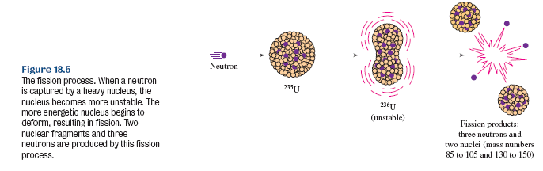
Nuclear Fission

Slide 39
Chain Reactions
In a chain reaction the products cause the reaction to continue or magnify.
For a chain reaction to continue, enough fissionable material must be present so that each atomic fission causes, on average, at least one additional fission.
The minimum quantity of an element needed to support a self-sustaining chain reaction is called the critical mass.
Since energy is released in each atomic fission, chain reactions provide a steady supply of energy.

Slide 40
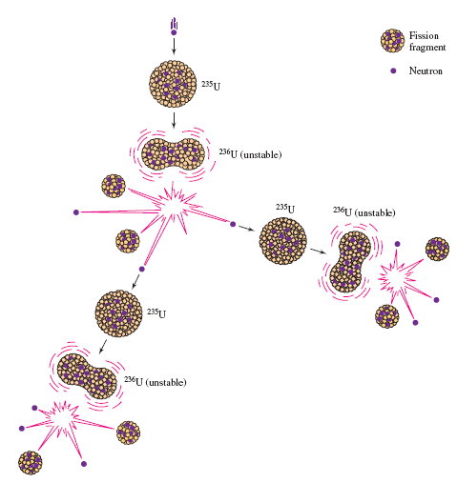
Chain Reactions
Figure 18.6 Fission and chain reaction of U-235. Each fission produces 2 major fission fragments and 3 neutrons, which may be captured by other U-235 nuclei, continuing the chain reaction.

Slide 41
Your Turn!
A nucleus of U-235 absorbs a neutron, undergoes fission, and produces two fission fragments and two neutrons. One fission fragment is Xe-144, what is the other?
Sr-90
Xe-91
Rb-88
Br-92

Slide 42
Nuclear Power
A nuclear power plant is a thermal power plant in which heat is produced by a nuclear reactor.
The major components of a nuclear reactor are
  an arrangement of nuclear fuel, called the reactor core.
  a control system, which regulates the rate of fission and thereby the rate of heat generation.
  a cooling system, which removes the heat from the reactor and keeps the core at the proper temperature.

Slide 43
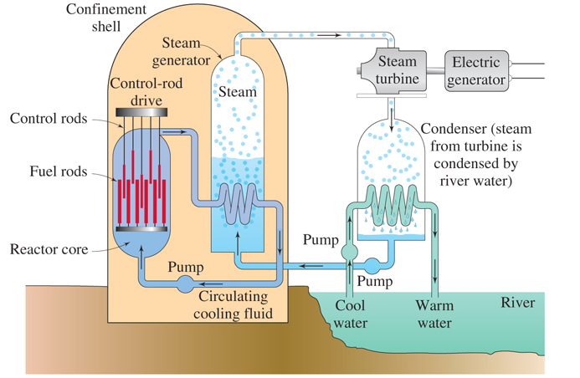

Nuclear Power

Slide 44
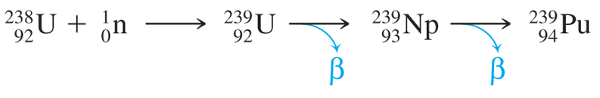
Breeder Reactors
Breeder reactors generate nuclear power as well as additional fissionable material while fission is occurring.
In a breeder reactor, excess neutrons convert non-fissionable isotopes, such as U-238 or Th-232, to fissionable isotopes, Pu-239 or U-233.

Slide 45
The Atomic Bomb
The atomic bomb is a fission bomb.
It involves a very fast reaction that releases a tremendous amount of energy.
A minimum critical mass of fissionable material is required for a bomb.
The fissionable material of an atomic bomb is stored as two or more subcritical masses and are then brought together to achieve a nuclear detonation.

Slide 46
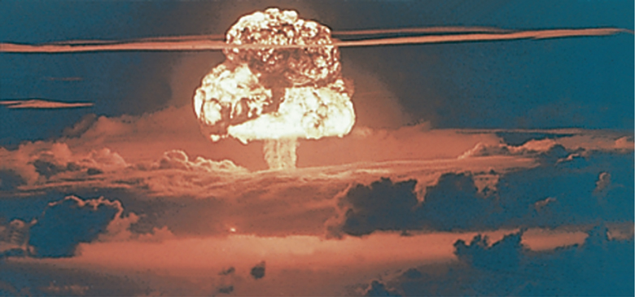

The Atomic Bomb
The hazards include
shock wave
explosive pressure
tremendous heat
intense nuclear radiation
radioactive fission products contaminating area after the explosion

Slide 47
Nuclear Fusion
Nuclear fusion is the process of uniting the nuclei of two light elements to form one heavier nucleus.
The masses of the two nuclei that fuse into a single nucleus are greater than the mass of the nucleus formed by their fusion. The difference in mass produces the great amount of energy released.
3.0150
amu
1.0079
amu
4.0026
amu
4.0229 amu
4.0229 amu – 4.0026 amu = 0.0203 amu

Slide 48
Fusion Power
The potential for fusion power is great because
  Virtually infinite amounts of energy are possible from fusion power.
  While uranium supplies are limited, deuterium supplies are abundant (sea water).
  Fusion power is much “cleaner” than fission power because it doesn’t generate radioactive waste.
  There are no fusion reactors yet because of the difficulty of maintaining the temperatures needed for fusion.

Slide 49
Your Turn!
In a fusion reaction two nuclei of H-2 combine to form a nucleus of
H-4
He-4
He-2
Li-4

Slide 50
Your Turn!
Which statement does not describe nuclear fusion?
This reaction occurs at very high temperatures
This reaction uses uranium as a fuel
This reaction converts mass into energy
This reaction does not occur naturally on Earth

Slide 51
Your Turn!
In which type of reaction do the nuclei of two light elements unite to form a heavier nucleus?
Fission
Fusion
Alpha decay
Beta decay

Slide 52
Mass-Energy Relationship in Nuclear Reactions
The mass defect is the difference between the mass of a nucleus and the sum of the masses of the protons and neutrons that make up the nucleus.
The energy equivalent to this mass is the nuclear binding energy. The higher the binding energy, the more stable the nucleus.
It is this tremendous amount of energy that is being harnessed in fission and fusion power. There are 9.0x10¹³J of energy released for every g of mass converted to energy..

Slide 53
Calculate the Nuclear Binding Energy for an Alpha Particle
Known
proton mass = 1.0073 g/mol, neutron mass = 1.0087 g/mol
α mass = 4.0015 g/mol and 1.0 g = 9.0 x 10¹³J
First calculate the sum of the individual parts of an α particle and then calculate the mass defect:
2 protons: 2 x 1.0073 g/mol = 2.0146 g/mol
2 neutrons: 2 x 1.0087 g/mol = 2.0174 g/mol 4.0320 g/mol
Plan
The mass defect = 4.0320 – 4.0015 = 0.0305 g/mol
Calculate
The nuclear binding energy is
(0.0305 g/mol)(9.0 x 10¹³J/g) = 2.7x10¹² J/mol

Slide 54
Transuranium Elements
All elements with atomic numbers greater than 92 are man-made and do not occur naturally.
All were made in minute quantities by high-energy particle accelerators.
Plutonium (the most important transuranium element) was found as the beta decay product of the very first transuranium element discovered (Np).

Slide 55
Biological Effects of Radiation
Ionizing radiation is radiation with enough energy to dislocate bonding electrons and create ions when passing through matter.
Alpha particles, beta particles, gamma rays and X-rays are all ionizing.
Ionizing radiation damages or kills living cells.
Radiation damage is greatest in the nuclei of the cells that are undergoing rapid cell division, making nuclear therapy useful for cancer treatment.

Slide 56
Your turn!
Which is true about ionizing radiation?
It dislocates bonding electrons and creates ions
It can damage DNA molecules
Both large acute doses and small chronic doses are harmful
All the above are true

