Slide 1
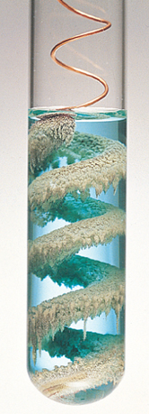
Chapter 17
Oxidation-Reduction
Cu_{(s)} + 2AgNO_{3(aq)} → 2Ag_{(s)} + Cu(NO₃)_{2(aq)}
copper
wire
colorless
solution
silver
crystals
pale blue
solution
Introduction to General, Organic, and Biochemistry 10e
John Wiley & Sons, Inc
Morris Hein, Scott Pattison and Susan Arena
Notes:
Figure 17.3 A coil of copper placed in a silver nitrate solution forms silver crystals on the wire the pale blue of the solution indicates the presence of copper ions.

Slide 2
Chapter Outline
17.1 Oxidation Number 17.2 Oxidation-Reduction 17.3 Balancing Oxidation-Reducing Equations | 17.4 Balancing Ionic Redox Equations 17.5 Activity Series of Metals 17.6 Electrolytic and Voltaic Cells

Slide 3
Oxidation Number
The oxidation number (oxidation state) is an integer assigned to each element in a particle that allows us to keep track of electrons associated with each atom.
An oxidation number of 0 means the atom has the same number of electrons assigned to it as there are in the free neutral atom. (Elements are 0.)
A positive oxidation number means the atom has fewer electrons assigned to it than in the neutral atom.
A negative oxidation number means the atoms has more electrons assigned to it than in the neutral atom.

Slide 4

Molecular Substances
Elements and molecules whose electrons are equally shared have zero oxidation numbers:
Polar bonds are made of unequally shared electron pairs. The electrons are assigned to the more electronegative element.
+1
-1
Assigned to Cl.

Slide 5
Rules for Assigning Oxidation Numbers
Elements in the free state are 0.
H is +1 except in metal hydrides where it is -1.
O is –2 except in peroxide where it is –1 and in OF₂ where it is +2.
In covalent compounds the negative oxidation number is assigned to the most electronegative atom.
The sum of the oxidation numbers in a compound is zero.
The sum of the oxidation numbers in a polyatomic ion is the charge of the ion.

Slide 6
Finding the Oxidation Number
Write the oxidation number of each known atom below the atom in the formula.
Multiply each oxidation number by the number of atoms of that element in the compound.
Write an expression indicating the sum of all the oxidation numbers in the formula.
  Sum = 0 for a compound
  Sum = charge for a polyatomic ion.

Slide 7
Nitrogen Oxides
Oxygen is -2 since it is the more electronegative element.
N₂O
-2
2N +(-2)=O
N = +1
N₂O₃
-2
2N +3(-2)=O
N = +3
NO₂
-2
N +2(-2)=O
N = +4
 | N₂ | N₂O | NO | N₂O₃ | NO₂ | N₂O₅
N oxidation number | 0 | +1 | +2 | +3 | +4 | +5

Slide 8
Oxidation Number of Ions
Cr₂O₇²⁻
2Cr + 7(-2) = -2
Cr = +6
CO₃²⁻
C + 3(-2) = -2
C = +4
HSO₄⁻
S + 1(+1) + 4(-2) = -1
S = +6

Slide 9
Your Turn!
What is the oxidation number of manganese in MnO₂?
0
+2
+4
-2
-4

Slide 10
Your Turn!
What is the oxidation number of sulfur in H₂SO₃?
+2
+4
+6
-4
-6

Slide 11
Your Turn!
What is the oxidation number of carbon in C₂O₄²⁻?
0
+1
+2
+3
+4

Slide 12
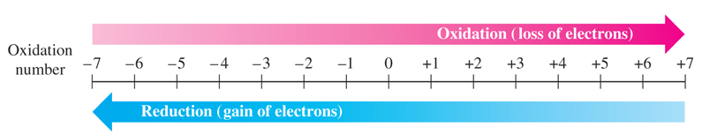
Oxidation-Reduction (Redox)
Redox reactions are chemical processes in which the oxidation numbers of an element are changed.
Oxidation occurs whenever the oxidation number increases from loss of electrons.
Reduction occurs whenever the oxidation number decreases from gain of electrons.
Notes:
Figure 17.1 Oxidation and reduction. Oxidation results in an increase in the oxidation number, and reduction results in a decrease in the oxidation number.

Slide 13
Redox
Easy ways to remember which is which:
OIL RIG: Oxidation Is Loss, Reduction Is Gain
LEO the lion goes GER: Lose Electrons – Oxidation,
Gain Electrons – Reduction
Oxidizing Agent – the substance that causes an increase in the oxidation state of another substance by gaining electrons. It is reduced in the process.
Reducing Agent - the substance that causes an decrease in the oxidation state of another substance by losing electrons. It is oxidized in the process..

Slide 14
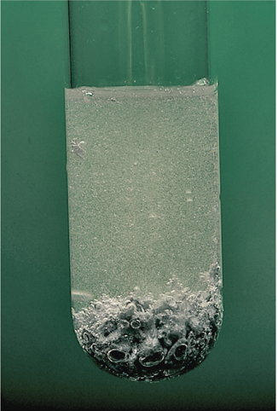
Zinc and Hydrochloric Acid
In the reaction between Zn and HCl, we see vigorous bubbles of H₂.
Zn_{(s)} + 2HCl_{(aq)} →ZnCl_{2(aq)} + H_{2(g)}
net ionic equation:
Zn_{(s)} + 2H⁺_{(aq)} →Zn²⁺_{(aq)} + H_{2(g)}
Oxidation: Zn⁰ → Zn²⁺ +2e⁻
Reduction: 2H⁺ +2e⁻ →H₂⁰

Slide 15
Your Turn!
Which reactant was the reducing agent in the reaction between zinc and hydrochloric acid?
Zn_{(s)} + 2HCl_{(aq)} →ZnCl_{2(aq)} + H_{2(g)}
Zn
HCl
ZnCl₂
H₂

Slide 16
Your Turn!
Which reactant is reduced in the following equation?
2 Ca_{(s)} + O_{2(g)}→ 2 CaO_{(s)}
Ca
O₂
CaO

Slide 17
Balancing Redox Equations
Half-Reaction Method:
unbalanced equation: Al + Cl₂ → AlCl₃
Oxidation half-reaction:
Reduction half-reaction:
2Al_{(s)} → 2Al³⁺_{(aq)} + 6e⁻
Al_{(s)} → Al³⁺_{(aq)} + 3e⁻
3Cl₂ + 6e⁻ → 6Cl⁻
Cl₂ + 2e⁻ → 2Cl⁻
2Al +3 Cl₂ → 2(Al³⁺ + 3Cl⁻ )→2AlCl₃
Make sure number of electrons lost = number of electrons gained.
The balanced equation is the sum of the two half reactions.

Slide 18
Balancing Redox Equations
Change-in-oxidation-number strategy
Assign oxidation numbers to every element.
Write 2 half-reactions using only the 2 elements that changed. One half-reaction must produce electrons and the other must use electrons.
Multiply the half-reactions by the smallest whole number to make sure numbers of electrons lost are equal to numbers of electrons gained.

Slide 19
Balancing Redox Equations
Change-in-oxidation-number strategy (continued)
Transfer the coefficient in front of each substance in the balanced half-reaction to the substance in the original equation.
Balance the remaining elements that are not oxidized or reduced.
Check to make sure both sides of the equation have the same number of atoms of each element.

Slide 20
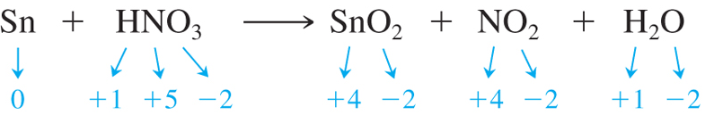
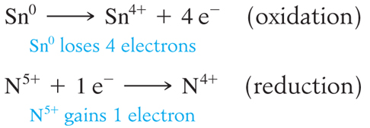
Example 1
Sn_{(s)} + HNO_{3(aq)} → SnO_{2(s)} + NO_{2(g)} + H₂O_{(l)}
Step 1: Assign oxidation numbers
Step 2: Write the two half reactions

Slide 21
Example 1 (continued)
Sn_{(s)} + HNO_{3(aq)} → SnO_{2(s)} + NO_{2(g)} + H₂O_{(l)}
Step 3: Ensure number e⁻ lost = number e⁻ gained
Sn⁰ → Sn⁴⁺ + 4 e⁻ (oxidation)
4N⁵⁺ + 4e⁻ → 4N⁴⁺ (reduction)
Step 4: Transfer coefficients back into equation
Sn_{(s)} + 4HNO_{3(aq)} → SnO_{2(s)} + 4NO_{2(g)} + H₂O_{(l)}
Step 5: Finish balancing the equation
Sn_{(s)} + 4HNO_{3(aq)} → SnO_{2(s)} + 4NO_{2(g)} + 2H₂O_{(l)}

Slide 22
Example 2
Pb_{(s)} + PbO_{2(aq)}+ H₂SO_{4(aq)} → PbSO_{4(s)}+ H₂O_{(l)}
Step 1: Assign oxidation numbers
PbO_{2(aq)}+ H₂SO_{4(aq)} → PbSO_{4(s)}+ H₂O_{(l)}
+4 -2 +1 +6 -2 +2 +6 -2 +1 -2
Step 2: Write the two half reactions
Pb⁴⁺ + 2 e⁻ → Pb²⁺ (reduction)
Pb → Pb²⁺ + 2 e⁻ (oxidation)

Slide 23
Example 2 (continued)
Pb_{(s)} + PbO_{2(aq)}+ H₂SO_{4(aq)} → PbSO_{4(s)}+ H₂O_{(l)}
Step 3: Ensure number e⁻ lost = number e⁻ gained
Pb⁴⁺ + 2 e⁻ → Pb²⁺ (reduction)
Pb → Pb²⁺ + 2 e⁻ (oxidation)
Step 4: Transfer coefficients back into equation
There is a Pb²⁺ in both half-reactions, so we need a 2.
Pb_{(s)} + PbO_{2(aq)}+ H₂SO_{4(aq)} → 2PbSO_{4(s)}+ H₂O_{(l)}
Step 5: Finish balancing the equation
Pb_{(s)} + PbO_{2(aq)}+ 2H₂SO_{4(aq)} → 2PbSO_{4(s)}+ 2H₂O_{(l)}

Slide 24
Your Turn!
What is the oxidation half reaction for the unbalanced reaction
Ca_{(s)} + O_{2(g)}→ CaO_{(s)}
Ca²⁺ + 2e⁻ → Ca
Ca²⁺ → Ca + 2e⁻
Ca + 2e⁻ → Ca²⁺
Ca → Ca²⁺ + 2e⁻

Slide 25
Your Turn!
What is the reduction half reaction for the unbalanced reaction
Ca_{(s)} + O_{2(g)}→ CaO_{(s)}
2O²⁻ + 4e⁻ → O₂
2O²⁻ → O₂ + 4e⁻
O₂ + 4e⁻ → 2O²⁻
O₂ → 2O²⁻ + 4e⁻

Slide 26
Your Turn!
How many electrons are transferred in the reaction
2 Ca_{(s)} + O_{2(g)}→ 2 CaO_{(s)}
1
2
3
4
5

Slide 27
Balancing Ionic Redox Equations
Ion-Electron Strategy for Balancing Redox Equations
Write the two half-reactions that contain the elements being oxidized and reduced. Use entire molecule or ion.
Balance elements other than oxygen and hydrogen.
Balance hydrogen and oxygen.
Acidic Solutions
a. Add H₂O to balance oxygen.
b. Add H⁺ to balance hydrogen.

Slide 28
Ionic Redox Equations (continued)
Balance hydrogen and oxygen (continued).
Basic Solutions
Balance as if in acid.Then add as many OH⁻ ions to each side of the equation as there are H⁺ ions in the equation.
Combine OH⁻ with H⁺ to form H₂O.
Rewrite the equation, canceling equal numbers of water molecules that appear on opposite side of the equation.

Slide 29
Ionic Redox Equations (continued)
Add electrons (e⁻) to each half-reaction to bring them into electrical balance.
Since the loss and gain of electrons must be equal, multiply each half-reaction by the appropriate number to make the number of electrons the same in each half-reaction.
Add the two half-reactions together, canceling electrons and any other identical substances that appear on opposite sides of the equation.

Slide 30
Example 1 (in acid)
Sn²⁺_{(aq)} + IO₄⁻_{(aq)} → Sn⁴⁺_{(aq)} + I⁻_{(aq)}
Write the two half-reactions
Balance elements other than oxygen and hydrogen.
oxidation: Sn²⁺ → Sn⁴⁺
reduction: IO₄⁻ → I⁻

Slide 31
Example 1 (in acid)
Sn²⁺_{(aq)} + IO₄⁻_{(aq)} → Sn⁴⁺_{(aq)} + I⁻_{(aq)}
Balance hydrogen and oxygen.
a. Add H₂O to balance oxygen.
b. Add H⁺ to balance hydrogen.
oxidation: Sn²⁺ → Sn⁴⁺
reduction: IO₄⁻ → I⁻
IO₄⁻ → I⁻ + 4H₂O
IO₄⁻ + 8H⁺→ I⁻ + 4H₂O

Slide 32
Example 1 (in acid)
Sn²⁺_{(aq)} + IO₄⁻_{(aq)} → Sn⁴⁺_{(aq)} + I⁻_{(aq)}
Add electrons (e⁻) to each half-reaction to bring them into electrical balance.
Ensure number e⁻ lost = number e⁻ gained
oxidation: Sn²⁺ → Sn⁴⁺
reduction: IO₄⁻ + 8H⁺→ I⁻ + 4H₂O
Sn²⁺ → Sn⁴⁺ + 2 e⁻
4Sn²⁺ → 4Sn⁴⁺ + 8 e⁻
8 e⁻ + IO₄⁻ + 8H⁺→ I⁻ + 4H₂O

Slide 33
Example 1 (in acid)
Sn²⁺_{(aq)} + IO₄⁻_{(aq)} → Sn⁴⁺_{(aq)} + I⁻_{(aq)}
Add the two equations together, combining like terms.
oxidation: Sn²⁺ → Sn⁴⁺
reduction: IO₄⁻ + 8H⁺→ I⁻ + 4H₂O
Sn²⁺ → Sn⁴⁺ + 2 e⁻
4Sn²⁺ → 4Sn⁴⁺ + 8 e⁻
8 e⁻ + IO₄⁻ + 8H⁺ → I⁻ + 4H₂O
4Sn²⁺_{(aq)} + IO₄⁻_{(aq)} + 8H⁺ _{(aq)} → 4Sn⁴⁺_{(aq)} + I⁻_{(aq)} + 4H₂O _{(l)}

Slide 34
Your Turn!
Which of these is a correctly balanced reduction half-reaction in acid for the following reaction?
H₂O_{2(aq)} + Cr₂O₇²⁻ _{(aq)} → Cr³⁺_{(aq)} + O_{2(g)}
Cr₂O₇²⁻_{(aq)} + 14H⁺ _{(aq)} → Cr³⁺_{(aq)} + 7H₂O_{(l)} + 9e⁻
Cr₂O₇²⁻_{(aq)} + 14H⁺ _{(aq)} → 2Cr³⁺_{(aq)} + 7H₂O_{(l)} + 6e⁻
Cr₂O₇²⁻_{(aq)} + 14H⁺ _{(aq)} + 9e⁻ → Cr³⁺_{(aq)} + 7H₂O_{(l)}
Cr₂O₇²⁻_{(aq)} + 14H⁺ _{(aq)} + 6e⁻ → 2Cr³⁺_{(aq)} + 7H₂O_{(l)}

Slide 35
Your Turn!
Which of these is a correctly balanced oxidation half-reaction in acid for the following reaction?
H₂O_{2(aq)} + Cr₂O₇²⁻ _{(aq)} → Cr³⁺_{(aq)} + O_{2(g)}
H₂O_{2(aq)} → O_{2(g)} + 2H⁺ _{(aq)} + 1e⁻
H₂O_{2(aq)} → O_{2(g)} + 2H⁺ _{(aq)} + 2e⁻
H₂O_{2(aq)} + 1e⁻ → O_{2(g)} + 2H⁺ _{(aq)}
H₂O_{2(aq)} + 2e⁻ → O_{2(g)} + 2H⁺ _{(aq)}

Slide 36
Example 2 (in base)
Zn_{(s)} + NO₃⁻_{(aq)} → NH_{3(aq)} + Zn(OH)₄²⁻_{(aq)}
Write the two half-reactions
Balance elements other than oxygen and hydrogen.
oxidation:
reduction:
Zn → Zn(OH)₄²⁻
NO₃⁻ → NH₃

Slide 37
Example 2 (in base)
Zn_{(s)} + NO₃⁻_{(aq)} → NH_{3(aq)} + Zn(OH)₄²⁻_{(aq)}
Balance hydrogen and oxygen.
Add H₂O to balance oxygen.
Add H⁺ to balance hydrogen.
Add OH⁻ to neutralize H⁺.
Combine OH⁻ with H⁺ to form H₂O and simplify.
oxidation:
reduction:
Zn → Zn(OH)₄²⁻
Zn + 4H₂O → Zn(OH)₄²⁻
Zn + 4H₂O → Zn(OH)₄²⁻ + 4H⁺
Zn + 4H₂O + 4OH⁻→ Zn(OH)₄²⁻ + 4H₂O
Zn + 4OH⁻→ Zn(OH)₄²⁻
NO₃⁻ → NH₃
NO₃⁻ → NH₃ + 3 H₂O
NO₃⁻ + 9 H⁺ → NH₃ + 3 H₂O
NO₃⁻ + 9 H₂O → NH₃ + 3 H₂O + 9 OH⁻

Slide 38
Example 2 (in base)
Zn_{(s)} + NO₃⁻_{(aq)} → NH_{3(aq)} + Zn(OH)₄²⁻_{(aq)}
Add electrons (e⁻) to each half-reaction to bring them into electrical balance.
Ensure number e⁻ lost = number e⁻ gained
oxidation:
reduction:
Zn + 4OH⁻→ Zn(OH)₄²⁻
Zn + 4OH⁻→ Zn(OH)₄²⁻ + 2 e⁻
4Zn + 16OH⁻→ 4Zn(OH)₄²⁻ + 8 e⁻
NO₃⁻ + 9 H₂O → NH₃ + 3 H₂O + 9 OH⁻
NO₃⁻ + 9 H₂O + 8 e⁻ → NH₃ + 3 H₂O + 9 OH⁻

Slide 39
Example 2 (in base)
Zn_{(s)} + NO₃⁻_{(aq)} → NH_{3(aq)} + Zn(OH)₄²⁻_{(aq)}
Add the two equations together, combining like terms.
oxidation:
reduction:
16-9=7 OH⁻
4Zn + 16OH⁻→ 4Zn(OH)₄²⁻ + 8 e⁻
NO₃⁻ + 6 H₂O + 8 e⁻ → NH₃ + 9 OH⁻
4Zn_{(s)}+ NO₃⁻_{(aq)}+7OH⁻_{(aq)}+6H₂O_{(l)}→ NH_{3(aq)}+ 4Zn(OH)₄²⁻_{(aq)}

Slide 40
Relative Reactivity of Metals
If you put a piece of copper wire in 1M AgNO₃ a reaction takes place.
Cu_{(s)} + 2AgNO_{3(aq)} → 2Ag_{(s)} + Cu(NO₃)_{2(aq)}
If you put a piece of silver wire in 1M Cu(NO₃)₂ no reaction occurs.
2Ag_{(s)} + Cu(NO₃)_{2(aq)} → no reaction
Therefore, copper is a more active metal than silver.
Notes:
Figure 17.3 A coil of copper placed in a silver nitrate solution forms silver crystals on the wire the pale blue of the solution indicates the presence of copper ions.

Slide 41
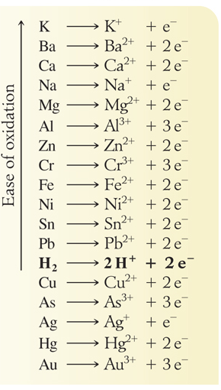
Activity Series of Metals
Activity series: A listing of metallic elements in descending order of reactivity.
Cu is above Ag, which means that Cu can replace Ag in a compound.

Slide 42
Using the Activity Series
The reactivity of the metals listed decreases from top to bottom.
A free metal can displace the ion of any metal below it in the activity series.
Free metals above H react with acids to liberate H₂.
Free metals below H don’t react with acids.
Reaction conditions like temperature and pressure may affect the relative position of some of the metals.

Slide 43
Your Turn!
Rank these metals from least reactive to most reactive using the data below:
Cu_{(s)} + HCl_{(aq)} → no reaction
Zn_{(s)} + 2HCl_{(aq)} → ZnCl_{2(aq)} + H_{2(g)}
Mg_{(s)} + ZnCl_{2(aq)} → MgCl_{2(aq)} + Zn_{(s)}
Cu < Zn < Mg
Cu < Mg < Zn
Mg < Zn < Cu

Slide 44
Your Turn!
What are the likely products of a reaction of chromium with concentrated hydrochloric acid?
no reaction
CrCl and H
CrCl₃ and H
CrCl and H₂
CrCl₃ and H₂

Slide 45
Your Turn!
What are the likely products of a reaction of aluminum with 1M NiCl₂?
no reaction
AlCl₂ and Ni
AlCl₃ and Ni
AlCl and Ni
AlNi and Cl₂

Slide 46
Electrolytic Cells
Electrolysis is the process in which electrical energy is used to bring about chemical change.
An electrolytic cell uses electricity to produce a chemical change for nonspontaneous redox reaction.
Electrolysis is used to manufacture Na and NaOH, Cl₂ and H₂, as well as to purify and electroplate metals.

Slide 47
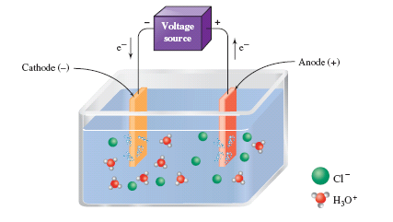
Electrolytic Cells - Cathode
Cathode – negative electrode
Hydronium ions migrate to the cathode and are reduced.
Reaction at the cathode:
H₃O⁺ + 1e⁻ → H⁰ + H₂O
H⁰ + H⁰ → H₂
2HCl_{(aq)} → H_{2(g)} + Cl_{2(g)}
Notes:
Figure 17.4 During the electrolysis of a HCl solution, positive hydronium ions are attracted to the cathode, where they gain electrons and form hydrogen gas. Chloride ions migrate to the anode, where they lose electrons and form chlorine gas. The equation for this process is 2HCl_{(aq)} → H_{2(g)} + Cl_{2(g)}.

Slide 48
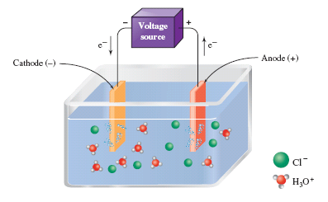
Electrolytic Cells - Anode
Anode – positive electrode
Chloride ions migrate to the anode and are oxidized.
Reaction at the anode:
Cl⁻→ Cl⁰ + e⁻
Cl⁰ + Cl⁰→ Cl₂
Figure 17.4 Place Holder Electrolysis of HCl
Net Reaction
2HCl_{(aq)} → H_{2(g)} + Cl_{2(g)}
Notes:
Figure 17.4 During the electrolysis of a HCl solution, positive hydronium ions are attracted to the cathode, where they gain electrons and form hydrogen gas. Chloride ions migrate to the anode, where they lose electrons and form chlorine gas. The equation for this process is 2HCl_{(aq)} → H_{2(g)} + Cl_{2(g)}.

Slide 49
Your Turn!
In the electrolysis of fused (molten) calcium chloride, the product at the cathode is
Ca²⁺
Cl⁻
Cl₂
Ca

Slide 50
Voltaic Cells
Voltaic cell produces electrical energy from a spontaneous chemical reaction. (Also known as a galvanic cell).
When a piece of zinc is put in a copper(II) sulfate solution, the zinc quickly becomes coated with metallic copper. This occurs because zinc is above copper in the activity series.
If this reaction is carried out in a voltaic cell, an electric current is produced.

Slide 51
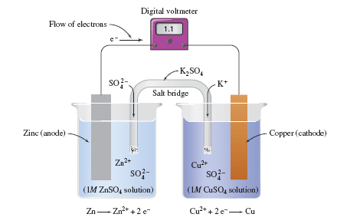
Voltaic Cells
anode – oxidation
Zn⁰(s) → Zn²⁺(aq) + 2e⁻
cathode – reduction
Cu²⁺(aq) + 2e⁻ → Cu⁰(s)
Net Ionic Equation:
Zn⁰(s) + Cu²⁺(aq) → Zn²⁺(aq) + Cu⁰(s)
Notes:
Figure 17.5 Zinc-copper voltaic cell. The cell has a potential of 1.1 volts when ZnSO₄ and CuSO₄ solutions are 1.0 M. The salt bridge provides electrical contact between the two half-cells.

Slide 52
Your Turn!
Towards which compartment will electrons flow in a voltaic cell?
  Toward the cathode
  Toward the anode
  It depends on the reaction

