Slide 1
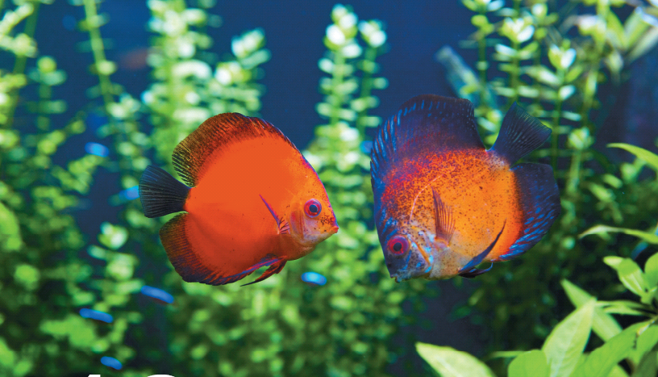
Chapter 16
Chemical Equilibrium
Keeping fish in an aquarium requires maintaining an equilibrium among the living organisms and the water.
Introduction to General, Organic, and Biochemistry 10e
John Wiley & Sons, Inc
Morris Hein, Scott Pattison, and Susan Arena

Slide 2
Chapter Outline
16.1 Reversible Reactions 16.2 Rates of Reaction 16.3 Chemical Equilibrium 16.4 Le Châtelier’s Principle 16.5 Effect of Concentration 16.6 Effect of Volume 16.7 Effect of Temperature 16.8 Effect of Catalysts | 16.9 Equilibrium Constants 16.10 Ion Product Constant for Water 16.11 Ionization Constants 16.12 Solubility Product Constant 16.13 Acid-Base Properties of Salts 16.14 Buffer Solutions: The Control of pH

Slide 3
Reversible Reactions
Most chemical reactions are reversible. They consist of a forward reaction (reactants are converted into products) and a reverse reaction (the products are converted back into reactants.)
A + B → C + D (forward reaction)
C + D → A + B (reverse reaction)
Eventually, the rate of the forward reaction is equal to the rate of the reverse reaction. This is the point when equilibrium is attained.
A + B C + D
→
→

Slide 4
Reversible Reactions
We measure the equilibrium vapor pressures at different temperatures to generate the vapor pressure curve.
liquid + heat vapor
Forward reaction: liquid + heat → vapor (evaporation)
Reverse reaction: vapor → liquid + heat (condensation)
At equilibrium, the
rate of evaporation = rate of condensation
and the vapor pressure of the liquid is no longer changing with time.
→
→

Slide 5
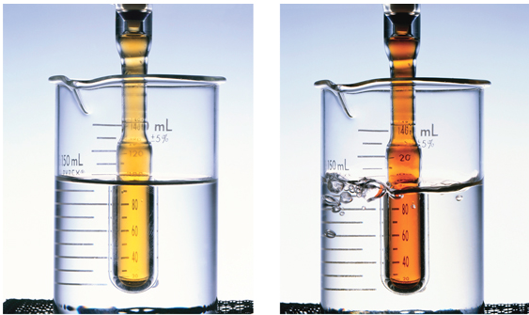
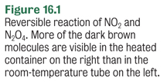
Reversible Reactions
brown gas 2NO_{2(g)} N₂O_{4(g)} colorless gas
Forward reaction: 2NO_{2(g)} → N₂O_{4(g)} + heat
Reverse reaction: N₂O_{4(g)} + heat→ 2NO_{2(g)}
→
→
25°C
90°C

Slide 6
Rates of Reactions
The study of reaction rates and reaction mechanisms is known as chemical kinetics.
What factors affect the rate reaction?
Frequency of collisions between reactants (concentration effects)
Energy of the collisions needed for effective collisions between reactants
(temperature and catalytic effects)

Slide 7
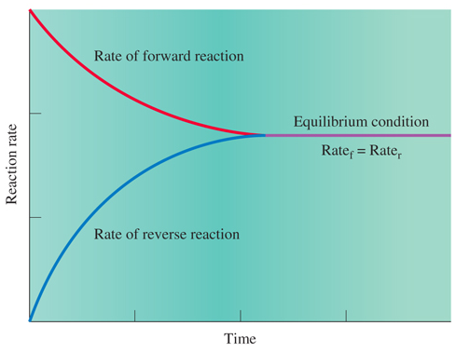
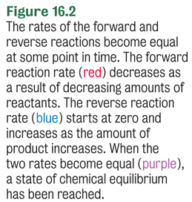
Rates of Reactions and Equilibrium

Slide 8
Chemical Equilibrium
Any system at equilibrium represents a dynamic state in which two or more opposing processes are taking place simultaneously at the same rate.
Chemical equilibrium:
Rate_{forward reaction} = Rate_{reverse reaction}
HF_{(aq)} + H₂O_{(l)} H₃O⁺_{(aq)} + F⁻_{(aq)}
At equilibrium, the HF is ionizing at the same rate that it is reforming, so the concentrations of HF, F⁻ and H₃O⁺ are constant.
→
→

Slide 9
Your Turn!
Equilibrium is reached in a chemical reaction when
The reactants are completely consumed
The concentrations of all reactants and products become equal
The rates of the opposing reactions become equal
The forward and reverse reactions stop

Slide 10
Le Châtelier’s Principle
If a stress is applied to a system in equilibrium, the system will respond in such a way as to relieve that stress and restore equilibrium under a new set of conditions.
What kinds of things stress chemical equilibria?
Changes in concentration, temperature and volumes of gases.

Slide 11
Effect of Concentration
Consider the reaction: 3H_{2(g)} + N_{2(g)} 2NH_{3(g)}
At equilibrium, Rate_{f} = Rate_{r}.
We add H₂ to the equilibrium system which increases Rate_{f} and more NH₃ is made and a stoichiometric amount of N₂ and H₂ is used up.
As [NH₃] increases, Rate_{r} increases and the Rate_{f} slows down as reactants are used up.
Eventually the system returns to equilibrium.
→
→

Slide 12
Adding Reactant to the
System at Equilibrium
3H_{2(g)} + N_{2(g)} 2NH_{3(g)}
In the end, you will have more H₂ and NH₃ than you had initially and less N₂. The equilibrium shifted right!
This table summarizes the changes:
→
→
Concentrations | Change
[H₂] | increase
[N₂] | decrease
[NH₃] | increase

Slide 13
Reactant Product
→
→
Stressor | Shift | Increase equilibrium concentration | Decrease equilibrium concentration
Add reactant | Right | Product | Reactant
Remove reactant | Left | Reactant | Product
Add product | Left | Reactant | Product
Remove product | Right | Product | Reactant
Notes:
You can predict the result of changing a condition of a system at equilibrium by categorizing the change as one of the four stressors.

Slide 14
Effect of Concentration
→
→
Cu²⁺_{(aq)} + 4NH_{3(aq)} [Cu(NH₃)₄²⁺]_{(aq)}
pale blue royal blue
What color will you see if aqueous ammonia is added to a medium blue solution containing the above equilibrium?
Adding ammonia will
cause a shift right,
resulting in an increase
in the royal blue ion!
Concentrations | Change
[Cu²⁺] | decrease
[NH₃] | increase
[Cu(NH₃)₄²⁺] | increase

Slide 15
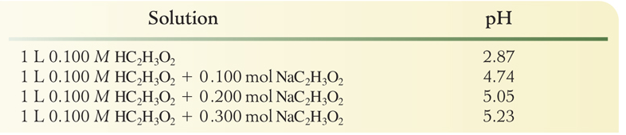
HC₂H₃O_{2(aq)} +H₂O_{(l)} H₃O⁺_{(aq)} + C₂H₃O₂⁻ _{(aq)}
→
→
Adding NaC₂H₃O₂ to a pH 2.87 solution will
increase the [C₂H₃O₂⁻]
cause an increase in the rate of the reverse reaction and result in a shift left
decrease the [H₃O⁺] and increase the pH

Slide 16
HC₂H₃O_{2(aq)} +H₂O_{(l)} H₃O⁺_{(aq)} + C₂H₃O₂⁻ _{(aq)}
→
→
Adding NaOH to a pH 2.87 solution will
decrease the [H₃O⁺] as the hydroxide neutralizes the hydronium ion.
cause an decrease in the reverse reaction and result in a shift right
Concentrations | Change
[HC₂H₃O₂] | decrease
[H₃O⁺] | decrease
[C₂H₃O₂⁻] | increase

Slide 17
Your Turn!
In which direction will the point of equilibrium shift when the concentration of nitrogen increases in the following equilibrium?
3H_{2(g)} + N_{2(g)} 2NH_{3(g)}
Shift to the right
Shift to the left
No shift
→
→
Concentrations | Change
[H₂] | decrease
[N₂] | increase
[NH₃] | increase

Slide 18
Your Turn!
In which direction will the point of equilibrium shift when the concentration of chloride ion increases in the following equilibrium?
AgCl_{(s)} Ag⁺_{(aq)} + Cl⁻_{(aq)}
Shift to the right
Shift to the left
No shift
→
→
Amount | Change
AgCl(s) | increase
[Ag⁺] | decrease
[Cl⁻] | increase

Slide 19
Your Turn!
What color will the following equilibrium be if HCl is added which will decrease the ammonia concentration?
Cu²⁺_{(aq)} + 4NH_{3(aq)} [Cu(NH₃)₄²⁺]_{(aq)}
pale blue royal blue
pale blue
royal blue
No shift
→
→
Concentrations | Change
[Cu²⁺] | increase
[NH₃] | decrease
[Cu(NH₃)₄²⁺] | decrease

Slide 20
Your Turn!
In the following equilibrium; as I_{2(g)} is added, the concentration of H_{2(g)} will
H_{2(g)} + I_{2(g)} 2 HI_{(g)}
Increase
Decrease
Remain the same
→
→
Concentrations | Change
[H₂] | decrease
[I₂] | increase
[HI] | increase

Slide 21
Effect of Changes in Volume
A decrease in volume in a gas phase reaction will increase the pressure of all gases (reactants AND products).
The balanced equation determines whether the change will cause a shift left to make more reactant or a shift right to make more product.
The reaction will shift to the side with the smaller number of molecules of gas.

Slide 22
Effect of Changes in Volume
How will a decrease in container volume affect the equilibrium concentration of ammonia in the reaction:
3H_{2(g)} + N_{2(g)} 2NH_{3(g)}
4 moles of gas → 2 moles of gas
The equilibrium will shift to the right, making more NH₃.
→
→
Concentrations | Change
[H₂] | decrease
[N₂] | decrease
[NH₃] | increase

Slide 23
Effect of Changes in Volume
How will a decrease in container volume affect the equilibrium concentration of hydrogen in the reaction:
H_{2(g)} + I_{2(g)} 2HI_{(g)}
2 moles of gas → 2 moles of gas
The equilibrium will not shift, so the amount of hydrogen will not change.
→
→

Slide 24
Your Turn!
In which direction will equilibrium shift when the volume of the reaction vessel decreases in the following equilibrium?
PCl_{5(g)} PCl_{3(g)} + Cl_{2(g)}
Shift to the right
Shift to the left
No shift
→
→
Concentrations | Change
[PCl₅] | increase
[PCl₃] | decrease
[Cl₂] | decrease

Slide 25
Your Turn!
In which direction will equilibrium shift when the volume of the reaction vessel increases in the following equilibrium?
2CO_{2(g)} 2CO_{(g)} + O_{2(g)}
Shift to the right
Shift to the left
No shift
→
→
Concentrations | Change
[CO₂] | decrease
[CO] | increase
[O₂] | increase

Slide 26
Your Turn!
In which direction will equilibrium shift when the volume of the reaction vessel increases in the following equilibrium?
AgCl_{(s)} Ag⁺_{(aq)} + Cl⁻_{(aq)}
Shift to the right
Shift to the left
No shift
Pressure and volume changes only affect gases!
→
→

Slide 27
Effect of Temperature
An increase in temperature increases the rate of both the forward and reverse reactions because of the increase in the kinetic energy of the collisions.
However, the application of heat to increase the temperature favors the reaction where heat is a reactant (heat is absorbed).
A + heat B (endothermic reaction)
Adding heat will shift the equilibrium to the right.
A B + heat (exothermic reaction)
Adding heat will shift the equilibrium to the left.
→
→
→
→

Slide 28
Effect of temperature
brown gas 2NO_{2(g)} N₂O_{4(g)} colorless gas + heat
Increasing the temperature favors the reverse reaction shifting the equilibrium left.
→
→
25°C
90°C

Slide 29
Effect of Temperature
How will an increase in temperature affect the equilibrium concentration of ammonia in the reaction:
3H_{2(g)} + N_{2(g)} 2NH_{3(g)} + 92.5 kJ
The reaction is exothermic (heat is a product).
To increase the temperature, heat must be added.
The reverse reaction is favored and the equilibrium will shift to the left.
Ammonia will decrease.
→
→

Slide 30
Your Turn!
In which direction will equilibrium shift when the reaction vessel is cooled in the following equilibrium?
88kJ + PCl_{5(g)} PCl_{3(g)} + Cl_{2(g)}
Shift to the right
Shift to the left
No shift
→
→
Concentrations | Change
[PCl₅] | increase
[PCl₃] | decrease
[Cl₂] | decrease

Slide 31
Effect of Catalysts
A catalyst is a substance that influences the rate of a reaction but can be fully recovered at the end of the reaction.
A catalyst does not shift the equilibrium or change the yield of either reactants or products.
A catalyst lowers the energy of activation of the reaction and thus affects the rate of the reaction.
The activation energy is the minimum energy required for the reaction to occur.

Slide 32
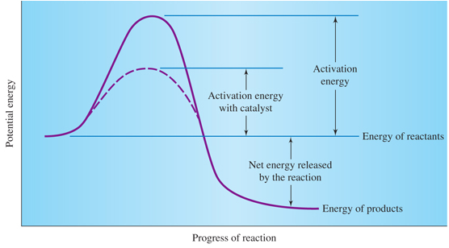
Reaction Energy Diagram
Notes:
Figure 16.3 Energy diagram for an exothermic reaction
Energy is put into the reaction (activation energy) to initiate the process. In the reaction shown, all of the activation energy and the net energy are released as the reaction proceeds to products. Note that the presence of a catalyst lowers the activation energy but does not change the energies of the reactants or the products.

Slide 33
Your Turn!
In which direction will the point of equilibrium shift when a catalyst is added to the following equilibrium system?
3H_{2(g)} + N_{2(g)} 2NH_{3(g)} + 92.5 kJ
Shift to the right
Shift to the left
No shift
→
→

Slide 34
Equilibrium Constants
For every equilibrium,
aA + bB cC + dD
There is a mass law expression defining the equilibrium constant, K_{eq}:
Only substances whose Molar concentration can vary go into the mass law expression: Generally this will be aqueous solutions and gases.
→
→

Slide 35
Equilibrium Constants
For the equilibrium,
3H_{2(g)} + N_{2(g)} 2NH_{3(g)}
There is a mass law expression:
The value of K_{eq} is determined by the equilibrium concentrations of H₂, N₂ and NH₃.
→
→

Slide 36
Equilibrium Constants
The magnitude of an equilibrium constant is a measure of the extent or efficiency of the reaction.
A large K_{eq} (>>1) means that the relative amount of products compared to reactants are favored.
A small K_{eq} (<<1) means that the relative amount of reactants compared to products are favored.
Values close to 1 mean that both reactants and products are present in significant amounts.

Slide 37
Your Turn!
Calculate the value of K_{eq} for the following equilibrium when [ H₂ ] = 0.228 M, [ I₂ ] = 0.228 M, and [ HI ] =1.544 M.
H_{2(g)} + I_{2(g)} 2HI_{(g)}
29.7
59.4
0.0337
0.0219
45.9
→
→

Slide 38
Ion Product Constant for Water
Pure water auto-ionizes
H₂O_{(l)} + H₂O_{(l)} H₃O⁺_{(aq)} + OH⁻_{(aq)}
Concentration H₃O⁺ = Concentration OH⁻ = 1.00×10⁻⁷M
Ion Product Constant for Water:
K_{w} = [H₃O⁺][OH⁻] = 1.00×10⁻¹⁴ (at 25°C)
Any solution that contains water contains both H₃O⁺ and OH⁻!
→
→

Slide 39
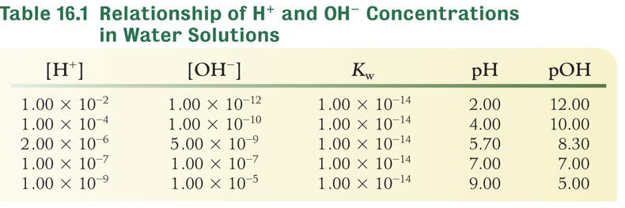
Relationship of [H₃O⁺] and [OH⁻]
K_{w} = [H₃O⁺][OH⁻] = 1.00×10⁻¹⁴
pH= -log[H₃O⁺]
pOH= -log[OH⁻]
pH + pOH = 14

Slide 40
Using K_{w}
K_{w} = [H₃O⁺][OH⁻] = 1×10⁻¹⁴
pH= -log[H₃O⁺]
Calculate the [H⁺] in a 0.0152 M NaOH solution
[H⁺]= 1×10⁻¹⁴/[OH⁻]
[H⁺] = 1×10⁻¹⁴/[0.0152M] = 6.58×10⁻¹³ M
Calculate the pH of a 0.0152 M NaOH solution
pH = -log (6.58×10⁻¹³ M) = 12.182

Slide 41
Your Turn!
What is the [ OH⁻ ] in a 0.00010 M solution of HCl?
1.0 × 10⁻¹⁴ M
1.0 × 10⁻¹⁰ M
1.0 × 10⁻⁴ M
1.0 × 10⁻⁷ M

Slide 42
Ionization Constants
The acid ionization constant, K_{a}, for a weak acid is a measure of the extent to which the acid ionizes in water. Water is the solvent and its concentration doesn’t measurably change during ionization, so it does not go into the K_{a} expression.
HC₂H₃O_{2(aq)} + H₂O_{(l)} H₃O⁺_{(aq)} + C₂H₃O₂⁻_{(aq)}
→
→

Slide 43
Your Turn!
Which acid ionization constant would indicate the strongest acid?
3.5 × 10⁻⁴
9.5 × 10⁻⁸
1.5 × 10⁻⁹
1.3 × 10⁻¹³

Slide 44
[H⁺] in a Weak Acid
Determine the [H⁺] in a 0.20 M solution of HC₂H₃O₂
  K_{a} = 1.8 × 10⁻⁵
→
HC₂H₃O_{2(aq)} + H₂O_{(l)} H₃O⁺_{(aq)} + C₂H₃O₂ ⁻_{(aq)}
→
 | Initial | Equil.
[H⁺] | 0 | Y
[C₂H₃O₂⁻] | 0 | Y
[HC₂H₃O₂] | 0.20 | 0.20-Y
 | Initial | Equil.
[H⁺] | 0 | 1.9x10⁻³
[C₂H₃O₂⁻] | 0 | 1.9x10⁻³
[HC₂H₃O₂] | 0.20 | 0.20
Y = 1.90 × 10⁻³ M
16-44

Slide 45
% Ionization in a Weak Acid
Determine the % ionization of a 0.20 M solution of HC₂H₃O₂
→
→
HC₂H₃O_{2(aq)} + H₂O_{(l)} H₃O⁺_{(aq)} + C₂H₃O₂ ⁻_{(aq)}
 | Initial | Equil.
[H⁺] | 0 | 1.9x10⁻³
[C₂H₃O₂⁻] | 0 | 1.9x10⁻³
[HC₂H₃O₂] | 0.20 | 0.20
16-45

Slide 46
Your Turn!
Hydrocyanic acid, HCN, is a weak acid whose K_{a} value is 4.0 ×10⁻¹⁰. What is the [H⁺] in 0.10 M HCN?
1.0 × 10⁻⁴
6.3 × 10⁻⁶
4.0 × 10⁻¹⁰
1.0 × 10⁻¹¹

Slide 47
Solubility Product Constants
Saturated solutions have solid in equilibrium with dissolved solute.
CaF_{2(s)} Ca²⁺_{(aq)} + 2F⁻_{(aq)}
We define the solubility product, K_{sp}, as
K_{sp} = [Ca²⁺][F⁻]²
The amount of solid does not affect the equilibrium and therefore does not go into the equilibrium constant expression.
→
→

Slide 48
Solubility
Calculate the solubility of HgBr₂ at 25°C and the [Hg²⁺] and [Br⁻], if the K_{sp} = 1.3 × 10⁻¹⁹
HgBr_{2(s)} Hg²⁺_{(aq)} + 2Br⁻_{(aq)}
Let Y = the amount of HgBr₂ that dissolves.
Then [Hg²⁺] = Y and [Br⁻] = 2Y
K_{sp} = [Hg²⁺][Br⁻]² = [Y ][2Y]² = 4Y³ = 1.3 × 10⁻¹⁹
Y = (3.25 × 10⁻²⁰)^{1/3} = 3.2 × 10⁻⁷M = solubility of HgBr₂
→
→

Slide 49
Common Ion Effect
A shift in the equilibrium position upon addition of an ion already contained in the solution is known as the common ion effect.
Sodium hydroxide is added to a saturated Mg(OH)₂ solution until the [OH⁻] is 0.010M.
Mg(OH)_{2(s)} Mg²⁺_{(aq)} + 2OH⁻_{(aq)}
The addition of hydroxide ions will shift the equilibrium to the left and reduce the magnesium ions in solution.
→
→

Slide 50
Common Ion Effect
Sodium hydroxide is added to a saturated Mg(OH)₂ solution until the [OH⁻] is 0.010M. What will be the [Mg²⁺] in solution? K_{sp} = 5.6 × 10⁻¹²
Mg(OH)_{2(s)} Mg²⁺_{(aq)} + 2OH⁻_{(aq)}
K_{sp} = [Mg²⁺][OH⁻]²= [Mg²⁺ ] [0.010 ]² = 5.6 × 10⁻¹²
[Mg²⁺] = 5.5 × 10⁻⁸ M when the [OH⁻] = 0.0100M
→
→

Slide 51
Your Turn!
The K_{sp} of silver iodide is 8.3 × 10⁻¹⁷. What is the solubility of silver iodide ?
8.3 × 10⁻¹⁷
1.7 × 10⁻¹⁶
2.7 × 10⁻⁶
9.1 × 10⁻⁹

Slide 52
Acid-Base Properties of Salts
Hydrolysis is the term used for reactions in which water is split.
The conjugate base of a weak acid will react with water to produce the hydroxide ion and the weak acid.
C₂H₃O₂ ⁻_{(aq)} + H₂O_{(l)} HC₂H₃O_{2(aq)} + OH⁻_{(aq)}
The conjugate acid of a weak base will react with water to produce the hydronium ion and the weak base.
NH₄⁺_{(aq)} + H₂O_{(l)} NH_{3(aq)} + H₃O⁺_{(aq)}
→
→
→
→

Slide 53
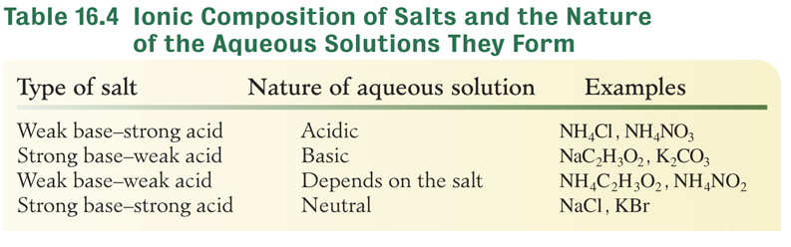
Acid-Base Properties of Salts
Will KCN be acidic, basic or neutral?
Basic since it is the salt of a strong base (KOH) and a weak acid (HCN).

Slide 54
Buffer Solutions
A buffer solution resists changes in pH when diluted or when small amounts of acid or base are added.
Buffer solutions can be made by mixing together (usually in equimolar amounts) either
a weak acid with a salt containing its conjugate base
a weak base with a salt containing its conjugate acid
The buffer capacity of the solution is the extent to which the buffer can absorb added acid or base and still maintain the pH.

Slide 55
Buffer Solutions
Consider a buffer made of 0.1 M HC₂H₃O₂ and 0.1 M NaC₂H₃O₂.
The solution contains an acid (HC₂H₃O₂) to neutralize added base so the pH doesn’t change:
OH⁻_{(aq)} + HC₂H₃O_{2(aq)} C₂H₃O₂ ⁻_{(aq)} + H₂O_{(l)}
It also contains a base (C₂H₃O₂⁻) to neutralize added acid so the pH doesn’t change:
H₃O⁺_{(aq)} + C₂H₃O₂ ⁻_{(aq)} HC₂H₃O_{2(aq)}+ H₂O_{(l)}
→
→
→
→

Slide 56
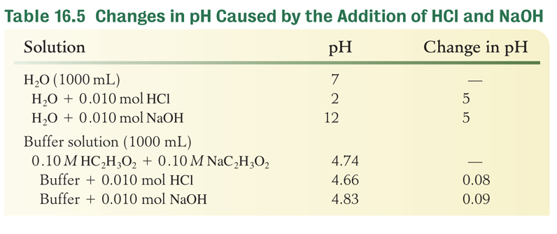
Buffer Solutions

