Slide 1
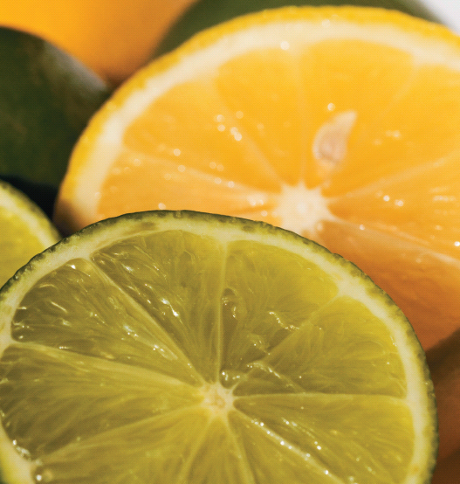
Chapter 15
Acids, Bases, and Salts
Lemons and limes are examples of food which contains acidic solutions.
Introduction to General, Organic, and Biochemistry 10e
John Wiley & Sons, Inc
Morris Hein, Scott Pattison, and Susan Arena

Slide 2
Chapter Outline
15.1 Acids and Bases 15.2 Reactions of Acids 15.3 Reactions of Bases 15.4 Salts 15.5 Electrolytes and Nonelectrolytes 15.6 Dissociation and Ionization of Electrolytes 15.7 Strong and Weak Electrolytes | 15.8 Ionization of Water 15.9 Introduction to pH 15.10 Neutralization 15.11 Writing Net Ionic Equations 15.12 Acid Rain 15.13 Colloids 15.14 Properties of Colloids 15.15 Applications of Colloidal Properties

Slide 3
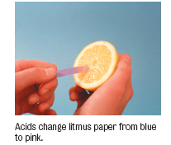
Arrhenius Acids
Definition: An acid solution contains an excess of H⁺ ions.
Properties
Sour taste
Turn blue litmus red
The ability to react with
Metals to produce H₂ gas
Bases to produce salt and water
Carbonates to produce carbon dioxide

Slide 4
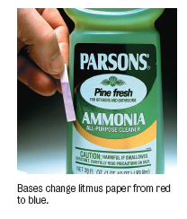
Arrhenius Bases
Definition: A base solution contains an excess of OH⁻ ions.
Properties
Bitter or caustic taste
Turn red litmus blue
Slippery, soapy feeling
Neutralize acids

Slide 5
Your Turn!
Which type of solution would have a sour taste and turn blue litmus red?
Acid
Base
Salt

Slide 6
Brønsted-Lowry Acids and Bases
An acid is a proton (H⁺) donor.
A base is a proton (H⁺) acceptor.
HCl_{(g)} + H₂O_{(l)} → H₃O⁺_{(aq)} + Cl⁻_{(aq)}
hydronium ion
H
••
••
••
+
H
•
•
•
•
•
•
••
-
•
Cl
+
H
O
H
O
•
•
•
→
•
•
+
•
•
••
••
••
Cl
•
•
••
H
H
Acid
Base
Conjugate Acid
Conjugate Base

Slide 7
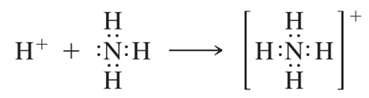
Brønsted-Lowry Acids and Bases
Ammonia is a weak base that forms the ammonium ion and the hydroxide ion in water.
Conjugate acid-base pairs: NH₄⁺ – NH₃ and H₂O – OH⁻
NH_{3(aq)} + H₂O_{(l)}
OH⁻_{(aq)}
+
NH₄⁺ _{(aq)}
→
→
+ H⁺
- H⁺
NH₄⁺ _{(aq)}
OH⁻_{(aq)}

Slide 8
Your Turn!
What is the conjugate acid of hydrogen phosphate?
H₂PO₄⁻
H₃PO₄
H₃PO₄⁺
HPO₄²⁻

Slide 9
Your Turn!
Which are the two Bronsted-Lowry acids in the following equation?
H₂S + H₂O HS ⁻ + H₃O ⁺
HS ⁻ and H₂O
H₂S and HS ⁻
H₂S and H₃O ⁺
H₃O ⁺ and H₂O
→
→

Slide 10
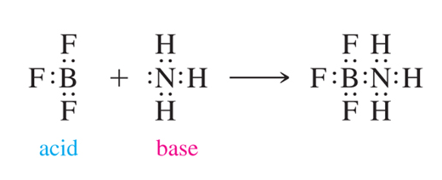
Lewis Acid-Base Definition
A base is an electron pair donor.
An acid is an electron pair acceptor.

Slide 11
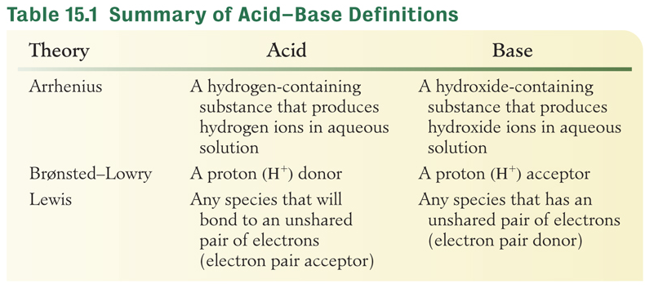
Three Acid-Base Theories
Use the theory that best explains the reaction under consideration:

Slide 12
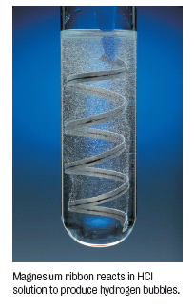
Reactions of Acids
Acids react with metals that lie above H in the activity series:
acid + metal → salt + hydrogen
2HCl_{(aq)} + Mg_{(s)} → MgCl_{2(aq)} + H_{2(g)}
Acids react with bases (neutralization)
acid + base → salt + water
2HCl_{(aq)} + Ca(OH)_{2(aq)}→ CaCl_{2(aq)} + 2H₂O _{(l)}

Slide 13
Reactions of Acids
Acids react with metal oxides
acid + base → salt + water
2HCl_{(aq)} + Na₂O_{(s)} → 2NaCl_{(aq)} + H₂O_{(l)}
Acids react with metal carbonate
acid + base → salt + water + carbon dioxide
2HCl_{(aq)} + Na₂CO_{3(aq)}→ 2NaCl_{(aq)} + H₂O_{(l)} + CO_{2(g)}

Slide 14
Reactions of Bases
Bases can be amphoteric
as base: Zn(OH)_{2(aq)}+ 2HBr_{(aq)} → ZnBr_{2(aq)} + 2H₂O_{(l)}
as acid: Zn(OH)_{2(aq)}+ 2NaOH_{(aq)} → Na₂Zn(OH)_{4(aq)}
NaOH and KOH react with metals
base + metal + water → salt + hydrogen
2NaOH_{(aq)} + 2Al(s) + 6H₂O_{(l)} → 2NaAl(OH)_{4(aq)} + 3H₂O_{(g)}

Slide 15
Your Turn!
What gas is produced by the reaction of sodium bicarbonate with acetic acid?
Hydrogen
Carbon dioxide
Nitrogen
Oxygen

Slide 16
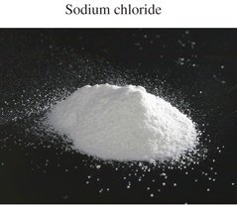
Salts
Salts are the result of acid-base neutralization reactions.
HCl_{(aq)}+ NaOH_{(aq)}→ NaCl_{(aq)}+ H₂O_{(l)}
Salts are ionic compounds composed of a cation (usually a metal or the ammonium ion) and an anion (not oxide or hydroxide).
Salts are usually crystals with high melting and boiling points.

Slide 17
Your Turn!
What salt forms from the reaction of magnesium hydroxide and sulfuric acid?
MgS
Mg₂S
MgSO₄
Mg₂SO₄

Slide 18
Your Turn!
What salt forms from the reaction of aluminum oxide and hydrobromic acid?
AlBr
AlBr₃
Al₂Br
Al₂Br₃

Slide 19
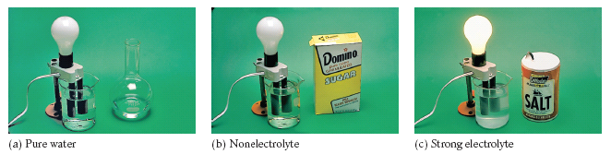

Electrolytes and Nonelectrolytes
Electrolytes are compounds whose aqueous solutions conduct electricity.
Nonelectrolytes are substances whose aqueous solutions are nonconductors.

Slide 20
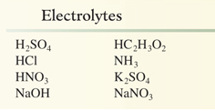
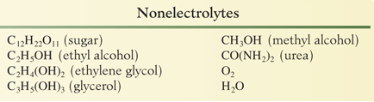
Electrolytes and Nonelectrolytes
It is the movement of ions that conduct electricity in water .
Acids, bases and salts are electrolytes because they produce ions in water when they dissolve.

Slide 21
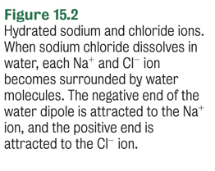
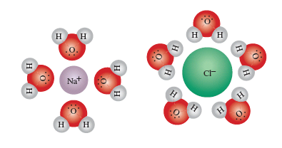
Dissociation of Electrolytes
Salts dissociate into cations and anions when they dissolve in water.
NaCl_{(s)} → Na⁺_{(aq)} + Cl⁻_{(aq)}

Slide 22
Ionization of Electrolytes
Ionization is the formation of ions; it is the result of the chemical reaction with water.
Acids ionize in water, producing hydronium ions and anions.
HCl_{(g)} + H₂O_{(l)} → H₃O⁺_{(aq)} + Cl⁻_{(aq)}
H₃PO_{4(aq)} + H₂O_{(l)} H₃O⁺_{(aq)} + H₂PO₄⁻_{(aq)}
Weak bases ionize in water, producing hydroxide ions and cations.
NH_{3(aq)} + H₂O_{(l)} OH⁻ _{(aq)} + NH₄⁺_{(aq)}
→
→
→
→

Slide 23
Your Turn!
Which will dissociate when placed in water?
CH₃OH
HCl
KBr
HClO₄

Slide 24
Your Turn!
A solution is tested with the conductivity apparatus and the light bulb did not light. Which of the following is not likely?
The beaker contained only water.
The beaker contained water and C₆H₁₂O₆.
The beaker contained water and CaCl₂.
All of the above are likely possibilities.

Slide 25
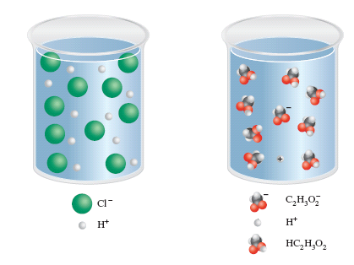
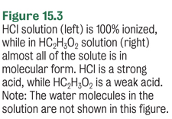
Strong and Weak Electrolytes
Strong electrolytes are essentially 100% ionized in water (HCl).
Weak electrolytes are much less ionized (HC₂H₃O₂).

Slide 26
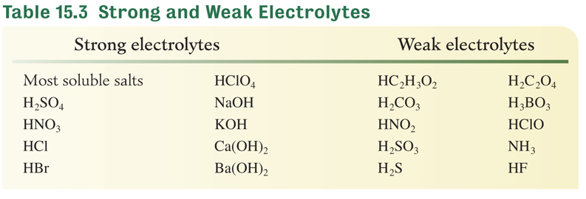
Strong and Weak Electrolytes
Use double arrows to indicate weak ionization.
HC₂H₃O_{2(aq)} + H₂O_{(l)} H₃O⁺_{(aq)} + C₂H₃O₂⁻_{(aq)}
HF_{(aq)} + H₂O_{(l)} H₃O⁺_{(aq)} + F⁻_{(aq)}
→
→
→
→

Slide 27
Salts
Salts dissociate into at least 2 ions.
A 1M solution of NaCl produces a 2M solution of ions.
NaCl_{(s)} → Na⁺_{(aq)} + Cl⁻_{(aq)}
1 mole 1 mole + 1 mole
A 1M solution of CaCl₂ produces a 3M solution of ions.
CaCl_{2(s)} → Ca²⁺_{(aq)} + 2Cl⁻_{(aq)}
1 mole 1 mole + 2 mole

Slide 28
Your Turn!
What is the concentration of chloride ion in a 2.0 M solution of calcium chloride?
1.0 M
2.0 M
3.0 M
4.0 M

Slide 29
Colligative Properties of
Electrolyte Solutions
Colligative properties depend on the moles of dissolved particles so you have to take that into account when you compute freezing point depressions and boiling point elevations.
What is the boiling point elevation of a 1.5 m aqueous solution of calcium chloride? (The boiling point elevation constant for water is 0.512 °C/m.)

Slide 30
Your Turn!
What is the boiling point of a 2.0 m aqueous solution of sodium chloride? (The boiling point elevation constant for water is 0.512 °C/m.)
101.02 °C
1.02 °C
2.05 °C
102.05 °C

Slide 31
Ionization of Water
Pure water auto-ionizes
H₂O_{(l)} + H₂O_{(l)} H₃O⁺_{(aq)} + OH⁻_{(aq)}
Concentration H₃O⁺ = Concentration OH⁻ = 1×10⁻⁷ M [H₃O⁺]×[OH⁻] = 10⁻¹⁴
In acid solutions, [H₃O⁺]>[OH⁻]
In basic solution, [H₃O⁺]<[OH⁻]
→
→

Slide 32
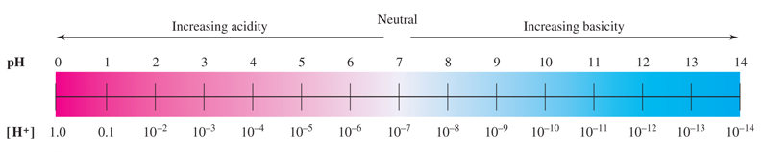

Introduction to pH
pH = -log[H⁺]
In pure water, [H⁺] = 1×10⁻⁷ M so
pH = -log(10⁻⁷) = 7
high H⁺
low OH⁻
low H⁺
high OH⁻

Slide 33
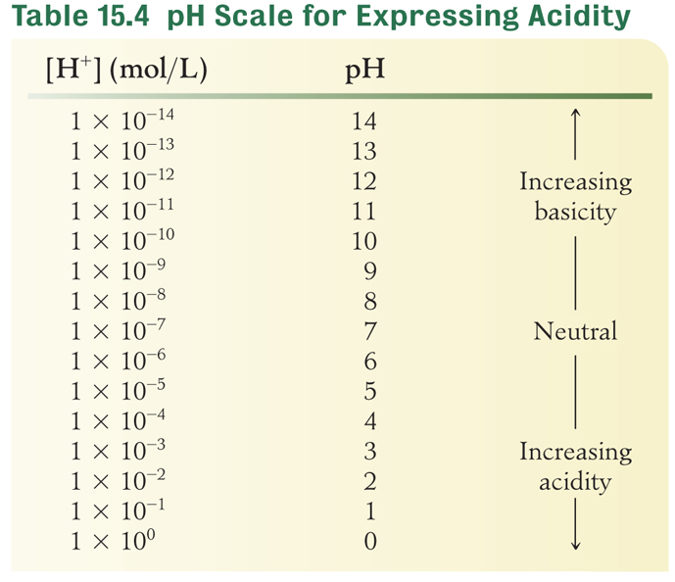
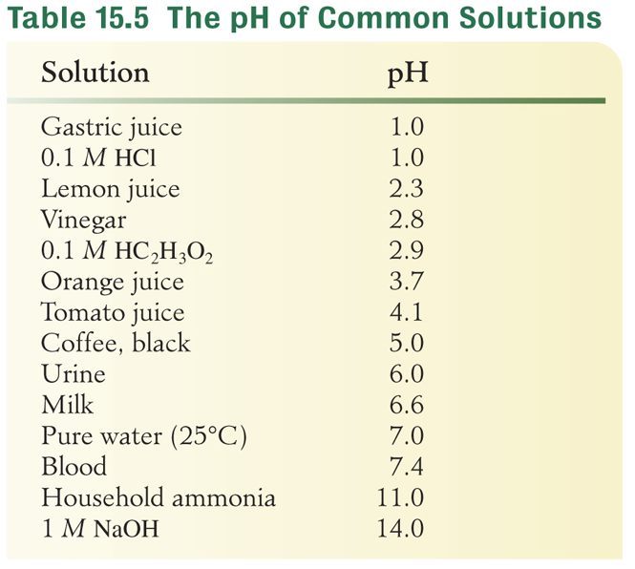
pH

Slide 34
Your Turn!
How many times more acidic is a solution with a pH of 3 than a solution with a pH of 5?
2
20
200
100

Slide 35
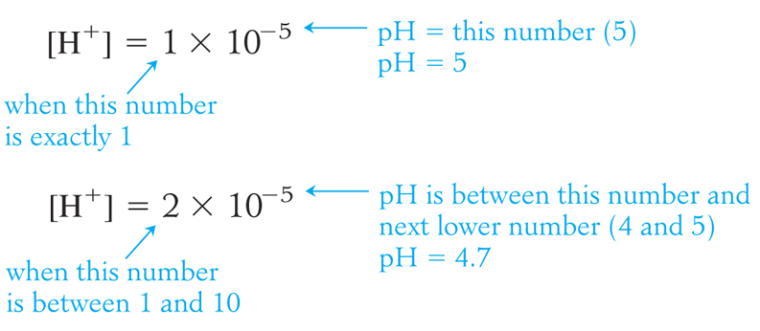
Introduction to pH
pH = -log[H⁺]

Slide 36
Introduction to pH
Calculate the pH of a 0.015M H⁺ solution.
pH = - log (0.015) = 1.82
Note: The digits to the left of the decimal place in the pH (the characteristic of the log) reflect the power of ten in the [H⁺]. In this case, the 1. The characteristic is NOT one of the significant figures in the pH.
The number of decimal places for the mantissa of a log must equal the number of significant figures in the original number.

Slide 37
Your Turn!
What is the pH of a 0.020 M hydrochloric acid solution?
0.020
-2.0
1.70
1.7
-1.7

Slide 38
Your Turn!
What is the pH of a solution of sodium hydroxide that has a hydronium ion concentration of 2.5×10⁻¹¹?
11
10.6
-10.60
10.60

Slide 39
Neutralization
Neutralization: acid + base → salt + water
HCl_{(aq)} + NaOH_{(aq)}→ H₂O_{(l)} + NaCl_{(aq)}
Total Ionic Equation:
[H⁺_{(aq)}+Cl⁻_{(aq)} ]+[Na⁺_{(aq)} +OH⁻_{(aq)}]→ H₂O_{(l)} + Na⁺_{(aq)}+Cl⁻_{(aq)}
Remove spectator ions (Na⁺ and Cl⁻)
Net Ionic Equation: H⁺_{(aq)} + OH⁻ _{(aq)} → H₂O_{(l)}
The driving force for the reaction is the reaction between the hydronium ion and the hydroxide ion to form water.

Slide 40
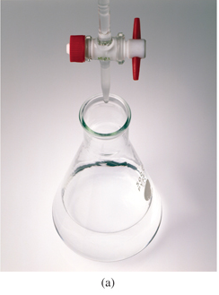
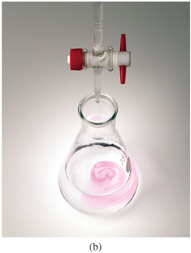
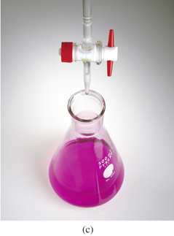
Titration
A titration measures the volume of one reagent required to react with a measured mass or volume of another reagent.
A titration is used to determine the amount of acid or base present in a sample.
An indicator is used to signal the endpoint, when stoichiometric amounts of acid and base are present.
A buret is used to deliver the titrant into an Erlenmeyer flask.
Notes:
Titration. (a) Before the titration begins, the liquid in the flask is colorless and clear. (b) At the endpoint a pole pink color persists in the flask. (d) After the endpoint, the color of the solution turns bright pink, indicating an excess of base.

Slide 41
Titration
If 22.59 mL of 0.1096 M HCl is used to titrate 25.00 mL of NaOH to a phenolphthalein endpoint, what is the molarity of the NaOH? HCl_{(aq)} + NaOH_{(aq)}→ H₂O_{(l)} + NaCl_{(aq)}
Knowns
22.59 mL 0.01096M HCl
25.00 mL NaOH
Solving for
base molarity
Calculate

Slide 42
Titration
What is the molarity of a sodium hydroxide solution if 21.93 mL of NaOH is required to titrate 0.243 g oxalic acid, H₂C₂O₄?
H₂C₂O_{4(aq)} + 2NaOH_{(aq)} → Na₂C₂O_{4(aq)} + 2H₂O_{(l)}
Knowns
0.243 g H₂C₂O₄
21.93 mL NaOH
Solving for
base molarity
Calculate

Slide 43
Your Turn!
What is the concentration of a HNO₃ solution if 10.0 mL of the solution is neutralized by 3.6 mL of a 0.20M NaOH solution?
0.072 M
53.6 M
0.56 M
5.6 M

Slide 44
Writing Net Ionic Equations
Strong electrolytes in solution are written in their ionic form. NaOH_{(aq)} is written Na⁺_{(aq)} +OH⁻_{(aq)}
Weak electrolytes and nonelectrolytes are written in their molecular form. H₂O_{(l)} , HC₂H₃O_{2(aq)}
Solids and gases are written in their molecular form.
The net ionic equation does not include spectator ions.
Equations must be balanced, both in atoms and in electrical charge.

Slide 45
Net Ionic Equation
Formula Equation
BaCl_{2(aq)} + Na₂SO_{4(aq)}→ BaSO_{4(s)} + 2NaCl_{(aq)}
Total Ionic Equation
(Ba²⁺_{(aq)}+ 2Cl⁻_{(aq)}) + (2Na⁺_{(aq)}+ SO₄²⁻_{(aq)} ) →
BaSO_{4(s)} + 2Na⁺_{(aq)}+2Cl ⁻_{(aq)}
Net Ionic Equation
Ba²⁺ _{(aq)}+ SO₄²⁻ _{(aq)} → BaSO_{4(s)}

Slide 46
Net Ionic Equation
Formula Equation
Na₂CO_{3(aq)} + 2HCl_{(aq)} → 2NaCl_{(aq)} + CO_{2(g)} + H₂O_{(l)}
Total Ionic Equation
(2Na⁺_{(aq)}+ CO₃²⁻_{(aq)}) + (2H⁺_{(aq)}+2Cl⁻_{(aq)} ) →
2Na⁺_{(aq)}+2Cl⁻_{(aq)} + CO_{2(g)} + H₂O_{(l)}
Net Ionic Equation
CO₃²⁻_{(aq)} + 2H⁺_{(aq)} → CO_{2(g)} + H₂O_{(l)}

Slide 47
Your Turn!
What is the net ionic equation when hydrobromic acid reacts with potassium hydroxide?
H ⁺ + OH ⁻ → HOH
H ⁺ + Br⁻ → HBr
K ⁺ + OH ⁻ → KOH
K ⁺ + H⁻→ KH

Slide 48
Acid Rain
Acid rain is defined as atmospheric precipitation that is more acidic than usual.
The general process for the formation of acid rain:
emission of nitrogen and sulfur oxides into the air
transportation of these oxides throughout the atmosphere
chemical reactions between the oxides and water, forming sulfuric acid and nitric acid
rain or snow carries the acids to the ground

Slide 49
Colloids
Solution – Clear homogeneous mixture
Suspension – Cloudy heterogeneous mixture with solute particles that can be separated by filtration
Colloid – A mixture in which the dispersed particles are larger than the solute ions or molecules of a true solution and smaller than the particles of a suspension.
Colloids can’t be separated by filtration, and often appear to be cloudy.

Slide 50
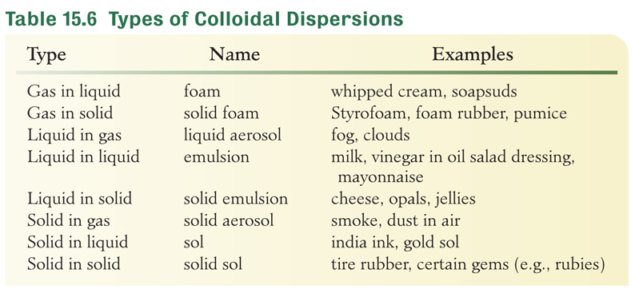
Colloids

Slide 51
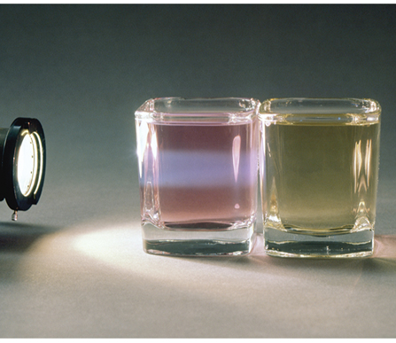
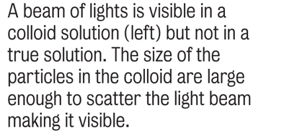
Properties of Colloids
Brownian Motion – erratic motion of colloidal particles caused by the bombardment of solvent molecules.
Tyndall Effect – scattering of light by colloidal particles.

Slide 52
Application of Colloidal Properties
Activated charcoal has a very large surface area. It can be used in gas masks to adsorb poisonous gases which stick to the surface of the charcoal.
Colloidal particles become charged when they adsorb ions on their surface. The Cotrell process uses high voltage charged plates to clean colloidal dust and smoke particles from air.
Dialysis is the process by which dissolved solutes can be removed from colloidal dispersions through a semi permeable membrane (a dialyzing membrane).

