Slide 1
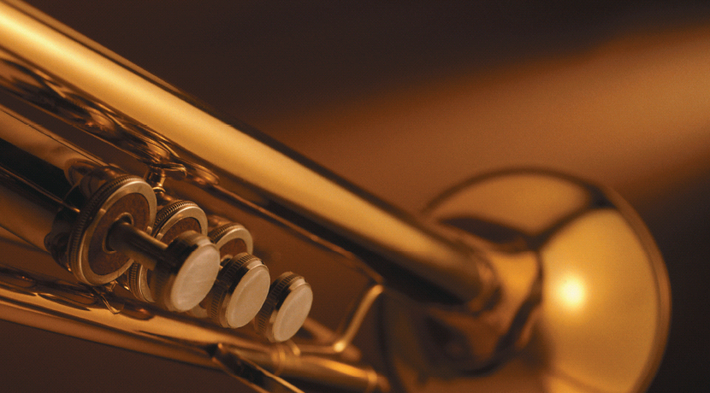
Chapter 14
Solutions
Brass, a solid solution of zinc and copper, is used to make musical instruments and many other objects.
Introduction to General, Organic, and Biochemistry 10e
John Wiley & Sons, Inc
Morris Hein, Scott Pattison, and Susan Arena

Slide 2
Chapter Outline
14.1 General Properties of Solutions 14.2 Solubility 14.3 Factors Related to Solubility 14.4 Rate of Dissolving Solids | 14.5 Solutions: A Reaction Medium 14.6 Concentration of Solutions 14.7 Colligative Properties of Solutions 14.8 Osmosis and Osmotic Pressure

Slide 3
General Properties of Solutions
A solution is a homogeneous mixture of one or more solutes and the solvent.
The solute is the substance being dissolved.
The solvent is the dissolving agent and is usually the most abundant substance in the mixture.
Air is a solution of N_{2(g)}, O_{2(g)}, Ar_{(g)}, CO_{2(g)}...
What substance is the solvent in air?
N_{2(g)}, since 78% of air is N₂.

Slide 4
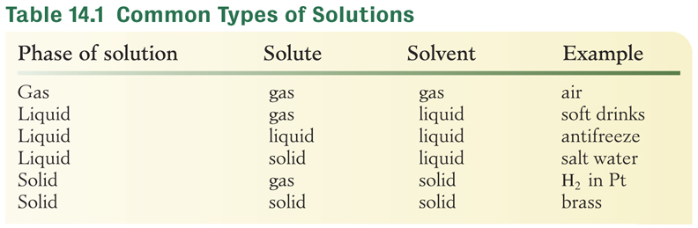
Common Types of Solutions
What gas is the solute in soft drinks?
carbon dioxide
What is another solute in soft drinks?
sugar and
flavorings

Slide 5
Properties of a True Solution
A homogeneous mixture of 2 or more components whose ratio can be varied.
The dissolved solute is molecular or ionic in size (less than 1 nm).
Liquid or gaseous solutions can be colored or colorless and are usually transparent.
The solute will not settle out of the solution.
The solute can be separated from the solvent by physical means.

Slide 6
Your Turn!
Sweet tea is prepared by dissolving an instant tea packet in water. Which substance is the solvent?
sugar
tea
water

Slide 7
Your Turn!
A solution of alcohol and water is prepared by adding 25 mL of water to 75 mL methyl alcohol. Which substance is the solute?
methyl alcohol
water

Slide 8
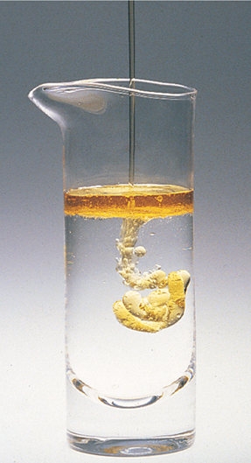

Solubility
Solubility describes the amount of a substance that will dissolve in a specified amount of solvent at a particular temperature.
For example: 36 g NaCl/100 g H₂O at 20°C
Miscible is the term used if 2 liquids will dissolve in each other.
Immiscible is used if the liquids will not dissolve in each other.

Slide 9
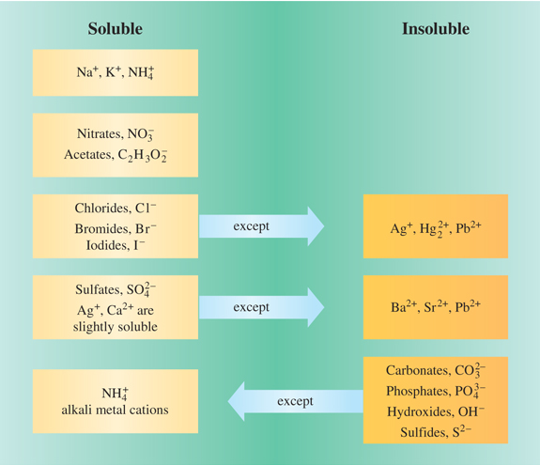
Ionic Compound Solubility Rules
NaCl
soluble
AgNO₃
soluble
AgCl
insoluble
AgOH
insoluble

Slide 10
Your Turn!
Use the ionic compound solubility rules to predict the solubility of barium sulfate.
soluble
insoluble

Slide 11
Your Turn!
Use the ionic compound solubility rules to predict the solubility of ammonium carbonate.
soluble
insoluble

Slide 12
Factors Related to Solubility
“Like dissolves like”
Polar compounds dissolve in polar solvents, like water and alcohol (CH₃CH₂OH)
  Acetone [(CH₃)₂CO] dissolves in water because it has a net dipole on the O to C bond, making it polar.
Nonpolar compounds dissolve in nonpolar solvents, like petroleum ether and CCl₄
  Hexane [CH₃(CH₂)₄CH₃] dissolves in petroleum ether because they are both nonpolar.

Slide 13
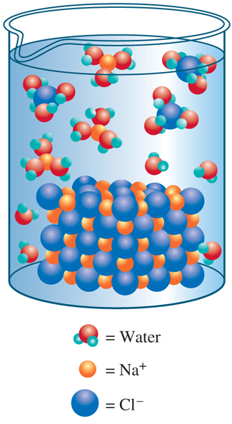
Ionic Solubility
Many ionic compounds dissolve in water because they form ion to dipole forces with water (a strong intermolecular force).
The ions become surrounded by water (become hydrated).
The cation is attracted to the partially negative O in water
The anion is attracted to the partially positive H in water.
Notes:
Figure 14.3 Dissolution of sodium chloride in water. Polar water molecules are attracted to Na and Cl- ions in the salt crystal, weakening the attraction between the ions. As the attraction between the ions weakens, the ions move apart and become surrounded by water dipoles. The hydrated ions slowly diffuse away from the crystal to become dissolved in solution.

Slide 14
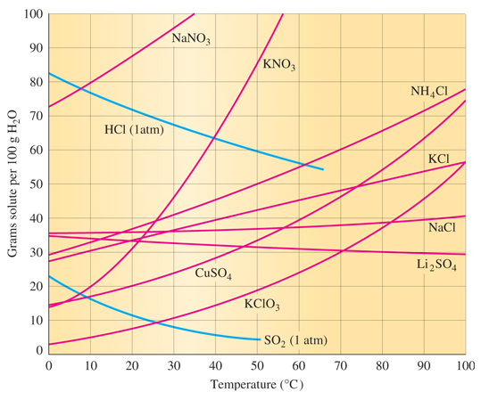
Temperature and Solubility
Most solids’ solubility increases with increasing temperature. (See red lines.)
All gases solubility decreases with increasing temperature. (See blue lines.)
Notes:
Figure 14.4 Solubility of various compounds in water. Solids are shown in red and gases are shown in blue.

Slide 15
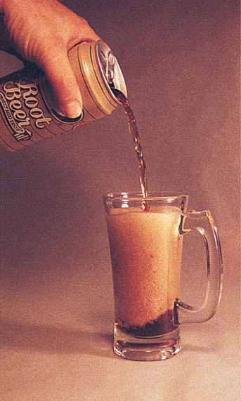
Pressure and Solubility
Pressure does not affect the solubility of solids or liquids, but there is a large effect with gases.
The solubility of gas in a liquid is proportional to the pressure of the gas over the liquid.
Sodas are canned under high pressure. When you open a can, the pressure decreases and bubbles form, releasing the excess gases.
Notes:
Pouring root beer into a glass illustrates the effect of pressure on solubility. The escaping carbon dioxide produces the foam.

Slide 16
Your Turn!
Under what conditions are gases most soluble in liquids?
high temperature, high pressure
high temperature, low pressure
low temperature, high pressure
low temperature, low pressure

Slide 17
Saturated and Unsaturated Solutions
Saturated solutions contain as much dissolved solute as the solvent will hold at a given temperature.
Saturated solutions are always in equilibrium with undissolved solute.
undissolved solute dissolved solute
Any point on the solubility curve represents a saturated solution of that solute.
Unsaturated solutions contain less solute than the amount needed to saturate the solution.
→
→

Slide 18
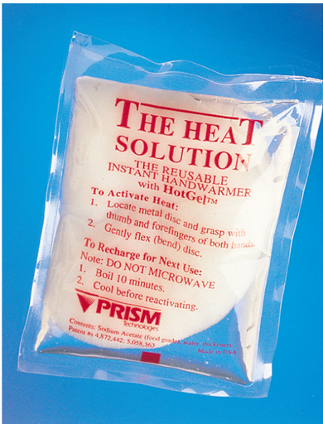
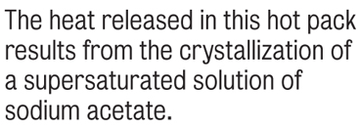
Supersaturated Solutions
Supersaturated solutions contain more solute than the amount needed to saturate the solution at a particular temperature.
Supersaturated solutions are unstable – stirring, adding a crystal of solute – will cause the excess solute to come out of solution.

Slide 19
Your Turn!
What mass of this compound will dissolve at 30°C?
5.0 g
5.4 g
5.8 g
6.0 g

Slide 20
Your Turn!
6.0 g of solute is dissolved in 100 g of water at 60°C. The solution is allowed to cool to 25°C. No crystals form. The solution is:
saturated
unsaturated
supersaturated

Slide 21
Your Turn!
The addition of a crystal sodium acetate to a sodium acetate solution causes additional crystals of sodium acetate to precipitate. The original solution was
Saturated
Supersaturated
Unsaturated

Slide 22
Rate of Dissolving Solids
  Particle Size
  A solid can dissolve only at the surface that is in contact with the solvent.
  Smaller crystals have a larger surface to volume ratio than large crystals.
  Smaller crystals dissolve faster than larger crystals.

Slide 23
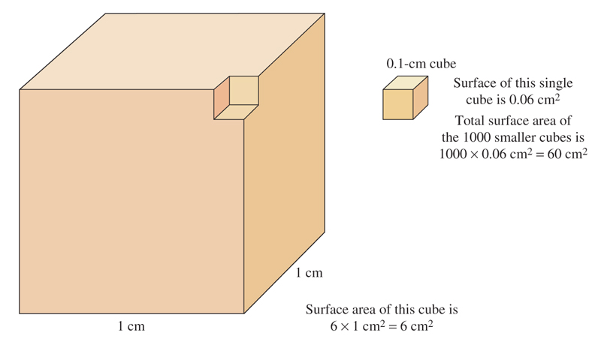

Surface Area

Slide 24
Rate of Dissolving Solids
Temperature
Increasing the temperature increases the rate at which most compounds dissolve.
  This occurs because solvent molecules strike the surface of the solid more frequently, causing the solid to dissolve more rapidly.
  The dissolved solute particles are also carried away from the solid by the higher kinetic energy solvent molecules, allowing more solvent to hit the surface.

Slide 25
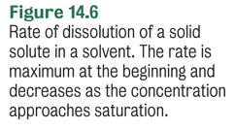
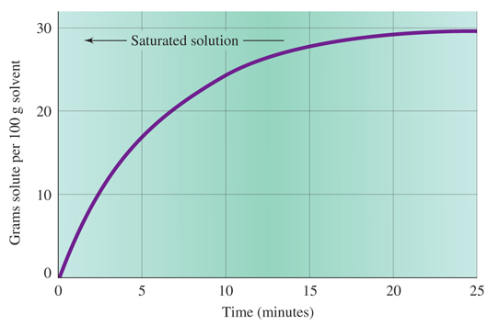
Rate of Dissolving Solids
Concentration of solution

Slide 26
Rate of Dissolving Solids
Agitation or Stirring
Stirring rapidly distributes the dissolved solute throughout the solution, eliminating the saturated solution that forms at the surface of the solid.
Moving dissolved solute away from the surface increases the contact between water molecules and the solid and increases the rate of dissolving.

Slide 27
Your Turn!
Which would most likely increase the solubility of a solid in water?
Stirring
Grind the solid to increase its surface area
Increase the pressure
Increase the temperature
All of the above

Slide 28
Solutions: A Reaction Medium
Dissolving reactants allows them to come into solution.
Combining two solids usually will not result in any significant reaction:
KCl_{(s)} + AgNO₃ _{(s)} → no reaction
But if you dissolve those same reactants in water, the silver ion can collide with the chloride ion, resulting in solid AgCl.
KCl_{(aq)} + AgNO_{3(aq)} → AgCl_{(s)} + KNO_{3(aq)}

Slide 29
Concentration of Solutions
Qualitative expressions of concentration:
A dilute solution contains a relatively small amount of dissolved solute.
A concentrated solution contains a relatively large amount of solute.
Hydrochloric acid is sold as a concentrated 12 M (moles/ L) solution. A dilute 0.1 M solution is commonly found in labs.

Slide 30
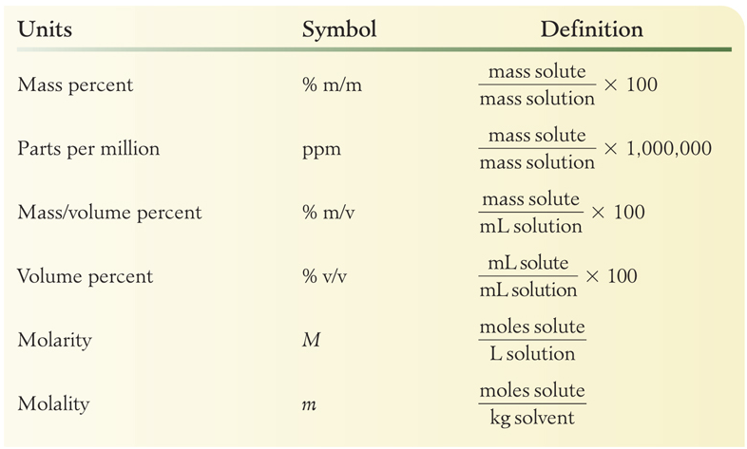
Concentration of Solutions
Quantitative expressions of concentration:

Slide 31
Mass Percent
Calculate the mass % NaCl in a solution prepared by dissolving 50. g NaCl in 150. g H₂O.
50. g NaCl (solute)
150. g H₂O (solvent)
50. g NaCl + 150. g H₂O =
200. g mass of solution
Knowns
Solving for
Calculate
= 25% NaCl

Slide 32
Mass Percent
Calculate the mass of Na₂CO₃ and water needed to make 350. g of a 12.3% solution.
350. g solution
12.3% solution
Knowns
Solving for
mass of solute (Na₂CO₃) and mass of H₂O
Calculate
= 43.1 g Na₂CO₃
mass of H₂O = 350. g – 43.1 g = 307 g H₂O

Slide 33
Mass-Volume Percent
Normal saline is a 0.90 m/v % NaCl solution. What mass of sodium chloride is needed to make 50. mL of normal saline?
50. mL solution
0.90 m/v% solution
Knowns
Solving for
mass of solute (NaCl)
Calculate
= 0.45 g NaCl

Slide 34
Volume Percent
What volume of beer that is 6.0 % by volume alcohol contains 200. ml CH₃CH₂OH (ethyl alcohol)?
Knowns
200. mL EtOH (solute)
6.0 volume % solution
volume of solution
Solving for
volume of solution = 3.3 L beer
Calculate
200 mL EtOH

Slide 35
Your Turn!
A 20.0 % solution of KCl has a mass of 400. g. What mass of KCl is contained in this solution?
20.0 g
80.0 g
320. g
400. g

Slide 36
Your Turn!
A solution is prepared by mixing 20.0 mL of propanol with enough water to produce 400.0 mL of solution. What is the volume percent of propanol in this solution?
A. 0.500 %
B. 4.76 %
C. 5.00 %
D. 5.26 %

Slide 37
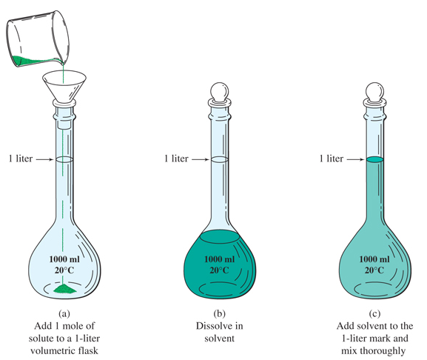

Molarity
A 1.0 M KCl solution is prepared by dissolving 1.0 moles KCl in enough water to make 1.0 L of solution.

Slide 38
Molarity
Calculate the molarity of a solution prepared by dissolving 9.35 g KCl in enough H₂O to make 250. mL solution.
9.35 g KCl (solute)
250. mL solution
Knowns
Solving for
= 0.502 M KCl
Calculate

Slide 39
Solution Stoichiometry
How many milliliters of 0.175 M Hg(NO₃)₂ is needed to completely precipitate 2.50 g KI?
Hg(NO₃)_{2 (aq)} + 2 KI_{(aq)} → 2KNO_{3(aq)} + HgI_{2(s)}
Plan
g KI → mol KI → mol Hg(NO₃)₂→ mL soln
= 43.0 mL of 0.175 M Hg(NO₃)₂

Slide 40
Dilution
Dilution: Adding solvent to a concentrated solution to make a more dilute solution.
When you dilute a concentrated solution, only the volume of solution changes. The quantity of solute remains the same.
Volume (V) × Molarity (M) = moles of solute
V₁ × M₁ = V₂ × M₂

Slide 41
Dilution
V₁ × M₁ = V₂ × M₂
How many milliliters of 12 M HCl are needed to make 500. mL of 0.10 M HCl?
12 M HCl (concentrated solution) M₁
0.10 M HCl (dilute solution) C₂
500. mL (dilute solution) V₂
Knowns
Solving for
volume of 12 M HCl V₁
Calculate
4.2 mL of 12 M HCl

Slide 42
Your Turn!
What is the molarity of a solution in which 5.85 g of NaCl is dissolved in 200. mL of solution?
0.500 M
1.00 M
2.00 M
4.00 M

Slide 43
Your Turn!
What is the molarity of the resulting solution when 300. mL of a 0.400 M solution is diluted to 800. mL?
0.109 M
0.150 M
1.07 M
1.47 M

Slide 44
Colligative Properties of Solutions
A colligative property is any property of a solution that depends on the number of solute particles, and not on the nature of the particles.
Solutions will have
Lower vapor pressures than the pure solvent
Higher boiling points than the pure solvent
Lower freezing points than the pure solvent
Osmosis and osmotic pressure are also colligative properties of solutions.

Slide 45
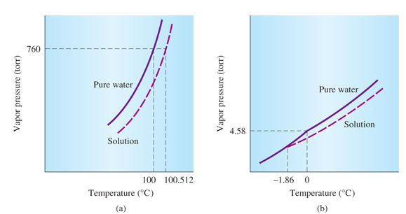
Vapor Pressure Lowering
Dissolving solute in a solvent lowers the vapor pressure of the solvent, decreasing the boiling point (graph a) and the freezing point (graph b) of the solvent.
Notes:
Figure 14.8 Vapor pressure curves of pure water and water solutions, showing (a) boiling point elevation and (b) freezing point depression effects (concentration: 1mol solute/1 kg water).

Slide 46
Molality
Since we are looking at properties that depend on the number of particles in the solvent, we use molality, which is the number of moles of solute per kg of solvent.
What is the molality of a solution prepared by dissolving 0.10 mol sugar in 0.50 kg water?

Slide 47
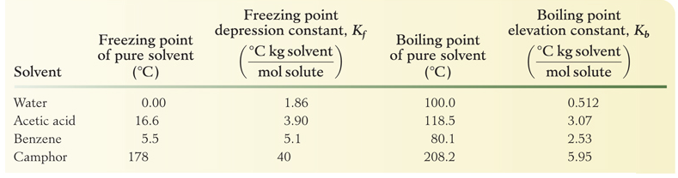
Colligative Properties
To calculate the effect of dissolving un-ionized and nonvolatile solutes on the boiling point or freezing point of the solvent, we use the equation:

Slide 48
Boiling Point Elevation
What is the boiling point of a solution prepared by dissolving 0.10 mol sugar in 0.50 kg water? The normal boiling point of water is 100.0°C and the boiling point constant for water is 0.512 °C/m.
The boiling point goes up, so we need to add 0.10°C to the boiling point of pure water.

Slide 49
Freezing Point Elevation
What is the freezing point of a solution prepared by dissolving 0.10 mol sugar in 0.50 kg water? The normal freezing point of water is 0.0°C and the freezing point constant for water is 1.86 °C/m.
The freezing point goes down, so we need to subtract 0.37°C from the freezing point of pure water.

Slide 50
Your Turn!
What is the boiling point of a 4.00 m aqueous solution of a nonvolatile nonelectrolyte? (The boiling point elevation constant for water is 0.512° C/m.)
100.00° C
102.05° C
97.95° C
2.05° C

Slide 51
Your Turn!
When compared to pure water, aqueous solutions always have
Higher boiling point and higher freezing point
Lower boiling point and lower freezing point
Higher boiling point and lower freezing point
Lower boiling point and higher freezing point

Slide 52
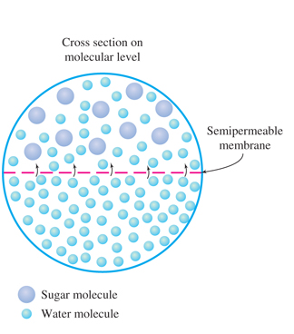
Osmosis
Osmosis is the diffusion of water, either from a dilute solution or from pure water, through a semipermeable membrane into a solution of higher concentration.

Slide 53
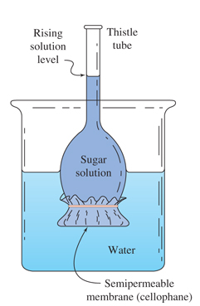
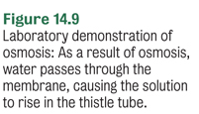
Osmotic Pressure
The osmotic pressure of a solution can be measured by applying enough pressure to stop the flow of water due to osmosis.
The difference between the applied pressure and the atmospheric pressure is the osmotic pressure.

Slide 54
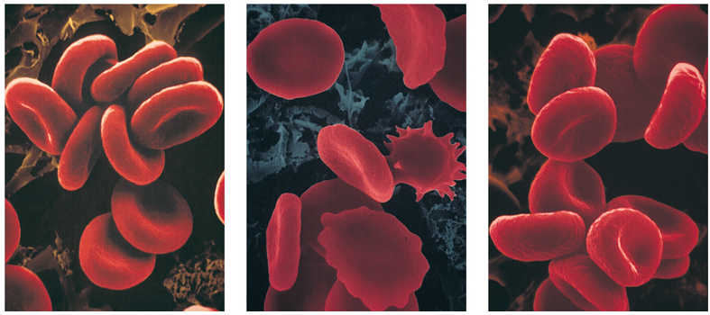
Blood and Osmosis
Isotonic – same concentration of dissolved particles (0.9% saline)
Hypertonic – higher concentration (for example, 1.6% saline)
Hypotonic – lower concentration (for example, 0.2% saline)
The effect
of different
concentrations
on red blood
cells.
isotonic
hypertonic
hypotonic

