Slide 1
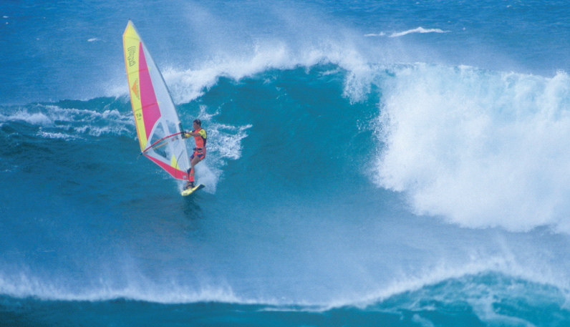
Chapter 13
Properties of Liquids
Liquid water provides the base for the recreation of windsurfing and also for our bodies., Water is a unique liquid on our blue planet.
Introduction to General, Organic, and Biochemistry 10e
John Wiley & Sons, Inc
Morris Hein, Scott Pattison, and Susan Arena

Slide 2
Chapter Outline
13.1 What is a Liquid? 13.2 Evaporation 13.3 Vapor Pressure 13.4 Surface Tension 13.5 Boiling Point 13.6 Freezing Point or Melting Point | 13.7 Changes of State 13.8 The Hydrogen Bond 13.9 Hydrates 13.10 Water, a Unique Liquid 13.11 Water Purification

Slide 3
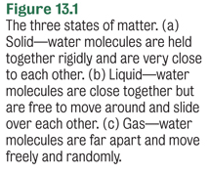
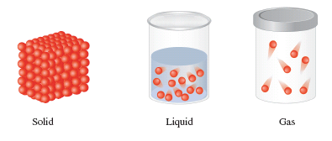
What Is a Liquid?

Slide 4
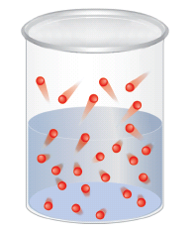
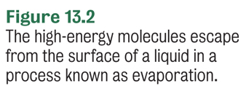
Evaporation
Evaporation or vaporization is the escape of molecules from the liquid state to the gas or vapor state.
liquid → vapor

Slide 5
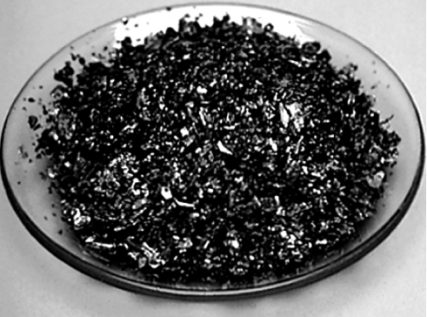
Sublimation
Sublimation is the phase change from the solid state to the gas or vapor state without going through the liquid state.
solid → vapor
CO_{2(s)} → CO_{2(g)}
I_{2(s)} → I_{2(g)}
Iodine crystals

Slide 6
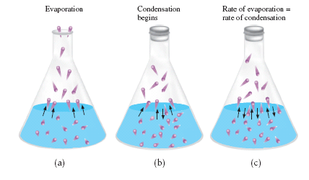
Vapor Pressure
In a closed container, an equilibrium develops where there are as many molecules evaporating as there are condensing.
Vapor pressure is the pressure exerted by a vapor in equilibrium with its liquid.
evaporation
liquid vapor
condensation
Notes:
Figure 13-3 (a) Molecules in an open flask evaporate in the atmosphere.
(b) When the flask is stoppered the number of gaseous molecules increases inside the flask. Some gasous molecules collide with the surface of the liquid and stick – condensation occurs.
(c) When the rate of evaporation equals the rate of condensation, an equilibrium between the liquid and vapor is established.

Slide 7
Vapor Pressure
Is independent of the quantity of the liquid or its surface area
Increases with increasing temperature.
Depends on the strength of the attraction between molecules in the liquid state.
Volatile liquids have very weak attractive forces and so evaporate rapidly at room temperature. Volatile liquids have high vapor pressures at 25°C.

Slide 8
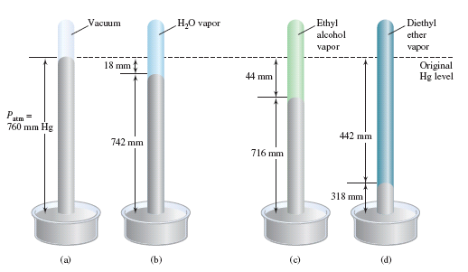
Vapor Pressure
Notes:
Figure 13.4
(a) A barometer measures atmospheric pressure. To measure the vapor pressure of a liquid a tiny amount is injected into the barometer.
(b) The water vapor presses the Hg down 24 mm (vapor pressure = 24 mm Hg)
(c) Ethyl alcohol presses the Hg level down 44 mm (vapor pressure = 44 mm Hg)
(d) Diethyl ether has a vapor pressure of 318 mm Hg

Slide 9
Your Turn!
The vapor pressure of diethyl ether was 318 mm Hg while the vapor pressure of ethyl alcohol was 44 mm Hg. Which substance has stronger attractive forces between molecules?
diethyl ether
ethyl alcohol

Slide 10
Your Turn!
In a system at equilibrium between the liquid and gas phases
Particles stop changing phase
The rate at which particles change from liquid to gas exceeds the rate at which they change from gas to liquid.
The rate at which particles change from gas to liquid equals the rate at which they change from liquid to gas.

Slide 11
Your Turn!
Which has the lowest vapor pressure?
100 mL of gasoline at 15°C
25 mL of gasoline at 50°C
50 mL of gasoline at 50°C
25 mL of gasoline at 70°C

Slide 12
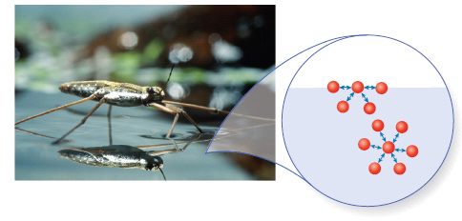
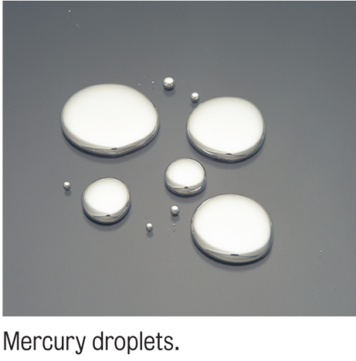
Surface Tension
Surface Tension is the resistance of a liquid to an increase in its surface area.
Molecules on the surface of the liquid are strongly attracted by the molecules within the liquid.
Surface tension increases with increasing attractive forces between molecules.
Image
Place Holder
Notes:
A water strider skims the surface of the water as a result of surface tension. At the molecular level the surface tension results from the net attraction of the water molecules toward the liquid below. In the interior of the water, the forces are balanced in all directions.

Slide 13
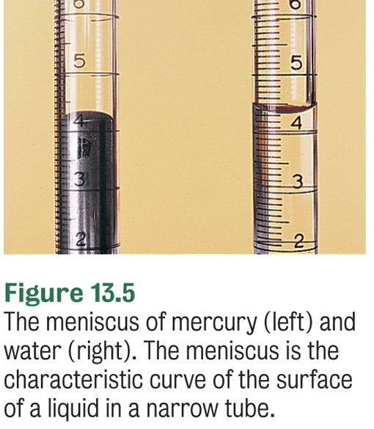
Capillary Action
Capillary action is the spontaneous rise of a liquid in a narrow tube.
The shape of the meniscus reflects the relative strength of the cohesive forces within the liquid and the adhesive forces between the liquid and the tube.

Slide 14
Your Turn!
Mercury has a convex meniscus. Which statement best explains this?
The adhesive forces are stronger than the cohesive forces.
The cohesive forces are stronger than the adhesive forces.

Slide 15
Boiling Point
The boiling point of a liquid is the temperature at which the vapor pressure of a liquid is equal to the external pressure above the liquid.
Where is the boiling point of a liquid higher, at sea level or in the mountains?
At sea level since the atmospheric pressure is higher.

Slide 16
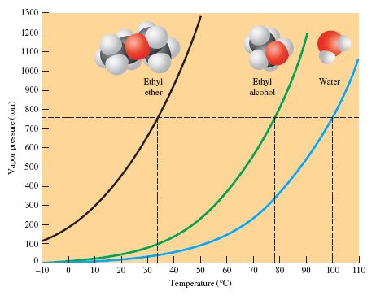
Boiling Point
The normal boiling point is the temperature when the vapor pressure is 1 atm.
Water – 100°C
Ether – 35°C
Ethyl Alcohol – 78°C

Slide 17
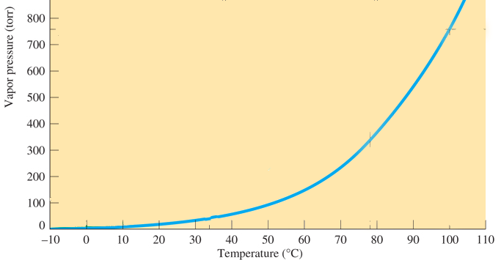
Your Turn!
The vapor pressure curve for water is given below. What is the boiling point of water at 300 mmHg?
100°C
86°C
76°C
30°C

Slide 18
Freezing Point
The freezing point or melting point is the temperature at which the solid phase of a substance is in equilibrium with its liquid phase.
We add ice to keep our drinks cool. What is the temperature of iced water?
Roughly 0°C as long as there is ice present in the glass.
melting
solid liquid
freezing

Slide 19
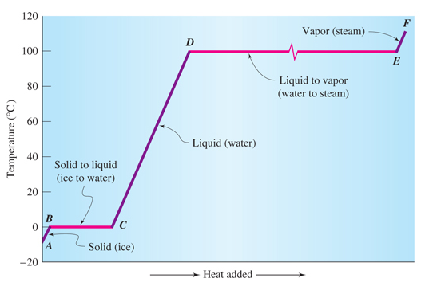
Changes of State
Heat of vaporization
Heat of fusion
Notes:
Figure 13.7 Heating curve for a pure substance – the absorption of heat by a substance from the solid state to the vapor state. Using water as an example, the AB interval represents the ice phase; BC interval, the melting of ice to water; CD interval, the elevation of the temperature of water from 0°C to 100°C; DE interval, the boiling of water to steam; and EF interval, the heating of steam.

Slide 20
Energy and Phase Changes
The heat of fusion is the energy required to change one gram of a solid at its melting point to liquid.
The heat of fusion for water is 335 J/g. Calculate the amount of heat needed to melt 25.0 g of ice at 0°C.

Slide 21
Energy and Phase Changes
The heat of vaporization is the energy required to change one gram of a liquid to vapor at its normal boiling point.
The heat of vaporization for water is 2259 J/g. Calculate the amount of heat needed to vaporize 25.0 g of water at 100°C.

Slide 22
Energy Calculations
Calculate the energy needed to convert 25.0 g ice at 0°C to steam at 100°C.
Plan
1. melt ice (mass x heat of fusion)
2. warm water from 0° to 100°C
3. evaporate water (mass x heat of vaporization)
4. sum the energies
Calculate

Slide 23
Your Turn!
What quantity of heat must be removed from 2.0 g of liquid water at 0 °C to completely freeze the water? The heat of fusion of ice is 335 J/g.
32 J
1.7 J
670 J
0.060 J

Slide 24
Your Turn!
A sample of liquid water at 100. °C absorbs 113 kJ of heat energy. How much of the water will be converted to steam? The heat of vaporization of water is 2259 J/g.
50.0 g
0.0200 g
255 g
113 g

Slide 25
Your Turn!
A sample of water at 10.0 ° C absorbs 4410 J of heat energy. The temperature of the sample increases to 72.0 °C. What is the mass of the water? The specific heat of liquid water is 4.184 J/g°C.
14.7 g
17.0 g
256 g
297 g

Slide 26
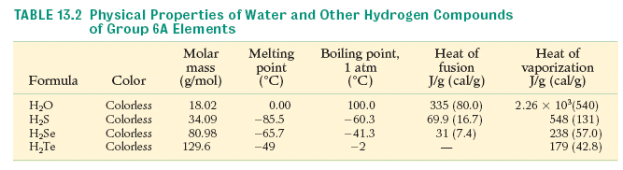
The Hydrogen Bond
Water has extremely high melting and boiling points as well as heats of fusion and vaporization.
The liquid water molecules are strongly attracted to each other by hydrogen bonds.

Slide 27
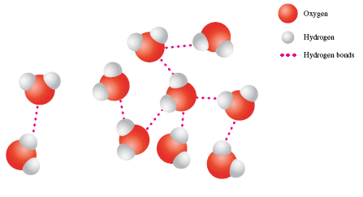
The Hydrogen Bond
Hydrogen bonds are one type of intermolecular force of attraction between molecules.
Hydrogen bonds are much weaker than ionic or covalent bonds which are intramolecular forces.
Notes:
Figure 13.8 Hydrogen bonding. Water in the liquid and solid states exists as aggregates in which the water molecules are linked together by hydrogen bonds.

Slide 28
The Hydrogen Bond
Compounds that can form hydrogen bonds have hydrogen covalently bonded to F, O or N.
..
H
H
H
H
O
..
H
..
H
..
H
C – C – C – C – N – H
H
C – O – C – C
H
..
H
H
H
H
H
H
H
Can hydrogen bond.
Cannot hydrogen bond.

Slide 29
Your Turn!
Which molecule has forms hydrogen bonds?
H₂O
H₂S
H₂Se
H₂Te
all of the above

Slide 30
Your Turn!
Hydrogen bonds do not form between molecules of
HF
HCl
H₂O
NH₃

Slide 31
Your Turn!
The high boiling point of water is due to
Polar covalent bonds
Nonpolar covalent bonds
Ionic bonds
Hydrogen bonds

Slide 32
Hydrates
Hydrates are solids that contain water molecules as part of their crystalline structure.
The water molecules in the structure are known as the water of crystallization or the water of hydration.
CaCl₂∙2H₂O
The formula lists the anhydrous (without water) formula of the compound followed by a dot and the numbers of water of hydration.
The compound CaCl₂∙2H₂O has 2 waters of hydration.

Slide 33
Hydrates
The name of the hydrate states that it is a hydrate and the numbers of water molecules using the appropriate prefix.
CaCl₂∙2H₂O calcium chloride dihydrate
FeCl₃∙6H₂O iron(III) chloride hexahydrate

Slide 34
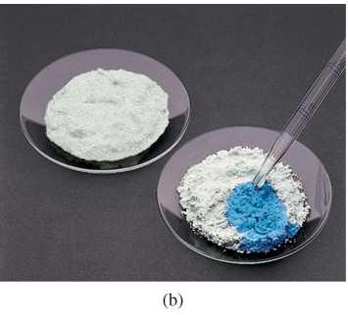
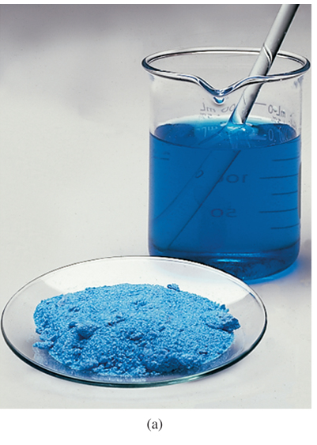
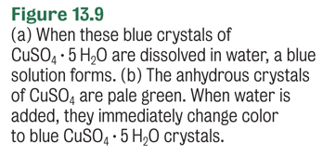
Copper(II) sulfate pentahydrate
CuSO_{4(s)} +5H₂O_{(l)} → CuSO₄∙5H₂O_{(s)}

Slide 35
Decomposition of Hydrates
Heating the hydrate will remove the water of hydration.
Mass percent of water in CuSO₄∙5H₂O:
CuSO₄∙5H₂O_{(s)} CuSO_{4(s)} + 5H₂O_{(g)}
250°C

Slide 36
Your Turn!
What mass of water is found in one mole of barium hydroxide octahydrate?
126.14 g
144.16 g
162.18 g
108.12 g
18.02 g

Slide 37
Your Turn!
What is the percent water in CoCl₃⋅6H₂O?
38.9 %
14.5%
65.4 %
39.5 %

Slide 38
Physical Properties of Water
Water’s unique physical properties are the result of its bent geometric shape and its ability to form strong hydrogen bonds with adjacent water molecules.
solid | liquid | gas
specific heat 2.05 J/g°C density 0.917 g/mL melting point 0°C heat of fusion 335 J/g | specific heat 4.18 J/g°C density 1.00 g/mL (4°C) boiling point 100°C heat of vaporization 2259 J/g | specific heat 2.08J/g°C density depends on T

Slide 39
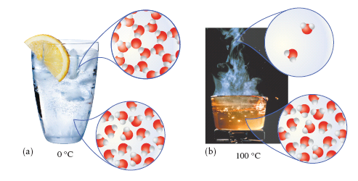
Water

Slide 40
Formation of Water
Combination Reaction
H_{2(g)} + O_{2(g)} → 2H₂O_{(g)} + 484 kJ
Double Replacement Reactions
NaOH_{(aq)} + HCl_{(aq)} → NaCl_{(aq)} + H₂O_{(l)} + 56 kJ
Combustion Reactions
CH_{4(g)} + 2O_{2(g)} → CO_{2(g)} + H₂O_{(l)} + 803 kJ

Slide 41
Your Turn!
What are the products of the reaction of aqueous calcium hydroxide with hydrochloric acid?
CaCl and H₂O
CaCl₂ and H₂
CaCl₂ and H₂O
Ca(OH)_{2(aq)} + 2HCl_{(aq)} → CaCl_{2(aq)} + 2H₂O_{(l)}

Slide 42
Reactions with Metals
React with cold water: Na, K, Ca
2Na_{(s)} + 2H₂O_{(l)} → 2NaOH_{(aq)} + H_{2(g)}
Ca_{(s)} + 2H₂O_{(l)} → Ca(OH)_{2(aq)} + H_{2(g)}
React with boiling water: Mg
Mg_{(s)} + H₂O_{(l)} → MgO_{(s)} + H_{2(g)}
React with steam: Zn, Al, Fe
Zn_{(s)} + H₂O_{(l)} → ZnO_{(s)} + H_{2(g)}
Don’t React at all: Ag, Au, Cu
most reactive metals
Activity Series
least reactive metals

Slide 43
Reactions of Water with Metal Oxides
Metal oxides are basic anhydrides.
Water soluble metal oxides react with water to form metal hydroxides.
Na₂O_{(s)} + H₂O_{(l)} → 2NaOH_{(aq)}
CaO_{(s)} + H₂O_{(l)} → Ca(OH)_{2(aq)}
Many metal oxides are not water soluble, so they don’t form basic solutions.

Slide 44
Reactions of Water with Nonmetal Oxides
Nonmetal oxides are acid anhydrides. They react with water to form acidic solutions.
CO_{2(g)} + H₂O_{(l)} → H₂CO_{3(aq)} Carbonic acid
SO_{2(g)} + H₂O_{(l)} → H₂SO_{3(aq)} Sulfurous acid
SO_{3(g)} + H₂O_{(l)} → H₂SO_{4(aq)} Sulfuric acid
N₂O_{5(g)} + H₂O_{(l)} → 2HNO_{3(aq)} Nitric acid

Slide 45
Your Turn!
Which is an acidic anhydride?
Magnesium oxide
Dinitrogen trioxide
Lithium oxide
Sodium oxide

Slide 46
Your Turn!
What are the products of the reaction of potassium metal with water?
K₂O and H₂
KO and H₂
KOH and H₂

Slide 47
Fresh Water Purification
Purifying fresh water for drinking
Screening – Removal of large items (fish, trash).
Flocculation and sedimentation – Addition of chemicals (lime and alum) to form a jelly like precipitate of Al(OH)3 that traps most of the suspended sediment and carries it to the bottom.
Sand Filtration – Water is drawn off the top and passed through fine sand filters that remove remaining sediment and bacteria.

Slide 48
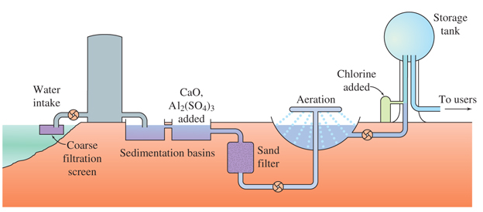

Fresh Water Purification
Purifying fresh water for drinking (continued)
Aeration – Aeration removes objectionable odors.
Disinfection – Chlorine gas or ozone are used to kill the bacteria that remain in the water.

