Slide 1
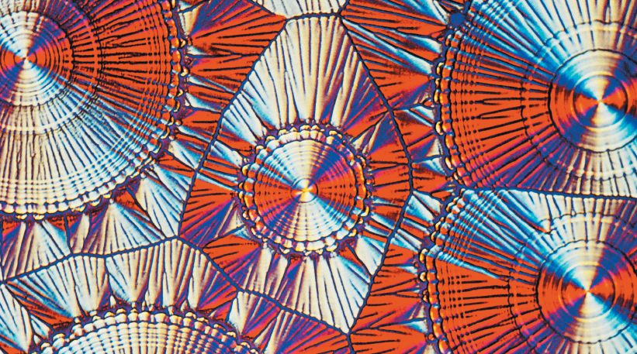
Chapter 11
Chemical Bonds: The Formation of Compounds from Atoms
The atoms in vitamin C (ascorbic acid) bond together in a very specific orientation to form the shape of the molecule. The molecules collect together into a crystal, which has been photographed here in a polarized micrograph (magnified 200 times).
Introduction to General, Organic, and Biochemistry 10e
John Wiley & Sons, Inc
Morris Hein, Scott Pattison, and Susan Arena

Slide 2
Chapter Outline
11.1 Periodic Trends in Atomic Properties 11.2 Lewis Structures of Atoms 11.3 The Ionic Bond: Transfer of Electrons from One Atom to Another 11.4 Predicting Formulas of Ionic Compounds 11.5 The Covalent Bond: Sharing Electrons | 11.6 Electronegativity 11.7 Lewis Structures of Compounds 11.8 Complex Lewis Structures 11.9 Compounds Containing Polyatomic Ions 11.10 Molecular Shape 11.11 The Valence Shell Electron Pair Repulsion (VSEPR) Model

Slide 3
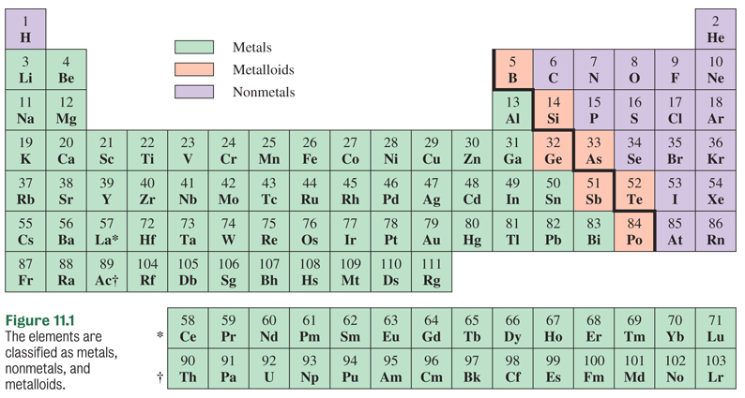
Periodic Trends in Atomic Properties
Metallic character increases from right to left and top to bottom on the periodic table.

Slide 4
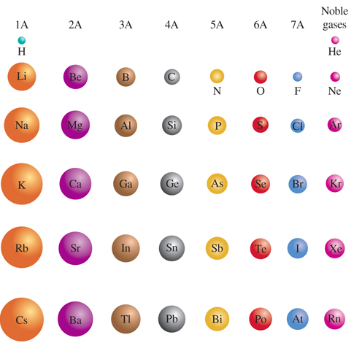
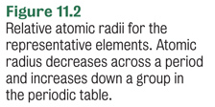
Atomic Radii
What factors increase the size of atoms?
Increase in number of energy levels.
Within an energy level, increase in nuclear charge.

Slide 5
Ionization Energy
The amount of energy required to remove an electron from a gaseous atom.
Na + 496 kJ/mol→ Na⁺ + e⁻
1s²2s²2p⁶3s¹ → 1s²2s²2p⁶
Ionization energy in Group A elements increases from the bottom to the top on the periodic table.
Ionization energy increases from left to right across a period.
He

Slide 6
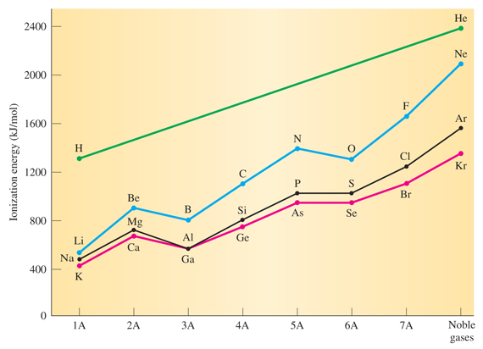
Ionization Energy
Notes:
Figure 11.3 Periodic relationship of the first ionization energy for representative elements in the first four periods.

Slide 7
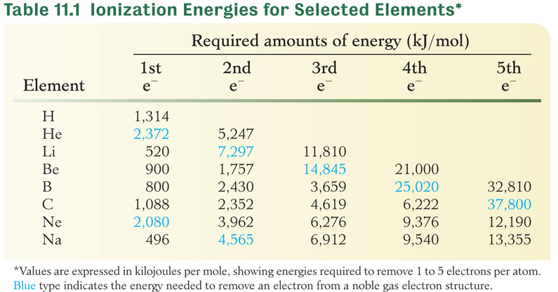
Ionization Energy
More energy is needed to remove an electron from an element or ion with a noble gas electron configuration.

Slide 8
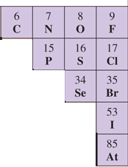
Nonmetals
Have relatively high ionization energies.
Gain electrons to be stable.
Form anions (negatively charged ions).
The most active nonmetals are found
in the upper right corner of the table.

Slide 9
Your Turn!
Which elements have the highest ionization energies?
halogens
alkali metals
noble gases
alkaline earth metals

Slide 10
Your Turn!
Metals generally form ions by
Gaining electrons, forming positive ions
Losing electrons, forming positive ions
Gaining electrons, forming negative ions
Losing electrons, forming negative ions

Slide 11
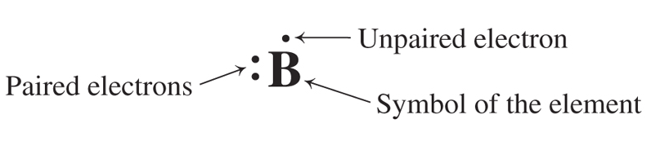
Lewis Structures of Atoms
Lewis structures use dots to represent the valence electrons of an atom.
The symbol of the element represents the nucleus and the electrons in filled inner shells.
Boron has the electron configuration: [He]2s²2p¹

Slide 12
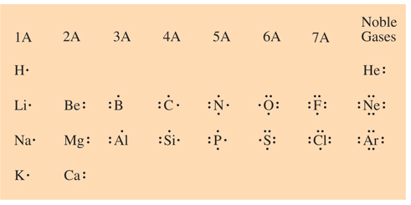
Lewis Structures of Atoms
Figure 11.4 Lewis structures of the first 20 elements. Dots represent electrons in the outermost s and p energy levels only.
Notes:
Figure 11.4 Lewis structures of the first 20 elements. Dots represent electrons in the outermost s and p energy levels only.

Slide 13
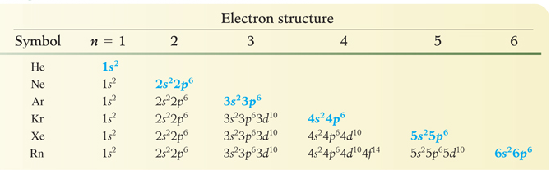
The Noble Gases
The representative elements tend to gain, lose or share enough electrons to have the same number of electrons as the very stable noble gases.
*Each noble gas has eight valence electrons (except He).

Slide 14
Your Turn!
How many valence electrons are present in an atom of bromine in the ground state and how many does bromine need to gain to have the same electron configuration as a noble gas?
1, 7
2, 6
3, 5
7, 1

Slide 15
Your Turn!
How many valence electrons are present in an atom of aluminum in the ground state and what charge will it form when it loses those electrons?
3, +3
3, -3
5, +3
1, +1
13, +3

Slide 16
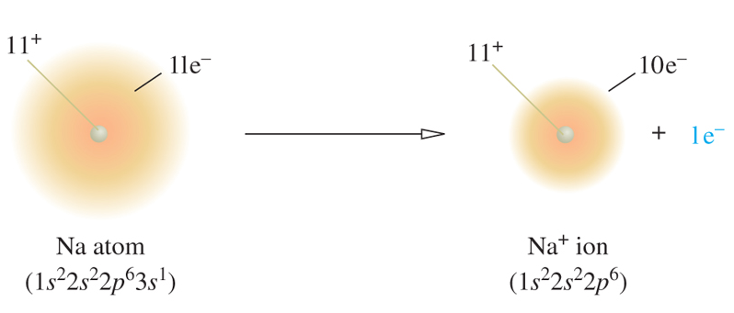
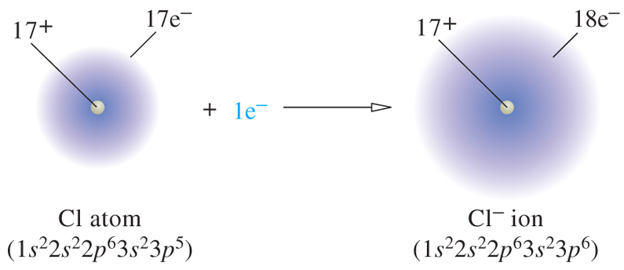
Ion Formation
Sodium loses one valence electron.
Chlorine gains one valence electron.

Slide 17
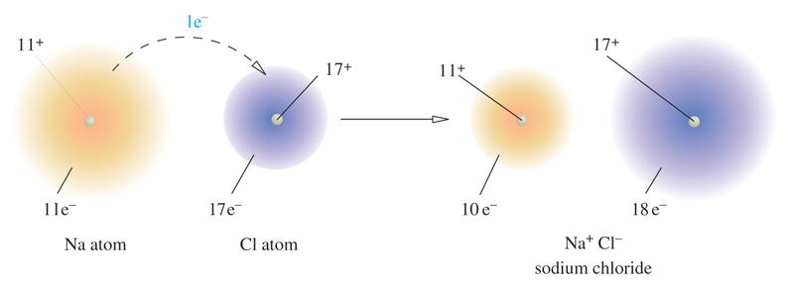
Ionic Bond Formation
An ionic bond is the attraction of oppositely charged particles.
Na
+
Cl
[Na]⁺
[ Cl ]⁻

Slide 18
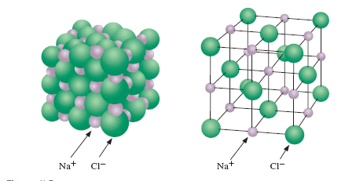
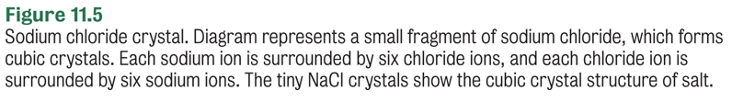
NaCl Crystal

Slide 19
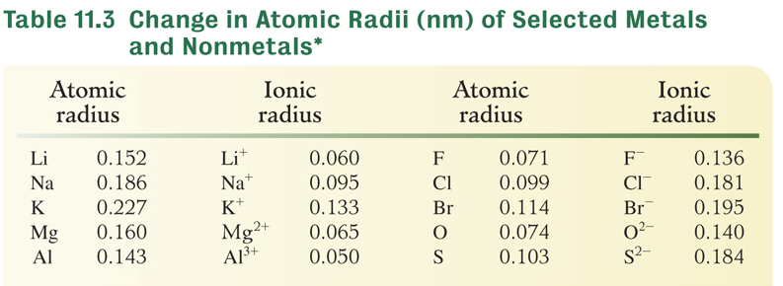
Atomic and Ionic Radii
*The metals lose electrons to become cations. The nonmetals gain electrons to become anions.

Slide 20
Your Turn!
Which element forms an ion that is larger than its atom?
Lithium
Calcium
Chromium
Fluorine

Slide 21
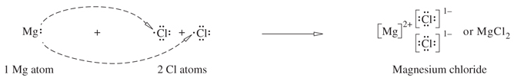
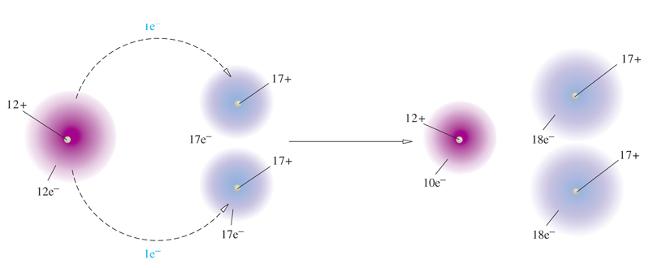
Formation of Magnesium Chloride
Mg needs to lose 2 electrons: [Ne]3s²
Cl needs to gain 1 electron: [Ne]3s²3p⁵
We will need to transfer 2 electrons from Mg to Cl.
2 Cl are needed!

Slide 22
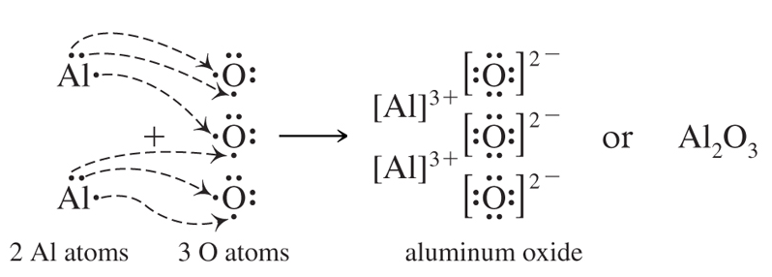
Formation of Aluminum Oxide
Al needs to lose 3 electrons: [Ne]3s² 3p¹
O needs to gain 2 electron: [He]2s²2p⁴
We will need to transfer 6 electrons.
2 Al and 3 O
are needed!

Slide 23
Your Turn!
A Cl⁻¹ ion has an electron configuration similar to that of
Neon
Argon
Krypton
Xenon

Slide 24
Predicting Formulas of Ionic Compounds
Elements within a group behave similarly because their valence electron configuration is the same.
If sodium oxide is Na₂O, then oxides of other Group IA elements will also exist in a 2:1 ratio:
Li₂O, K₂O, Rb₂O
If sodium oxide is Na₂O, then sulfides of the Group IA elements will also exist in a 2:1 ratio.
Na₂S, K₂S, Rb₂S

Slide 25
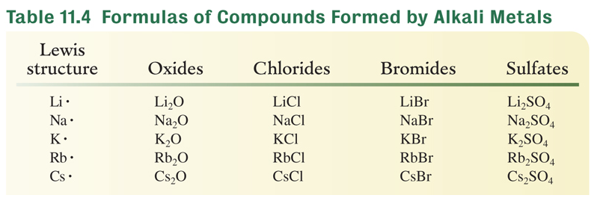
Predicting Formulas of Ionic Compounds
Calcium sulfate is CaSO₄.
What is the formula for barium sulfate?
BaSO₄

Slide 26
Your Turn!
Calcium phosphide is Ca₃P₂. What is the empirical formula of barium nitride?
BaN
Ba₃N
Ba₂N₃
Ba₃N₂

Slide 27
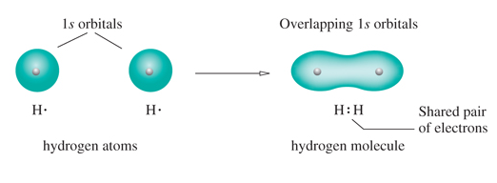
The Covalent Bond
Molecules exist as discrete units held together by covalent bonds.
A covalent bond consists of a pair of electrons shared by two atoms.
Figure 11.8 The formation of a hydrogen molecule from two hydrogen atoms. The two 1s orbitals overlap, forming the H₂ molecule.

Slide 28
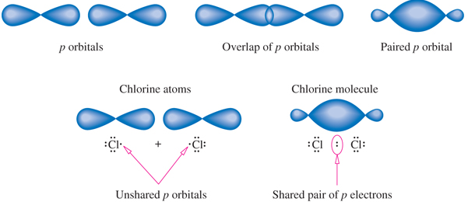
The Covalent Bond- Cl₂
The Cl-Cl bond is created by overlapping p orbitals.
Figure 11.9 Pairing p electrons in the formation of a chlorine molecule.

Slide 29

Other Diatomic Elements
Single bonds are formed in hydrogen and the halogens because each atom needs only 1 more electron to be stable.
A double bond is formed by oxygen because each atom has 6 valence electrons and needs 2 more to be stable.
A triple bond is formed by nitrogen because each atom has 5 valence electrons and needs 3 more to be stable.

Slide 30
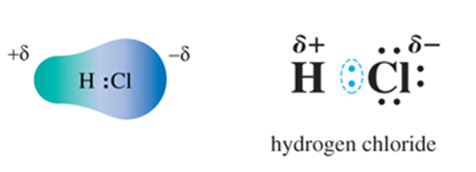
Electronegativity
Electronegativity is a measure of the attractive force that one atom in a covalent bond has for the electrons of the bond.
Chlorine is more electronegative than H. The pair of shared electrons in HCl is closer to the Cl atom than to the H atom, giving Cl a partial negative charge with respect to the H atom.

Slide 31
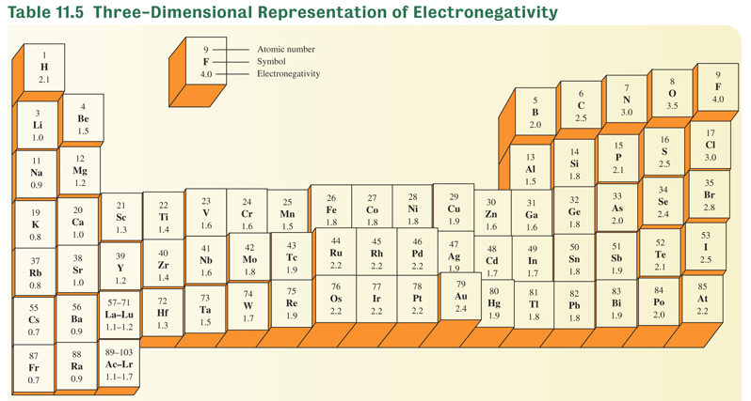
Electronegativity

Slide 32
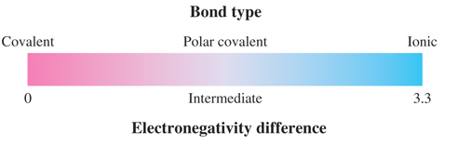
The Bonding Continuum
Bonding is determined by differences in electronegativities
If the difference in electronegativity between 2 atoms is
greater than 2, the bonding is ionic.
equal to 0, the bonding is covalent (equal sharing).
in between 0 and 2, the bonding is polar covalent (unequal sharing).

Slide 33
Nonpolar Covalent Bonds
Nonpolar covalent bonds have very small or no differences in electronegativity between the two atoms of the bond.
The electrons are shared equally.
C-S electronegativity difference = 2.5 – 2.5 = 0
N-Cl electronegativity difference = 3.0 – 3.0 = 0

Slide 34
Polar Covalent Bonds
Polar covalent bonds are found when the two different atoms are sharing the electrons unequally.
Look for differences in electronegativity less than 2.
P- O electronegativity difference = 3.5 – 2.1 = 1.4
N-C electronegativity difference = 3.0 – 2.5 = 0.5
P O
N C

Slide 35
Polar or Ionic
If the electronegativity difference between two bonded atoms is greater than 1.7-1.9, the bond will be more ionic than covalent.
  P- F electronegativity difference = 4.0 – 2.1 = 1.9
If the electronegativity difference is greater than 2, the bond is strongly ionic.
  Si- F electronegativity difference = 4.0 – 1.8 = 2.2
If the electronegativity difference is less than 1.5, the bond is strongly covalent.

Slide 36
Your Turn!
A bond that is principally ionic will form between
Magnesium and chlorine
Silicon and phosphorus
Selenium and oxygen
Oxygen and nitrogen

Slide 37
Your Turn!
A polar covalent bond will form between which two atoms?
Beryllium and fluorine
Hydrogen and chlorine
Sodium and oxygen
Fluorine and fluorine

Slide 38
Molecular Shape and Polarity
Molecules with polar bonds may or may not be polar depending on their geometry.
Symmetric arrangements of polar bonds result in nonpolar molecules.
O = C = O
Asymmetric arrangements of polar
bonds result in polar molecules.
N
H
H
H

Slide 39
Lewis Structures of Compounds
Sum number of valence electrons
Draw the skeletal structure and bond atoms with a single bond (2 electrons). Note that H can have only one bond so cannot be a central atom.
Subtract electrons used from the sum
Distribute pairs of electrons on remaining atoms to complete their octet (except H)
Form double/triple bonds if necessary to complete octet.

Slide 40
Lewis Structure: NF₃
Sum the valence electrons: N +3F = 5 + 3(7) = 26
Arrange skeletal structure and bond atoms.
Subtract bonding electrons from sum: 26-3(2) = 20
Distribute the 20 electrons in pairs to complete the octet of each atom.
..
..
..
:
:
F N F
F N F
..
..
:
F
F
:
..

Slide 41
Lewis Structure: CH₂O
Sum the valence electrons: C+2H+O = 4 + 2(1) +6 = 12
Arrange skeletal structure and bond atoms.
Subtract bonding electrons from sum: 12-3(2) = 6
Distribute the 6 electrons in pairs to complete the octet of each atom.
Form double/triple bonds if necessary to complete octet.
..
..
:
:
H C O
H C O
H C O
..
..
H
H
H

Slide 42
Lewis Structure: CO
Sum the valence electrons: C+O = 4 + 6 = 10
Arrange skeletal structure and bond atoms.
Subtract bonding electrons from sum: 10-1(2) = 8
Distribute the 8 electrons in pairs to complete the octet of each atom.
Form double/triple bonds if necessary to complete octet.
C O
C O
C O
:
:
:
..
:
..

Slide 43
Complex Lewis Structures: NO₂⁻
Sum the valence electrons: N+2O+1(e⁻) = 5+2(6)+1 =18
Note the extra electron from the -1 charge.
Arrange skeletal structure and bond atoms.
Subtract bonding electrons from sum: 18-2(2) = 14
Distribute the 14 electrons in pairs to complete the octet of each atom.
Form double/triple bonds if necessary to complete octet.
:
:
:
:
:
[
:
]⁻
:
:
:
:
O N O
O N O
:
:
:

Slide 44
Complex Lewis Structures: NO₂⁻
A molecule or ion that has multiple correct Lewis structures show resonance.
The nitrite ion has 2 resonance structures:
[
:
:
:
]⁻
[
:
:
:
]⁻
:
:
or
:
:
O N O
O N O
:
:

Slide 45
Compounds Containing Polyatomic Ions
Ionic compounds containing polyatomic ions have both ionic bonds and covalent bonds.
NaNO₂ is a food preservative. It has an ionic bond between the Na⁺ and the NO₂⁻, but the bonding within the polyatomic ion is covalent.
[
:
:
:
]⁻
Na⁺
:
:
O N O
:

Slide 46
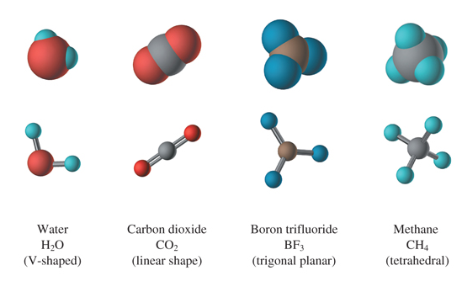
Molecular Shape
Figure 11.12 Geometric shapes of common molecules. Each molecule is shown as a ball and stick model (showing the bonds) and as a spacefilling model (showing the shape).

Slide 47
VSEPR
Valence Shell Electron Pair Repulsion modeling is the method used for visualizing the effects of the repulsion that exists between bonding and nonbonding electrons around the central atom.
Arranging the electron pairs as far apart as possible minimizes the electron pair repulsions and determines the molecular geometry.

Slide 48
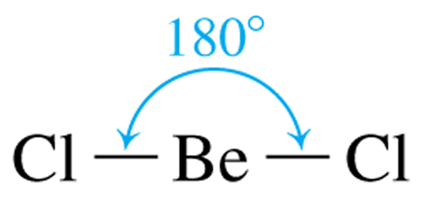
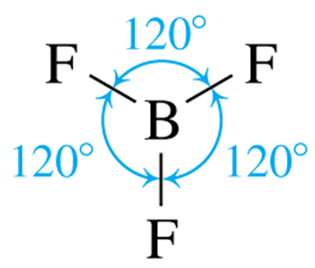
VSEPR
Linear structures result when two pairs of electrons surround the central atom.
Trigonal Planar structures when three pairs of electrons surround the central atom.
BeCl₂
BF₃

Slide 49
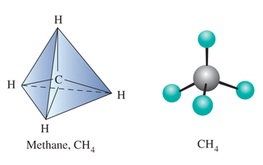
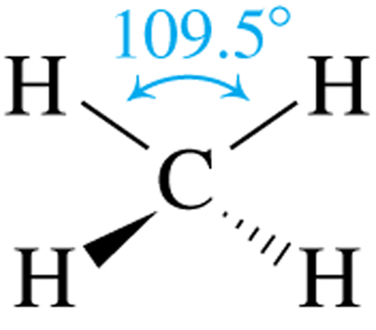
VSEPR
Tetrahedral structures when four pairs of electrons surround the central atom.
Methane (CH₄) is shown 3 different ways.

Slide 50
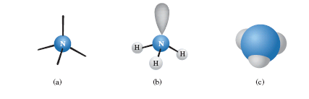

Molecular Shape and Lone Pairs
The 4 electron pairs in NH₃ are arranged in a tetrahedral structure.
The arrangement of the three bonds is pyramidal.
..
H N H
H

Slide 51
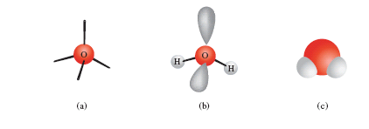

Molecular Shape and Lone Pairs
The 4 electron pairs in H₂O are arranged in a tetrahedral structure.
The arrangement of the two bonds is bent.
..
H O H
..

Slide 52
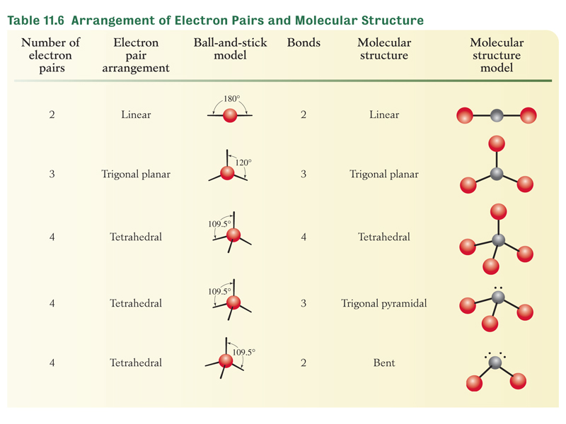
VSEPR

Slide 53
Determining Molecular Shape
Using VSEPR
Draw the Lewis structure for the molecule.
Count the electron pairs and arrange them to minimize repulsions.
Determine the positions of the atoms.
Name the molecular structure from the position of the atoms.

Slide 54
Your Turn!
What is the molecular geometry for CH₂O?
linear
trigonal planar
tetrahedral
trigonal pyramidal
bent
..
:
H C O
..
H

Slide 55
Your Turn!
What is the molecular geometry for NF₃?
linear
trigonal planar
tetrahedral
trigonal pyramidal
bent
..
..
..
:
:
F N F
..
..
:
F
:
..

Slide 56
Your Turn!
Is the molecule NF₃ polar or nonpolar?
Polar, because it has polar bonds arranged symmetrically around the N.
Polar, because it has polar bonds arranged asymmetrically around the N.
Nonpolar, because it has polar bonds arranged symmetrically around the N.

Slide 57
Your Turn!
What is the molecular geometry for CF₄?
linear
trigonal planar
tetrahedral
trigonal pyramidal
bent

Slide 58
Your Turn!
Is the molecule CF₄ polar or nonpolar?
Polar, because it has polar bonds arranged symmetrically around the C.
Polar, because it has polar bonds arranged asymmetrically around the C.
Nonpolar, because it has polar bonds arranged symmetrically around the C.

Slide 59
Your Turn!
What is the molecular geometry for CO₂?
linear
trigonal planar
tetrahedral
trigonal pyramidal
bent

