Slide 1

Chapter 10
Modern Atomic Theory
and the Periodic Table
The amazing colors in these fireworks explosions are the result of electrons transferring between energy levels in atoms.
Introduction to General, Organic, and Biochemistry 10e
John Wiley & Sons, Inc
Morris Hein, Scott Pattison, and Susan Arena

Slide 2
Chapter Outline
10.1 A Brief History 10.2 Electromagnetic Radiation 10.3 The Bohr Atom 10.4 Energy Levels of Electrons | 10.5 Atomic Structures of the First 18 Elements 10.6 Electron Structures and the Periodic Table

Slide 3
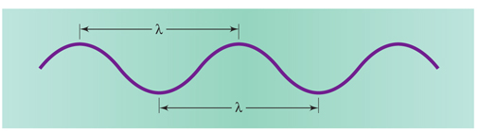
Electromagnetic Radiation
Frequency tells how many waves pass a particular point per second.
Speed tells how fast a wave moves through space.
Figure 10.1 The wavelength of this wave is shown by λ. It can be measured from peak to peak or trough to trough.

Slide 4
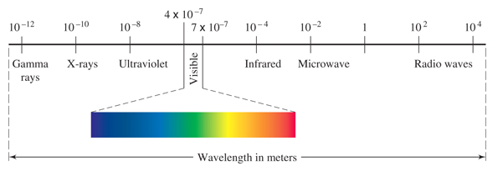
The Electromagnetic Spectrum
Visible light is only a small part of the electromagnetic spectrum.

Slide 5
Your Turn!
The number of waves that pass a particular point per second is known as
Frequency
Wavelength
Amplitude
Speed

Slide 6
Your Turn!
The color of visible light is determined by its
Speed
Wavelength
Amplitude

Slide 7
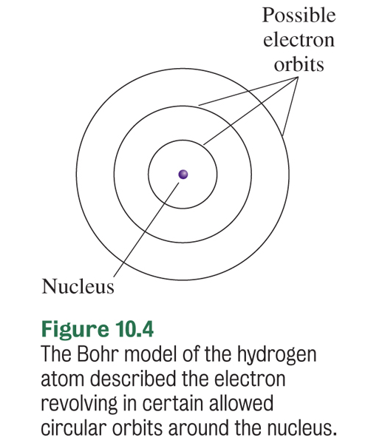
Bohr Model (1912-1913)
Danish physicist Niels Bohr proposed that electrons in an atom are organized into discrete energy levels.
He pictured the negative electrons in orbits around the positive nucleus.
His evidence: the line spectra of the elements.

Slide 8
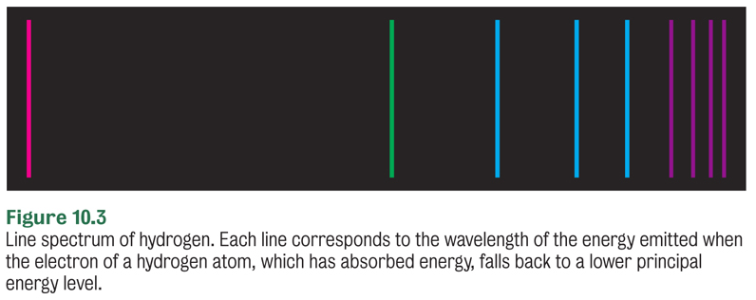
Line Spectrum
Atoms absorb energy to give off light..
Prisms or diffraction gratings separate the light into a line spectrum for the element.

Slide 9
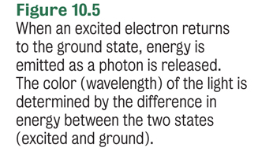
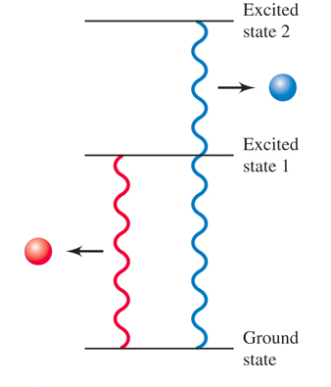
Line Spectrum

Slide 10
Why so many lines?
Absorbed energy
5
4
Potential energy of hydrogen electron
3
Released energy
2
Each line in the spectrum corresponds to electrons moving from a higher energy level to a lower energy level.
1

Slide 11
Your Turn!
The lowest possible energy level for an electron is known as
Low state
Ground state
Basement state
Excited state

Slide 12
Bohr Model
Was based on electrons having fixed energy levels and therefore quantized amounts of energy.
Accounted for spectral lines.
Worked very well for hydrogen but did not work well for heavier atoms.
Another model is needed that describes the behavior of electrons as waves.

Slide 13

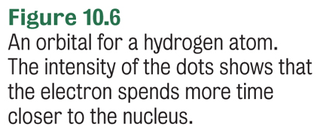
The Wave-Mechanical Model
This mathematical model of the atom describes the energy of the electron with some certainty, but the actual location of the electron is uncertain.
An orbital is the region in space where there is a high probability of finding an electron with a given energy.

Slide 14
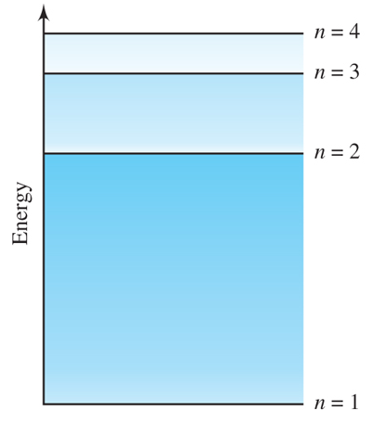
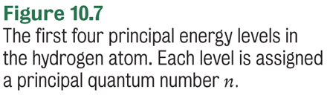
Energy Levels of Electrons
Electrons in atoms are organized into discrete principal energy levels (n, where n is an integer).
Lowest energy level is n = 1, then n = 2, etc.
As n increases, the energy of the electron increases, and the electron is on average further from the nucleus.
Notes:
Figure 10.7 The first four principal energy levels in the hydrogen atom. Each level is assigned a principal quantum number n.

Slide 15
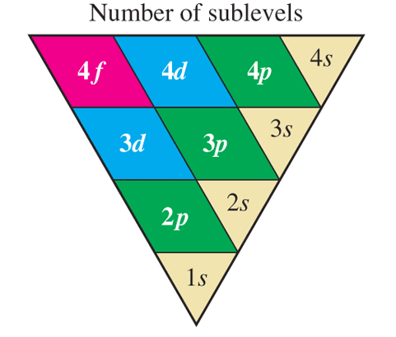
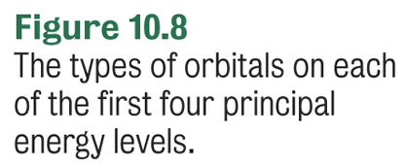
Sublevels
Energy levels are subdivided into sublevels.
n = 1 has the sublevel 1s.
n = 2 has the sublevels 2s and 2p.
Each sublevel is made up of orbitals of the same type and energy.

Slide 16
Electron Spin
Each electron in an atom appears to be spinning on its axis.
Pauli exclusion principle states that an atomic orbital can hold a maximum of two electrons, which must have opposite spin.
What is the maximum number of electrons in any orbital?
2

Slide 17
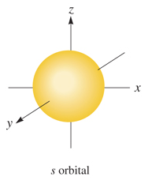
s Sublevels
Every principal energy level has an s sublevel that contains a single s orbital. (1s, 2s, 3s, etc.)
There is a 90% probability of finding the electron within a spherical region surrounding the nucleus.
Each s orbital holds 2 electrons with opposite spin.

Slide 18
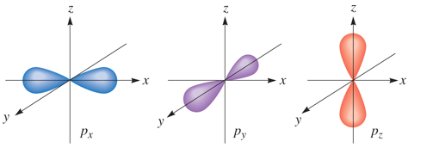
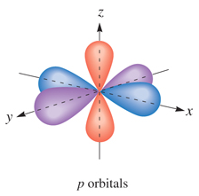
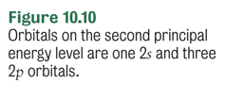

p Sublevels
Every principal energy level starting at n = 2 has a p sublevel (2p, 3p, etc.) that contains 3 equal energy p orbitals. The orbitals only differ by their orientation in 3-D space.

Slide 19
Your Turn!
What is the maximum number of electrons in a 2p orbital?
2
4
6
8
A 2p sublevel holds 6 electrons, 2 electrons per orbital.

Slide 20
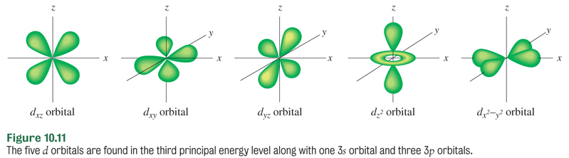
d Sublevels
Every principal energy level starting at n = 3 has a d sublevel (3d, 4d, etc.) that contains 5 equal energy d orbitals. These orbitals have more complex shapes and are higher in energy than the s and p orbitals.

Slide 21
Your Turn!
What is the maximum number of electrons in a 3d sublevel?
2
4
6
10
A 3d sublevel has 5 orbitals, so it holds 10 electrons, 2 electrons per orbital.

Slide 22
Summary
Each subshell is composed of orbitals
The number of orbitals depends on the subshell
2 electrons per orbital
Subshell s p d f
Number of Orbitals 1 3 5 7
Electrons 2 6 10 14

Slide 23
Rules for Distributing Electrons
No more than two electrons can occupy one orbital.
Electrons occupy the lowest energy orbitals available. s < p < d < f for a given value of n
Each orbital in a sublevel is occupied by a single electron before a second electron enters. (Hunds Rule)

Slide 24
Your Turn!
In the fourth principal energy level, which sublevel contains electrons with the greatest energy?
4s
4p
4d
4f

Slide 25
Your Turn!
How many orbitals are found in a 5p sublevel?
1
3
5
7

Slide 26
Your Turn!
What is the maximum number of electrons that can occupy the third principal energy level?
2
6
8
18

Slide 27
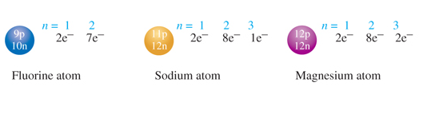
Atomic Structure
One way to indicate atomic structure shows the structure of the nucleus and the number of electrons in each energy level.
Notes:
Figure 10.13 Atomic structure diagrams of F, Na, and Mg atoms. The number of protons and neutrons is shown in the nucleus. The number of electrons is shown in each principal energy level outside the nucleus.

Slide 28
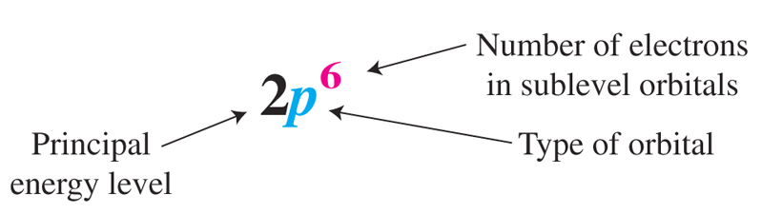
Electron Configuration
Another useful atomic structure shows the distribution of electrons in the atom.

Slide 29
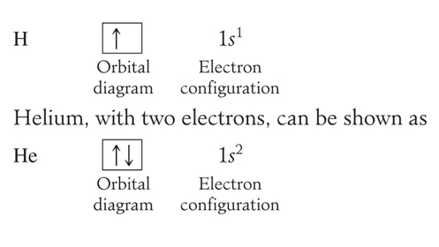
Orbital Diagram
Electron configurations can also be shown with orbital diagrams. Each box represents an orbital.
Up and down arrows represent electrons of opposite spin.

Slide 30
Atomic Structure
₃Li 1s²2s¹ ₄Be 1s²2s²
₅B 1s²2s²2p¹
₆C 1s²2s²2p²
₇N 1s²2s²2p²
₈O 1s²2s²2p²
1s
2s
1s
2s
1s
2s
2p
1s
2s
2p
1s
2s
2p
1s
2s
2p

Slide 31
Atomic Structure
₃Li 1s²2s¹ ₄Be 1s²2s²
₅B 1s²2s²2p¹
₆C 1s²2s²2p²
₇N 1s²2s²2p²
₈O 1s²2s²2p²
1s
2s
1s
2s
1s
2s
2p
1s
2s
2p
1s
2s
2p
1s
2s
2p

Slide 32
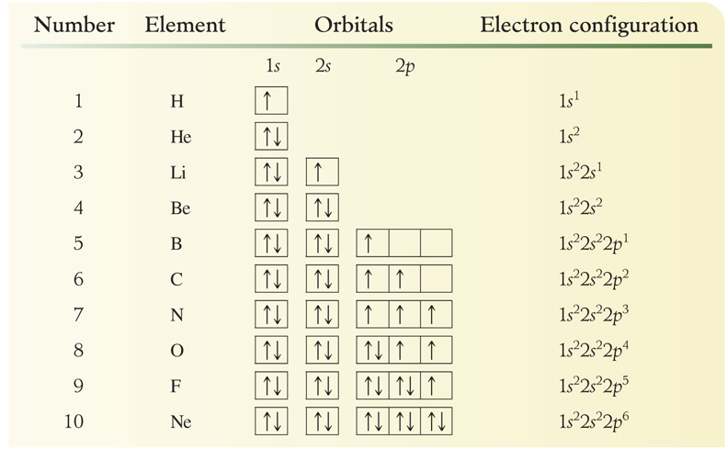
Atomic Structure

Slide 33
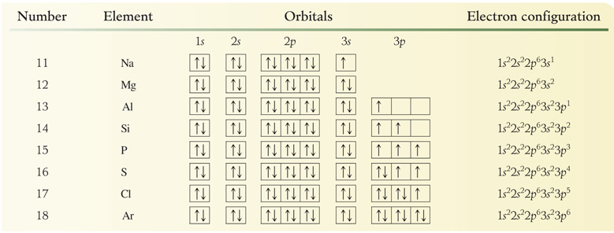
Atomic Structure
Remember to sum the superscripts in the electron configuration. They should add up to the atomic number for the element.

Slide 34
Valence Electrons
The valence electrons include all of the electrons in the highest principal quantum number (the outermost energy level).
These electrons are the electrons that are involved in bonding.
Phosphorus: 1s² 2s² 2p⁶ 3s² 3p³
Phosphorus has 5 valence electrons.

Slide 35
Your Turn!
Atoms of which element have the following electron configuration?
1s² 2s² 2p⁶ 3s²3p⁶
Cl
Ca
Ar
S

Slide 36
The Periodic Table
Each horizontal row in the periodic table is called a period.
The number of each period corresponds to the outermost energy level of the element.
For example, Ar is in period 3 and its outermost energy level is 3.
1s² 2s² 2p⁶ 3s²3p⁶
Argon has 8 electrons in energy level 3.

Slide 37
The Periodic Table
Groups or Families contain elements whose properties are similar.
Representative Elements – A Groups
Alkali Metals –1A
Alkaline Earth Metals – 2A
Halogens – 7A
Noble Gases – 8A

Slide 38
Other Groups to Know
Transition Metals – B Groups
Inner Transition Metals
  Lanthanides (Rare Earth) – Atomic Nos. 58 -71
  Actinides – Atomic Nos. 90 – 103

Slide 39
Your Turn!
Which element is a transition element?
sodium
fluorine
copper
lead

Slide 40
Your Turn!
Chlorine is a member of what family of elements?
Noble gases
Alkali metals
Halogens
Chalcogens

Slide 41
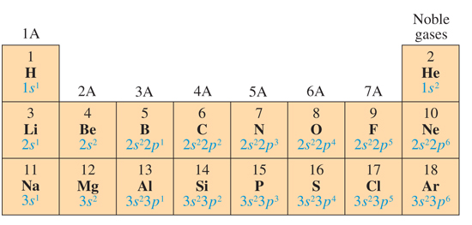

Valence Electrons and Groups
In the following groups, the group number is the number of valence electrons.
Elements within a group have the same valence electron configuration.

Slide 42
Your Turn!
In which category of the periodic table does each element contain valence electrons in the second principal energy level?
The alkaline earth elements
The alkali metals
Group 2A
Period 2

Slide 43
Your Turn!
On the periodic table, elements in the same group contain the same number of
Protons
Electrons
Principal energy levels in their ground state
Valence electrons in their ground state

Slide 44
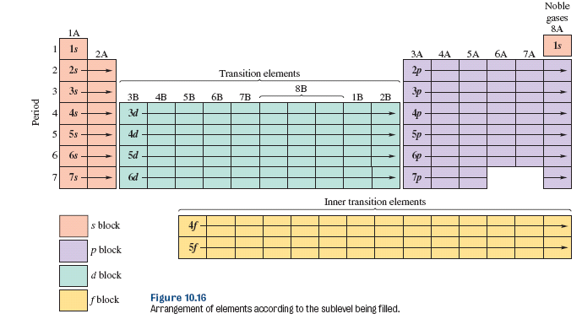
Electron Configurations and the Periodic Table

Slide 45
Electron Configurations and the Periodic Table
The number of the period corresponds with the highest occupied energy level.
The group numbers for the representative elements are equal to the total number of valence electrons.
The elements within a group have the same number of valence electrons.
The elements within each of the s, p, d, f blocks are filling s, p, d, f orbitals.
There are discrepancies within the transition elements.

Slide 46
Abbreviated Electron Configurations
Use the symbol of the nearest preceding noble gas to represent the electron configuration of the core electrons.
Phosphorus: 1s² 2s² 2p⁶ 3s² 3p³
[Ne] 3s² 3p³
Core Electrons
Valence Electrons

Slide 47
Your Turn!
The electron configuration, [Ar] 4s¹, is the ground state electron configuration of
Potassium
Phosphorous
Fluorine
Sodium

Slide 48
Your Turn!
The electron configuration, [Ne] 3s² 3p¹, is the ground state electron configuration of
Sodium
Aluminum
Argon
Sulfur

