Slide 1
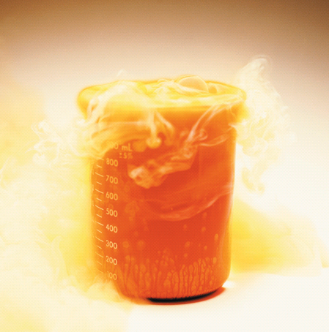
Chapter 8
Chemical Equations
Flames and sparks result
when aluminum foil is dropped
Into liquid bromine.
Introduction to General, Organic, and Biochemistry 10e
John Wiley & Sons, Inc
Morris Hein, Scott Pattison, and Susan Arena

Slide 2
Chapter Outline
8.1 The Chemical Equation 8.2 Writing and Balancing Chemical Equations 8.3 Information in a Chemical Equation 8.4 Types of Chemical Equations 8.5 Heat in Chemical Reactions 8.6 Global Warming: The Greenhouse Effect

Slide 3
The Chemical Equation
Chemical shorthand for a chemical reaction.
Reactants → Products
Whole number coefficients indicate numbers of each substance participating in the reaction.
Special conditions for the reaction are often written over the arrow. (Δ means heat is supplied to the reaction.)
Physical states of each substance are indicated.
4Al_{(s)} + 3O_{2(g)} 2Al₂O_{3(s)}

Slide 4
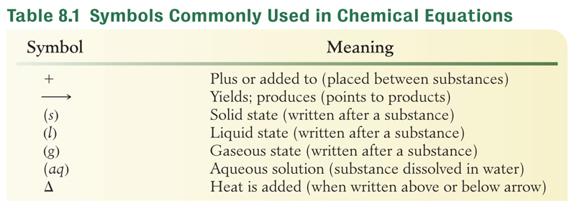
The Chemical Equation
Mg_{(s)} + 2HCl_{(aq)} H_{2(g)} + MgCl_{2(aq)}
NaOH_{(aq)} + HCl_{(aq)} H₂O_{(l)} + NaCl_{(aq)}

Slide 5
Your Turn!
In the reaction: CuSO₄ + BaBr₂ → CuBr₂ + BaSO₄
BaBr₂ and BaSO₄ are reactants
BaSO₄ and CuBr₂ are products
CuSO₄ and BaSO₄ are reactants
CuSO₄ and BaBr₂ are products

Slide 6
Writing and Balancing
Chemical Equations
A balloon filled with a hydrogen and oxygen gas explodes when heated. The product is water vapor.
Identify the reaction
Write the unbalanced equation
Balance the equation
A balanced equation has the same number of each kind of atom on each side of the equation.
Hydrogen gas + oxygen gas → water gas
R = reactants
P = products
H_{2(g)} + O_{2(g)} → H₂O_{(g)}
R | 2 H | 2 O
P | 2 H | 1 O
R | 2 H | 2 O
P | 4 H | 2O
R | 4 H | 2 O
P | 4 H | 2 O
2
2
H_{2(g)} + O_{2(g)} → H₂O_{(g)}

Slide 7
Writing and Balancing
Chemical Equations
Phosphorus burns in air to produce diphosphorus pentoxide.
Identify the reaction
Write the unbalanced equation
Balance the equation
  phosphorus + oxygen → diphosphorus pentoxide
P₄ + O₂ → P₂O₅
R | 4 P | 2 O
P | 2 P | 5 O
R | 4 P | 2 O
P | 4 P | 10 O
R | 4 P | 10 O
P | 4 P | 10 O
P₄ + O₂ → P₂O₅
5
2
Hint: Start with most complex compound.

Slide 8
Your Turn!
Given the unbalanced equation:
HCl + NH₃ → NH₄Cl
When properly balanced, the sum of the balancing coefficients is
7
5
3
4
6
HCl + NH₃ → NH₄Cl

Slide 9
Your Turn!
Given the unbalanced equation:
NH₃ → H₂ + N₂
When properly balanced, the sum of the balancing coefficients is
3
6
9
12
2NH₃ → 3H₂ + N₂

Slide 10
Writing and Balancing
Chemical Equations
Zinc metal reacts with silver nitrate to produce zinc nitrate and silver metal.
Identify the reaction
Write the unbalanced equation
Balance the equation
  zinc + silver nitrate → zinc nitrate + silver
Zn + AgNO₃ → Zn(NO₃)₂ + Ag
R | 1 Zn | 1 Ag | 1 NO₃
P | 1 Zn | 1 Ag | 2 NO₃
R | 1 Zn | 2 Ag | 2 NO₃
P | 1 Zn | 1 Ag | 2 NO₃
R | 1 Zn | 2 Ag | 2 NO₃
P | 1 Zn | 2 Ag | 2 NO₃
Zn + AgNO₃ → Zn(NO₃)₂ + Ag
2
2
Hint: Balance polyatomic ions as a unit.

Slide 11
Your Turn!
Given the unbalanced equation:
Co + CuSO₄ → Co₂(SO₄)₃ + Cu
When properly balanced, the sum of the balancing coefficients is
6
7
8
9
10
2Co + 3CuSO₄ → Co₂(SO₄)₃ + 3Cu

Slide 12
Your Turn!
Given the unbalanced equation:
Al(OH)₃ + H₂SO₄ → Al₂(SO₄)₃ + H₂O
When properly balanced, the sum of the balancing coefficients is
4
9
12
24
2Al(OH)₃ + 3H₂SO₄ → Al₂(SO₄)₃ + 6H₂O

Slide 13
Writing and Balancing
Chemical Equations
Ethylene burns in air to produce carbon dioxide and water.
Identify the reaction
Write the unbalanced equation
Balance the equation
  ethylene + oxygen → carbon dioxide + water
C₂H₄ + O₂ → CO₂ + H₂O
R | 2 C | 4 H | 2 O
P | 1 C | 2 H | 2+1 O
R | 2 C | 4 H | 2 O
P | 2 C | 2 H | 4+1 O
R | 2 C | 4 H | 2 O
P | 2 C | 4 H | 4+2 O
R | 2 C | 4 H | 6 O
P | 2 C | 4 H | 4+2 O
C₂H₄ + O₂ → CO₂ + H₂O
3
2
2
Hint: Balance hydrogen and oxygen last.

Slide 14
Acetylene (C₂H₂) burns in air to produce carbon dioxide and water.
Identify the reaction
Write the unbalanced equation
Balance the equation
  acetylene + oxygen → carbon dioxide + water
C₂H₂ + O₂ → CO₂ + H₂O
R | 2 C | 2 H | 2 O
P | 1 C | 2 H | 2+1 O
R | 2 C | 2 H | 2 O
P | 2 C | 2 H | 4+1 O
R | 2 C | 2 H | 5 O
P | 2 C | 2 H | 4+1 O
R | 4 C | 4 H | 10 O
P | 4C | 4 H | 8+2 O
2( )
C₂H₂ + O₂ → CO₂ + H₂O
2
Hint: Use a fraction to balance O, then multiply all coefficients by two to eliminate the fraction.
2 C₂H₂ + 5 O₂ → 4 CO₂ + 2 H₂O

Slide 15
Your Turn!
Given the unbalanced equation:
C₂H₆ + O₂ → CO₂ + H₂O
When properly balanced, the sum of the balancing coefficients is
23
19
17
9
13
2C₂H₆ + 7O₂ → 4CO₂ + 6H₂O

Slide 16
Your Turn!
Given the unbalanced equation:
C₃H₈ + O₂ → CO₂ + H₂O
When properly balanced, the sum of the balancing coefficients is
7
9
15
23
13
C₃H₈ + 5O₂ → 3CO₂ + 4H₂O

Slide 17
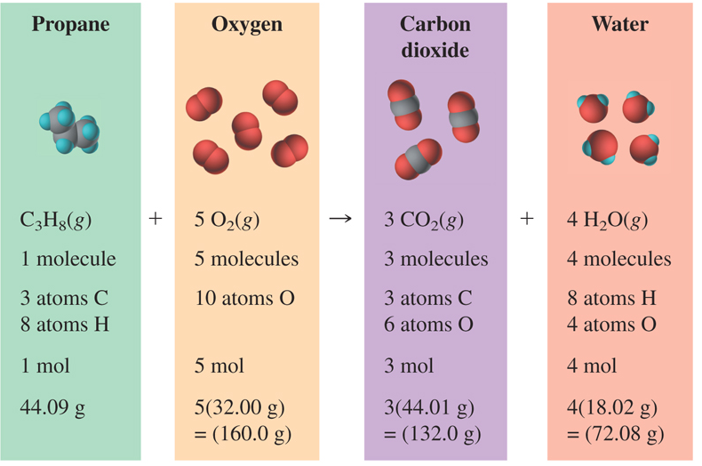
Information in a Chemical Equation

Slide 18
Information in a Chemical Equation
H_{2(g)} | + | F_{2(g)} | → | 2HF(g)
1 molecule |  | 1 molecule |  | 2 molecules
2 atoms H |  | 2 atoms F |  | 2 atoms H + 2 atoms F
1 mol H₂ |  | 1 mol F₂ |  | 2 mol HF
How many moles of HF can be made from 2 moles of hydrogen gas and 2 moles of fluorine gas?
4 moles of hydrogen fluoride gas

Slide 19
Your Turn!
How many molecules of oxygen gas are needed to burn 2 molecules of propane according to the balanced equation ?
5 molecules of oxygen
6 molecules of oxygen
10 molecules of oxygen
15 molecules of oxygen
C₃H₈ + 5O₂ → 3CO₂ + 4H₂O

Slide 20
Types of Chemical Equations
Combination Reactions
Decomposition Reactions
Single-Displacement
Double-Displacement
A + B → AB
AB → A + B
A + BC → B + AC or
A + BC → C + BA
A B+ CD → AD + CB

Slide 21
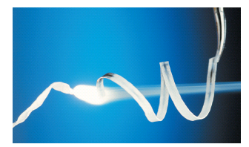
Combination Reactions
1. metal + oxygen → metal oxide
2Mg_{(s)} + O_{2(g)} → 2MgO_{(s)}
4Fe_{(s)} + 3O_{2(g)} → 2Fe₂O_{3(s)}
2. nonmetal + oxygen → nonmetal oxide
C_{(s)} + O_{2(g)} → CO_{2(g)}
2N_{2(s)} + O_{2(g)} → 2N₂O _{(g)}
A + B → AB

Slide 22
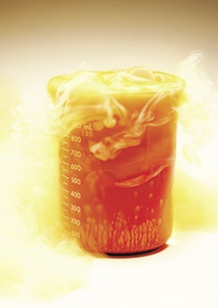
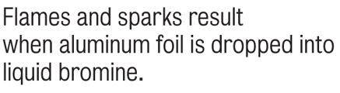
Combination Reactions
3. metal + nonmetal → salt
2Al_{(s)} + 3Br_{2(l)} → 2AlBr_{3(s)}
2K_{(s)} + I_{2(s)} → 2KI_{(s)}
4. metal oxide + water → metal hydroxide
K₂O_{(s)} + H₂O_{(l)} → 2KOH_{(aq)}
SrO_{(s)} + H₂O_{(l)} → Sr(OH)_{2(aq)}
A + B → AB

Slide 23
Combination Reactions
5. nonmetal oxide + water → oxy-acid
SO_{3(g)} + H₂O_{(l)} → H₂SO_{4(aq)}
P₂O_{5(s)} + 3H₂O_{(l)} → 2H₃PO_{4(aq)}
N₂O_{5(s)} + H₂O_{(l)} → 2HNO_{3(aq)}
A + B → AB

Slide 24
Decomposition Reactions
1. Metal oxides decompose into metals and oxygen gas.
2HgO_{(s)} 2Hg_{(l)} + O_{2(g)}
2PbO_{2(s)} 2PbO_{(s)} + O_{2(g)}
2. Metal carbonates form metal oxides and CO₂.
Na₂CO_{3(s)} Na₂O + CO_{2(g)}
3. Metal bicarbonates form metal carbonates, CO₂ and H₂O.
NaHCO_{3(s)} Na₂CO_{3(s)} + CO_{2(g)} + H₂O_{(g)}
AB → A + B

Slide 25
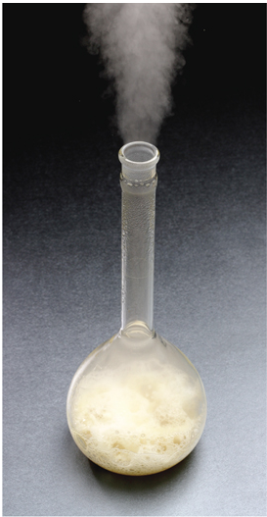

Decomposition Reactions
AB → A + B
4. Other examples:
2Hg₂O_{2(aq)} 2H₂O_{(l)} + O_{2(g)}
2NaClO_{3(s)} 2NaCl_{(s)} + 3O_{2(g)}

Slide 26
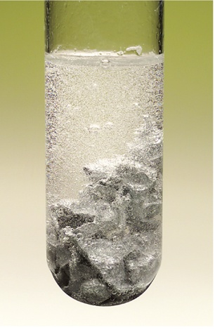
Single Displacement Reactions
If A is a metal: A + BC → B + AC
If A is a nonmetal: A + BC → C + BA
Zn_{(s)} + 2HCl_{(aq)} → ZnCl_{2(aq)} + H_{2(g)}
When pieces of zinc metal are placed
in hydrochloric acid, hydrogen
bubbles form immediately.

Slide 27
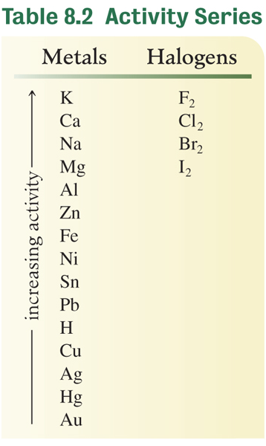
Activity Series
More active elements can replace less
active elements.
2Al_{(s)} + 3CuCl_{2(aq)} → 2AlCl_{3(aq)} + 3Cu _{(s)}
Hg_{(l)} + CuSO_{4(aq)} → no reaction

Slide 28
Your Turn!
Consider the following reactions:
A_{(s)} + HCl_{(aq)} → no reaction
B_{(s)} + 2HCl_{(aq)} → BCl_{2(aq)} + H_{2(g)}
What is the correct activity series?
least active A < B < H most active
least active A < H < B most active
least active B < H < A most active

Slide 29
Single Displacement Reactions
1. Metal + acid → H₂ + salt
Fe_{(s)} + 2HCl_{(aq)} → FeCl_{2(aq)} + H₂ _{(g)}
Cu(s) + HCl(aq) → no reaction
2. metal + water → H₂ + metal oxide
or metal hydroxide
2K_{(s)} + 2H₂O_{(l)} → 2KOH_{(aq)} + H₂ _{(g)}
3Fe_{(s)} + 4H₂O_{(g)} → Fe₃O_{4(s)} + 4H₂ _{(g)}

Slide 30
Single Displacement Reactions
3. Metal + salt → metal + salt
Sn_{(s)} + 2AgNO_{3(aq)} → Sn(NO₃)_{2(aq)} + Ag_{(s)}
Zn_{(s)} + AlCl_{3(aq)} → no reaction
4. halogen + halide salt→ halogen +
halide salt
F_{2(g)} + 2NaCl_{(aq)} → 2NaF_{(aq)} + Cl₂ _{(g)}
I_{2(s)} + 2NaCl_{(aq)} → no reaction

Slide 31
Your Turn!
The reaction: Ba_{(s)} + PtCl_{2(aq)} → BaCl_{2(aq)} + Pt_{(s)}, will occur if
Pt is more active than Ba
Ba is more active than Pt
Ba is more active than O
O is more active than Pt

Slide 32
Your Turn!
The likely products of the reaction between Al and NiCl₂ are
AlNi and Cl₂
AlCl₂ and Ni
AlCl and Ni
AlCl₃ and Ni
no reaction

Slide 33
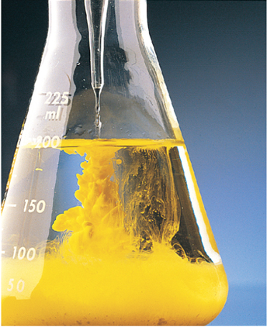
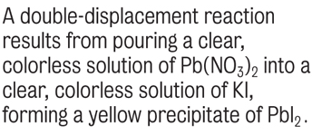
Double Replacement Reactions
A B+ CD → AD + CB
Cations exchange anions
Pb(NO₃)_{2(aq)} + 2KI_{(aq)} → PbI_{2(s)} + 2KNO_{3(aq)}
Evidence of chemical change:
Evolution of heat
Formation of precipitate
Formation of gas bubbles

Slide 34
Neutralization Reactions
Double replacement: A B+ CD → AD + CB
acid + base → salt + water + heat
HCl_{(aq)} + NaOH_{(aq)} → NaCl_{(aq)} + H₂O_{(l)}
Detected by increase in temperature (release of heat).
H₂SO_{4(aq)} + Ba(OH)_{2(aq)} → BaSO_{4(s)} + 2H₂O_{(l)}
Detected by increase in temperature and formation of a cloudy precipitate.

Slide 35
Metal Oxide + Acid Reactions
Double replacement: A B+ CD → AD + CB
metal oxide + acid → salt + water
Heat is released by the production of water
ZnO_{(s)} + 2HCl_{(aq)} → ZnCl_{2(aq)} + H₂O_{(l)}
Na₂O_{(s)} + 2HCl_{(aq)} → 2NaCl_{(aq)} + H₂O_{(l)}

Slide 36
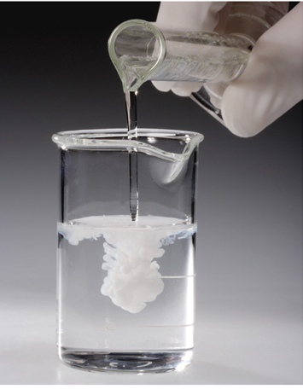
Precipitation Reactions
Double replacement: A B+ CD → AD + CB
An insoluble product (precipitate) is formed and indicated by placing an (s) after its formula in the equation.
Check the solubility table in Appendix V to
see if a precipitate forms.
BaCl_{2(aq)} + Na₂SO_{4(aq)}→ BaSO_{4(s)} + 2NaCl_{(aq)}
2NaCl_{(aq)} + Hg₂(NO₃)_{2(aq)}→ 2NaNO_{3(aq)} + Hg₂Cl_{2(s)}
Notes:
When barium chloride is poured into a solution of sodium sulfate, a white precipitate of barium sulfate forms.

Slide 37
Gas Forming Reactions
Double replacement: A B+ CD → AD + CB
NaCl_{(s)} + H₂SO_{4(l)}→ NaHSO_{4(s)} + HCl_{(g)}
Na₂S_{(aq)} + 2HCl_{(aq)}→ H₂S_{(g)} + 2NaCl _{(s)}
H₂SO_{4(aq)} + 2NaCN_{(aq)} → Na₂SO_{4(aq)} + 2HCN_{(g)}
Double replacement reactions that form H₂CO₃, H₂SO₃ or NH₄OH are quickly followed by the decomposition of these compounds into gases (indirect gas production).

Slide 38
Indirect Gas Forming Reactions
metal carbonate + acid → salt + CO_{2(g)} + H₂O_{(l)}
Na₂CO_{3(aq)} + 2HCl_{(aq)} → 2NaCl_{(aq)} + CO_{2(g)} + H₂O_{(l)}
metal sulfite + acid → salt + SO_{2(g)} + H₂O_{(l)}
Na₂SO_{3(aq)} + 2HCl_{(aq)} → 2NaCl_{(aq)} + SO_{2(g)} + H₂O_{(l)}
ammonium salt + base → salt + NH_{3(g)} + H₂O_{(l)}
NH₄NO_{3(aq)} + NaOH_{(aq)} → NaNO_{3(aq)} + NH_{3(g)} + H₂O_{(l)}

Slide 39
Your Turn!
What are the likely products of the reaction of copper(II) oxide with nitric acid?
CuNO₃ + H₂O
Cu(NO₃)₂ + H₂O
Cu(NO₂)₂ + H₂O
CuNO₂ + H₂O
CuO_{(s)} + 2HNO_{3(aq)} → Cu(NO₃)_{2(aq)} + H₂O_{(l)}

Slide 40
Your Turn!
What are the likely products of the reaction of sodium sulfide with iron(III) chloride?
FeS + NaCl
FeS₃ + NaCl
Fe₃S + NaCl
Fe₂S₃ + NaCl
2FeCl_{3(aq)} + 3Na₂S_{(aq)} → Fe₂S_{3(s)} + 6NaCl_{(aq)}

Slide 41
Your Turn!
What are the likely products of the reaction of sodium hydrogen carbonate with hydrochloric acid?
NaCl + H₂CO₃
NaCl + H₂O + CO₂
NaCl + H₂O + CO₃
NaCl + H₂ + CO₃
NaHCO_{3(aq)} + HCl_{(aq)} → NaCl_{(aq)} + H₂O_{(l)} + CO_{2(g)}

Slide 42
Heat in Chemical Reactions
Endothermic reactions absorb heat
O_{2(g)} + N_{2(g)} + 181 kJ → 2NO_{(g)}
Exothermic reactions release heat
2 Al_{(s)} + Fe₂O_{3(s)} → 2Fe_{(s)} + Al₂O_{3(s)} + 852 kJ
The amount of heat absorbed or released is the
heat of reaction.

Slide 43
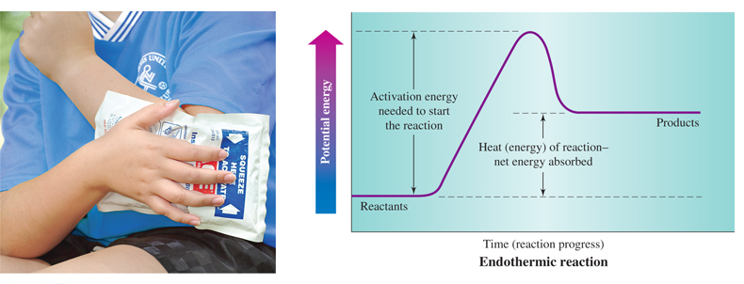
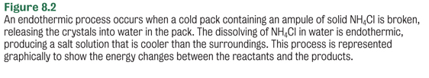
Endothermic Reactions

Slide 44
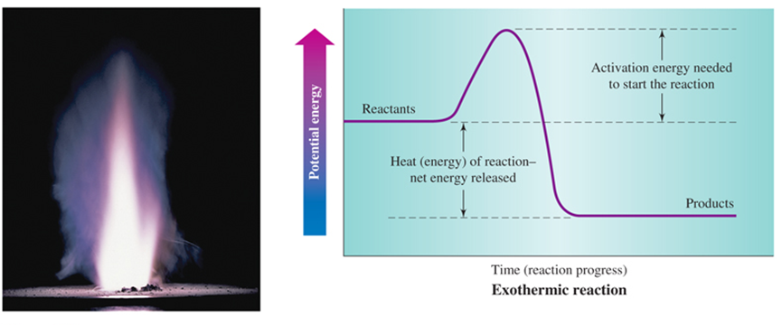

Exothermic Reactions

Slide 45
Your Turn!
Consider the reaction: H₂ + I₂ + 12.6 kJ → 2 HI. When one mole of HI is produced
A. 12.6 kJ of energy is absorbed
B. 6.3 kJ of energy is absorbed
C. 12.6 kJ of energy is released
D. 6.3 kJ of energy is released

Slide 46
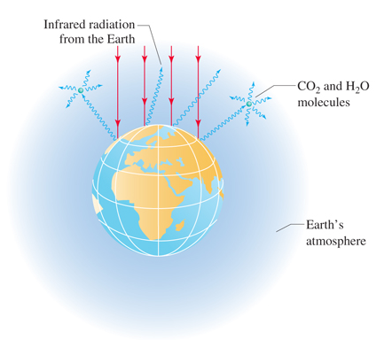
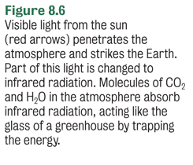
Global Warming:
The Greenhouse Effect

Slide 47
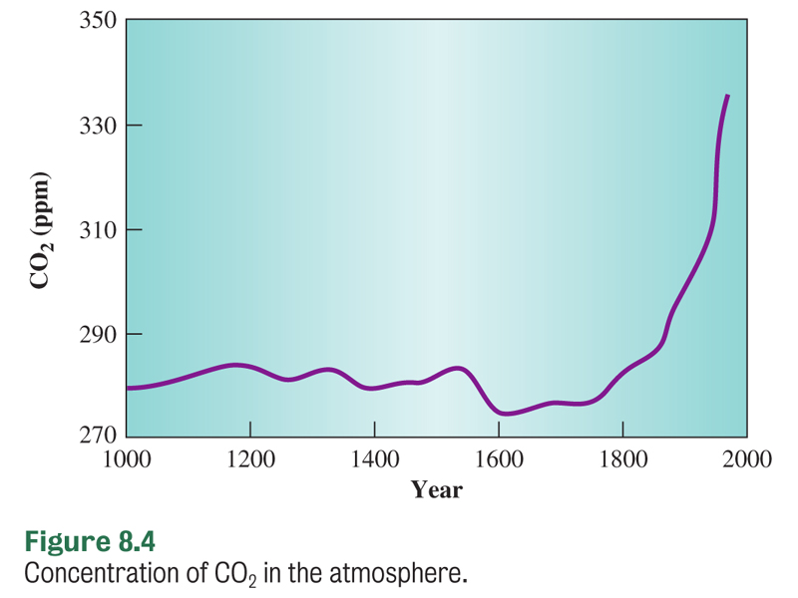
Global Warming:
The Greenhouse Effect
Increased carbon dioxide levels have caused a 0.74°C rise in global temperatures over the last 100 years.

