Slide 1
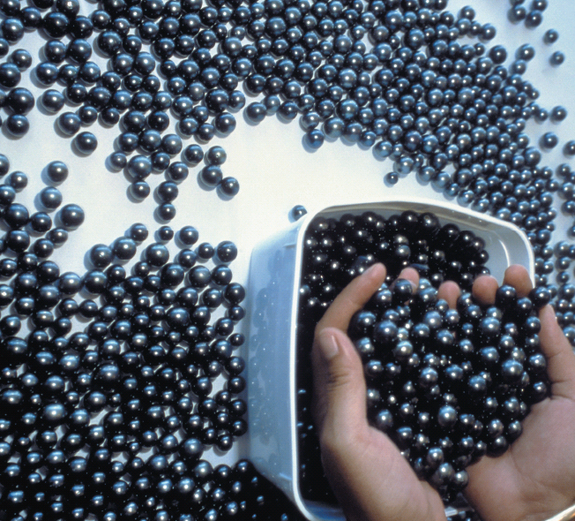
Chapter 7
Quantitative Composition of Compounds
These black pearls are made of layers of calcium carbonate. They can be measured by counting or weighing.
Introduction to General, Organic, and Biochemistry 10e
John Wiley & Sons, Inc
Morris Hein, Scott Pattison, and Susan Arena

Slide 2
Chapter Outline
7.1 The Mole 7.2 Molar Mass of Compounds 7.3 Percent Composition of Compounds 7.4 Empirical Formula versus Molecular Formula | 7.5 Calculating Empirical Formulas 7.6 Calculating the Molecular Formula from the Empirical Formula

Slide 3
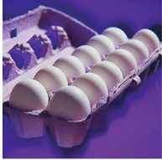
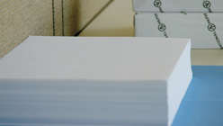

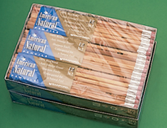
Convenient Ways of Counting Items
1 dozen eggs = 12 eggs
1 ream paper = 500 sheets
1 gross pencils = 144 pencils
How do chemists count really small things, like atoms?
1 mole atoms = 6.022×10²³ atoms
This number is known as Avogadro’s number.
:
1×10 ⁻¹⁰ m

Slide 4
The Mole
1 mole of anything contains Avogadro’s number (6.022×10²³ ) of particles.
1 mol atoms = 6.022×10²³ atoms
1 mol molecules = 6.022×10²³ molecules
1 mol ions = 6.022×10²³ ions
Avogadro’s number can be used as a conversion factor:

Slide 5
The Mole
Calculate the number of atoms in 2.4 mol Na.
Plan
2.5 mol Na → Na atoms
Calculate

Slide 6
Your Turn!
How many moles of HCl are present in 4.3×10²³ molecules?
2.6×10⁴⁷ mol
0.71 mol
2.6 mol
7.1×10⁴⁵ mol

Slide 7
Convenient Ways of Counting
It is often convenient to count using mass.
For example, a canning recipe calls for 150 apples to be peeled and cored.
The average mass of an individual apple is 235 g. How many kg are needed to complete this recipe?
The canner should buy 35 kg of apple.

Slide 8
Counting Atoms with Mass
Chemists count atoms by using mass since individual atoms are too small to count.
Average mass of an atom = atomic mass in amu
Average mass of 1 mole of atoms = atomic mass expressed in grams (molar mass).
1 mol atoms = atomic mass in grams
1 mol atoms = 6.022×10²³ atoms
atomic mass in grams = 6.022×10²³ atoms

Slide 9
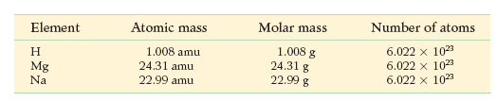
The Mole

Slide 10
Your Turn!
Which of these is not correct?
The mass of 1 atom of C is 12.01 amu.
The mass of 1 mole of C atoms is 12.01 g.
Avogadro’s number of atoms has a mass of 12.01 amu.
Avogadro’s number of atoms has a mass of 12.01 g.
C
6
12.01

Slide 11
The Mole
Calculate the mass of 2.4 mol C.
 | atomic mass
C | 12.01
Plan
2.4 mol C → g
Molar mass is a conversion factor:
Calculate

Slide 12
Your Turn!
What is the correct set up to calculate number of moles of atoms contained in 3.52 g Al?
a.
b.
c.
 | atomic mass
Al | 26.98

Slide 13
The Mole
Calculate the number of atoms in 36.0 g C.
 | atomic mass
C | 12.01
Plan
36.0 g C → moles C → atoms C
Calculate

Slide 14
Your Turn!
What is the mass of 3.01 ×10²³ atoms of lead?
104 g
414 g
0.500 g
1.04×10⁴⁸ g
 | atomic mass
Pb | 207.2

Slide 15
Your Turn!
1 gram of which of the following elements would contain the largest number of atoms?
nitrogen
hydrogen
phosphorus
oxygen
 | atomic mass
N | 14.01
H | 1.01
P | 30.97
O | 16.00

Slide 16
Molar Mass of Compounds
1 mol compound = 6.022×10²³ formula units compound
Molar mass of compound = mass of 1 mol compound
The molar mass of a compound is the sum of the atomic masses of each atom in the compound.
What is the molar mass of CO₂?
1C 1(12.01g)
2O 2(16.00g)
CO₂ 44.01g/mol
 | atomic mass
C | 12.01
O | 16.00

Slide 17
Molar Mass of Compounds
What is the molar mass of Al₂(CO₃)₃?
2Al 2(26.98g)
3C 3(12.01g)
9O 9(16.00g)
Al₂(CO₃)₃ 233.99g/mol
 | atomic mass
Al | 26.98
C | 12.01
O | 16.00

Slide 18
Your Turn!
What is the molar mass of (NH₄)₃PO₄?
141.04g/mol
144.07g/mol
146.09g/mol
149.12g/mol
 | atomic mass
N | 14.01
H | 1.01
P | 30.97
O | 16.00

Slide 19
Your Turn!
What is the molar mass of Mg(ClO₄)₂?
301.01g/mol
191.21g/mol
223.21g/mol
123.76g/mol
 | atomic mass
Mg | 24.31
Cl | 35.45
O | 16.00

Slide 20
Using Molar Masses of Compounds
Molar mass = 1 mol = 6.022×10²³ formula units
Calculate the mass of 0.150 mol Mg(ClO₄)₂
Plan
0.150 mol Mg(ClO₄)₂ → g Mg(ClO₄)₂
Calculate

Slide 21
Using Molar Masses of Compounds
Molar mass = 1 mol = 6.022×10²³ formula units
Calculate the number of moles in 35 g H₂O.
Plan
35 g H₂O → moles H₂O
 | atomic mass
H | 1.01
O | 16.00
Calculate

Slide 22
Using Molar Masses of Compounds
Molar mass = 1 mol = 6.022×10²³ formula units
Calculate the number of molecules in 35 g H₂O.
Plan
35 g H₂O → mol H₂O→ molecules H₂O
Calculate

Slide 23
Your Turn!
How many moles of molecules are present in 146 g of glucose (C₆H₁₂O₆)?
180. mol
0.810 mol
26300 mol
4.88×10²³ mol
 | atomic mass
C | 12.01
H | 1.01
O | 16.00

Slide 24
Your Turn!
What is the mass of 1.20 ×10²³ molecules of CH₃OH?
161g
38.5g
32.1g
6.39g
 | atomic mass
C | 12.01
H | 1.01
O | 16.00

Slide 25
Your Turn!
How many molecules are present in 4.21 moles of HBr?
2.53×10²³ molecules
2.53×10²⁴ molecules
6.99×10⁻²⁴ molecules
3.97×10² molecules
6.99×10²⁴ molecules
 | atomic mass
H | 1.01
Br | 79.90

Slide 26
Percent Composition of Compounds
Percent composition is a list of the mass percent of each element in a compound.
Na₂CO₃ is
43.38% Na
11.33% C
45.29% O
How do we calculate the mass percent of Na₂CO₃?

Slide 27
Calculating Percent Composition
First determine the molar mass of Na₂CO₃
2(22.99gNa) + 1(12.01gC) + 3(16.00 gO) = 105.99g/mol Na₂CO₃
Then find ratio of the mass of each element to the mass of the compound.
Notes:
Round the percents to two decimal places.

Slide 28
Calculating Percent Composition
A compound is found to consist of 2.74g of iron and 5.24g of chlorine. What is the percent composition of the compound?
1. Calculate the mass of the product formed:
  2.74g Fe + 5.24g Cl = 7.98g product
2. Calculate the percent for each element.

Slide 29
Your Turn!
What is the percent carbon in acetic acid, HC₂H₃O₂?
40.01% C
20.00% C
6.73% C
39.99% C
 | atomic mass
C | 12.01
H | 1.01
O | 16.00

Slide 30
Your Turn!
A 6.00g sample of calcium sulfide is found to contain 3.33g of calcium. What is the percent by mass of sulfur in the compound?
80.2% S
55.5% S
44.5% S
28.6% S

Slide 31
Empirical Formula versus
Molecular Formula
The molecular formula for a substance is the actual number of atoms of each element.
C₆H₁₂O₆
The empirical formula is the lowest whole number ratio of atoms in a compound.
CH₂O
Note that the molecular formula is a whole number multiple of the empirical formula.
(CH₂O)₆

Slide 32
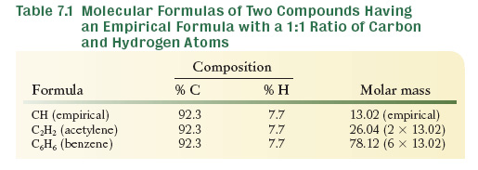
Empirical Formula versus
Molecular Formula
It is possible for several different molecules to have the same empirical formula.

Slide 33
Your Turn!
What is the empirical formula for the compound P₄O₁₀?
P₄O₁₀
P₂O₅
PO_{2.5}
PO₃

Slide 34
Calculating Empirical Formulas
Steps for calculating an empirical formula:
Assume 100g of compound and express the mass of each element in grams.
Convert the grams of each element to moles.
Find the mole ratio of each element. Round to nearest whole number if it is close to the whole number.
If necessary, multiply the ratios by the smallest whole number that will convert them to a whole number.

Slide 35
Calculating Empirical Formulas
Calculate the empirical formula of a compound that is 63.19% Mn and 36.81% O.
1. Assume 100 g of material.
63.19 g Mn
36.81 g O
2. Convert grams of each element to moles:
 | atomic mass
Mn | 54.94
0 | 16.00

Slide 36
Calculating Empirical Formulas
3. Change the numbers of atoms to whole numbers by dividing by the smallest number.
The simplest ratio of Mn:O is 1:2.
Empirical formula = MnO₂

Slide 37
Calculating Empirical Formulas
Calculate the empirical formula of a compound that is 72.2% Mg and 27.8% N.
1. Assume 100 g of material.
72.2 g Mg
27.8 g O
2. Convert grams of each element to moles:
 | atomic mass
Mg | 24.31
N | 14.01

Slide 38
Calculating Empirical Formulas
3. Change the numbers of atoms to whole numbers by dividing by the smallest number.
4. Multiply by a number that will give whole numbers.
Mg: (1.500)2 = 3.00 N: (1.000)2 = 2.00
Empirical formula = Mg₃N₂

Slide 39
Your Turn!
What is the empirical formula of an alcohol that is 52.13% C, 13.15% H and 34.72% O.
CH₂O
C₄HO₃
C₂H₆O
C₂H₃O₂
 | atomic mass
C | 12.01
H | 1.01
O | 16.00

Slide 40
Calculating the Molecular Formula from the Empirical Formula
The molecular formula will be either equal to the empirical formula or some integer multiple of it.
The ratio of the molecular mass to the mass predicted by the empirical formula tells us how many times larger the molecular formula is.

Slide 41
Calculating the Molecular Formula from the Empirical Formula
Determine the molecular formula for glyceraldehyde which has a molar mass of 90.08 g/mol and an empirical formula of CH₂O.
(CH₂O)₃ = C₃H₆O₃

Slide 42
Calculating the Molecular Formula from the Empirical Formula
Determine the molecular formula of a nitrogen oxide compound (N_{x}O_{y}) with a molar mass of 92.011 g/mol and a empirical formula of NO₂.
(NO₂)₂ = N₂O₄

Slide 43
Your Turn!
What is the molecular formula of a compound with the empirical formula CH₂Cl and molar mass of 197.92 g/mol?
CH₂Cl
C₂H₄Cl₂
C₃H₆Cl₃
C₄H₈Cl₄
 | atomic mass
C | 12.01
H | 1.01
Cl | 35.45

Slide 44
Calculating the Molecular Formula
A disinfectant is known to be 76.57% C , 6.43% H, and 17.00% O. It has a molar mass of 188.24 g/mol Determine its molecular formula.
Determine the mass and moles of C, H and O.
C: 76.57%(188.24g) = 144.1 g C/(12.01g/mol) = 12
H: 6.43% (188.24g) = 12.1 g H/(1.01g/mol) = 12
O: 17.00%(188.24g) = 32.00 g O/(16.00 g/mol) = 2
Molecular formula: C₁₂H₁₂O₂

Slide 45
Your Turn!
What is the molecular formula of a substance that consists of 85.60% C and 14.40% H and has a molar mass of 28.08 g/mol?
CH₂
C₂H₂
CH₃
C₂H₄
C₂H₆
 | atomic mass
C | 12.01
H | 1.01

