Slide 1

Chapter 6
Nomenclature of Inorganic Compounds
This seashell is formed from the chemical calcium carbonate, commonly called limestone. It is the same chemical used in many calcium supplements for our diets.
Introduction to General, Organic, and Biochemistry 10e
John Wiley & Sons, Inc
Morris Hein, Scott Pattison, and Susan Arena

Slide 2
Chapter Outline
6.1 Common and Systematic Names 6.2 Elements and Ions 6.3 Writing Formulas from Names of Ionic Compounds | 6.4 Naming Binary Compounds 6.5 Naming Compounds Containing Polyatomic Ions 6.6 Acids

Slide 3
Common and Systematic Names
Common names are arbitrary and are often related to the physical or chemical properties of the compound.
Systematic names precisely identify the chemical composition of the compound.
Formula Common Name Systematic Name
N₂O laughing gas dinitrogen monoxide
HCl muriatic acid hydrochloric acid
CaCO₃ limestone calcium carbonate
NaCl table salt sodium chloride

Slide 4
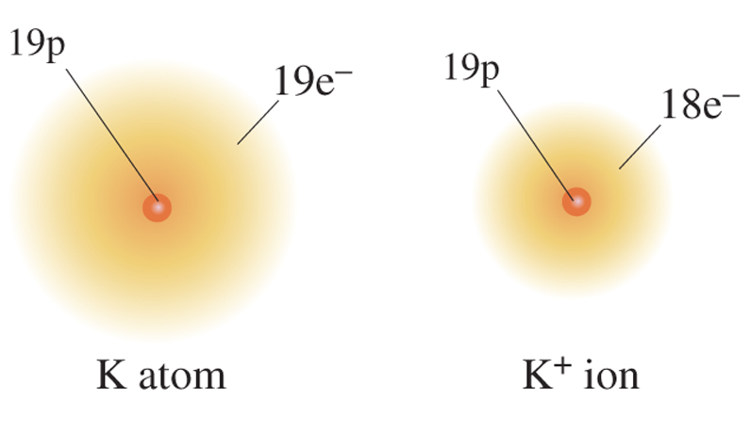
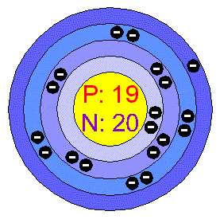
Forming Cations
Metals lose electrons to be stable.
Metal ions are positively charged because they have more positive protons than negative electrons.
potassium
potassium ion
K → K⁺ + e⁻

Slide 5
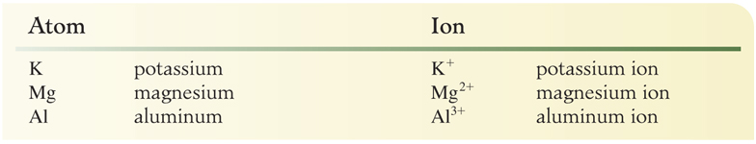
Naming Cations
Cations are named the same as their parent atoms, as shown here:

Slide 6
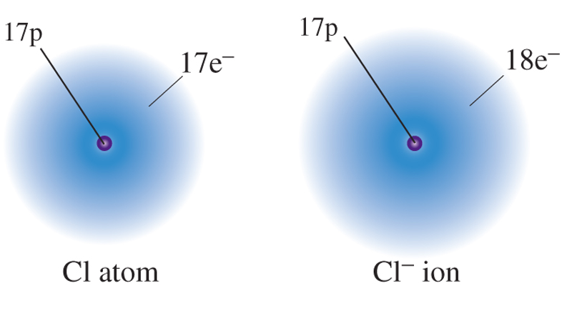
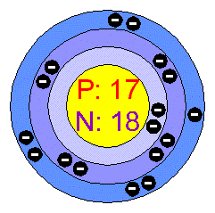
Forming Anions
Nonmetals gain electrons to be stable.
Nonmetal ions are negatively charged because they have fewer positive protons than negative electrons.
chlorine
chloride ion
Cl + e⁻ → Cl⁻

Slide 7
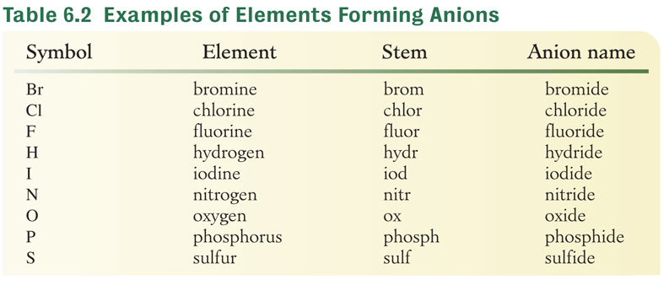
Naming Anions
Monatomic anions use the stem of the element’s name and the ending changed to ide.

Slide 8
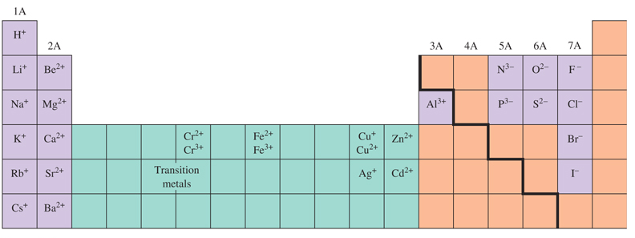
Ion Charges
Metals on the left side of the periodic table form only one ion.
Many metals form more than one ion. Often these are the transition metals.
The charge of a nonmetal is group number -8.

Slide 9
Your Turn!
Calcium is an element in group 2A. Which of the following statements is correct about calcium forming an ion?
Ca gains two electrons, forming Ca²⁺
Ca gains two electrons, forming Ca²⁻
Ca loses two electrons, forming Ca²⁻
Ca loses two electrons, forming Ca²⁺

Slide 10
Your Turn!
Phosphorus is a nonmetal in group 5A. The charge on the phosphide ion is
-3 because the element lost 3 electrons.
-3 because the element gained 3 electrons.
+3 because the element lost 3 electrons.
+3 because the element gained 3 electrons.

Slide 11
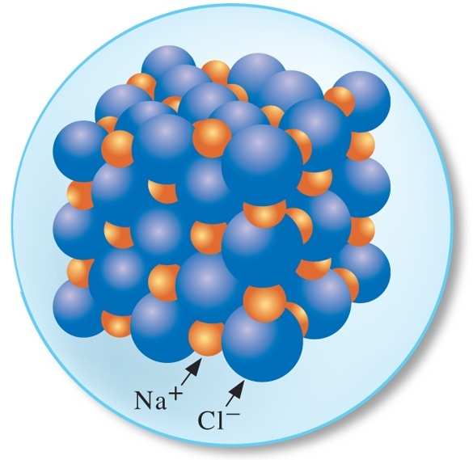
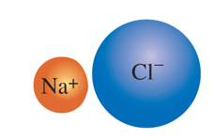
Ionic Compounds
Compounds are held together by the attractive forces between the cations (positive ions) and the anions (negative ions).
Formulas are the simplest whole number ratio of each element.
Solids at room temperature.
Conduct electricity when molten.
NaCl

Slide 12
Writing Formulas for Ionic Compounds
Write the formula for the metal ion followed by the formula for the nonmetal ion.
Combine the smallest numbers of each ion needed to give the charge sum equal to zero.
Write the formula for the compound as the symbol for the metal and nonmetal each followed by a subscript of the number determined in step 2.

Slide 13
Zinc Oxide
Write the formula for the metal ion followed by the formula for the nonmetal ion.
Combine the smallest numbers of each ion needed to give the charge sum equal to zero.
1 Zn²⁺ to 1O²⁻ is neutral. 1(+2) + 1(-2) = 0
Write the formula for the compound as the symbol for the metal and nonmetal each followed by a subscript of the number determined in step 2.
ZnO
Zn²⁺ O²⁻

Slide 14
Calcium Chloride
Write the formula for the metal ion followed by the formula for the nonmetal ion.
Combine the smallest numbers of each ion needed to give the charge sum equal to zero.
1 Ca²⁺ to 2 Cl⁻ is neutral. 1(+2) + 2(-1) = 0
Write the formula for the compound as the symbol for the metal and nonmetal each followed by a subscript of the number determined in step 2.
CaCl₂
Ca²⁺ Cl⁻

Slide 15
Aluminum Sulfide
Write the formula for the metal ion followed by the formula for the nonmetal ion.
Combine the smallest numbers of each ion needed to give the charge sum equal to zero.
2 Al³⁺ to 3 S²⁻ is neutral. 2(+3) + 3(-2) = 0
Write the formula for the compound as the symbol for the metal and nonmetal each followed by a subscript of the number determined in step 2.
Al₂S₃
Al³⁺ S²⁻

Slide 16
Writing Formulas for Ionic Compounds
Write the formulas for the compounds containing the following ions:
Al³⁺ and F⁻
Ca²⁺ and N³⁻
K⁺ and Cl⁻
Mg²⁺ and I⁻
AlF₃
Ca₃N₂
KCl
MgI₂

Slide 17
Your Turn!
What is the correct formula for the compound beryllium fluoride?
BeF
Be₂F
BeF₂
Be₂F₂

Slide 18
Your Turn!
What is the correct formula for the compound silver sulfide?
AgS
AgS₂
Ag₂S
2AgS

Slide 19
Naming Binary Ionic Compounds
Binary ionic compounds contain only two elements: a metal and a nonmetal.
Compounds containing a metal that forms only one type of cation
Write the name of the cation.
Write the name of the anion with the -ide ending.
AlF₃
Ca₃N₂
KCl
aluminum fluoride
calcium nitride
potassium chloride

Slide 20
Naming Binary Ionic Compounds
Common metals with only one type of cation: All metals in Group 1A, Group 2A, Al, Zn, Ag and Cd. Their charge is the group number.
Name these compounds:
BaI₂
Li₂O
CaC₂
Ag₂S
Rb₃N
barium iodide
lithium oxide
calcium carbide
silver sulfide
rubidium nitride

Slide 21
Your Turn!
What is the correct name for CdF₂?
Cadmium flourine
Cadmium flouride
Cadmium fluorine
Cadmium fluoride

Slide 22
Naming Binary Ionic Compounds
Compounds containing a metal that can form two or more types of cations
Stock System: The name of the cation is the name of the element with a Roman numeral in parentheses equal to the charge.
Fe²⁺ iron(II) Cu⁺ copper(I)
Fe³⁺ iron(III) Cu²⁺ copper(II)
Sn²⁺ tin(II) Pb²⁺ lead(II)
Sn⁴⁺ tin(IV) Pb⁴⁺ lead(IV)

Slide 23
Naming Binary Ionic Compounds
Write the name of the cation.
Write the charge on the cation as a Roman numeral in parenthesis.
Write the name of the anion with suffix –ide.
CoCl₃
Fe₃P₂
CuO
SnBr₄
cobalt(III) chloride
iron(II) phosphide
copper(II) oxide
tin(IV) bromide

Slide 24
Naming Binary Ionic Compounds
More Practice
CoCl₃
K₂S
HgF₂
AgBr
Fe₃P₂
PbI₄
cobalt(III) chloride
potassium sulfide
mercury(II) fluoride
silver bromide
iron(II) phosphide
lead(IV) iodide

Slide 25
Naming Binary Ionic Compounds
Classic System: the Latin name of the metal is modified with the suffixes –ous and –ic depending on the metal charge
Fe²⁺ ferrous Cu⁺ cuprous
Fe³⁺ ferric Cu²⁺ cupric
Sn²⁺ stannous Pb²⁺ plumbous
Sn⁴⁺ stannic Pb⁴⁺ plumbic
SnF₂
stannous fluoride
Fe₂O₃
ferric oxide

Slide 26
Your Turn!
CuCl₂ is
Copper chloride
Copper (I) chloride
Copper (II) chloride
Cuprous chloride
Copper chloride (II)

Slide 27
Your Turn!
HgS is
mercury(II) sulfide
mercury(I) sulfide
mercury sulfide
mercurous sulfide

Slide 28
Naming Binary Molecular Compounds
Binary molecular compounds contain two nonmetals or a nonmetal and a metalloid.
Write the name for the first element using a prefix if there is more than one atom of this element.
Write the stem of the second element with the suffix –ide. Use a prefix to indicate the number of atoms for the second element.
Series: Si, B, P, H, C, S, I, Br, N, Cl, O, F determines order listed. Electronegativity based
Atoms
1
2
3
4
5
6
7
8
9
10
Prefixes
mono
di
tri
tetra
penta
hexa
hepta
octa
nona
deca
CO carbon monoxide CO₂ carbon dioxide

Slide 29
Naming Binary Molecular Compounds
Name the following compounds:
P₂O₅
N₂O
NO₂
SF₆
S₂Cl₂
SiCl₄
Atoms
1
2
3
4
5
6
7
8
9
10
Prefixes
mono
di
tri
tetra
penta
hexa
hepta
octa
nona
deca
diphosphorus pentoxide
dinitrogen monoxide
nitrogen dioxide
sulfur hexafluoride
disulfur dichloride
silicon tetrachloride

Slide 30
Your Turn!
Arsenic pentachloride is
AsCl₅
As₅Cl
As₂Cl₅
AsCl

Slide 31
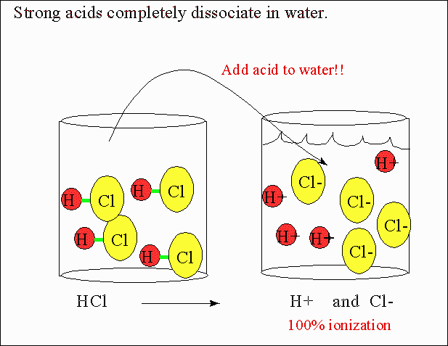
Some binary Hydrogen compounds dissociate into ions in solution

Slide 32
Acids Derived from Binary Compounds
Acid formulas begin with the element hydrogen.
The acid name refers to a solution while the pure substance is named using the previous rules.
To name binary acids in the aqueous phase:
Write the prefix hydro- followed by the stem of the second element and add the suffix –ic.
Write the word acid.
HCl_{(aq)} hydrochloric acid

Slide 33
Acids Derived from Binary Compounds
Name the following compounds:
HBr_{(g)}
HBr_{(aq)}
H₂S_{(aq)}
HF_{(aq)}
HI_{(aq)}
hydrogen bromide gas
hydrobromic acid
hydrosulfuric acid
hydrofluoric acid
hydroiodic acid

Slide 34
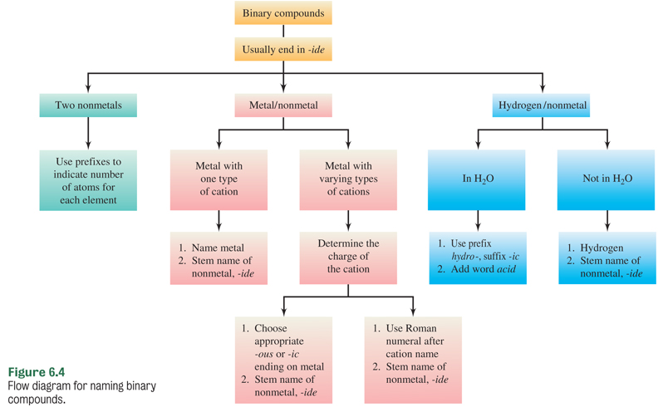
Naming Binary Compounds

Slide 35
Your Turn!
V₂O₅ is
divanadium pentoxide
vanadium pentoxide
vanadium(II) oxide
vanadium(V) oxide

Slide 36
Your Turn!
Sulfur dioxide is
SO
S₂O
SO₂

Slide 37
Your Turn!
A solution containing HF should be named
hydrogen fluoride
hydrofluoric acid
hydrofluoride acid

Slide 38
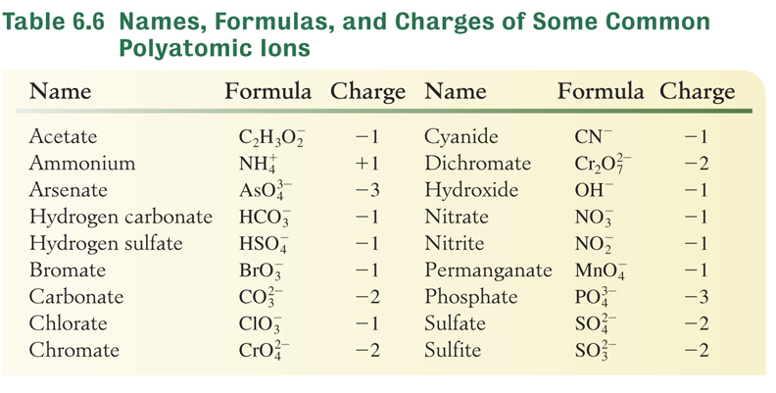
Polyatomic Ions
A polyatomic ion is an ion that contains 2 or more elements.

Slide 39
Polyatomic Ions
Many polyatomic ions that contain oxygen are called oxy-anions and generally have the suffix -ate or -ite.
Learn the names and formulas of the ions that end in -ate.
  sulfate nitrate
The ions whose names end in –ite have one less oxygen.
  sulfite
  nitrite

Slide 40
Polyatomic Ions
Some elements form more than two oxy-anions.
These additional prefixes are also used by bromate (BrO₃⁻), iodate (IO₃⁻), and phosphate (PO₄³⁻).
Formula | Anion Name
ClO₄⁻ | perchlorate
ClO₃⁻ | chlorate
ClO₂⁻ | chlorite
ClO⁻ | hypochlorite
per- means one more oxygen than -ate ion
hypo- means one less oxygen than -ite ion

Slide 41
Polyatomic Ions
Some polyatomic names end in –ide:
hydroxide OH⁻
cyanide CN⁻
hydrogen sulfide HS⁻
peroxide
Only one polyatomic ion is positive:
ammonium

Slide 42
Writing Formulas with Polyatomic Ions
Use parentheses around the polyatomic ion if you need to add a subscript to balance the charge.
Example: Ba²⁺ + Ba(NO₃)₂
Mn²⁺ +
Sr²⁺ +
K⁺ +
Cu²⁺ +
MnCO₃
Sr(OH)₂
K₂CrO₄
Cu₃(PO₄)₂

Slide 43
Naming Compounds Containing Polyatomic Ions
Write the name of the cation.
Write the name of the anion.
Name these compounds:
Hg(ClO₂)₂
Zn₃(PO₄)₂
NH₄NO₃
Pb(C₂H₃O₂)₂
mercury(II) chlorite
zinc phosphate
ammonium nitrate
lead(II) acetate

Slide 44
Your Turn!
Chlorate is ClO₃⁻. What is the formula of chromium(II) hypochlorite?
Cr(ClO₃)₂
CrClO₂
Cr(ClO₂)₂
Cr(ClO)₂
Cr(ClO₄)₂

Slide 45
Your Turn!
Sulfate is SO₄²⁻. Name the compound FeSO₄.
iron sulfate
iron(I) sulfate
iron(II) sulfate
iron(IV) sulfate

Slide 46
Oxy-Acids
Oxy-acids are neutral compounds that begin with H and end with an oxygen-containing polyatomic ion.
The name of the acid ends in –ic acid if the polyatomic ion ends in –ate.
sulfate SO₄²⁻ H₂SO₄ sulfuric acid
chlorate ClO₃⁻ HClO₃ chloric acid
The name of the acid ends in –ous acid if the polyatomic ion ends in –ite.
sulfite SO₃²⁻ H₂SO₃ sulfurous acid
chlorite ClO₂⁻ HClO₂ chlorous acid

Slide 47
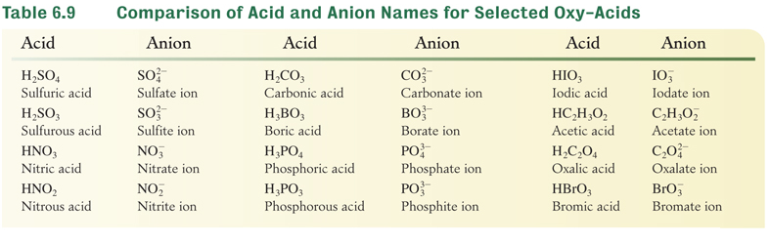
Oxy-Acids
Why are there 3 H in phosphoric acid?

Slide 48
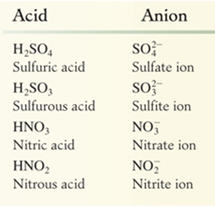
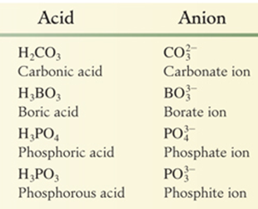
Oxy-Acids
Table 6.9 Comparison of Acid and Anion Names

Slide 49
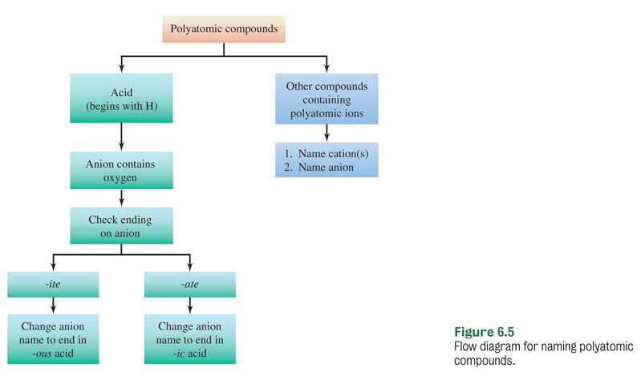
Naming Compounds Containing Polyatomic Ions

Slide 50
Your Turn!
Nitrate is NO₃⁻. HNO₂ is
Hydrogen nitrite
Hydrogen nitrogen dioxide
Nitric acid
Nitrous acid

Slide 51
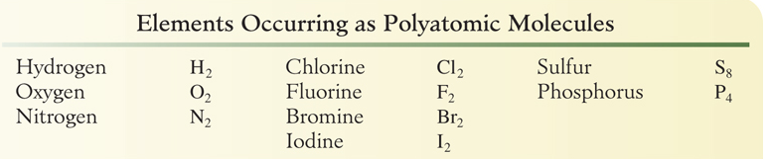
Element
Some elements do not exist as single atoms when they are not in compounds.
Diatomic molecules exist as two atoms bonded together.
Polyatomic molecules contain more than two atoms.
The air you are breathing is 78%N₂, 21%O₂ and 1%Ar.

