Slide 1

Chapter 5
Early Atomic Theory and Structure
Lightning occurs when electrons move to neutralize a charge difference between the clouds and the Earth
Introduction to General, Organic, and Biochemistry 10e
John Wiley & Sons, Inc
Morris Hein, Scott Pattison, and Susan Arena

Slide 2
Chapter Outline
5.1 Early Thoughts 5.2 Dalton’s Model of the Atom 5.3 Composition of Compounds 5.4 The Nature of Electric Charge | 5.5 Discovery of Ions 5.6 Subatomic Parts of the Atom 5.7 The Nuclear Atom 5.8 Isotopes of the Elements 5.9 Atomic Mass

Slide 3
Early Thoughts
The earliest models of the atom were developed by the ancient Greek philosophers.
Empedocles (about 440 B.C.) stated that all matter was composed of four “elements” – earth, wind, fire and water.
Democritus (about 470-370 B.C.) thought all forms of matter were composed of tiny indivisible particles, called atoms, derived from the Greek work for indivisible.

Slide 4
Dalton’s Model of the Atom (1803-1810)
Elements are composed of minute, indivisible particles called atoms.
  Atoms are made up of smaller particles
Atoms of the same element are alike in mass and size.
  Isotopes of elements exist
Atoms of different elements have different masses and sizes.
  Isotopes like C-14 and N-14 make this incorrect

Slide 5


Dalton’s Model of the Atom (cont.)
Chemical compounds are formed by the union of two or more atoms of different elements.
Atoms combine to form compounds in simple numerical ratios.
Atoms of two elements may combine in different ratios to form more than one compound.
H₂O
H₂O₂

Slide 6
Composition of Compounds
Law of definite composition states that a compound always contains two or more elements chemically combined in a definite proportion by mass.
Water | Hydrogen Peroxide
H₂O | H₂O₂
11.2%H | 5.9% H
88.8% O | 94.1% O
2H + 1O | 2H + 2O

Slide 7
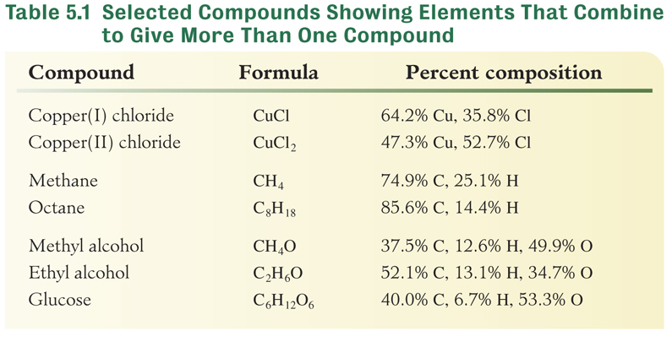
Law of Multiple Proportions
Atoms of two or more elements may combine in different ratios to produce more than one compound.

Slide 8
Natural Law versus Theory
Natural Law – summary of observed behavior
Laws do not undergo modification
Example: Law of Definite Composition
Theory (model) – explanation of the behavior
Theories are often modified or discarded over time
Example: Dalton’s Atomic Theory

Slide 9
Your Turn!
Which of the following statements in Dalton’s atomic theory has had to be modified or discarded in modern atomic theory?
Atoms of the same element are alike in mass and size.
Chemical compounds are formed by the union of two or more atoms of different elements.
Atoms combine to form compounds in simple numerical ratios.

Slide 10
Your Turn!
Which pair of formulas illustrates the law of multiple proportions?
CH₃Cl and CH₃OH
H₂O and HOH
CuCl₂ and CuBr
Na₂O and Na₂O₂

Slide 11
The Nature of Electric Charge
Charge may be of two types: positive and negative.
Unlike charges attract and like charges repel.
Charge may be transferred by contact or induction.
Force of attraction between ions is
  Reduced by distance between charges (r)
  Increased by increasing charge (q)
where k is a constant.

Slide 12
Your Turn!
Which of the following sets of ions have the greatest force of attraction?
Fe²⁺ and Na⁺
Fe²⁺ and O²⁻
Fe³⁺ and O²⁻

Slide 13
Your Turn!
As the distance between two oppositely charged particles increases, the force of attraction will
Increase
Decrease
Remain the same

Slide 14
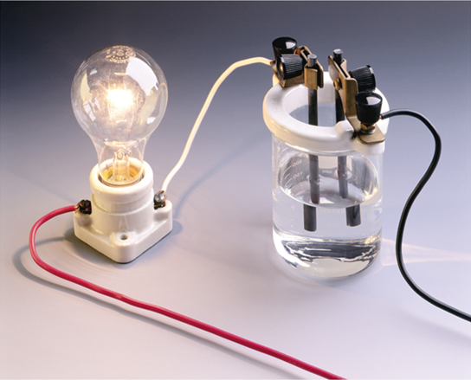
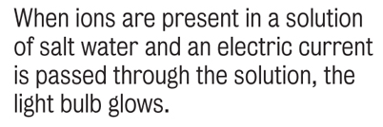
Discovery of Ions
Michael Faraday (1791-1867)
Discovered that compounds dissolved in water contain charged particles.
These charged particles conduct electricity.
Coined the term “ion” from the
Greek word “wanderer.”

Slide 15
Discovery of Ions
Svante Arrhenius (1859-1927)
He reasoned that an ion is an atom carrying a positive or negative charge.
Both positive and negative ions are present in a compound so the molten compound conducts electricity.
Cations move toward negative electrode (cathode)
Anions move toward positive electrode (anode)

Slide 16
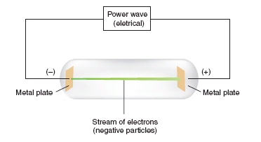
Subatomic Parts of the Atom
Cathode Rays (Electrons)
Discovered by J. J. Thomson in 1897
Travel in straight lines
Are negatively charged
Are deflected by electrical and magnetic fields
Notes:
Figure 5.3 Cathode ray tube. A stream of electrons passes between electrodes. The fast moving particles excite the gas inside the tube creating a greenish glow between the electrodes.

Slide 17
Electrons
The electron (e⁻) is a particle with
a mass of 9.110×10⁻²⁸ g or 1/1837 mass of a hydrogen atom.
a relative charge of -1.
a diameter of less than 10⁻¹² cm.

Slide 18
Your Turn!
Cathode rays are
Ions
Electrons
Protons
Neutrons

Slide 19
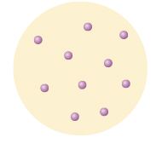
Subatomic Parts of the Atom
Protons
A relative charge of +1.
Mass is 1837 times the mass of an electron.
Thompson’s Plum Pudding Model (proposed in 1904)
Notes:
Figure 5.4 Thompson’s Model of the Atom In this early model of the atom, negative particles (electrons) were thought to be embedded in a positively charged sphere. It is sometimes called the plum pudding model.

Slide 20
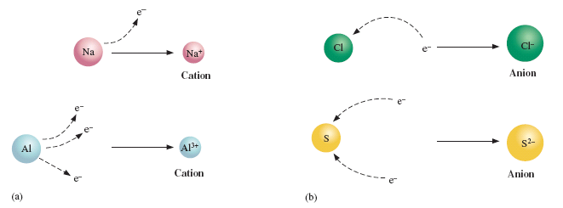
Subatomic Parts of the Atom
J. J. Thompson proposed that ions result from the loss and gain of electrons
Notes:
Figure 5.5 (a) When one or more electrons are lost from an atom, a cation is formed. (b) When one or more electrons are added to a neutral atom, an anion is formed.

Slide 21
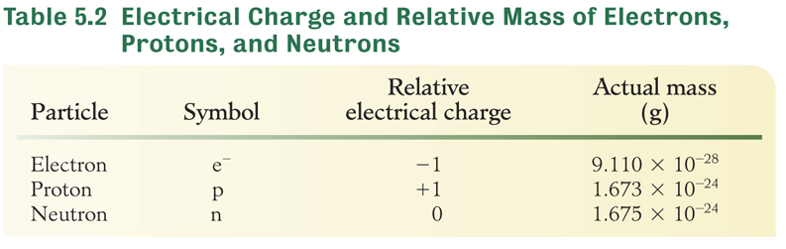
Subatomic Parts of the Atom
Neutrons
Discovered by James Chadwick in 1932.
Neutral charge

Slide 22
Your Turn!
A proton is a
Cation
Anion
None of the above

Slide 23
Your Turn!
A neutron is a
Cation
Anion
None of the above

Slide 24
Your Turn!
What is the relative mass of an electron?
Slightly larger than a proton
Slightly smaller than a proton
1/1837 the mass of a proton

Slide 25
Mass and Number of Atoms
Calculate number of atoms in 25 g of hydrogen, if each hydrogen atom has a mass of 1.673×10⁻²⁴ g.

Slide 26
Your Turn!
The mass of a copper atom is 1.045x10 ⁻²² g. How many copper atoms are present in a 94.5g sample of copper?
9.04 X 10 ²³
1.045 X 10 ⁻²²
1870
94.5

Slide 27
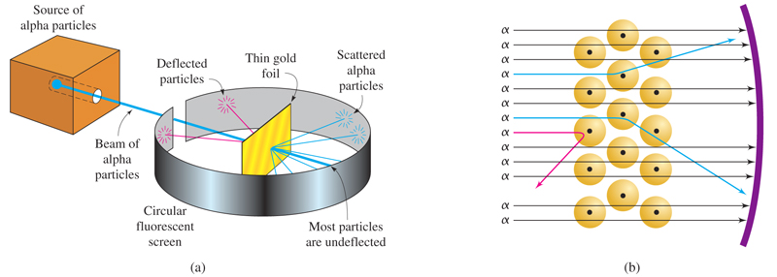

The Nuclear Atom

Slide 28
Rutherford’s Experiment
Observation | Hypothesis
Most alpha rays passed through Au as if nothing was there! | Most of the volume of an atom is empty space
Some alpha rays were deflected as if repelled by a like charge particle. | The nucleus or center of the atom is positive.
Some bounced back as if they encountered something very dense. | Most of the mass of the atom is in the nucleus.

Slide 29
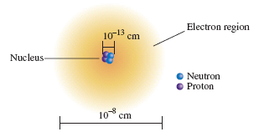
Nuclear Atom
Protons and neutrons make up the dense, positive nucleus.
Electrons occupy the empty space outside the nucleus.
A neutral atom contains the same number of electrons and protons.
Notes:
Figure 5.7 In the nuclear model of the atom, protons (p) and neutrons (n) are located in the nucleus. The electrons are found in the remainder of the atom (which is mostly empty space because electrons are very tiny).

Slide 30
Your Turn!
The mass of an atom is primarily determined by the mass of its
Protons
Neutrons
Electrons
Protons and neutrons
Protons, neutrons and electrons

Slide 31
Atomic Number of the Elements
The atomic number of an element is the number of protons in the nucleus.
The atomic number determines the identity of the element.
Example: Sodium has an atomic number of 11 so every sodium atom has 11 protons.
Since a neutral atom of Na has 11 protons, it also has 11 electrons.

Slide 32
Your Turn!
Use a periodic table to determine the atomic number of potassium. Which of the following is true?
Potassium has 15 protons and 15 electrons.
Potassium has 15 protons and 31 electrons.
Potassium has 19 protons and 19 electrons.
Potassium has 19 protons and 39 electrons.

Slide 33
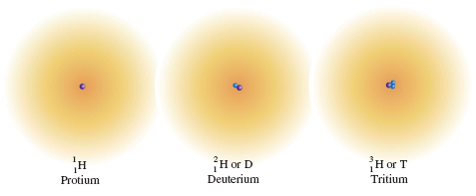
Isotopes of the Elements
Isotopes are atoms of an element with the same atomic number but different masses.
Isotopes have different numbers of neutron.
The mass number is the sum of protons and neutrons.
Notes:
Figure 5.8 The isotopes of hydrogen. The number of protons (purple) and neutrons (blue) are shown within the nucleus. The electron (e⁻) exists outside the nucleus.

Slide 34
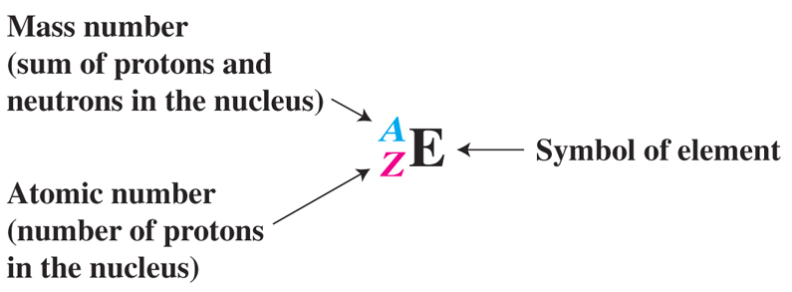
Isotopic Notation
Phosphorus-31 is the only stable P isotope.
The neutral atom has 15 protons and 15 electrons.
Number of neutrons = 31 - 15 = 16

Slide 35
Isotopes
Complete the table:
Element | Symbol | Atomic No. | Mass No. | No. of Protons | No. of Electrons | No. Of Neutrons
chlorine
17
37
17
17
20
lead
82
204
82
82
122
argon
18
38
18
18
20

Slide 36
Your Turn!
Carbon-14 dating involves measuring the amount of C-14 remaining in a fossil. How many neutrons does this radioactive isotope have?
14
6
8
20

Slide 37
Your Turn!
Approximately 50.70% of all atoms of bromine are atoms. How many neutrons, protons and electrons does this isotope of bromine have?
79 neutrons, 35 protons and 35 electrons
44 neutrons, 35 protons and 35 electrons
35 neutrons, 79 protons and 35 electrons
44 neutrons, 35 protons and 44 electrons
79 neutrons, 35 protons and 44 electrons

Slide 38
Your Turn!
What is the mass number of an atom that contains 30 protons, 30 electrons, and 35 neutrons?
35
30
65
95

Slide 39
Atomic Mass
The mass of an atom is so small that a table of relative atomic masses using atomic mass units was devised.
The atomic mass unit (amu) is defined as 1/12 mass of a C-12 atom.
1 amu = 1.6606x10⁻²⁴g
Atomic mass is a weighted average of the naturally occurring isotopes of an element compared to the atomic mass of carbon-12.

Slide 40
Atomic Mass
Isotope | Isotopic mass (amu) | Abundance (%) | Average atomic mass (amu)
 | 12.000 | 98.97 | 12.01
 | 13.003 | 1.11
Atomic mass of Carbon:
98.97% ¹²C (12.000 amu) + 1.11% ¹³C (13.003 amu) = 12.01 amu

Slide 41
Your Turn
Bromine has two stable isotopes: Br-79 (50.70%) and Br-81 (49.32%). The atomic masses are 78.92 amu and 80.92 amu respectively. Determine the average atomic mass of bromine.
50.70 amu
78.92 amu
80.00 amu
79.92 amu

