Slide 1
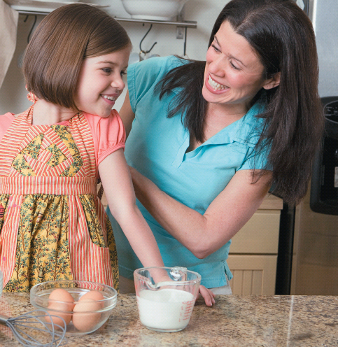
Chapter 2
Standards for Measurement
Careful and accurate measurements for each ingredient are essential when baking or cooking as well as in the chemistry laboratory.
Introduction to General, Organic, and Biochemistry 10e
John Wiley & Sons, Inc
Morris Hein, Scott Pattison, and Susan Arena

Slide 2
Chapter Outline
2.1 Scientific Notations 2.2 Measurement and Uncertainty 2.3 Significant Figures 2.4 Significant Figures in Calculations 2.5 The Metric System | 2.6 Dimensional Analysis 2.7 Measuring Mass and Volume 2.8 Measurement of Temperature 2.9 Density

Slide 3
Observations
Qualitative observations are descriptions of what you observe.
  Example: The substance is a gray solid.
Quantitative observations are measurements that include both a number and a unit.
  Example: The mass of the substance is 3.42 g.

Slide 4
Scientific Notation
Scientific notation is writing a number as the product of a number between 1 and 10 multiplied by 10 raised to some power.
Used to express very large numbers or very small numbers as powers of 10.
Write 59,400,000 in scientific notation
  Move the decimal point so that it is located after the first nonzero digit (5.94)
  Indicate the power of 10 needed for the move. (10⁷)
5.94×10⁷

Slide 5
Scientific Notation
Exponent is equal to the number of places the decimal point is moved.
Sign on exponent indicates the direction the decimal was moved
  Moved right → negative exponent
  Moved left → positive exponent
Write 0.000350 in scientific notation
  Move the decimal point so that it is located after the first nonzero digit (3.50)
  Indicate the power of 10 needed for the move. (10⁻⁴)
3.50×10⁻⁴

Slide 6
Your Turn!
Write 806,300,000 in scientific notation.
8.063×10⁻⁸
8.063×10⁸
8063×10⁻⁵
8.063×10⁵

Slide 7
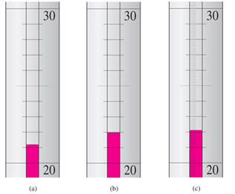
Measurement and Uncertainty
The last digit in any measurement is an estimate.
uncert
estimate
a. 21.2°C
+.1°C
certain
+.01°C
b. 22.0°C
c. 22.11°C
Notes:
Figure 2.1 Measuring temperature (°C) with various degrees of precision. Thermometers a and b are precise to 0.1°C while thermometer c is precise to 0.01°C.

Slide 8
Significant Figures
Significant Figures include both the certain part of the measurement as well as the estimate.
Rules for Counting Significant Figures
All nonzero digits are significant
  21.2 has 3 significant figures
An exact number has an infinite number of significant figures.
  Counted numbers: 35 pennies
  Defined numbers: 12 inches in one foot

Slide 9
Significant Figures
Rules for Counting Significant Figures (continued)
A zero is significant when it is
between nonzero digits
  403 has 3 significant figures
at the end of a number that includes a decimal point
  0.050 has 2 significant figures
  22.0 has 3 significant figures
  20. has 2 significant figures

Slide 10
Your Turn!
How many significant figures are found in 3.040×10⁶?
2
3
4
5
6

Slide 11
Significant Figures
Rules for Counting Significant Figures (continued)
A zero is not significant when it is
before the first nonzero digits
  0.0043 has 2 significant figures
a trailing zero in a number without a decimal point
  2400 has 2 significant figures
  9010 has 3 significant figures

Slide 12
Your Turn!
How many significant figures are found in 0.056 m?
5
4
3
2
1

Slide 13
Significant Figures
Why does 0.056 m have only 2 significant figures?
Leading zeros are not significant.
Lets say we measure the width of sheet of paper:
5.6 cm (the 5 was certain and the 6 was estimated)
This length in meters is 0.056 m (100 cm / m)
We use significant figures rules to be sure that the answer is as precise as the original measurement!

Slide 14
Rounding Numbers
Calculations often result in excess digits in the answer (digits that are not significant).
Round down when the first digit after those you want to retain is 4 or less
  4.739899 rounded to 2 significant figures is 4.7
Round up when the first digit after those you want to retain is 5 or more
  0.055893 round to 3 significant figures is 0.0559

Slide 15
Your Turn!
Round 240,391 to 4 significant figures.
240,300
240,490
240,000
240,400

Slide 16
What if we get it wrong?
Uncertainty in Calculations
Example 1. Density D = mass/volume
Object volume measured at 12.5 ml. Object mass measured at 109.35g
109.35/12.4 = 8.81854 g/ml
109.35/12.5 = 8.748 g/ml
109.35/12.6 = 8.67857 g/ml
Our answer could be as high as 8.82 or as low as 8.68… we need to avoid reporting our answer with a false certainty!!
Report D = 8.75 g/ml

Slide 17
Another Example
An object travels 0.056 meters in 36.2 seconds… what is its velocity?
Velocity = Distance/Time
0.055/36.2 = 0.00151933 m/s
0.056/36.2 = 0.0015469 m/s
0.057/36.2 = 0.00157458 m/s
Our answer could be as low as .00152 or as high as 0.00157 !!!
Report 2 sig figs! V = 0.0015 m/s

Slide 18

Significant Figures in Calculations
The result of the calculation cannot be more precise than the least precise measurement.
For example:
Calculate the area of a floor that is 12.5 ft by 10. ft
12.5 ft × 10. ft = 125 ft²
But the 10. has only 2 significant figures, so the correct answer is 130 ft².
10. ft
12.5 ft

Slide 19
Significant Figures in Calculations
Calculations involving Multiplication or Division
The result has as many significant figures as the measurement with the fewest significant figures .
9.00 m × 100 m
9.00 m × 100. m
9.0 m × 100. m
= 900 m² (100 has only 1 significant figure)
= 900. m² (both have 3 significant figures )
= 9.0×10² m² (9.0 has 2 significant figures )

Slide 20
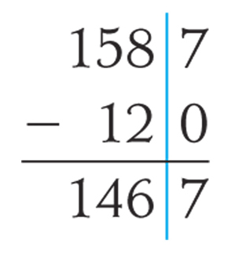
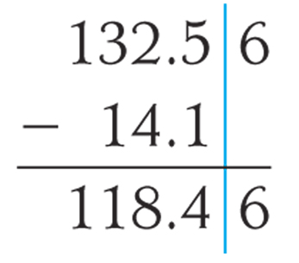
Significant Figures in Calculations
Calculations involving Addition and Subtraction
The result has the same precision (same number of decimal places) as the least precise measurement (the number with the fewest decimal places).
120 g is the least precise measurement.
The answer must be rounded to 1470 g.
1587 g - 120 g = ?
Key Idea: Match precision rather than significant figures!

Slide 21
Significant Figures in Calculations
Calculations involving Addition and Subtraction
The result has the same precision (same number of decimal places) as the least precise measurement (the number with the fewest decimal places).
14.1 g is the least precise measurement.
The answer must be rounded to 118.5 g.
132.56 g - 14.1 g = ?

Slide 22
Your Turn!
A student determined the mass of a weigh paper to be 0.101 g. He added CaCl₂ to the weigh paper until the balance read 1.626 g. How much CaCl₂ did he weigh out?
1.525 g
0.101 g
1.626 g
1.727 g

Slide 23
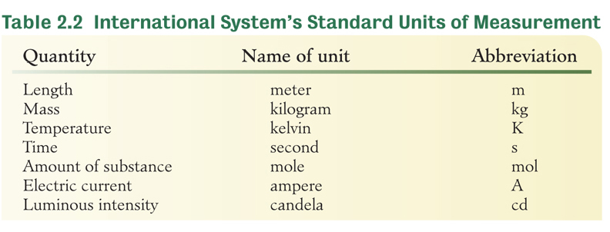
Metric System
The metric system or International System (SI) is a decimal system of units that uses factors of 10 to express larger or smaller numbers of these units.

Slide 24
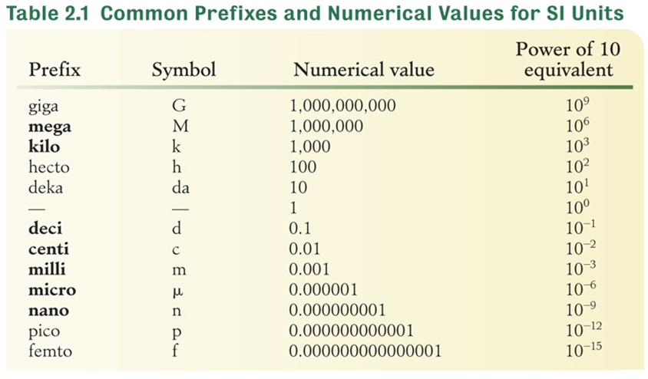
Metric System

Slide 25
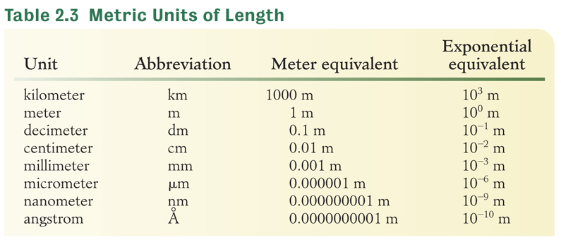
Units of Length
Examples of equivalent measurements of length:
1 km = 1000 m
1 cm = 0.01 m
1 nm = 10⁻⁹ m
100 cm = 1 m
10⁹ nm = 1 m

Slide 26
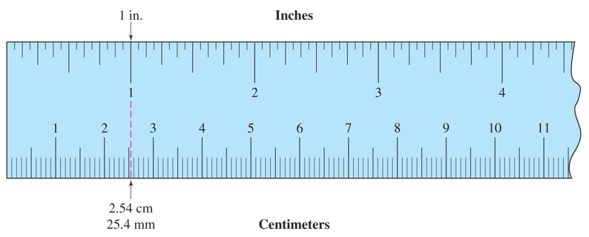
How big is a cm and a mm?
2.54 cm = 1 in
25.4 mm = 1 in
Figure 2.2 Comparison of the metric and American Systems of length measurement
Notes:
Figure 2.2 Comparison of the metric and American Systems of length measurement: 2.54cm = 1 in.

Slide 27
Dimensional Analysis:
Converting One Unit to Another
Read. Identify the known and unknown.
Plan. Identify the principles or equations needed to solve the problem.
Set up. Use dimensional analysis to solve the problem, canceling all units except the unit needed in the answer.
Calculate the answer and round for significant figures.
Check answer – Does it make sense?

Slide 28
Dimensional Analysis
Using units to solve problems
Apply one or more conversion factors to cancel units of given value and convert to units in the answer.
Example: Convert 72.0 inches to feet.

Slide 29
Conversion Factors
What are the conversion factors between kilometers and meters? 1 km = 1000 m
Divide both sides by 1000 m to get one conversion factor.
Divide both sides by 1 km to get the other conversion factor.
Use the conversion factor that has the unit you want to cancel in the denominator and the unit you are solving for in the numerator.

Slide 30
Dimensional Analysis
Calculate the number of km in 80700 m.
Unit₁ is 80700 m and unit₂ is km
Solution map (outline of conversion path): m → km
The conversion factor is

Slide 31
Dimensional Analysis
Calculate the number of inches in 25 m.
Solution map: m → cm → in
Two conversion factors are needed:
Round to 980 cm since 25 m has 2 significant figures.

Slide 32
Your Turn!
Which of these calculations is set up properly to convert 35 mm to cm?
Another way:

Slide 33
Dimensional Analysis
The volume of a box is 300. cm³. What is that volume in m³?
Unit₁ is 300. cm³ and unit₂ is m³
Solution map: (cm → m)³
The conversion factor is needed 3 times:

Slide 34
Dimensional Analysis
Convert 45.0 km/hr to m/s
Solution map: km→ m and hr → min→s
The conversion factors needed are

Slide 35
Your Turn!
The diameter of an atom was determined and a value of 2.35 × 10^{–8} cm was obtained. How many nanometers is this?
2.35×10⁻¹ nm
2.35×10⁻¹⁹ nm
2.35×10⁻¹⁵ nm
2.35×10¹ nm

Slide 36
Mass and Weight
Mass is the amount of matter in the object.
  Measured using a balance.
  Independent of the location of the object.
Weight is a measure of the effect of gravity on the object.
  Measured using a scale which measures force against a spring.
  Depends on the location of the object.

Slide 37
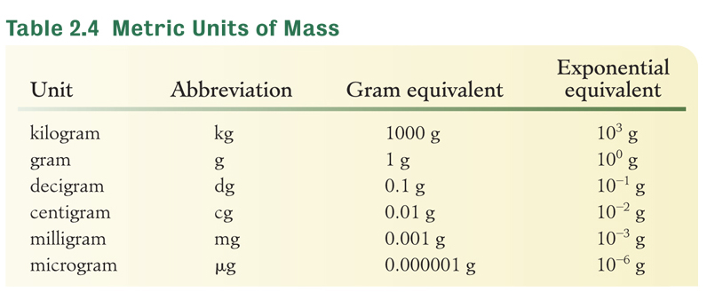
Metric Units of Mass
Examples of equivalent measurements of mass:
1 kg = 1000 g
1 mg = 0.001 g
1 μg = 10⁻⁶ g
1000 mg = 1 g
10⁶ μg = 1 g

Slide 38
Your Turn!
The mass of a sample of chromium was determined to be 87.4 g. How many milligrams is this?
8.74×10³ mg
8.74×10⁴ mg
8.74×10⁻³ mg
8.74×10⁻² mg

Slide 39
Units of Mass
Commonly used metric to American relationships:
  2.205 lb = 1 kg
  1 lb = 453.6 g
Convert 6.30×10⁵ mg to lb.
Solution map: mg → g → lb

Slide 40
Your Turn!
A baby has a mass of 11.3 lbs. What is the baby’s mass in kg? There are 2.205 lb in one kg.
11.3 kg
5.12 kg
24.9 kg
0.195 kg

Slide 41
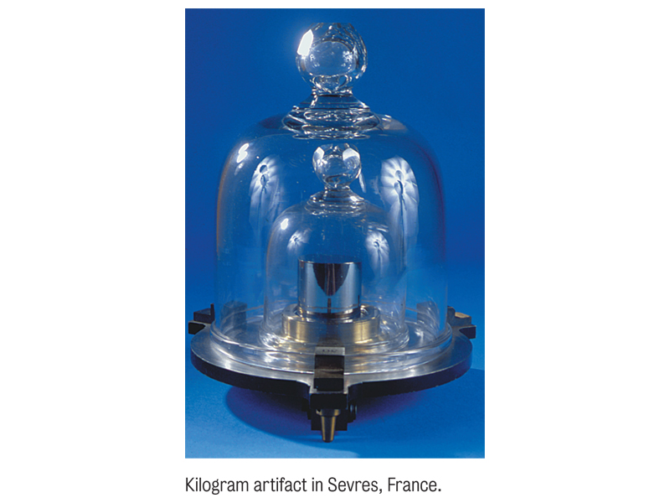
Setting Standards
The kg is the base unit of mass in the SI system
The kg is defined as the mass of a Pt-Ir cylinder stored in a vault in Paris.
The m is the base unit of length
1 m is the distance light travels in

Slide 42
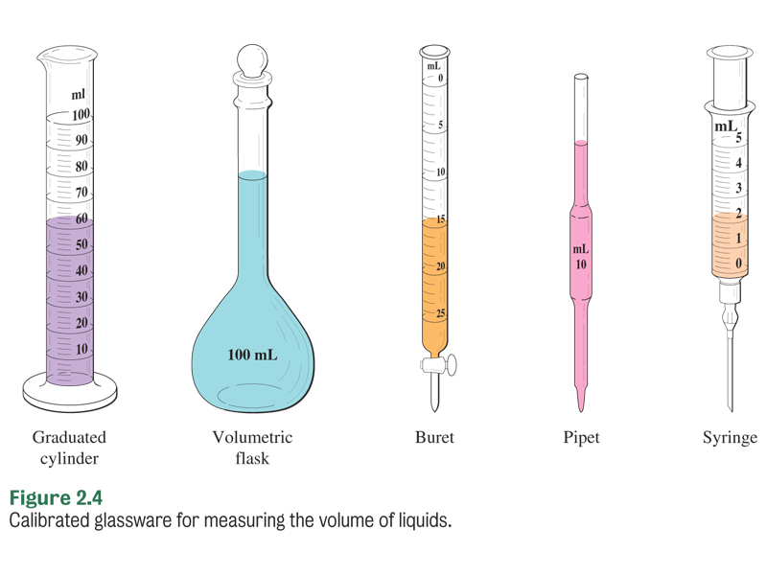
Volume Measurement
1 Liter is defined as the volume of 1 dm³ of water at 4°C.
1 L = 1000 mL
1 L = 1000 cm³
1 mL = 1 cm³
1 L = 10⁶ μL

Slide 43
Your Turn!
A 5.00×10⁴ μL sample of saline is equivalent to how many mL of saline?
500. mL
5.00×10³ mL
5.00×10¹³ mL
50.0 mL
5.00×10⁷ mL

Slide 44
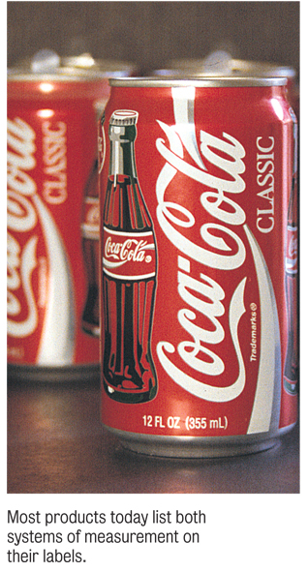
Units of Volume
Useful metric to American relationships:
  1 L =1.057 qt
  946.1 mL = 1 qt
A can of coke contains 355 mL of soda.
A marinade recipe calls for 2.0 qt of coke. How many cans will you need?

Slide 45
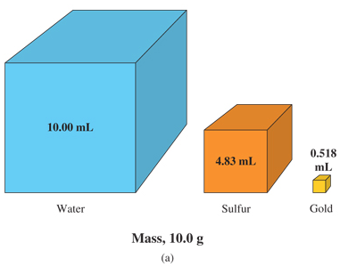
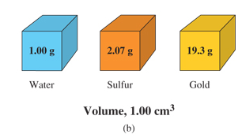
Density
Density is a physical characteristic of a substance that can be used in its identification.
Density is temperature dependent. For example, water
d^{4°C} = 1.00 g/mL but d^{25°C} = 0.997 g/mL.
Which substance is the most dense?
Water is at 4°C; the two solids at 20°C.
Notes:
Figure 2.6 (a) Comparison of the volumes of equal masses (10.0 g) of water, sulfur and gold.
(b) Comparison of the masses of equal volumes (1.00 cm³) of water, sulfur and gold.
Water is at 4°C; the two solids at 20°C.

Slide 46
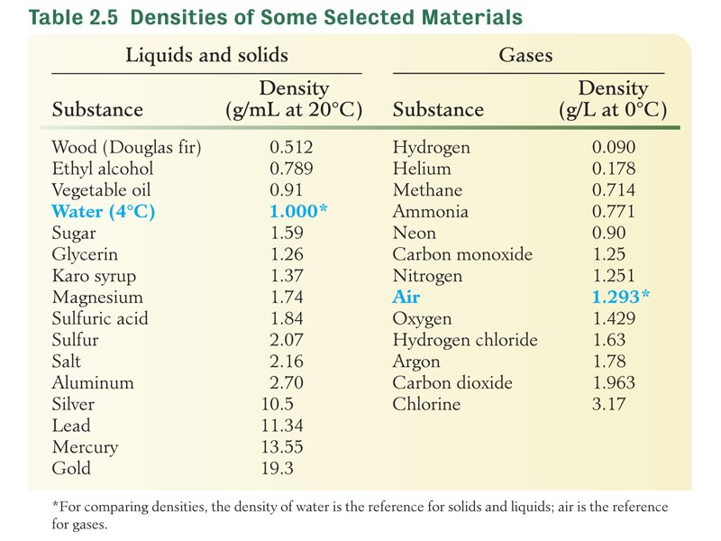
Density

Slide 47
Density by H₂O Displacement
If an object is more dense than water, it will sink, displacing a volume of water equal to the volume of the object.
A 34.0 g metal cylinder is dropped into a graduated cylinder. If the water level increases from 22.3 mL to 25.3 mL, what is the density of the cylinder?
First determine the volume of the solid:
Next determine the density of the solid:

Slide 48
Your Turn!
Use Table 2.5 to determine the identity of a substance with a density of 11 g/cm³.
silver
lead
mercury
gold

Slide 49
Density Calculations
Determine the mass of 35.0 mL of ethyl alcohol. The density of ethyl alcohol is 0.789 g/mL.
Approach 1: Using the density formula
Solve the density equation for mass:
Substitute the data and calculate:

Slide 50
Density Calculations
Determine the mass of 35.0 mL of ethyl alcohol. The density of ethyl alcohol is 0.789 g/mL.
Approach 2: Using dimensional analysis
Solution map: mL → g
35.0 mL

Slide 51
Your Turn!
Osmium is the most dense element (22.5 g/cm³). What is the volume of 225 g of the metal?
10.0 cm³
10 cm³
5060 cm³
0.100 cm ³

Slide 52
Your Turn!
A 109.35 g sample of brass is added to a 100 mL graduated cylinder with 55.5 mL of water. If the resulting water level is 68.0 mL, what is the density of the brass?
1.97 g/cm³
1.61 g/cm³
12.5 g/cm³
8.75 g/cm³

Slide 53
Thermal Energy and Temperature
Thermal energy is a form of energy associated with the motion of small particles of matter.
Temperature is a measure of the intensity of the thermal energy (or how hot a system is).
Heat is the flow of energy from a region of higher temperature to a region of lower temperature.

Slide 54
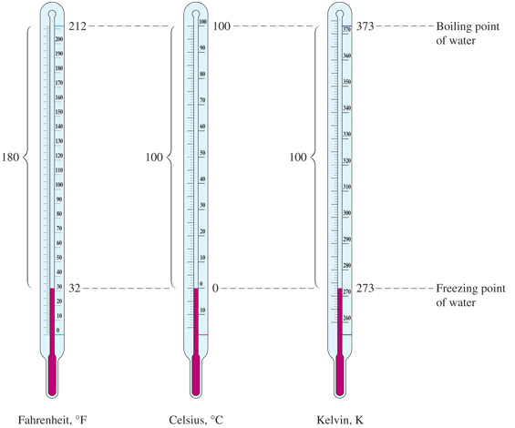
Temperature Measurement
Notes:
Figure 2.5 Comparison of Celsius, Kelvin and Fahrenheit temperature scales.

Slide 55
Temperature Measurement
Thermometers are often filled with liquid mercury, which melts at 234 K. What is the melting point of Hg in °F?
First solve for the Centigrade temperature:
Next solve for the Fahrenheit temperature:

Slide 56
Your Turn!
Normal body temperature is 98.6°F. What is that temperature in °C?
66.6°C
119.9°C
37.0°C
72.6°C
80.8°C

Slide 57
Your Turn!
On a day in the summer of 1992, the temperature fell from 98 °F to 75 °F in just three hours. The temperature drop expressed in celsius degrees (C°) was
13°C
9°C
45°C
41°C
75°C

Slide 58
Specific Gravity
Specific gravity (sp gr) of a substance is the ratio of the density of that substance to the density of a reference substance (usually water at 4°C).
It has no units and tells us how many times as heavy a liquid or a solid is as compared to the reference material.

