Slide 1
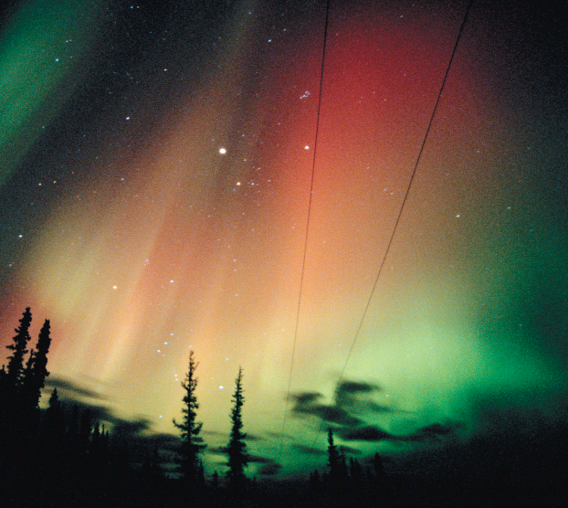
Chapter 1
An Introduction to Chemistry
The spectacular colors of the aurora borealis are the result of chemistry in our atmosphere.
Introduction to General, Organic, and Biochemistry 10e
John Wiley & Sons, Inc
Morris Hein, Scott Pattison, and Susan Arena

Slide 2
Chapter Outline
1.1 Why Study Chemistry? 1.2 The Nature of Chemistry 1.6 The Particulate Nature of Matter 1.7 Physical States of Matter 1.8 Classifying Matter | 1.3 Thinking Like a Chemist 1.4 A Scientific Approach to Problem Solving 1.5 The Scientific Method

Slide 3
The Nature of Chemistry
Chemistry is the science dealing with the composition of matter and the changes in composition that matter undergoes.
Matter is composed of particles, some with charge and some without charge.
Chemistry is also concerned with energy and energy changes of matter.
Most chemical behavior can be explained by the interactions of charged particles.

Slide 4
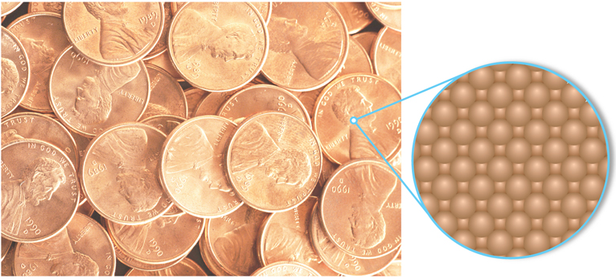
The Particulate Nature of Matter
Matter is anything that has mass and occupies space.
Matter is composed of discrete, tiny, fundamental particles called atoms.
The surface of a penny is made up of tiny identical copper atoms packed tightly together.
Notes:
Figure 3.1 The surface of a penny is made up of tiny identical copper atoms packed tightly together.

Slide 5
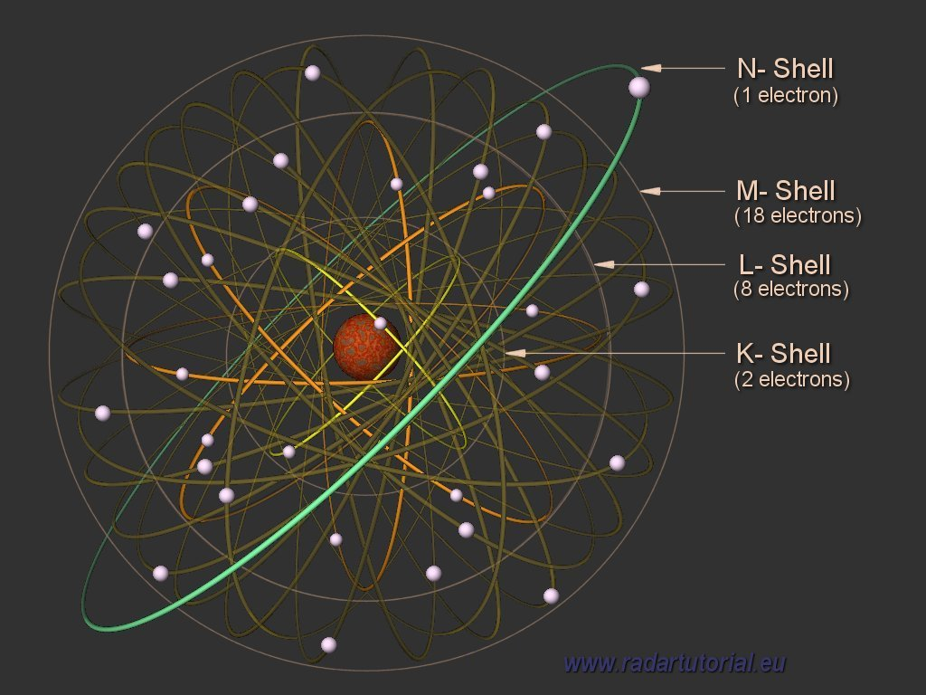
Copper Nucleus and Electrons

Slide 6
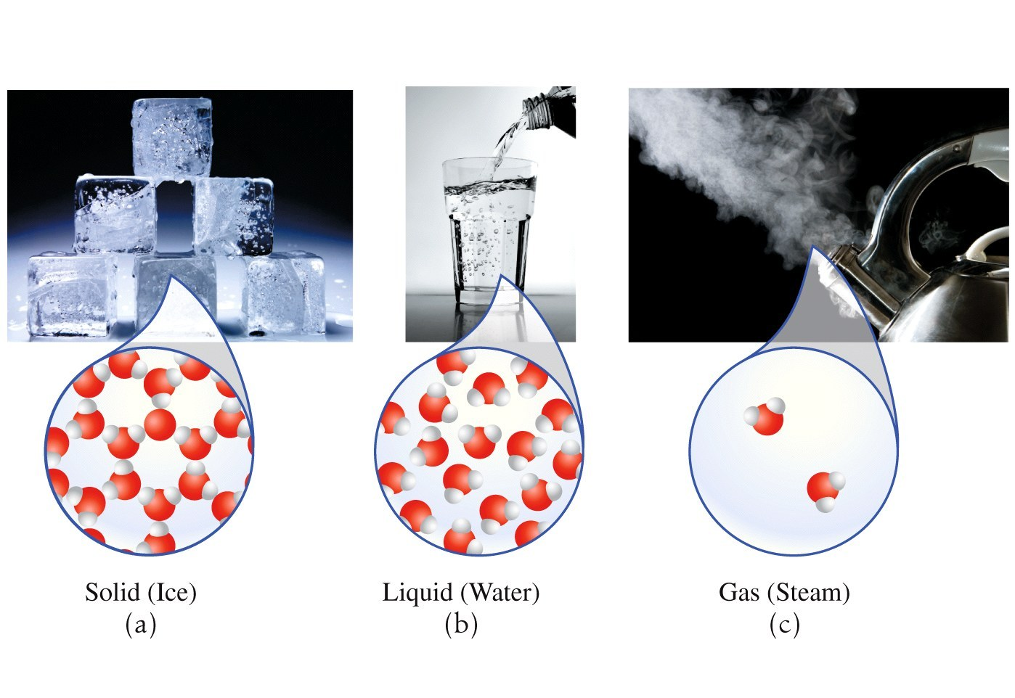
Physical States of Matter
How are they the same? How are they different?
Notes:
Figure 1.5 The three states of matter: (a) solid – water molecules are held together rigidly and are very close to each other; (b) Liquid – water molecules are close together but are free to move around and slide over each other; (d) Gas- water molecules are far apart and move freely and randomly.

Slide 7
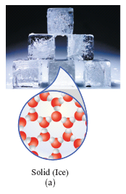
Solids
Definite shape
Definite volume
Essentially incompressible
Particles are tightly packed together
Particles are held together by very strong forces of attraction

Slide 8
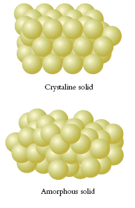
Solids
Crystalline solids exist in regular, repeating, three-dimensional geometric patterns.
Amorphous solids do not have any regular, internal geometric pattern.

Slide 9
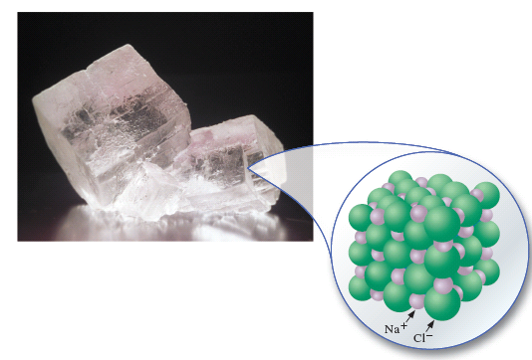
Solids
Crystalline solids have regular, repeating three dimensional patterns.
This is a large crystal of table salt.
Notes:
Figure 1.6 A large crystal of table salt. A salt crystal is composed of a three-dimensional array of particles.

Slide 10
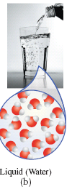
Liquids
Indefinite shape
Definite volume
Only slightly compressible
Particles are mobile, able to move around each other
Particles are held together by strong forces of attraction

Slide 11
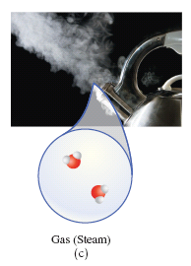
Gases
Indefinite shape
Indefinite volume
Compressible
Particles are far apart and are small compared to the volume they occupy
The attractive forces are so weak that the particles are independent of each other

Slide 12
States of Matter
Solid | Liquid | Gas
Definite shape | Indefinite shape (Takes shape of container) | Indefinite shape (Takes shape of container)
Definite volume | Definite volume | Indefinite (Expands to fill the container)
Incompressible | Slightly compressible | Compressible
Strong attractive forces, so particles are locked in place | Weaker attractive forces so particles can move around freely | Energy of particles are greater than their attractive forces
Rigidly clinging; tightly packed | Mobile; adhering | Independent of each other and far apart

Slide 13
Your Turn!
Which form of water has a definite volume, but no definite shape?
Ice
Liquid water
Steam

Slide 14
Your Turn!
Which form of water has molecules that are held together tightly by very strong intermolecular forces?
Ice
Liquid water
Steam

Slide 15
Your Turn!
Which form of water is compressible?
Ice
Liquid water
Steam

Slide 16
Your Turn!
What physical state is found in the container?
Solid
Liquid
Gas
Copyright 2009 John Wiley & Sons, Inc
1-16

Slide 17
Your Turn!
What physical state is found in the container?
Solid
Liquid
Gas
Copyright 2009 John Wiley & Sons, Inc
1-17

Slide 18
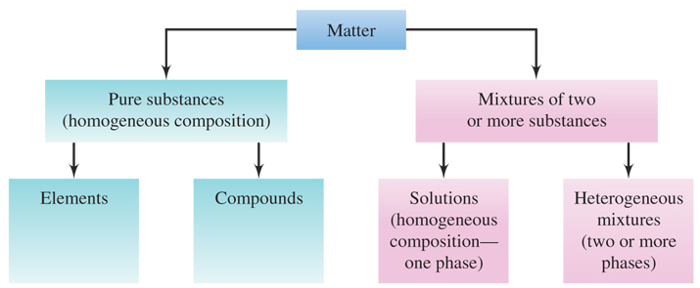
Classifying Matter
Notes:
Figure 1.7 Classification of matter. A pure substance is always homogeneous in composition, whereas a mixture always contains two or more substances and may be either homogeneous or heterogeneous.

Slide 19
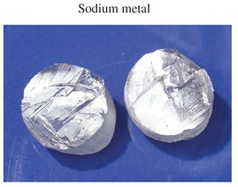
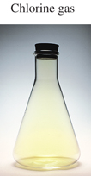
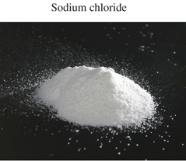
Classifying Matter
A substance has a definite, fixed composition
  Element (Na, Cl₂, Al)
  Compound (NaCl, H₂O, CO₂)
  also called pure substance

Slide 20
Classifying Matter
A mixture has a composition that can be varied
  Solutions are mixtures
  Strong coffee versus weak coffee
  5% salt solutions versus 10% salt solutions

Slide 21
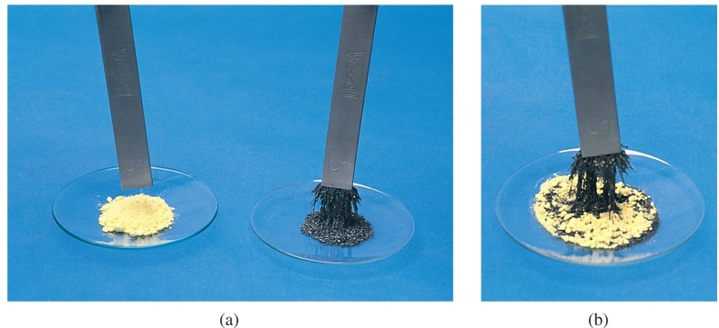
Distinguishing Mixtures from
Pure Substances
Mixtures can be separated by physical means.
(a) When iron and sulfur exist as pure substances, only the iron is attracted to a magnet.
(b) A mixture of Fe and S can be separated by using the difference in magnetic attraction.

Slide 22
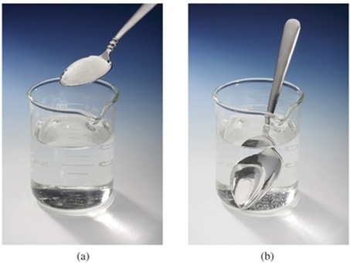
Classifying Matter
Homogeneous matter is uniform in appearance and has the same properties throughout.
Examples:
  Pure substance: Water
  Mixture: Sugar and water
  Solutions are always
  homogeneous mixtures
(a) water is the liquid in the beaker, and the white solid in the spoon is sugar.
(b) Sugar can be dissolved in the water to produce a solution.

Slide 23
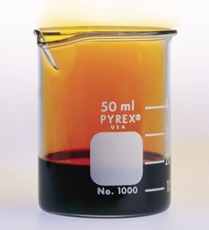
Classifying Matter
Heterogeneous matter consists of two or more physically distinct phases.
A phase is a homogeneous part of a system separated from other parts by physical boundaries.
Examples:
Liquid and gaseous bromine
Pure Substance: liquid and gaseous bromine; iced water
Mixture: Iced tea

Slide 24
Your Turn!
Freshly opened Coke is an example of a
An element
A compound
A homogeneous mixture
A heterogeneous mixture

Slide 25
Your Turn!
Air is an example of a
An element
A compound
A homogeneous mixture
heterogeneous mixture

Slide 26
Your Turn!
A clear, colorless liquid is heat in a beaker until all of the liquid is gone. The walls of the beaker are coated with a white crystalline solid. The liquid was:
An element
A compound
A homogeneous mixture
A heterogeneous mixture

Slide 27
Your Turn!
Which of these is an example of a solution?
Oil and vinegar salad dressing
Iced tea
Lemonade
Iced water

Slide 28
Your Turn!
Which of these is not a pure substance?
Fe
Fe₂O₃
Fe and O₂
All of these are pure substances

Slide 29
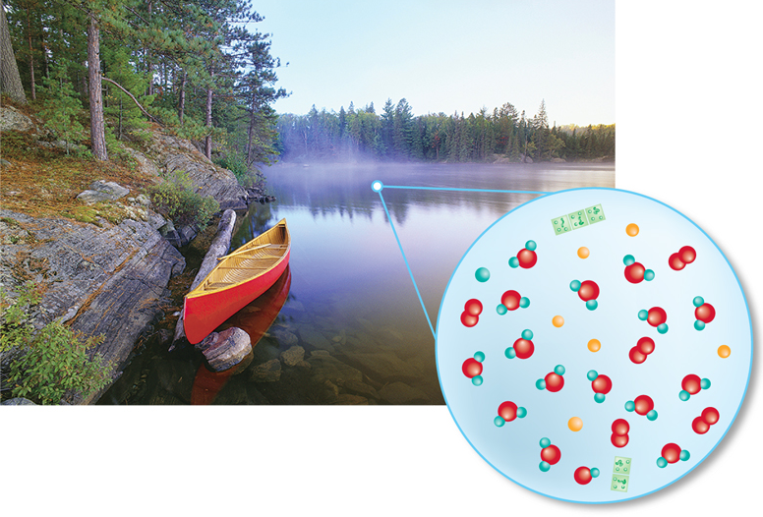
Thinking Like a Chemist
Figure 1.1 Inside a drop of lake water
we find water molecules, dissolved
substances and algae cells.

Slide 30
A Scientific Approach to Problem Solving
Define the problem.
Propose possible solutions.
  Science refers to this as making an hypothesis.
Decide which way to proceed or solve the problem.
  Scientists perform an experiment.

Slide 31
The Scientific Method
Collect the facts or data relevant to the problem.
  Done with carefully designed observations and experimentation.
Formulate a hypothesis that accounts for the data and that can be tested further.
Plan and do additional experiments to test the hypothesis.
Modify the hypothesis as necessary.

Slide 32
Your Turn!
A clear colorless liquid is combined with a second clear colorless liquid and the mixture is observed. Which of these is not an observation?
The test tube became hot.
The reaction is exothermic.
The mixture is cloudy.
The mixture is white.

Slide 33
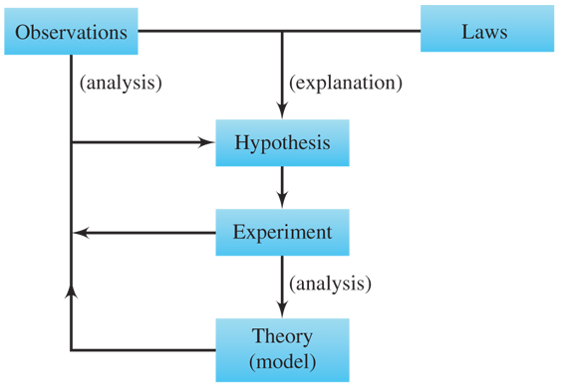
The Scientific Method
Law: Statements of natural phenomena to which there are no known exceptions.
Hypothesis: A tentative explanation of the facts that can be tested further
Theory: Well-tested hypothesis.
Notes:
Figure 1.2 The scientific method

Slide 34
Your Turn!
Which of these is a law?
Atoms consist of protons, neutrons, and electrons.
All matter is composed of atoms.
Atoms can form chemical bonds by sharing electrons.
The volume of a gas increases with increasing temperature.

Slide 35
Your Turn!
The statement, “An atom consists of a dense nucleus surrounded by a cloud of electrons”, is an example of
a theory
a law
an hypothesis
an observation

