Slide 2
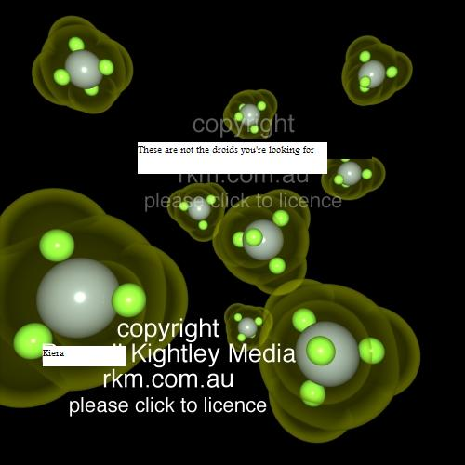
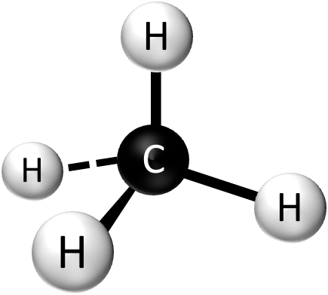
A one nanometer cubed volume of liquid Methane contains 16 molecules of Methane. Each methane molecule has four Hydrogens and one Carbon… Calculate the density of liquid Methane in grams/nm³ and convert to kg/m³
Carbon Atomic Mass = 1.995E-23g
Hydrogen Atomic Mass = 1.674E-24g

Slide 3
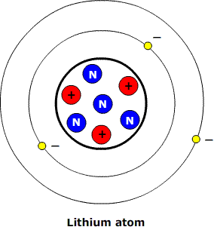
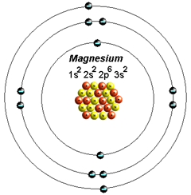
A Lithium atom has 3 protons, 4 neutrons . Orbiting its nucleus are 3 electrons. Its atomic radius is 0.152nm Calculate the density of the lithium atom in g/nm³ Convert this density to g/ml.
A Magnesium atom has 12 protons, 12 neutrons and 12 electrons… its atomic radius is 0.160nm… calculate the density of the Mg atom in g/nm³ . Convert this density to g/ml.
An isotope of the Mg atom has two more neutrons than normal. Assuming it has the same atomic radius, what is the density of this Mg atom?
A commonly observed ion of Mg has 12 protons, 12 neutrons and only 10 electrons. What is the density of this atom? What is the net charge on this atom?
⁼⁼
Neutron mass = 1.675E-24g, Charge = 0
Proton mass = 1.673E-24, Charge = +1
Electron mass = 9.11e-28g, Charge = -1
Volume of Sphere = 4/3 pi radius²

Slide 4
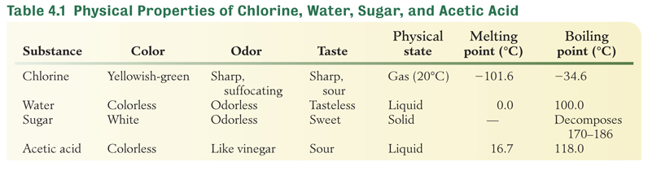
Properties of Matter

Slide 5
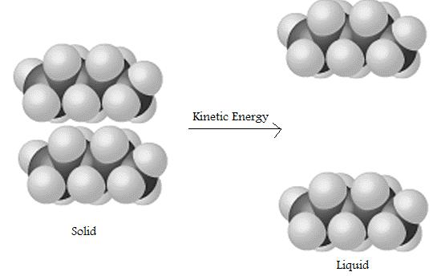
Physical/Chemical Change
In this class we will be concerned with differentiating between two kinds of change, chemical and physical. We will define “physical change” to refer to a change in the state of an atomic or molecular substance that is not associated with a change in the molecular species that compose that substance. This could be a change between solid, liquid and gas phases or it could involve changing between different solid states as discussed with carbon to diamond transitions.
When we looked at a physical change in lab we observed a change from solid to liquid states for long-chain hydrocarbons. In this case the physical change involved adding kinetic energy to the hydrocarbons to overcome attractive interactions that were holding them together.

Slide 6
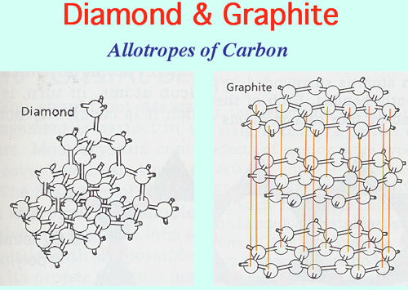
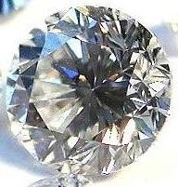

Slide 7
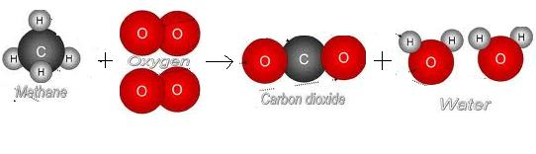
Physical/Chemical Change
As an example of chemical change we looked at the combustion of Hydrocarbons with Oxygen to make Carbon Dioxide and Water. In this case new molecules were made from recombination of the atoms of the old ones. And so the molecular species we end up with are different than the ones we start with. In combustion, electron hungry Oxygen atoms break apart hydrocarbons to form carbon dioxide and water.

Slide 8
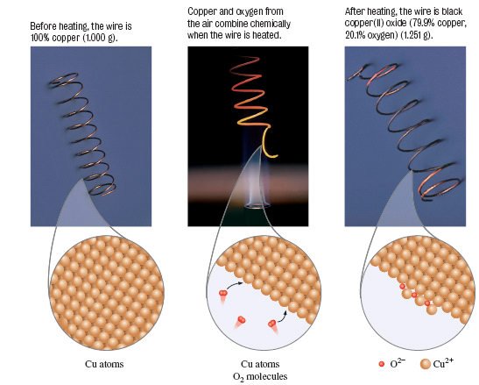
Chemical Change
Notes:
Figure 4.3 Chemical Change: Forming of copper(II) oxide from copper and oxygen.
Before heating, the wire is 100% copper (1.00 g)
Copper and oxygen from the air combine chemically when the air is heated.
After heating, the wire is black copper(II) oxide (1.251 g)

Slide 9
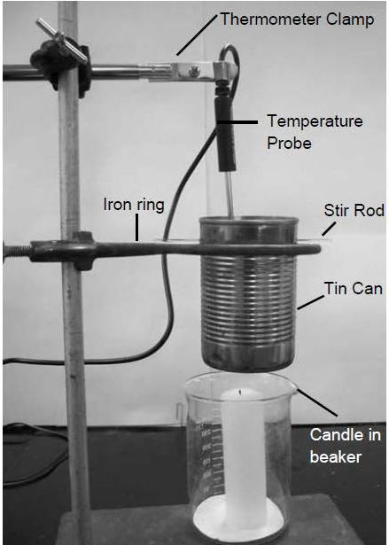
Revisiting Last Weeks Lab
In last weeks lab we calculated the amount of energy released by combusting a mass of hydrocarbons (candle). We made the assumption that all energy from the combustion was transferred to the mass of water in the tin can.
q₁ = mass_{water} x ∆T_{water} x Heat Capacity_{water}
In reality some of the heat was transferred to the tin can as well as to the water inside. To account for that energy as well, we would need to add another term to the calculation for the energy that went into the body of tin.
q₂ = mass_{tin} x ∆T_{tin} x Heat Capacity_{tin}
If a candle heats a 150g mass of water by 20⁰ C in a 50g tin can that is also heated by 20⁰ C, how much energy was released by the candle (joules)? If the mass of the candle was 0.5g, what is the heat of combustion of the wax in Joules/gram?
Heat Capacity_{water} = 4.184 Joules/g⁰ C
Heat Capacity_{tin} = 0.21 Joules/g⁰ C

Slide 10
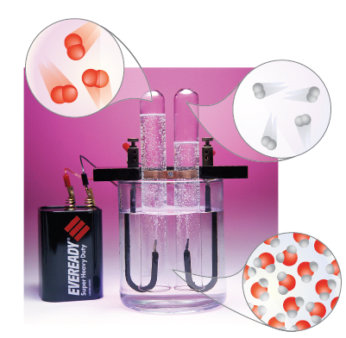
Electrolysis of Water
Notes:
Figure 4.4 Electrolysis of water produces hydrogen gas (on the right side) and oxygen gas (on the left). Note the ratio of the gases is 2.1.

Slide 11
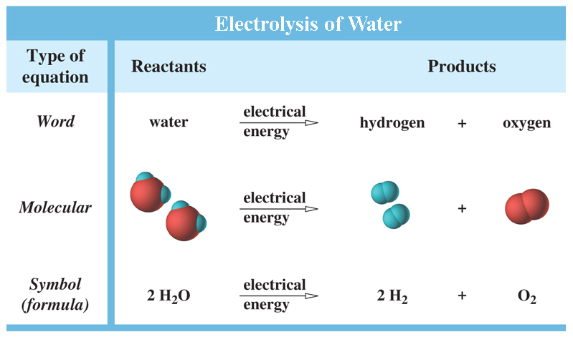
Chemical Equations
A chemical equation is a shorthand for expressing chemical changes.

Slide 12
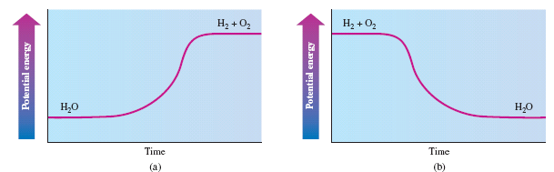
Conservation of Energy
The law of conservation of energy: Energy can be neither created nor destroyed, though it can be transformed from one form to another.

Slide 13
Energy
Energy can be converted from one form to another
Mechanical
Chemical
Electrical
Heat
Nuclear
Light
In chemistry, energy is most frequently released as heat.

Slide 14
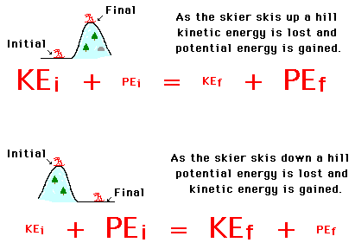
Kinetic and Potential Energy
Kinetic Energy is the energy possessed by and object due to its motion. KE = ½ mv²
Potential Energy is the energy an object has due to its position in a field. While we most commonly think of potential energy stored in a gravitational field, potential energy can be due to a charged objects position within an electric field.
The chemical potential energy stored in molecules can be thought of as the potential energy of electrons in the electric field caused by their attraction to positively charged nuclei.
When electrons fall through an electrical field they release potential energy that was stored in the electric field as electromagnetic waves.

Slide 15
The Nature of Electric Charge
Charge may be of two types: positive and negative.
Unlike charges attract and like charges repel.
Charge may be transferred by contact or induction.
Force of attraction between ions is
  Reduced by distance between charges (r)
  Increased by increasing charge (q)
where k is a constant.

Slide 16
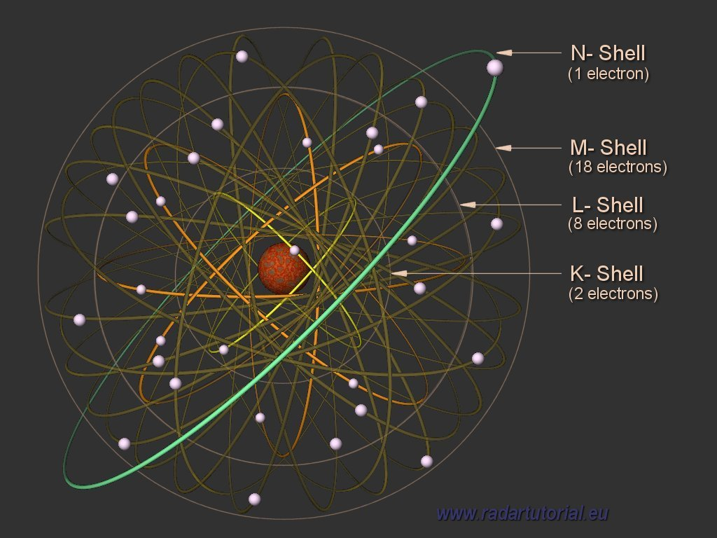

Slide 17
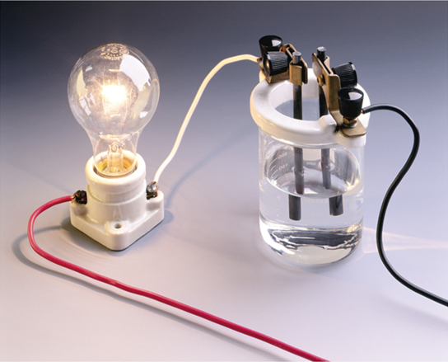
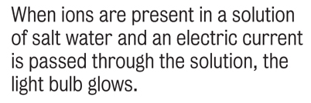
Discovery of Ions
Michael Faraday (1791-1867)
Discovered that compounds dissolved in water contain charged particles.
These charged particles conduct electricity.
Coined the term “ion” from the
Greek word “wanderer.”

Slide 18
Discovery of Ions
Svante Arrhenius (1859-1927)
He reasoned that an ion is an atom carrying a positive or negative charge.
Both positive and negative ions are present in a compound so the molten compound conducts electricity.
Cations move toward negative electrode (cathode)
Anions move toward positive electrode (anode)

Slide 19
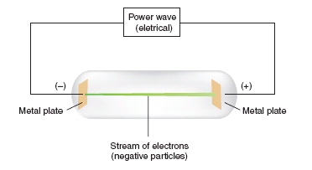
Subatomic Parts of the Atom
Cathode Rays (Electrons)
Discovered by J. J. Thomson in 1897
Travel in straight lines
Are negatively charged
Are deflected by electrical and magnetic fields
Notes:
Figure 5.3 Cathode ray tube. A stream of electrons passes between electrodes. The fast moving particles excite the gas inside the tube creating a greenish glow between the electrodes.

Slide 20
Electrons
The electron (e⁻) is a particle with
a mass of 9.110×10⁻²⁸ g or 1/1837 mass of a hydrogen atom.
a relative charge of -1.
a diameter of less than 10⁻¹² cm.

Slide 21
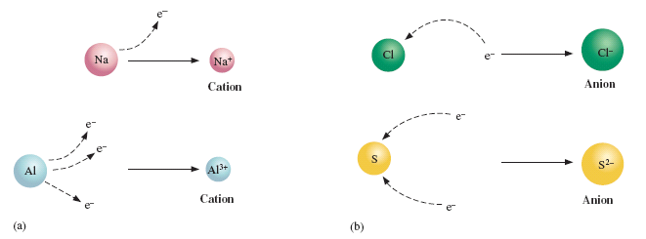
Subatomic Parts of the Atom
J. J. Thompson proposed that ions result from the loss and gain of electrons
Notes:
Figure 5.5 (a) When one or more electrons are lost from an atom, a cation is formed. (b) When one or more electrons are added to a neutral atom, an anion is formed.

Slide 22
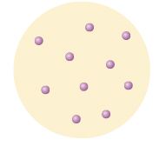
Subatomic Parts of the Atom
Protons
A relative charge of +1.
Mass is 1837 times the mass of an electron.
Thompson’s Plum Pudding Model (proposed in 1904)
Notes:
Figure 5.4 Thompson’s Model of the Atom In this early model of the atom, negative particles (electrons) were thought to be embedded in a positively charged sphere. It is sometimes called the plum pudding model.

Slide 23
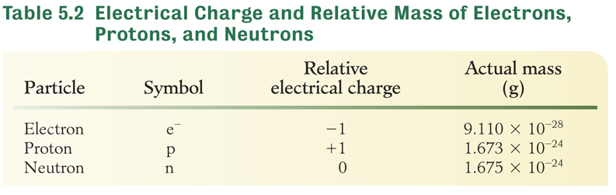
Subatomic Parts of the Atom
Neutrons
Discovered by James Chadwick in 1932.
Neutral charge

Slide 24
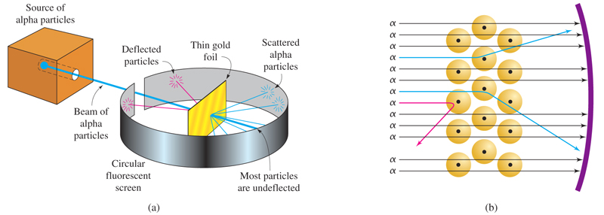

The Nuclear Atom

Slide 25
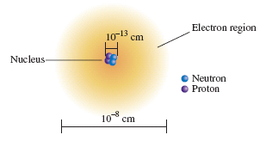
Nuclear Atom
Protons and neutrons make up the dense, positive nucleus.
Electrons occupy the empty space outside the nucleus.
A neutral atom contains the same number of electrons and protons.
Notes:
Figure 5.7 In the nuclear model of the atom, protons (p) and neutrons (n) are located in the nucleus. The electrons are found in the remainder of the atom (which is mostly empty space because electrons are very tiny).

Slide 26
Atomic Number of the Elements
The atomic number of an element is the number of protons in the nucleus.
The atomic number determines the identity of the element.
Example: Sodium has an atomic number of 11 so every sodium atom has 11 protons.
Since a neutral atom of Na has 11 protons, it also has 11 electrons.

Slide 27
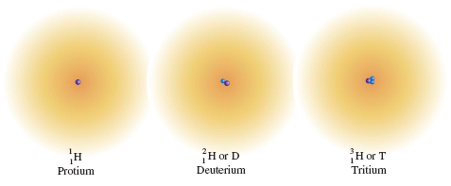
Isotopes of the Elements
Isotopes are atoms of an element with the same atomic number but different masses.
Isotopes have different numbers of neutron.
The mass number is the sum of protons and neutrons.
Notes:
Figure 5.8 The isotopes of hydrogen. The number of protons (purple) and neutrons (blue) are shown within the nucleus. The electron (e⁻) exists outside the nucleus.

Slide 28
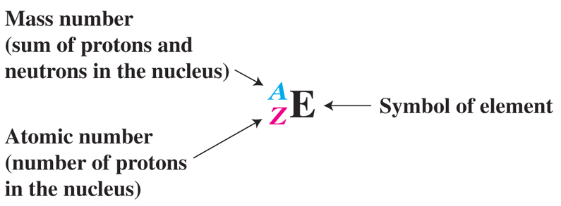
Isotopic Notation
Phosphorus-31 is the only stable P isotope.
The neutral atom has 15 protons and 15 electrons.
Number of neutrons = 31 - 15 = 16

Slide 29
Isotopes
Complete the table:
Element | Symbol | Atomic No. | Mass No. | No. of Protons | No. of Electrons | No. Of Neutrons
chlorine
17
37
17
17
20
lead
82
204
82
82
122
argon
18
38
18
18
20

