Slide 1
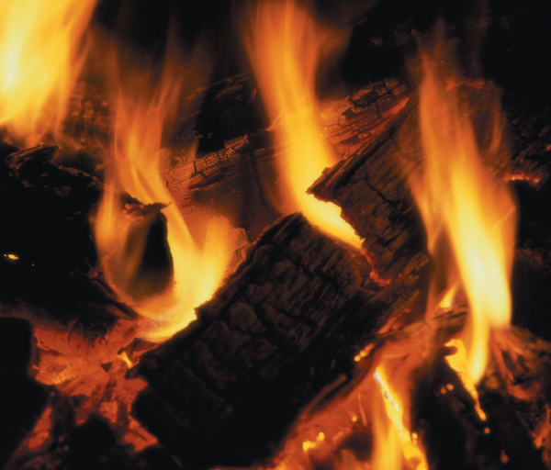
Chapter 4
Properties of Matter
A burning log undergoes chemical change resulting in the release of energy in the form of heat and light. The physical properties of the log change during the chemical reaction.
Introduction to General, Organic, and Biochemistry 10e
John Wiley & Sons, Inc
Morris Hein, Scott Pattison, and Susan Arena

Slide 2
Chapter Outline
4.1 Properties of Substances 4.2 Physical Changes 4.3 Chemical Changes 4.4 Conservation of Mass 4.5 Learn to Solve Problems 4.6 Energy | 4.7 Heat: Quantitative Measurement 4.8 Energy in Chemical Changes 4.9 Conservation of Energy 4.10 Energy in the Real World

Slide 3
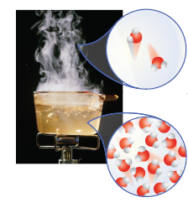
Properties of Substances
Physical Properties can be determined without changing the substance’s chemical composition.
Notes:
Figure 4.1 Physical property: The boiling point of water is a physical property. At its boiling point water changes from a liquid to a gas but the molecules remaing water molecules. They are still water but are further apart.

Slide 4
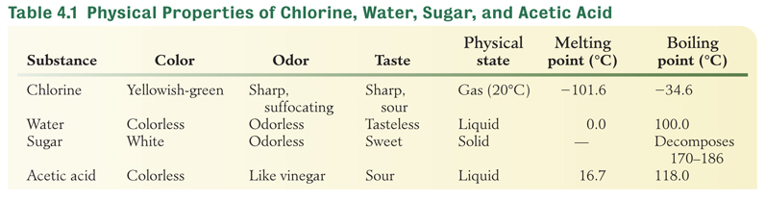
Properties of Matter

Slide 5
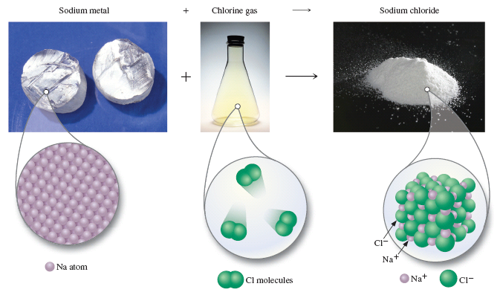
Properties of Substances
Chemical Properties describe the substance’s ability to react and to form new substances.
Notes:
Figure 4.2 Chemical Property. When sodium metal reacts with chlorine gas a new substance called sodium chloride forms.

Slide 6
Your Turn!
Which is not a physical property of aluminum?
Aluminum is silver and has luster.
The melting point of aluminum is 660º C.
Aluminum reacts with acid to produce an aluminum salt and hydrogen gas.
The density of aluminum at 25º C is 2.70 g/cm³.

Slide 7
Your Turn!
Which property of acetone is a chemical property?
The specific gravity of acetone is 0.79.
The boiling point of acetone is 56°C.
Acetone is a clear, colorless liquid
Acetone is a flammable liquid.

Slide 8
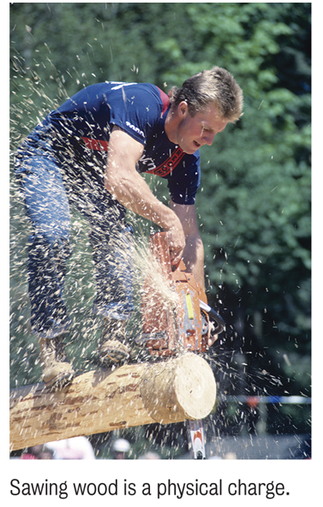
Physical Changes
Physical Changes are changes in physical properties or changes in state with no change in chemical composition.

Slide 9
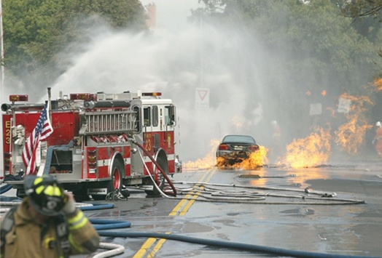
Chemical Changes
Chemical Changes involve the formation of new substances with new chemical and physical properties.
Combustion of gasoline is a chemical change.

Slide 10
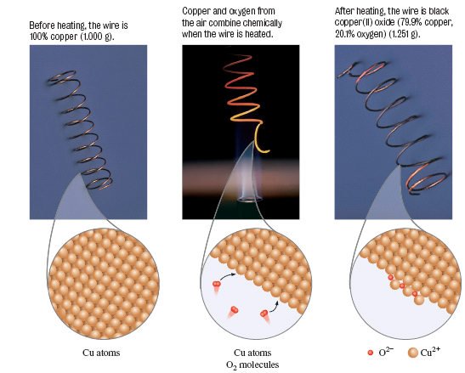
Chemical Change
Notes:
Figure 4.3 Chemical Change: Forming of copper(II) oxide from copper and oxygen.
Before heating, the wire is 100% copper (1.00 g)
Copper and oxygen from the air combine chemically when the air is heated.
After heating, the wire is black copper(II) oxide (1.251 g)

Slide 11
Your Turn!
Chemical changes always involve changes in which of the following?
Chemical composition
Physical properties
Chemical properties
All of the above

Slide 12
Chemical Change
Which of the following observations is not a chemical change?
converting coal (coal is a form of carbon) to carbon dioxide
converting hydrogen to water (water is H₂O)
converting iron to steel (steel is an alloy of iron)
converting sulfur to acid rain (acid rain contains H₂SO₄)

Slide 13
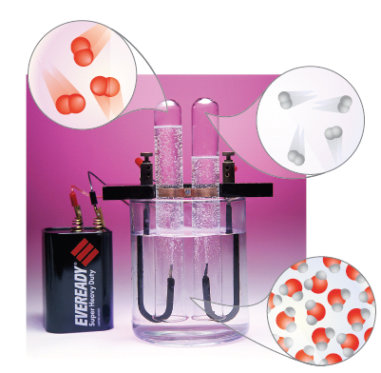
Electrolysis of Water
Notes:
Figure 4.4 Electrolysis of water produces hydrogen gas (on the right side) and oxygen gas (on the left). Note the ratio of the gases is 2.1.

Slide 14
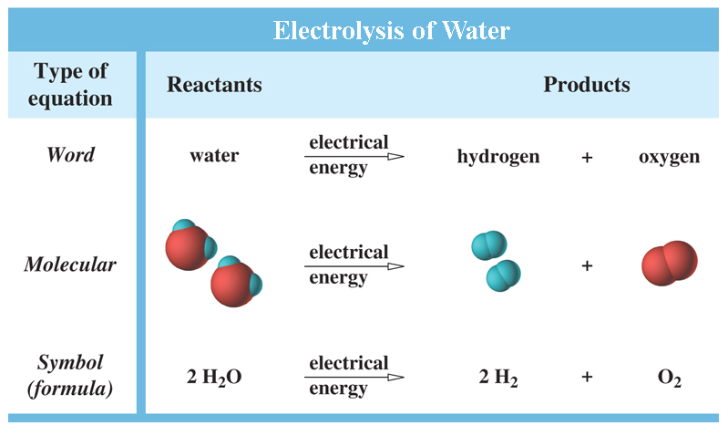
Chemical Equations
A chemical equation is a shorthand for expressing chemical changes.

Slide 15
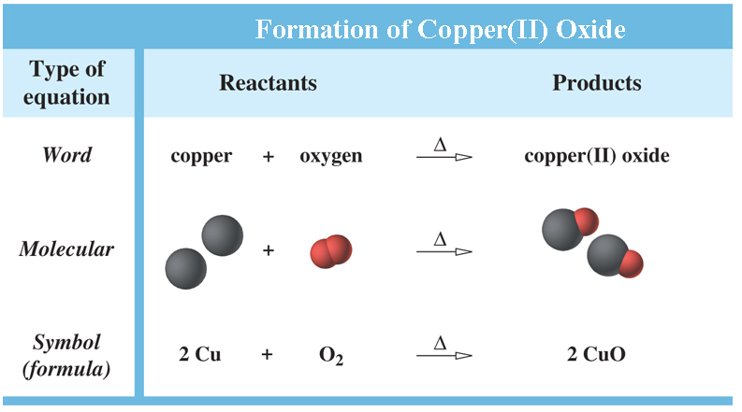
Chemical Equations
The reactants are the starting substances.
The products are the substances produced in the reaction.

Slide 16
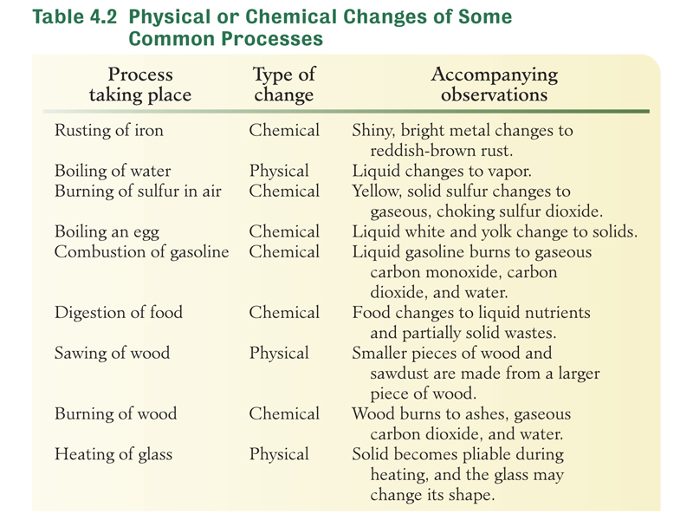
Chemical and Physical Changes

Slide 17
Your Turn!
Which is a chemical change?
A. Corrosion of steel
B. Freezing water
C. Evaporating gasoline
D. Forming fog

Slide 18
Your Turn!
Which is a chemical change?
Dry ice sublimes
A penny tarnishes
Ice cream melts
Rock is ground into sand

Slide 19
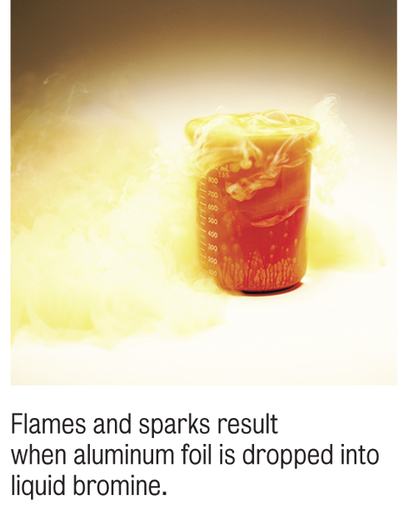
Conservation of Mass
The law of conservation of mass states that no change is observed in the total mass of the substances involved in a chemical change.
2Al_{(s)} + 3Br_{2(l)} → 2AlBr_{3(s)}
5.4g Al + 47.9g Br₂ → 53.3g AlBr₃
53.3g reactant → 53.3g product
mass of reactants = mass of products

Slide 20
Your Turn!
Carbon, when burned completely, forms carbon dioxide. If 11.7g of carbon combines with 31.3g of oxygen, what mass of carbon dioxide will be produced?
11.7g
19.6g
31.3g
43.0g

Slide 21
Learning to Solve Problems
The steps in solving problems successfully include
Read the problem carefully. Determine what is known and what is to be solved for.
Plan your strategy. Determine which principles are involved and what unit relationships are needed.
Setup your work logically, being sure that all unwanted units cancel.
Calculate and check your answer for appropriate significant figures.
Check your answer to be sure it is reasonable.

Slide 22
Energy
Energy is the capacity to do work.
Potential energy (PE) is stored energy, or energy due to position.
Burning gasoline: Energy stored in chemical bonds converted to kinetic energy.
Kinetic energy (KE) is energy associated with motion.
Steam at 100°C has more kinetic energy than water vapor at 25°C because the gas molecules are moving faster at the higher temperature.

Slide 23
Energy
Energy can be converted from one form to another
Mechanical
Chemical
Electrical
Heat
Nuclear
Light
In chemistry, energy is most frequently released as heat.

Slide 24
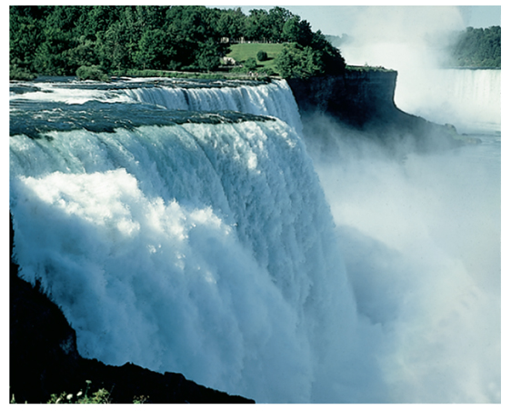
Energy Transformations
The mechanical energy of falling water is converted to electrical energy at the hydroelectric plant at Niagara Falls.
As the water falls potential energy is converted to kinetic energy and turns a turbine to produce electrical energy.

Slide 25
Your Turn!
What happens to the kinetic energy of a particle when a gas is heated?
Kinetic energy increases
Kinetic energy decreases
Kinetic energy remains constant
Depends on the gas

Slide 26
Energy Units
The SI unit for energy is the joule (J).
A commonly used unit for heat is the calorie (cal).
4.184 joules = 1 cal (exactly)
1 calorie or 4.184 J is the amount of heat needed to change the temperature of 1gram of H₂O 1°C.
Since joules and calories are so small we usually use kilojoules and kilocalories.
1kilojoules (kJ) = 1000 J
1 kcal = 1000 cal = 1 nutrition Calorie (Cal)

Slide 27
Conversions Between Units
How many kilojoules of energy are found in a 350 Calorie (350 kcal) frozen dinner?
Solution map: kcal → cal → J → kJ
Three conversion factors are needed:

Slide 28
Your Turn!
Which of the following terms defines the amount of energy required to raise one gram of water one degree on the Celsius scale?
1 calorie
1 Calorie
1 Kilocalorie
1 Joule
None of the above

Slide 29
Heat and Temperature
Imagine warming 2 different sized samples of Cu from 25°C to 100°C. The larger sample will require more energy (heat).
Temperature is a measure of the intensity of the thermal energy (or how hot a system is) and is independent of the quantity of the Cu.
The amount of heat needed for the temperature change depends on the quantity of substance and the magnitude of the temperature change.
Cu
10 g at 25°C
Cu
50 g at 25°C

Slide 30
Heat: Quantitative Measurement
Specific Heat is the amount of energy needed to change the temperature of 1 gram of a substance 1°C.
2 blocks are the same mass and are 25°C. Heat is consistently applied both. The block of copper ends up with a higher temperature than the block of iron. Why?
Cu has a lower specific heat than Fe, so less energy is required to change its temperature.
Fe
Cu
heat
Notes:
Specific heat of Cu = .385 J/g°C
Specific heat of iron = .473 J/g°C

Slide 31
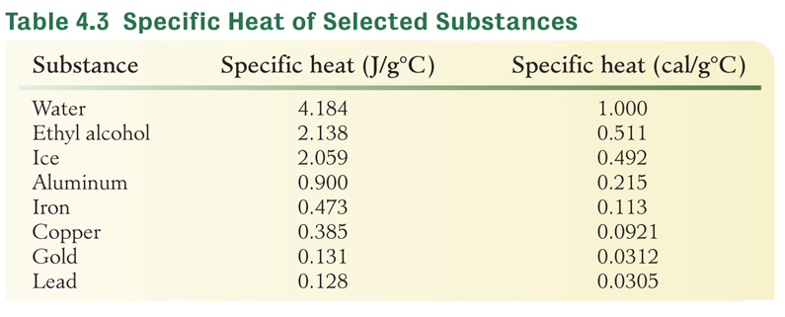
Heat: Quantitative Measurement
heat = mass × specific heat × Δt where Δt = T_{final} - T_{initial}
Why does the weather near the coast rarely exhibit extremely hot or cold temperatures?

Slide 32
Your Turn!
The specific heat of iron is 0.473 J/g^{º}C and the specific heat of lead is 0.128 J/g^{º}C. In order to raise the temperature of one gram of those metals by one degree Celsius
Both metals require the same amount of energy
The iron requires more energy than the lead
The lead requires more energy than the iron
No correct answer is given

Slide 33
Heat: Quantitative Measurement
Calculate the heat released as 55.2 g of copper (.385 J/g°C) cools from 85.0°C to 22.0°C.
heat = mass x specific heat x Δt
Heat change = 55.2 g × .385 J/g°C × (22.0-85.0)°C
Heat change = -1340 J
The negative value means that the copper lost energy, or energy was released to the surroundings.

Slide 34
Heat: Quantitative Measurement
A 208-g sample of a metal requires 1.75 kJ to change its temperature from 28.2°C to 89.5°C. What is the specific heat of this metal?

Slide 35
Heat: Quantitative Measurement
A 59.23-g sample of an unknown, silver, pure metal was heated to 98.9°C and then put into110.5-g of water at 24.3°C. The water was heated by the hot metal to a temperature of 26.4°C. What is the specific heat of the metal?
 | Solid | Water
mass | 59.23 g | 110.5 g
Specific heat | unknown | 4.18 J/g°C
Δt | (26.4-98.9) °C | (26.4-24.3)°C

Slide 36
Heat: Quantitative Measurement
Heat gained by the water:
110.5 g × 4.18 J/g°C × (26.4-24.3)°C = 970. J
Heat lost by solid = heat gained by water = -970. J
 | Solid | Water
mass | 59.23 g | 110.5 g
Specific heat | unknown | 4.18 J/g°C
Δt | (26.4-98.9) °C | (26.4-24.3)°C
Notes:
A 59.23-g sample of an unknown, silver, pure metal was heated to 98.9°C and then put into a coffee-cup calorimeter containing 110.5-g of water at 24.3°C. The water was heated by the hot metal to a temperature of 26.4°C. What is the specific heat of the metal?

Slide 37
Your Turn!
The specific heat of iron is 0.473 J/g^{º}C. How much energy is required to heat a 40.0 g sample of iron from 35.0ºC to 75.0ºC?
757 J
2080 J
6690 J
1320 J

Slide 38
Energy in Chemical Changes
In all chemical changes, matter either absorbs or releases energy.
Chemical reactions can be used to produce different forms of energy.
  We burn wood to produce heat and light.
  Chemical reactions in the car battery produce the electricity needed to start our cars.

Slide 39
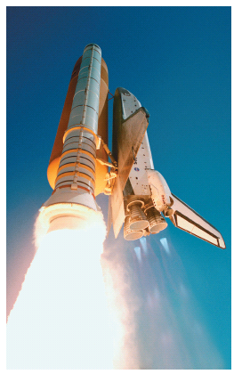
Energy in Chemical Changes
Chemical changes are often used to produce energy.
Notes:
Figure 4.5 One of the chemical changes helping to power the space shuttle is 2H₂ + O₂→ 2H₂O

Slide 40
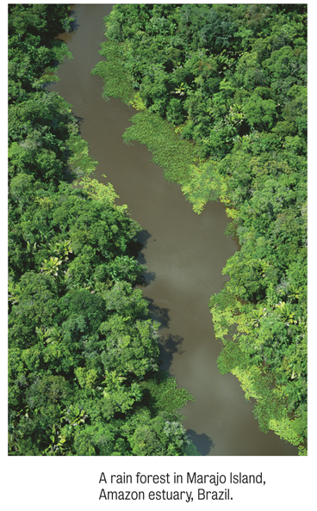
Energy in Chemical Changes
Energy can be used to cause chemical reactions.
Photosynthesis
Electrolysis

Slide 41
Your Turn!
Which of the following processes release energy?
Walking
Gasoline burning in our car engines
Dehydrating grapes to make raisons
Blowing up a balloon

Slide 42
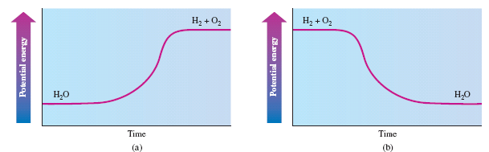
Conservation of Energy
The law of conservation of energy: Energy can be neither created nor destroyed, though it can be transformed from one form to another.

Slide 43
Energy Changes
Changes to a system that require energy have positive energy values meaning that the system gains energy.
Changes to a system that release energy have negative values because the system lost energy in the process.
For example, burning paper would have a negative energy value because the system loses energy as heat.
Boiling water would have a positive energy value because the system has to gain energy to boil the water.

Slide 44
Your Turn!
Which of the following processes result in the system losing energy and having negative energy values?
arctic ice melting
dry ice changing to vapor
starting a car
dynamite exploding

Slide 45
Your Turn!
Which of the following physical changes does not require energy to take place?
Evaporation
Melting
Condensation
Sublimation

Slide 46
Energy in the Real World
Chemical reactions in the sun produce the heat and light our planet needs to survive.
Plants use photosynthesis to store energy from the sun.
Plants decay and eventually produce fossil fuels (after millions of years).
We burn fossil fuels to do work.

Slide 47
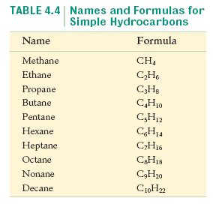
Energy in the Real World
Petroleum is composed of hydrocarbons.
Natural gas is usually a mixture of methane with small amounts of ethane propane and butane.
Coal is essentially carbon. It provides roughly 20% of US energy needs.

Slide 48
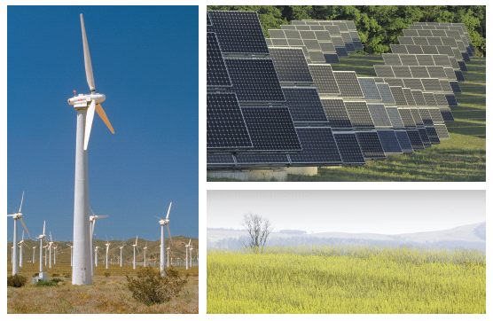
Exploring Other Energy Resources

Slide 49
Your Turn!
According to the law of conservation of energy, energy can be
Created
Destroyed
Created and destroyed
Converted from one form to another

