Slide 1

Chapter 3
Elements and Compounds
This reclining
Buddha in the Grand Palace in Bangkok, Thailand, is made of gold.
Introduction to General, Organic, and Biochemistry 10e
John Wiley & Sons, Inc
Morris Hein, Scott Pattison, and Susan Arena

Slide 2
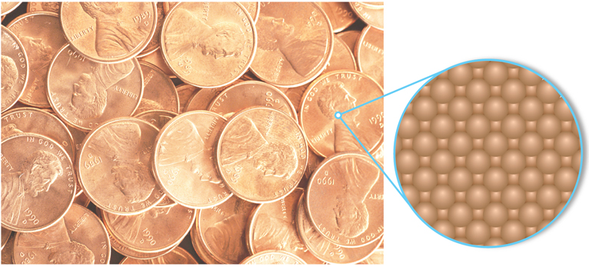
Elements
An atom is the smallest particle of an element that can exist.
Notes:
Figure 3.1 The surface of a penny is made up of tiny identical copper atoms packed tightly together.

Slide 3
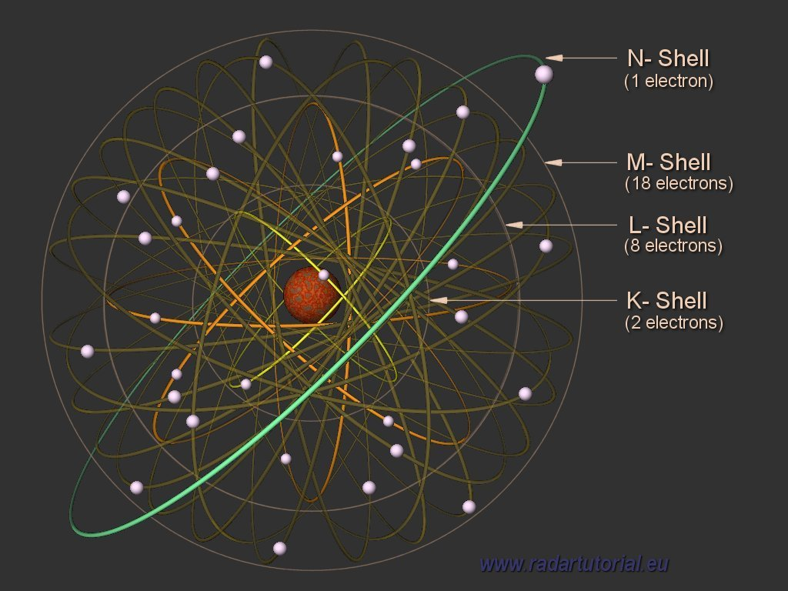
Copper Nucleus and Electrons

Slide 4
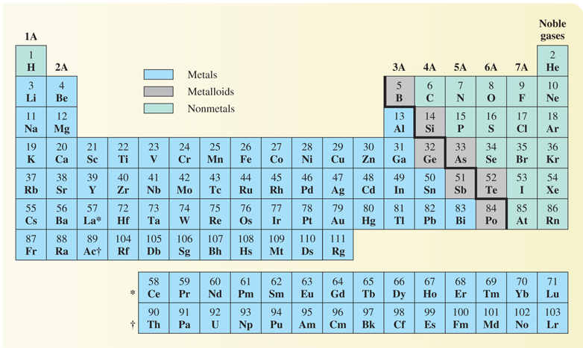
The Periodic Table lists all known elements in logical order. Each subsequent element has one more proton and one more electron than the previous element.

Slide 5
Elements
An element is a fundamental substance that cannot be broken down by chemical means to simpler substances.
When we say “element” we are implying that we have a substance composed of one type of atom. These atoms can exist as individual atoms or paired atoms depending on the atom type involved.
There are 118 known elements.
All but 4 of the first 92 elements occur in nature.
All elements beyond 92 except for plutonium (94) are man made.

Slide 6
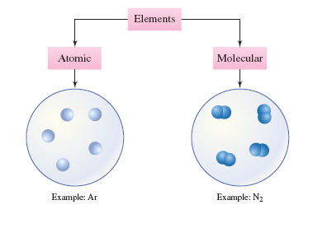
Elements

Slide 7
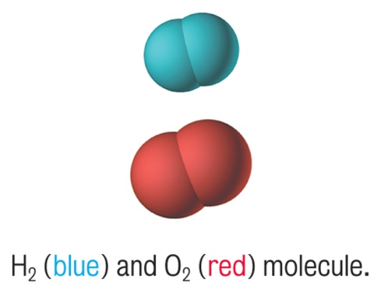
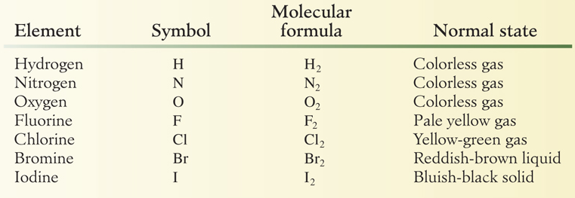
Elements That Exist as
Diatomic Molecules
Diatomic molecules each contain exactly two atoms.
There are 7 diatomic elements.

Slide 8
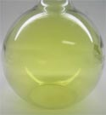
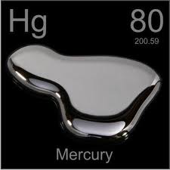
Elements at Standard Temperature and Pressure
Gasses:
Hydrogen, Nitrogen, Oxygen, Fluorine, Chlorine, Helium, Neon, Argon, Krypton, Xenon and Radon
Liquids:
Bromine and Mercury
Solids:
All others
Chlorine

Slide 9
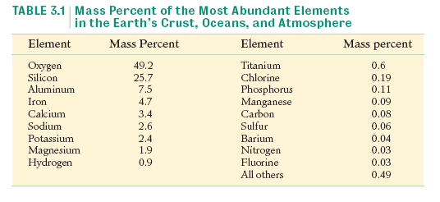
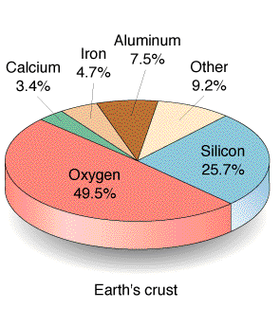
Distribution of Elements

Slide 10
Your Turn!
The most abundant element in the earth’s crust, oceans, and atmosphere is
A. Water
B. Hydrogen
C. Iron
D. Oxygen

Slide 11
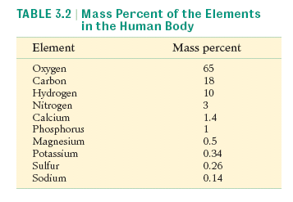
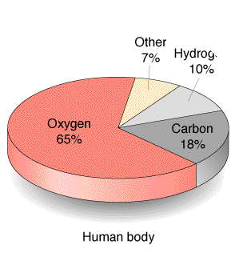
Distribution of Elements

Slide 12
Names of the Elements
The names of the elements are derived from a variety of sources:
Iodine comes from Greek iodes, which means violetlike.
Bismuth comes from the German weisse masse, which means white mass.
Germanium was named for Germany, where it was discovered.

Slide 13
Symbols of the Elements
Rules for symbols of elements
Symbols have either one or two letters.
If one letter is used, it is capitalized.
If two letters are used, only the first is capitalized.
N nitrogen I iodine Ni nickel
C carbon O oxygen Co cobalt

Slide 14
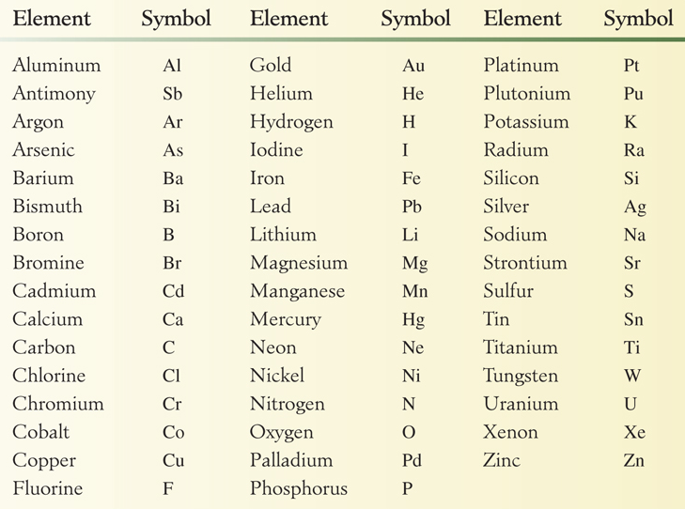
Symbols of Common Elements
Notes:
Table 3.3 Symbols of the most common elements

Slide 15
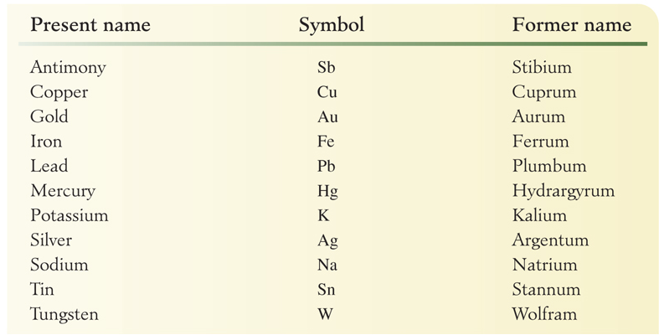
Symbols of Elements
Derived from Early Names
Notes:
Table 3.4 Symbols of the elements derived from early names

Slide 16
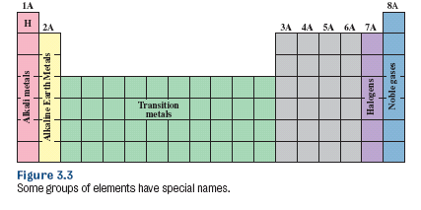
Introduction to the Periodic Table
Elements are arranged in order of increasing atomic number.
Elements within a group have similar properties.
The representative elements are groups IA-VIIA and the noble gases.

Slide 17
Your Turn!
The element potassium is in the first group on the Periodic Table (group IA). Potassium is
an alkali metal
an alkaline earth metal
a transition element
a halogen

Slide 18
Your Turn!
The elements on the periodic table are placed in order of increasing
Density
Atomic number
Boiling point
Atomic mass

Slide 19
Metals, Nonmetals and Metalloids
Notes:
Table 3.5 The Periodic Table

Slide 20
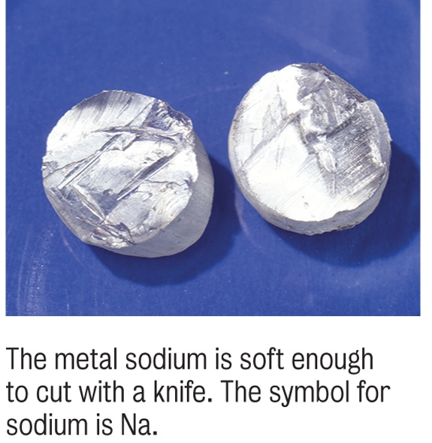
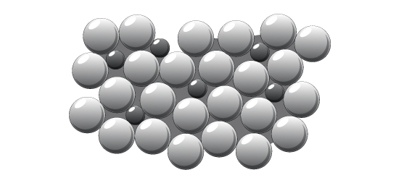
Classifying Elements: Metals
Some properties of metals:
Lustrous
Malleable
Conduct heat and electricity
Ductile
High density
High melting point
Combine with each other to make alloys.

Slide 21
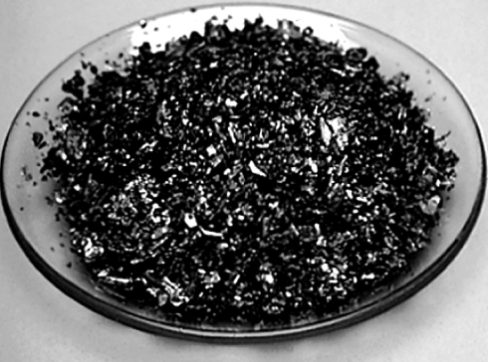
Classifying Elements: Nonmetals
Some properties of nonmetals:
Dull (if solid)
Brittle (if solid)
Poor conductors of heat and electricity
Non-Ductile
Low density
Low melting point
Combine to make Molecular Compounds
Iodine crystals

Slide 22
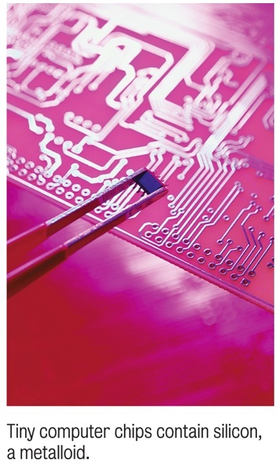
Classifying Elements: Metalloids
Metalloids have properties that are intermediate between those of metals and those of nonmetals.
Some are used to make the semiconductors we need for computer chips.

Slide 23
Your Turn!
A solid sample of an unknown element is dull and brittle and does not conduct heat or electricity. How should the element be classified?
Metal
Nonmetal
Metalloid
Transition element

Slide 24
Your Turn!
The majority of the elements are
Metals
Gases
Nonmetals
Metalloids

Slide 25
Your Turn!
Which is not a metalloid?
Boron (B)
Silicon (Si)
Germanium (Ge)
Aluminum (Al)

Slide 26
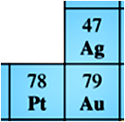
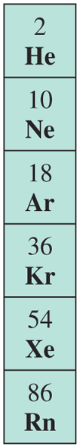
Elements in Their Natural States
Most elements are found as compounds in nature because they are very reactive.
The noble metals (gold, silver and platinum) are nonreactive and are found as elements in nature.
The noble gases are the least reactive elements and are found in uncombined form.

Slide 27
Your Turn!
Which of the following is not a diatomic element?
Fluorine
Oxygen
Nitrogen
Carbon

Slide 28
Your Turn!
Which of the following metals is not a solid at room temperature?
Iron
Aluminum
Chromium
Calcium
Mercury

Slide 29
Your Turn!
Which of the following nonmetals is not reactive?
Helium
Fluorine
Oxygen
Carbon

Slide 30
Compounds
Compounds are composed of two or more elements combined in a definite proportion by mass.
Elements are always combined in whole number ratios. Al₂O₃ KNO₃ CaCl₂
Can be decomposed chemically into simpler substances.
Each compound has unique properties that are different from the elements that make it up.

Slide 31
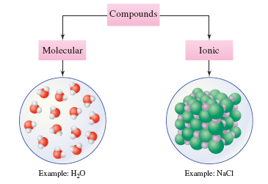
Compounds

Slide 32
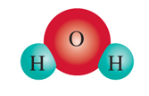

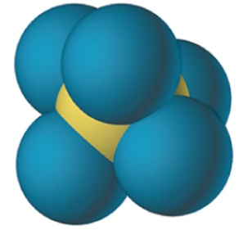
Molecules
A molecule is the smallest uncharged individual unit of a compound.
Usually composed of two or more nonmetals.
Can be solids, liquids or gases.
Do not conduct electricity.
H₂O
H₂O₂
PCl₅

Slide 33
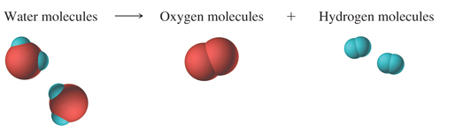
Water
Water molecules can be decomposed into oxygen molecules and hydrogen molecules.
The properties of water are very different from the properties of oxygen gas and hydrogen gas.
Notes:
Figure 3.7 A representation of the decomposition of water into oxygen and hydrogen molecules.

Slide 34
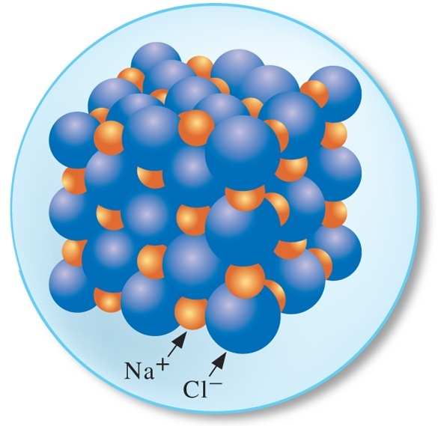
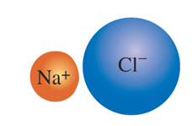
Ionic Compounds
Contain ions (charged particles).
Compounds are held together by the attractive forces between the cations (positive ions) and the anions (negative ions).
Formulas are the simplest whole number ratio of each element.
Solids at room temperature.
Conduct electricity when molten.
Are formed by combination of a metal and a non-metal.
NaCl

Slide 35
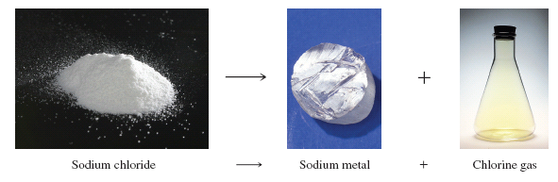
Sodium Chloride
The properties of sodium chloride are very different from the properties of sodium metal and chlorine gas.
2NaCl_{(s)} 2Na_{(s)} + Cl_{2(g)}
Figure 3.8 When sodium chloride (a) is decomposed,
it forms sodium metal (b) and chlorine gas (c).

Slide 36
Your Turn!
Which of the following is true?
Metals form anions with negative charges.
Metals form anions with positive charges.
Metals form cations with positive charges.
Metals form cations with negative charges.

Slide 37
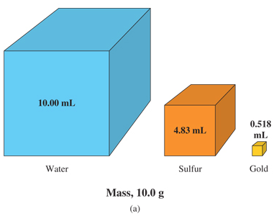
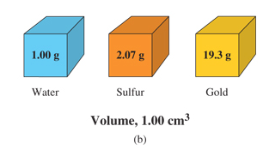
Density
Density is a physical characteristic of a substance that can be used in its identification.
Density is temperature dependent. For example, water
d^{4°C} = 1.00 g/mL but d^{25°C} = 0.997 g/mL.
Which substance is the most dense?
Water is at 4°C; the two solids at 20°C.
Notes:
Figure 2.6 (a) Comparison of the volumes of equal masses (10.0 g) of water, sulfur and gold.
(b) Comparison of the masses of equal volumes (1.00 cm³) of water, sulfur and gold.
Water is at 4°C; the two solids at 20°C.

Slide 38
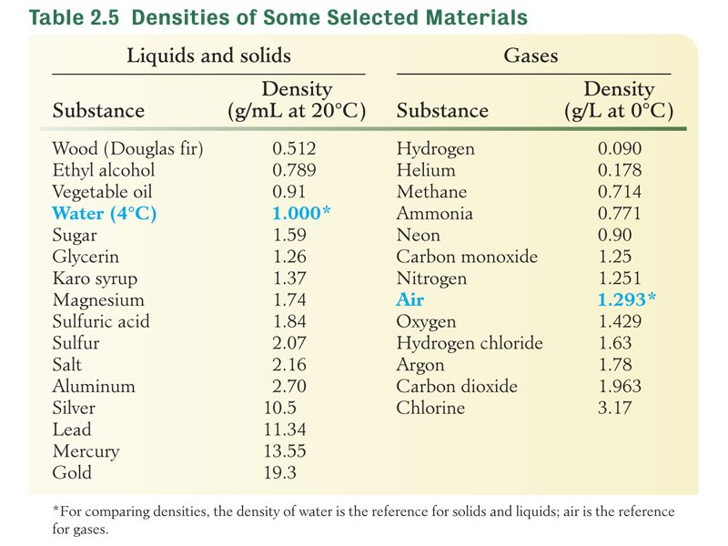
Density

Slide 39
Density by H₂O Displacement
If an object is more dense than water, it will sink, displacing a volume of water equal to the volume of the object.
A 34.0 g metal cylinder is dropped into a graduated cylinder. If the water level increases from 22.3 mL to 25.3 mL, what is the density of the cylinder?
First determine the volume of the solid:
Next determine the density of the solid:

Slide 40
Density Calculations
Determine the mass of 35.0 mL of ethyl alcohol. The density of ethyl alcohol is 0.789 g/mL.
Approach 1: Using the density formula
Solve the density equation for mass:
Substitute the data and calculate:

Slide 41
Density Calculations
Determine the mass of 35.0 mL of ethyl alcohol. The density of ethyl alcohol is 0.789 g/mL.
Approach 2: Using dimensional analysis
Solution map: mL → g
35.0 mL

Slide 42
Your Turn!
Osmium is the most dense element (22.5 g/cm³). What is the volume of 225 g of the metal?
10.0 cm³
10 cm³
5060 cm³
0.100 cm ³

Slide 43
Your Turn!
A 109.35 g sample of brass is added to a 100 mL graduated cylinder with 55.5 mL of water. If the resulting water level is 68.0 mL, what is the density of the brass?
1.97 g/cm³
1.61 g/cm³
12.5 g/cm³
8.75 g/cm³

Slide 44
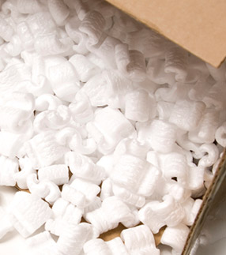
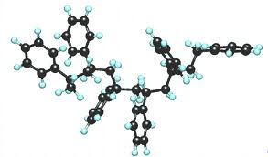
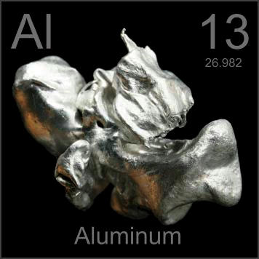
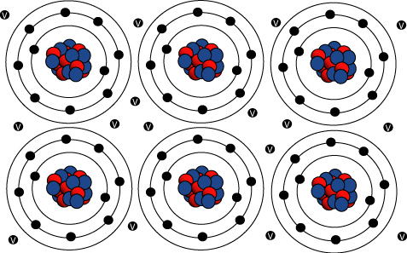
Foam vs. Metal
Polystyrene
Density = 1.06 g/ml
Aluminum
Density = 2.7 g/ml

Slide 45
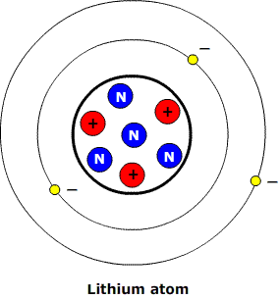
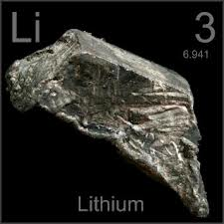
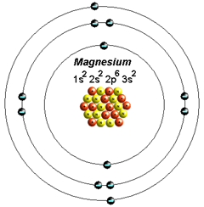
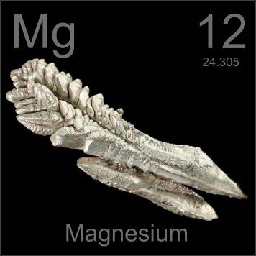
Lithium vs. Magnesium
Lithium
Atomic Radius = 0.152nm
Density = 0.534 g/ml
Magnesium
Atomic Radius = 0.160nm
Density = 1.738 g/ml

Slide 46
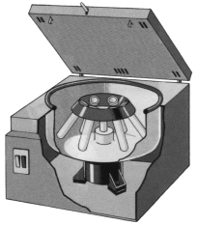
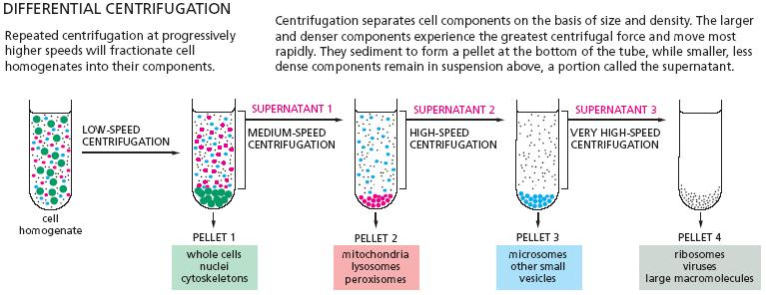
Centrifugation
Differential Centrifugation separates components of a mixture by size/density. Centrifugal forces pull the more dense matter to the bottom of the centrifuge tube while less dense matter stays at the top.

Slide 47
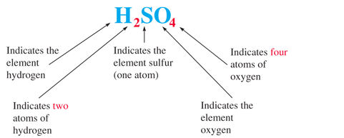
Chemical Formulas
Specifies the number of atoms of each element in the compound.
Notes:
Figure 3.9 b Explanation of the formula of H₂SO₄

Slide 48
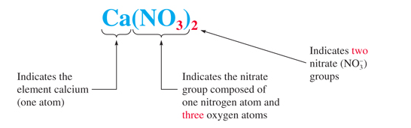
Chemical Formulas
When the formula contains more than one of a group of atoms that occurs as a unit, parentheses are placed around the group and a subscript is placed to the right of the group.
Notes:
Figure 3.9 c Explanation of the formula of Ca(NO₃)₂

Slide 49
Your Turn!
The formula for table sugar is C₁₂H₂₂O₁₁. How many oxygen atoms are found in a molecule of sugar?
1
12
22
11

Slide 50
Your Turn!
Aluminum sulfate is a compound that is often found in baking powder. How many sulfur atoms are found in Al₂(SO₄)₃?
4
12
3
7

Slide 51
Your Turn!
How many oxygen atoms are found in Al₂(SO₄)₃?
4
12
3
7

Slide 52
Your Turn!
The formula for ethyl alcohol is CH₃CH₂OH. How many H atoms are found in a molecule of ethyl alcohol?
6
3
5
1

Slide 53
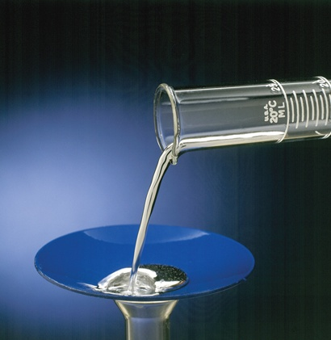
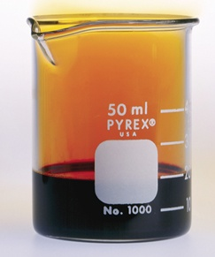
Physical States of the Elements
Most are solids at room temperature.
Some are gases (the noble gases, nitrogen, oxygen, fluorine and chlorine).
Two are liquids (mercury and bromine).

Slide 54
Chapter Outline
3.1 Elements 3.2 Distribution of Elements 3.3 Names of Elements 3.4 Symbols of the Elements 3.5 Introduction to the Periodic Table | 3.6 Elements in Their Natural States 3.7 Elements That Exist as Diatomic Molecules 3.8 Compounds 3.9 Chemical Formulas

