Slide 2

As Internal Energy U is a state function we can choose any path along which to evaluate the differential. We choose a reversible path so that we can express dU in terms of Entropy S
The second law allows us to re-cast this expression
To evaluate the spontaneity of a process we want to look at the dependence of the Gibbs Free Energy with respect to temperature and pressure changes.

Slide 3


At constant Temperature the Gibbs Free Energy increases with increasing Pressure
If the molar volume is relatively constant over the pressure range…
For solids and liquids the molar volume does not change significantly with pressure
For gases there are significant changes in volume as pressure changes

Slide 4
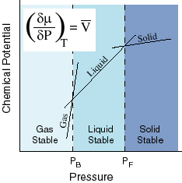
As they have the largest molar volume, the Gibbs Energy of gases varies most strongly with pressure, thus they are favored at low pressures. Generally liquids follow and then solids.
For some substances like water the molar volume of the liquid is lower than the molar volume of the solid. This leads to some of the special properties displayed by water.

Slide 5
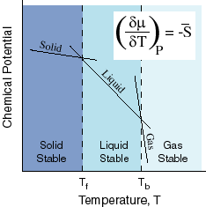
At constant Pressure the Gibbs Free Energy decreases with increasing Temperature
Molar entropies are always positive and so the Gibbs Free Energy of a substance always decreases with an increase in Temperature. In general the molar Entropy of a gas phase substance is largest followed by the liquid phase and then the solid phase.
Intersections of the Chemical Potential curves correspond to equilibrium points between the phases. These correspond to melting and boiling points. Because of the volume dependence of the chemical potentials with Pressure, a change in pressure will shift the temperatures at which the phase changes occur.
An increase in pressure will always lead to an increase in the boiling point.
For substances whose liquid phase has a larger volume than the solid phase an increase in pressure will lead to an increase in the melting point.
For a substance like water whose liquid phase has a smaller molar volume than the solid phase an increase in pressure will lead to a decrease in the melting point.
A large decrease in pressure can generate a situation where solid and gas reach equilibrium (sublimation) before solid and liquid do.
Note super heated/cooled substances are not at equilibrium. Glass is a super-cooled fluid

Slide 6
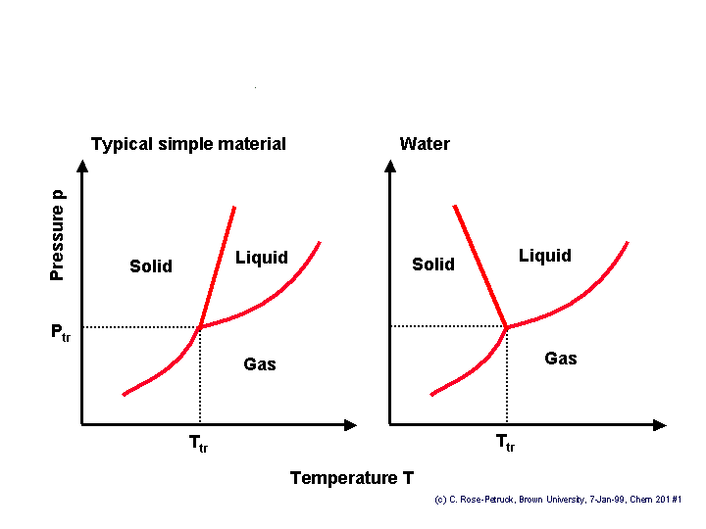
Phase diagrams trace out all the points in pressure/temperature space where two phases are in equilibrium. All points on the curve represent pressure/temperature combinations at which the chemical potentials of the phases are equal and the phases are in coexistence. There is always a combination of pressure and temperature where the chemical potentials of all three phases are in equilibrium, this is referred to as the triple point.
The effect of the larger molar volume of waters solid phase compared to its liquid phase can be seen in the phase diagram.
Where gas is in equilibrium with another phase P is the vapor pressure of the gas.

