Slide 1
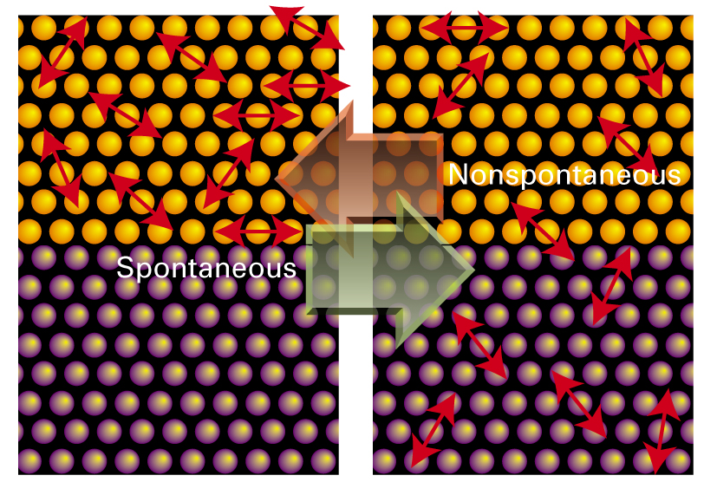
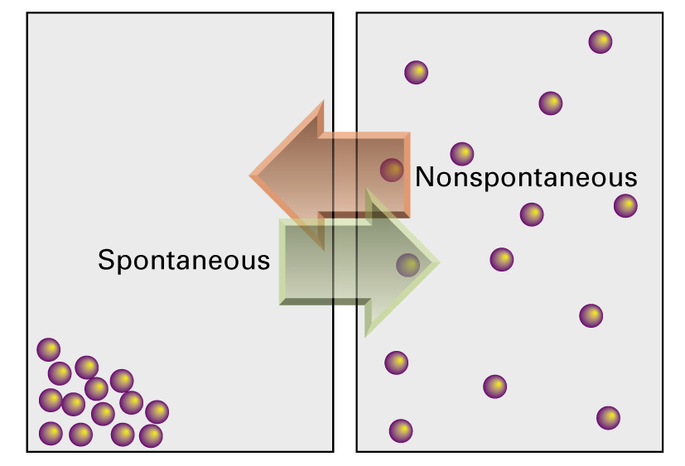
Some processes that do not occur are not in violation of the First Law

Slide 2
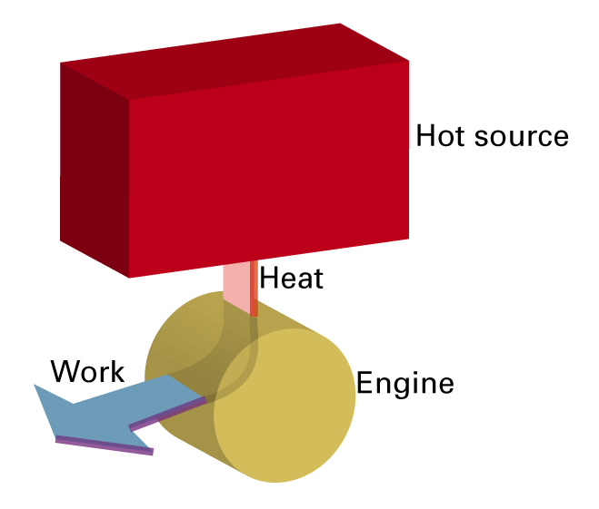
Second Law of Thermodynamics
It is impossible for a system to undergo a cyclic process whose sole effects are the flow of heat into the system from a heat reservoir and the performance of an equivalent amount of work by the system on the surroundings You have to shed some heat somewhere.
Notes:
Perpetual motion machine of the second kind is impossible.

Slide 3
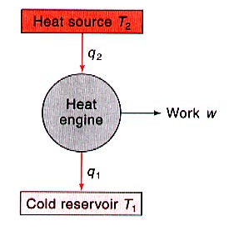
The Carnot Heat Engine
Idealized model for the operation of any heat engine
A heat engine draws heat from a heat source to do work on the surroundings and discharges some heat into a cold reservoir.
We can represent the engine as a 1 mole of an ideal gas in a cylinder fitted with a movable, frictionless piston that allows P-V work to be done on and by the gas.
Entropy
Entropy
Energy tends to become disordered!

Slide 4
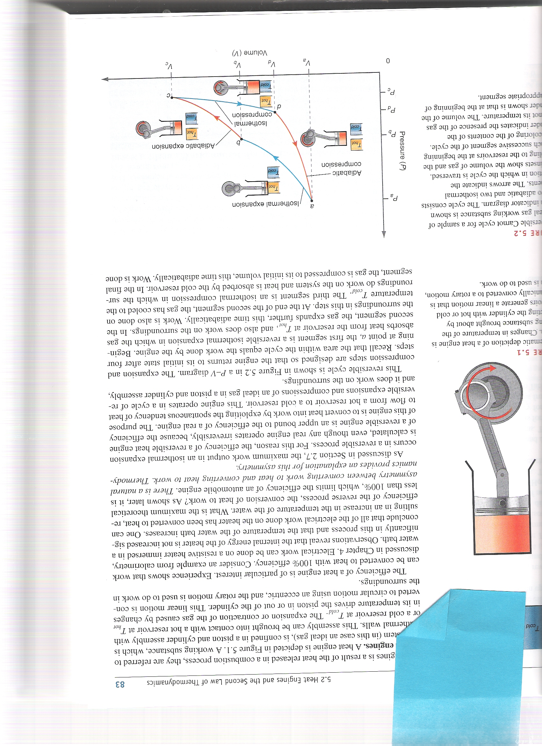
Carnot cycle
Adiabatic segments: to avoid losing heat to the surroundings at temperatures between T₂ and T₁
Isothermal segments: to absorb heat at T₂ and release at T₁
The volume of the cylinder shown is that at the beginning of the appropriate segment
Notes:
The reason of using isothermal and adiabatic segments is that no two isotherms at different T intersects. Therefore it is impossible to create a closed cycle of nonzero area.

Slide 5
The Carnot Cycle: Summary
 | Step 1 | Step 2 | Step 3 | Step 4
w | -nRT₂ln(V₂/V₁) | C_{V} (T₁-T₂) | -nRT₁ln(V₄/V₃) | C_{V} (T₂-T₁)
q | -w | 0 | -w | 0
∆U | 0 | w | 0 | w
w₁ + w₂ + w₃ + w₄= -nRT₂ln(V₂/V₁) + C_{V}(T₁-T₂) - nRT₁ln(V₄/V₃) + C_{V}(T₂-T₁)
w_{net} = -nRT₂ln(V₂/V₁) - nRT₁ln(V₄/V₃)
q₂ + q₁ = nRT₂ln(V₂/V₁) + nRT₁ln(V₄/V₃)
q_{net} = -w

Slide 6
Change in S for the Carnot cycle
For cyclic process involving any number of steps:

Slide 7





Implications of Carnot Cycle Analysis
Statements of Second Law
Impossible to convert heat into work with 100% efficiency. Cannot construct a device that operates in cycles and converts heat into work without producing some other change in the surroundings.
There is a new thermodynamic state function
Like other state functions, Entropy has an exact differential

Slide 8
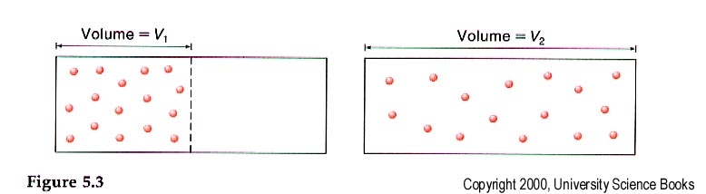

Why does a gas expand to fill its container?
or

Slide 9

Why do Temperatures of two pieces of metal equilibrate?
Two blocks of iron (1 mole each). One block at 273.15K, the other at 373.15K. Brought into thermal contact at 1atm of pressure. C_{p} iron = 25.1 J/K. What is ∆S for equilibration?

Slide 10

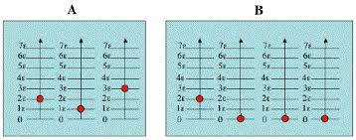
What is this “Entropy”?
For a spontaneous process in an isolated system ∆S is greater than zero
Disorder is a function of the number of different microstates available to a system at a particular energy level. When the energy of the system increases the number of microstates increases. When the volume of the system increases the number of microstates increases

Slide 11
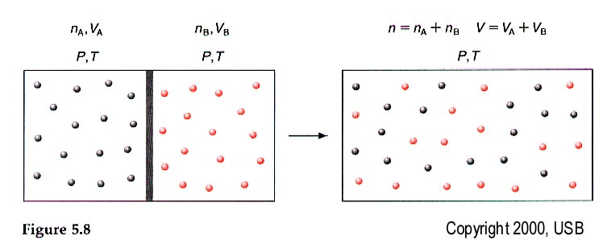
Two containers each contain one mole of an Ideal gas at 273.15K and 1atm of pressure. A barrier in the container is removed and the gases are allowed to mix. Derive this expression for ∆S for the process.
Consider this Entropy Homework Problem #1. To be submitted
Remember that ∆S must be calculated along a reversible path
Notes:
So far we’ve been dealing with the single gas. Lets calculate the entropy of mixing if we have to gases.
Entropy of mixing is positive since x <1 and ln x < 0.

Slide 13
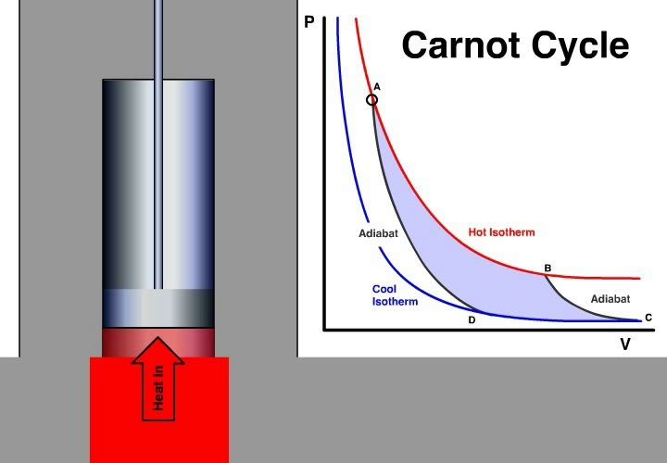
Carnot cycle

