Slide 1




The Enthalpy state function allows us to predict the heat that will be released or absorbed as a system proceeds from one state to another in real world constant pressure conditions.
If we sum the Enthalpy possessed by all reaction products and subtract the sum of the Enthalpy of the reactants, the difference is the heat that will be released or absorbed in the process.
Notes:
Comment on differences in notation used by me and by text

Slide 2


In the real world it is difficult to measure total Enthalpy content for a substance so we use a reference
To provide a reference state, the total enthalpy content of a pure element in its most stable state of aggregation at 298.15K and 1 atm of pressure is taken to be zero.
Now an enthalpy content for any material can be assigned by measuring the heat associated with formation of that material from pure elements in their standard states.
The standard enthalpy of formation is defined as the enthalpy change when 1 mole of a substance is made from its elemental precursors.

Slide 3
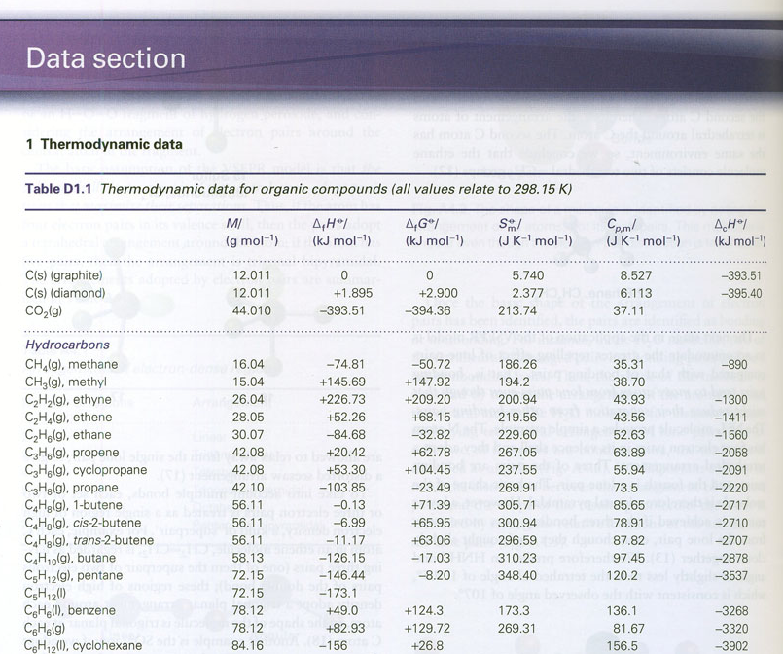
Data section in your text: Thermodynamic Data for various elements at 1bar and 298K
Notes:
Many compounds a tend to have lower enthalpy that the reference state. They are more stable than the ones with the positive values. The energy must be supplied in order to decompose them.

Slide 4
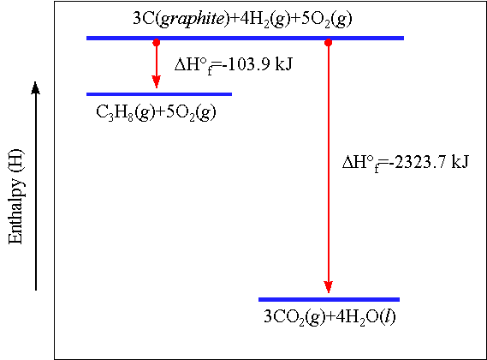
Calculate the Enthalpy of Combustion of Propane

Slide 5


Reactions at non standard temperatures must be adjusted for the change in energy content due to the temperature change

Slide 6
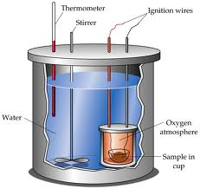
Determining ∆U and ∆H

