Slide 1
The First Law of Thermodynamics
The Internal Energy U of an isolated system is constant
Suggests that energy can neither be created or destroyed
Energy has to come from somewhere or go to somewhere
The Internal Energy of a system is stored in many forms
  Kinetic Energy: translation, vibration, rotation (for individual atoms and bulk matter
  Potential Energy: bond potentials, intermolecular potentials, gravitational and magnetic potentials, potential energies of atomic particles
We classify processes that exchange energy between system and surroundings as heat q and work w

Slide 2
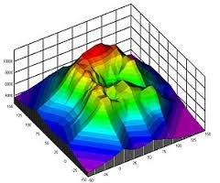
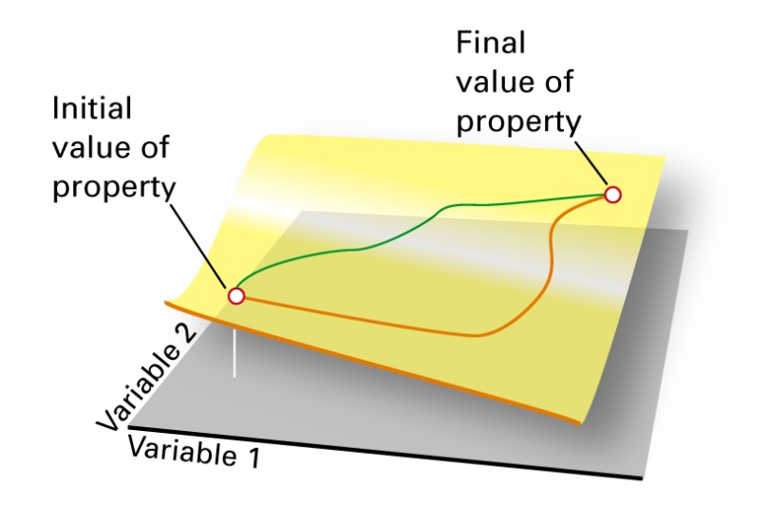


U is a State Function
The change in internal energy of a system as it moves between two states is independent of the path taken between the two states
Compare to gravitational potential and altitude
This property makes the differential dU an exact differential
The integral of dU around a closed path is zero

Slide 3
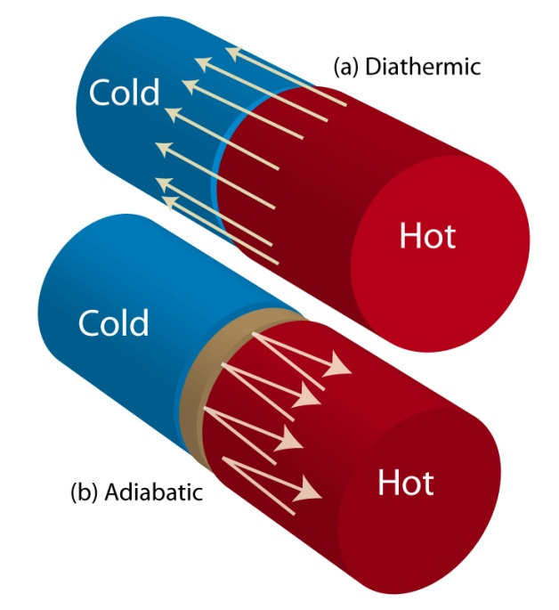
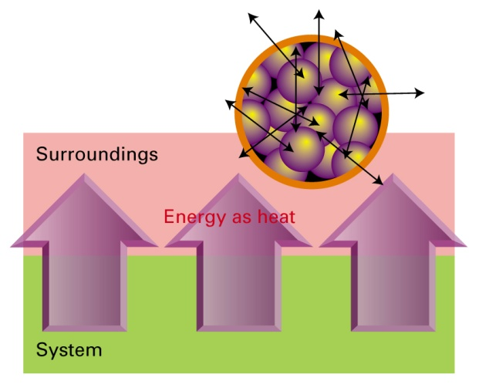
Heat q
Heat, q, is energy in transit due to a temperature difference
Heat achieves or utilizes random motion in the surroundings
A process that releases energy as heat is “exothermic”
A process that absorbs energy as heat is “endothermic”
A boundary between system and surroundings that allows the transfer of heat is “diathermal”
A boundary that does not allow transfer of energy as heat is “adiabatic”
Heat is an inexact differential, it is dependent on path

Slide 4
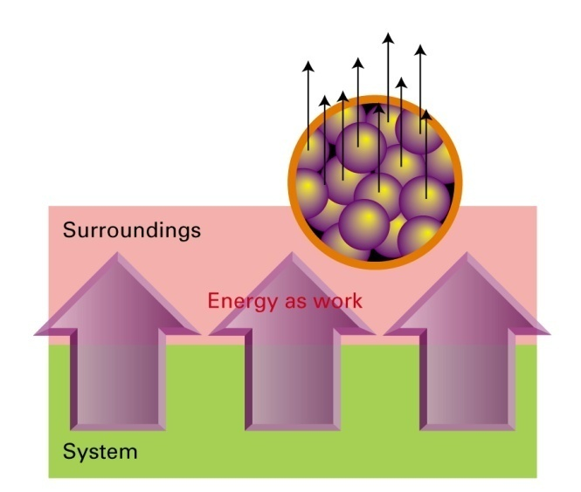
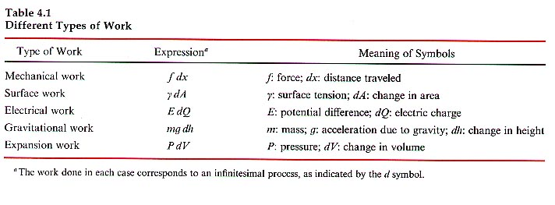
Work w
Work is the mode of energy transfer that achieves or utilizes uniform motion in the surroundings
Generally work is defined as energy absorbed or released when a force is exerted over a distance
Work is an inexact differential, depends on path
There are many different types of “work”

