Slide 1




The Boltzmann Distribution allows Calculation of Molecular Speeds
Mathematically the Boltzmann Distribution says that the probability of being in a
particular state depends on the energy content of that state (higher energy states
being less probable) and on the Temperature (higher temperature increases the
chances of being in a higher energy state). k, the “Boltzman Constant” represents the average amount of energy a molecule possesses at a given temperature. If k is multiplied by avgadro’s number you get the gas constant R which represents the average amount of energy per mole of molecules at a given temperature.
The translational kinetic energy depends on mass and velocity
z acts to “normalize” the probability distribution so that the sum of all probabilities is equal to 1. For the molecular speeds
we integrate the energy/temperature term over all possible velocities.
Now when z is placed in the denominator of our equation and we place the term representing just the range of interest
in the numerator, the result is an expression giving the probability of observing a molecule with the observed speed.

Slide 2
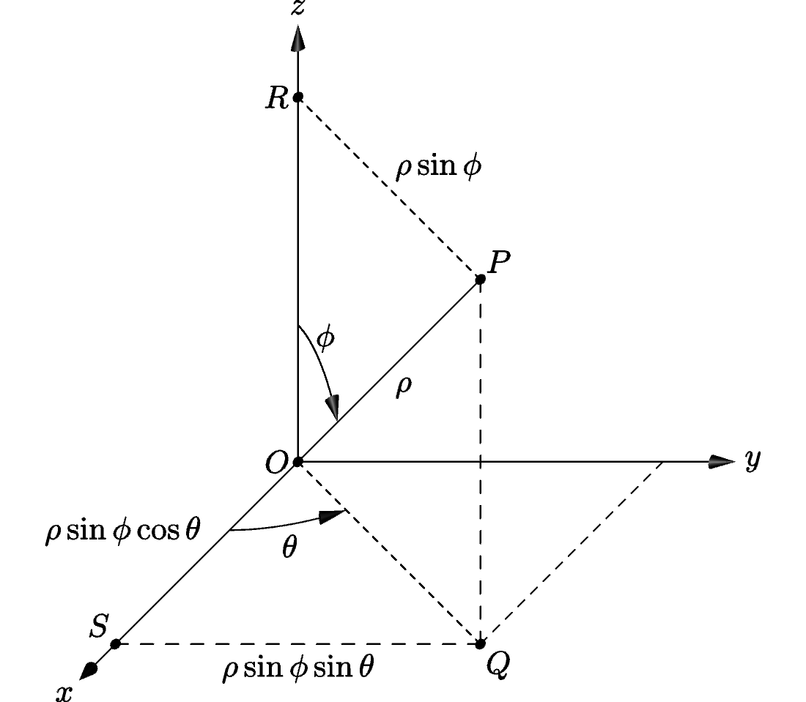

Conversion to spherical coordinates allows the probability distribution to be cast
In terms of the total velocity vector C instead of its x,y and z components

Slide 3

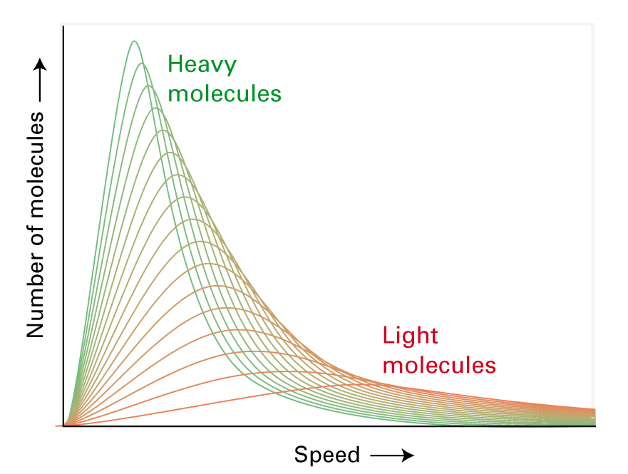
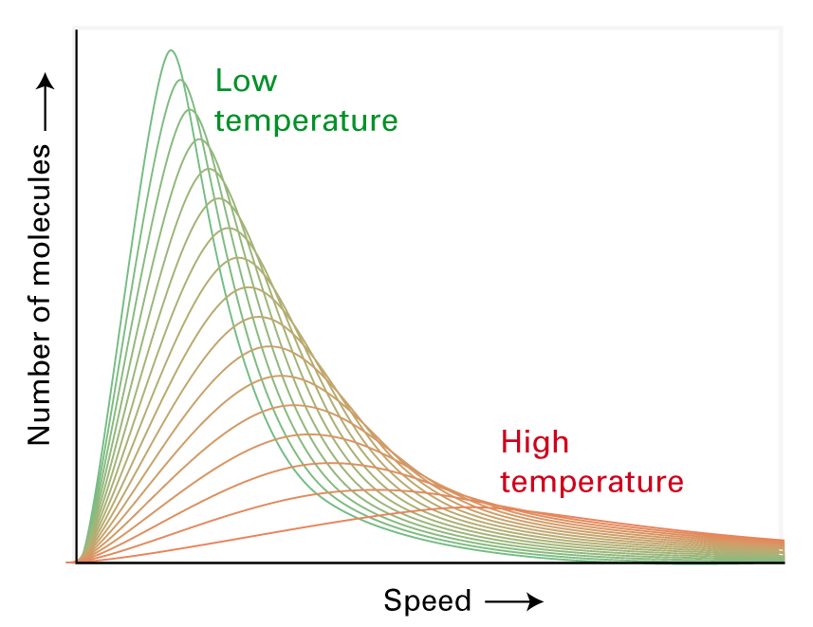
Distribution of molecular speeds
Probability is proportional to Range
Exponential decay increases with increased speed. Higher speeds are less probable.
Exponential decay increases with increased mass. Larger molecules move more slowly.
Exponential decay decreases with increased Temperature. High temperatures make high speeds more probable.
C² multiplier causes probability to go to zero as speed goes to zero. It is unlikely to find a molecule not moving.
The other term, 1/z, “normalizes” the probability distribution causing the sum of the probabilities to equal 1.

Slide 4


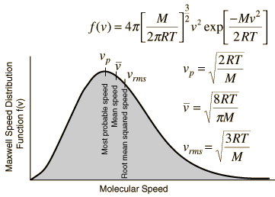

The distribution of velocities can be used to calculate other useful quantities

Slide 5
Table of some useful integrals

Slide 6


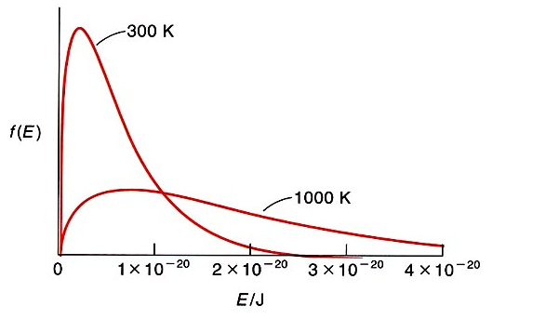
By using a mathematical technique called “change of variables” we can re-cast the equation to form a probability distribution of molecular kinetic energies

Slide 7
In reality some of the postulates of kinetic theory are not true and so real gasses do not always obey the IDG equation of state
Real molecules are not infinitely small point masses. They occupy space in the container and so the volume available to molecules is actually smaller than the container volume
Real molecules exert forces on each other and so their total energies are affected by their positions with respect to each other. In other words their kinetic energies (speeds) are affected by potential energies due to attractions/repulsions
Molecules attract each other at close distances and so do not remain in the gas phase at high pressure/low temperature conditions that favor these attractive interactions
All molecules repel each other at very close distances due to repulsive forces between electron clouds and so a gas does not collapse to zero volume at infinite pressure or zero Kelvin

Slide 8
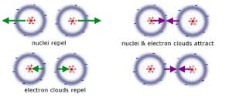
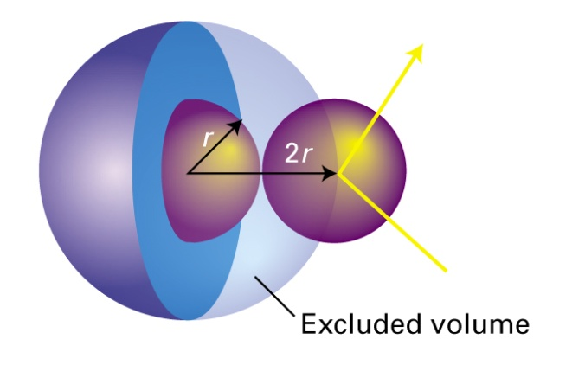
Several assumptions in IDG Law are flawed and lead to deviations from ideal behavior
Real molecules cannot always be modeled as non-interacting point masses. As discussed in lecture
particles with charge exert forces on each other and this leads to gas behavior at high pressure/low temperature that is not predicted by kinetic theory.
  Neutral molecules attract each other at short distances due to electric forces including dipole interactions and dispersion forces.
  All molecules repel each other when pushed too closely together due to the repulsive forces between their charged particles.
These forces cause two important postulates of Kinetic Theory to become untrue at conditions of high pressure/low temperature.
  Gas molecules are not “non interacting” and therefore their speeds are not simply a function of translational kinetic energy. Potential energy must also be considered. These interactions also cause the molecules to transition out of the gas phase under certain conditions.
  When pushed into very close contact molecules begin to repel each other and reach a point at which they cannot be compacted into smaller volumes. Due to this, molecules cannot simply be considered to be point masses that occupy no volume.

Slide 9
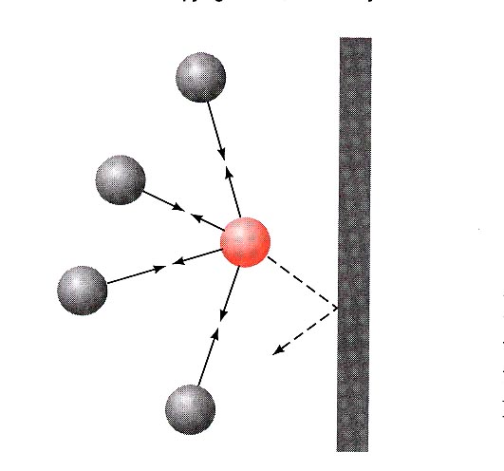
Intermolecular forces and pressure
The speed of the red gas molecule is reduced by the attractive forces exerted by its neighbors.
So the force with which it hits the wall is less than it would be if the neighbors weren’t present
  Pressure reduced
Notes:
Lets consider the effect of the intermolecular forces on the P.
P depends on the FREQUENCY OF MOLECULES COLLISION WITH THE WALLS and FORCE OF THE COLLISION (depends in momentum) both are reduced by attractive forces. In both cases the strength of these 2 terms depends or proportional to a # of molecule presents n/V (DENSITY OF A MOLECULES). The pressure is reduced in proportion to the square of these concentrations. ~(n/V)(n/V) (like statistic ) and if we introduce the proportionally constant = aN^2/V^2
P is measured pressure, so we need to add the term which account for the attractive forces, P + an²/V² takes care of attraction

Slide 10

Volume of real gases
Ideal gas
When the volume of the gas molecules becomes significant relative to the volume of the system, you have to take them into account
If we consider the gas molecules to have finite volume, the total volume of the system will be higher than if the gas was ideal (V-nb) (ideal gas negligible volume).
Notes:
(EFFECTIVE MOLE VOLUME b) Let say our gas in some container with volume V. If the container is very large than the volume of the gas itself is negligible (Ideal gas situation – infinite volume). In the next picture the volume of the gas became significant to the volume of the container (P up). The total Volume of the system will be higher than if the gas was ideal. Under these condition the actual V of the container will be the measured as V minus the volume occupied by the gas molecules, which is calculated by the amount of molecules (n) multiplied by their EFFECTIVE MOLE VOLUME b. The V-nb takes care of finite volume. The value of nb is the total effective volume of n moles of the gas. The unit for nb should be in L so b L mol⁻¹

Slide 11
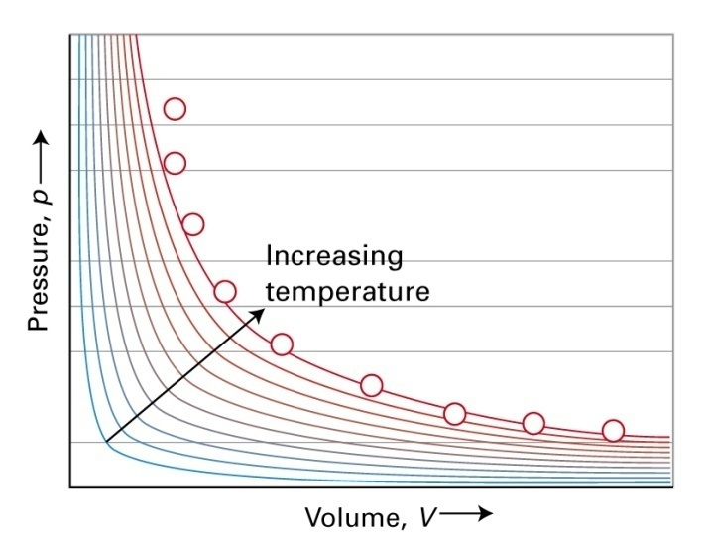
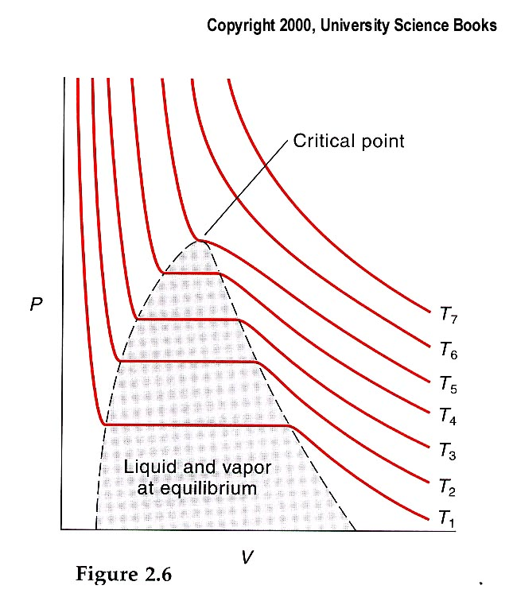
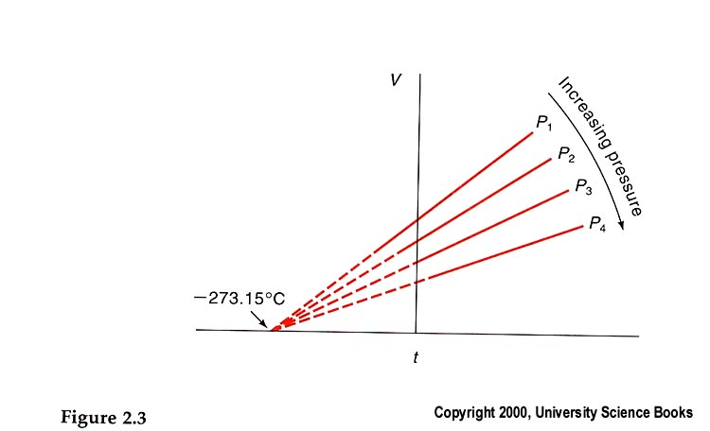
Condensation of gases
Above T₅ the gas is obeying Boyle’s law
  PV = constant
The critical temperature (T_{c}) is the temperature above which a gas cannot be liquefied, regardless of pressure or volume.
Critical point characterized by T_{c}, V_{c}, and P_{c.}
Critical point is a point of a zero slope and point of inflection.
CO₂ isotherms

Slide 12
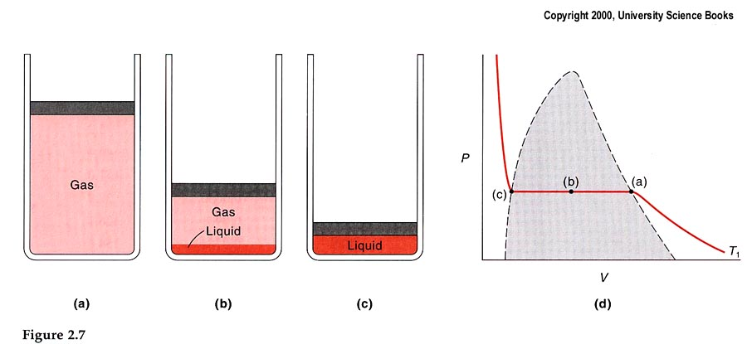
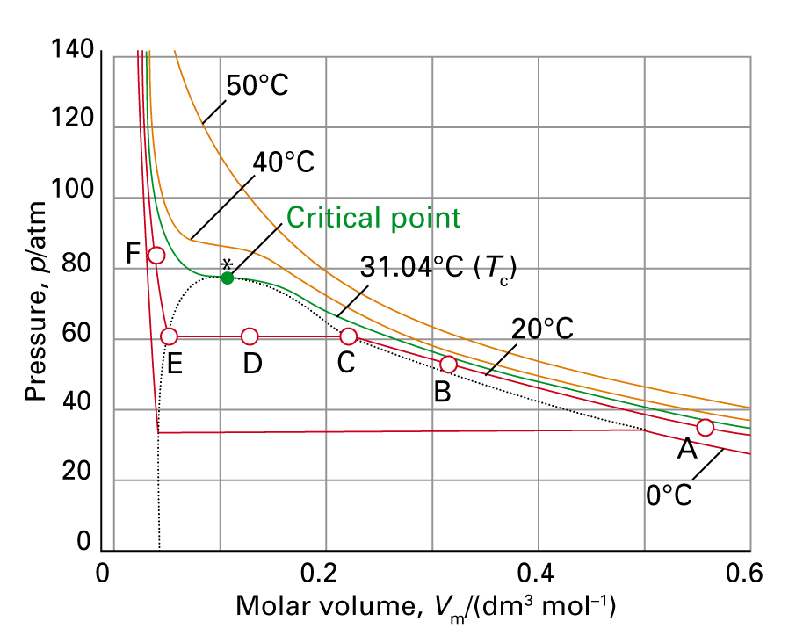
Liquefaction of CO₂ at T₁
Equilibrium vapor pressure
The phenomenon of condensation is a direct consequence of the nonideal behavior of gases. Attractive forces drives the condensation.
Notes:
LIQUEF’ACTION

Slide 13
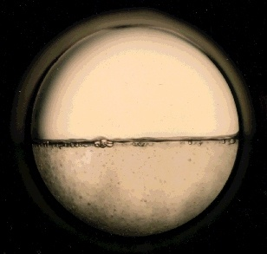

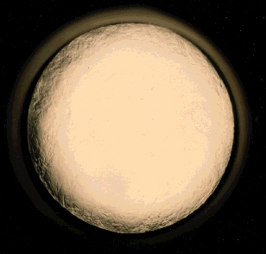
Supercritical Fluids
A supercritical fluid exhibits physicochemical properties intermediate between those of liquids and gases.
Supercritical fluids have a viscositiy close to gases, a density close to liquids, and a high diffusivity
http://www.pnl.gov
2 phases CO₂
Increase of T
D of gas and liquid is close
T_{c} and P_{c} no distinct phases
Notes:
Recent years application of the supercritical fluids (above the critical temperature and Pc). Supercritical fluids are highly compressed gases which combine properties of gases and liquids. It has the unique ability to diffuse through solids like a gas, and dissolve materials like a liquid. Additionally, it can readily change in density upon minor changes in temperature or pressure. This means that (taking a very simplistic approach) raw materials containing CO₂ soluble products can be selectively extracted or selectively precipitated to obtain ultra-pure extracts
Although the details are much more complex than this, it remains the dominant chemical-free technology for the production of decaffeinated coffee, nicotine-free tobacco, and many of the world's best spice extracts.
http://www.pnl.gov/supercriticalfluid/about.stm

Slide 14
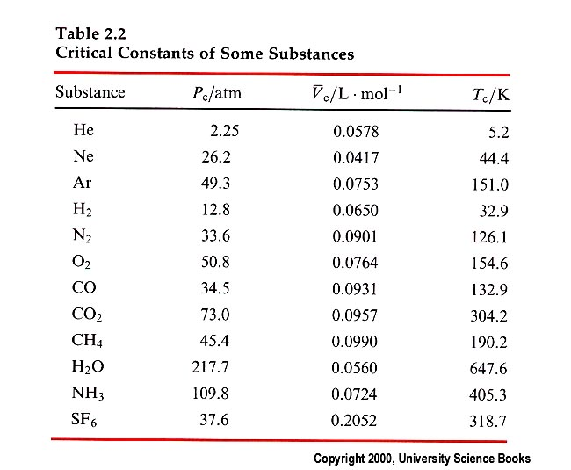
Critical constants
Critical constants are also a direct result of nonideal behavior of gases.
Above T_{c} kinetic energy of molecules is large enough for them to break away from attractive forces.
Below T_{c} the gas is compressible and the molecules can be brought within distances over which attractive interactions are possible.

Slide 15


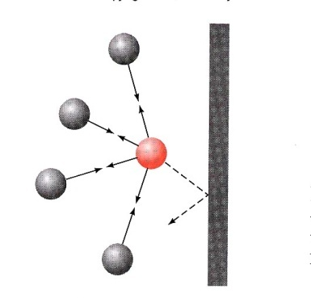

Van der Waals equation of state
The Van der Waals equation attempts to account for the finite volume of individual molecules of a non-ideal gas and the attractive forces between them
Container volume is adjusted by a term that accounts for volume occupied by molecules
Attractive forces are accounted for by a term that accounts for the decrease in pressure caused by the slowing of molecules on the perimeter of the container
Notes:
Now taking into to account the molecular interactions decrease the pressure we need to add this term to P. (P is what we measure and reduced by intermolecular interactions. So, we need to add this term to balance the equation as we started with the equation for an ideal gas)
UNITS: Mole²/L² which leads to a = atm L²Mole⁻²
So pressure has been increased by a factor of an²/V²..

Slide 16
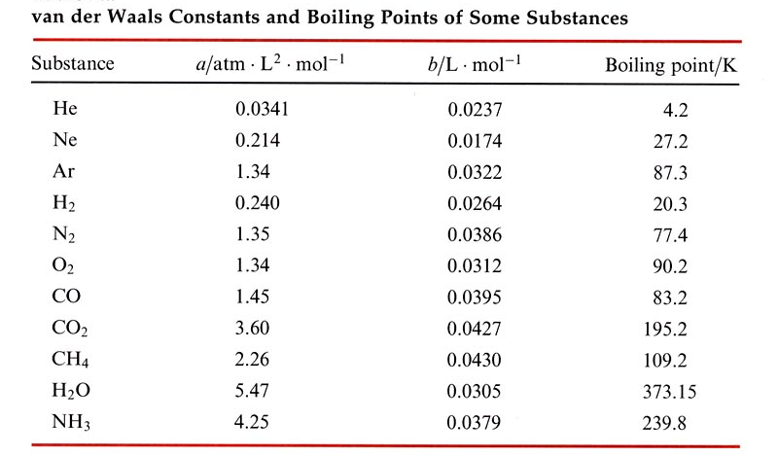
The boiling point and values of a and b
The boiling point of a gas is related to the strength of the intermolecular forces in the gas
Notes:
A and B should be determined experimentally. Higher the boiling point the stronger the intramolecular forces.
The value of a is correlated to the boiling point. In the case of b (effective mole volume) there is much less correlation with Bp, but it is somewhat proportional to size. CO and CO2 ok. But He and Neon is not correct. Neon is bigger in size.

Slide 17
Van der Waals is more predictive than the ideal gas law over a wider range of pressures and temperature
P_{observed}/atm | P_{ideal}/atm | P_{vdWaals}/atm
50 | 56.9 | 49.4
75 | 92.2 | 73.4
100 | 136 | 96
Values are for CO₂ at the same n and V and 298K
Notes:
The VdW eq, is valid over a wide range of pressures and T and provides better agreement with the experimental data. This is a table for CO₂. The values are at the same n and V and 298K. Does the ideal gas P always more than what is calculated with the VdW? At high P and very low temperatures the VdW became unreliable.

Slide 18



The Virial Equation of State uses a Power Series to fit observed behavior to a mathematical expression
The Compression Factor, Z, is the ratio of the observed volume of a gas to the volume predicted by IDG law
The equation of state is generated by using a P-series in 1/V to describe the behavior. P-series are often used when small corrections are needed to a mathematical model
For gasses that behave ideally the coefficients B and C are zero.
For gasses in which attractive forces decrease the volume a negative correction will be needed. For gasses in which repulsive forces increase the molar volume a positive correction is needed.
The first virial coefficient is the most important as it results in the largest correction.
Subsequent coefficients are used to further fit the data.

