Slide 2
CHEM 300
General Physical Chemistry I
Spring 2014
James Goodwin
Email: jgoodwin@ucsc.edu

Slide 3
What is Physical Chemistry?
physical chemistry, branch of science that combines the principles and methods of physics and chemistry. It provides a fundamental theoretical and experimental basis for all of chemistry, including organic, inorganic, analytical chemistry and biochemistry.
Topics of interest: the properties of gases and liquids, chemical equilibrium, reaction rates, molecular structure and etc. Among other factors of interest, the influence of temperature, pressure, electricity, light, concentration, and turbulence.
thermodynamics the study of transformation of energy
Kinetics chemical changes with time. Studies the rates of chemical reactions
Quantum theory Studies of molecular structure (electronic and atomic arrangements)
Statistical thermodynamics calculating bulk properties
We’ll cover gas laws and theory of gases, thermodynamics, properties of solutions, electrochemistry and kinetics this semester (C300). Quantum mechanics and statistical thermodynamics will be covered in C301.

Slide 4
Know This
Instructor: James Goodwin
E-mail: jgoodwin@ucsc.edu
Office: TBA
Office Hours: Tues 11:00am-1:00pm
Class Meets: 9:35am -10:50am Tue/Thur in Thornton Hall 326
Website: jamesgoodwin.yolasite.com
iLearn: will be up later in the semester
(ilearn.sfsu.edu to login)

Slide 5
Prerequisites for CHEM 300
PHYS 121 or PHYS 240, CHEM 215, MATH 227, CHEM 320, CHEM 333, and each with a grade of C or better.
Rationale for the prerequisite structure
CHEM 215, PHYS 121, 240 and MATH 227 provide essential background
CHEM 320 problem solving (quantitative analysis) and basic chemical concepts which helps to pass CHEM 300
CHEM 320 together with CHEM 300?

Slide 6
Textbooks and other resources
Texts:
Elements of Physical Chemistry by Peter Atkins and Julio de Paula, 6th ed. (2013) W.H. Freeman
Solution manual to accompany Elements of Physical Chemistry by David Smith (2013).
Other optional texts: Thermodynamics and Kinetics for the Biological Sciences, G. Hammes, Wiley, NY (2000) (ISBN: 0471374911) and Physical Chemistry for the Biological Sciences, G. Hammes (2007) (ISBN: 978-0-470-12202-0) can be useful.

Slide 7
Course grading
25% Homework
  Must be 90% correct for full credit
  10% deduction for every day past due
75% Exams (4 @ 25% lowest dropped or HW)
  Each covers ~3.5 chapters
  Most questions will be similar to homework or to examples done in class
  Final will be ~80% cumulative, 20% new material
  Must take final exam
Class participation
  Participation will be considered when assigning grades for someone on borderline. Includes class discussions, answering and asking questions, participating in the problem solving exercises in class and attendance at office hours.

Slide 8
Exam Re-Submissions
Original Required Response
  Re-write all mathematical/oral arguments as would have been required in original exam
  Must be neat/legible, correct and complete
Additional Essay Requirement
  Detailed written explanation of problem and strategy to solving. At least two paragraphs
  First Paragraph: Describe what the problem is asking. What system and physical properties are involved? What is the nature of the energetic properties we are concerned with?
  Second Paragraph: Describe the logic involved in solving the problem. What do we know about our system and how do we use it to get to the answer? What are the physical/mathematical connections between knowns and unknowns and what are the steps involved in linking them?

Slide 9
Cheating
The only “cheating” allowed is the use of a cheat sheet on exams
  An index card no more than 3” x 5”. You can cover both sides and either write it by hand or print it out on a computer. Please no other papers !
Cell phones
  Because of the proliferation of camera cell phones and text messaging, cell phones are banned from exams. If you’re caught with a cell phone out during an exam you will be asked to turn in your exam. If you leave to use the restroom you must turn your cell phone in to me first.
No sharing of calculators or other materials
  If students are caught exchanging calculators or other materials, they will both be asked to turn in their exams. A shared calculator must be passed through me.
Notes:
Cheat sheet: An index card no more than 5” x 8”. You can cover both sides and either write it by hand or print it out on a computer.
No reproductions (photocopies) and you will turn in your card with your exam.

Slide 10
How to do well in P-CHEM
Lecture
  Read relevant chapters before lecture
  Take notes
  Ask questions
  Actively participate in group problem solving exercises done in class
Studying
  Work problems & work in groups
  Use notes and book first to figure out problem without looking at the solutions.
  Repeat a problem until you can do it without looking at anything other than your “cheat sheet”. Do not try to memorize solutions.
  Review lecture video and make sure notes taken in class are complete
Notes:
with pen !!

Slide 11
“Physical chemistry is everything that is interesting”
Gilbert Newton Lewis 1875-1946

Slide 12
Physical Chemistry is about Matter and Energy
Physical/Chemical processes involve matter and the changes it undergoes
Matter is composed of particles having mass and charge, protons neutrons and electrons (other smaller particles).
Matter can exert forces on other matter and responds to forces exerted on it.
  Collision forces, Electromagnetic forces, Gravitational forces
Action of forces results in the exchange of energy
  Energy lost by matter exerting a force
  Energy gained by matter receiving/feeling a force
Direction of chemical change is governed by the natural tendency of energy to flow from places of abundance (high energy) to places of deficit (low energy)
Understanding how energy is stored in matter, the relative energies of states of matter and how energy is exchanged in matter allows us to understand the direction and speed of chemical reactivity. Allows us to engineer matter and to harvest energy from matter.

Slide 13
In Biology, Energy Matters
Biological systems (and all other systems) are governed by the laws of physics.
Biology has evolved/engineered ingenious ways to use energy/chemistry to efficiently accomplish tasks central to the continuation and progress of life.
We study biological systems/machines in order to make progress in: medicine, engineering, food production, environmental conservation, chemical synthesis, many others.
Studying and understanding the energetics of biological chemistry has been and always will be key to our species living in harmony with the chemical/biological world around us.

Slide 14
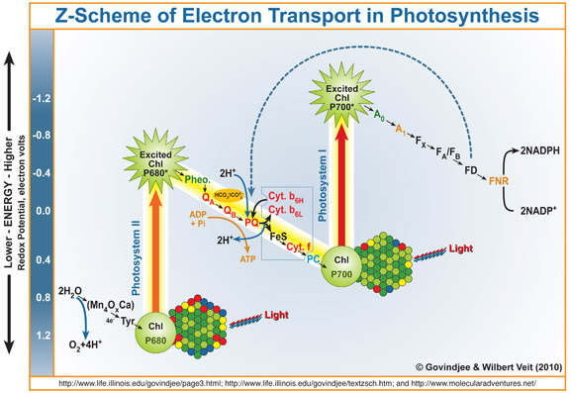
Biology uses Energy from Light
Notes:
Point out that H₂O and CO₂ molecules have electrons in low energy electronic states (bound to oxygen) and that organic molecules have high energy electrons. Photon energy used to increase electron energy.

Slide 15
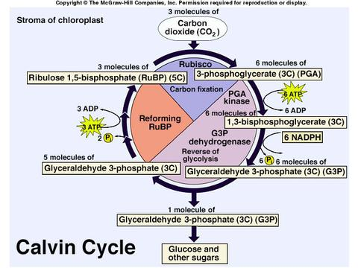
Macromolecules Synthesized from Energy Harvested from Sun
The majority of energy we use today (fossil fuels) was generated in this way.

Slide 16
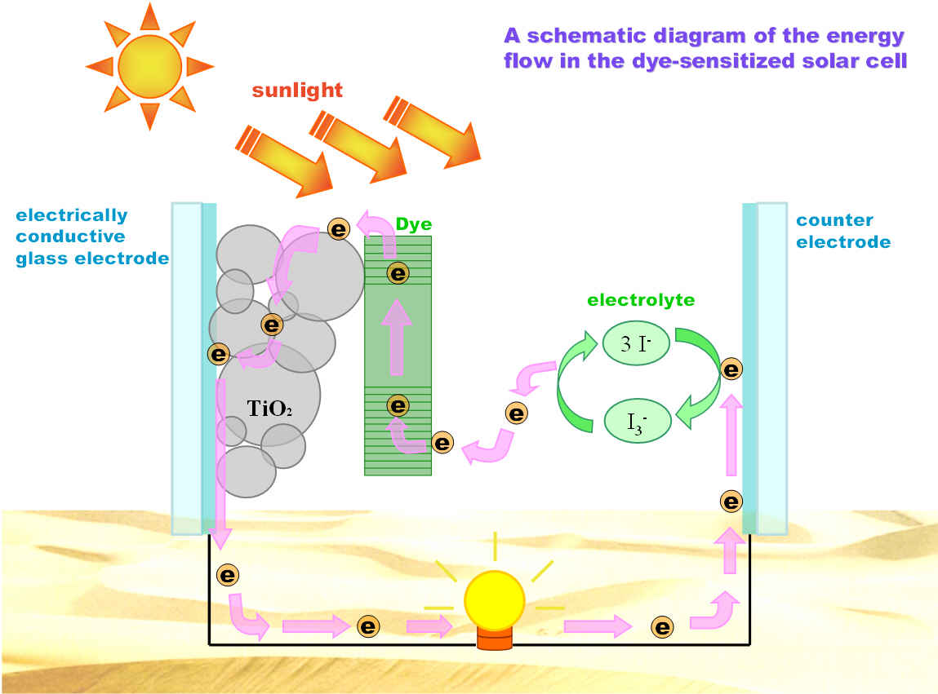
Modern Photovoltaic Devices Mimic Biological Light Harvesting Machines
Notes:
Both systems utilize photo-excitable cyclic organic molecules to harvest the energy of a photon.

Slide 17
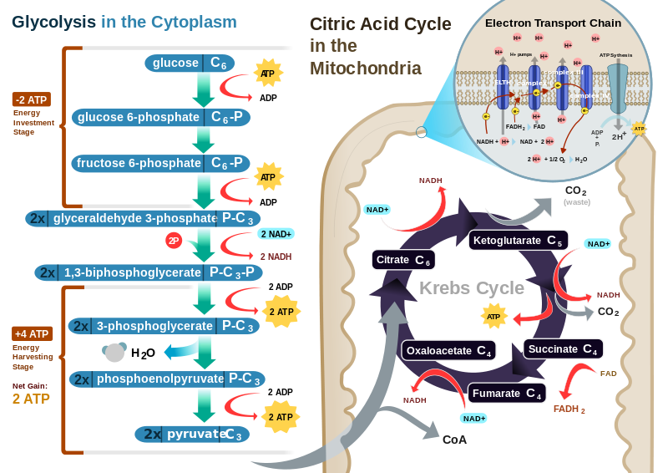
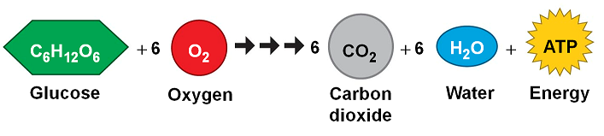
We Run a Combustion Reaction in Our Mitochondria

Slide 18
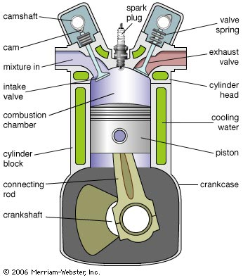
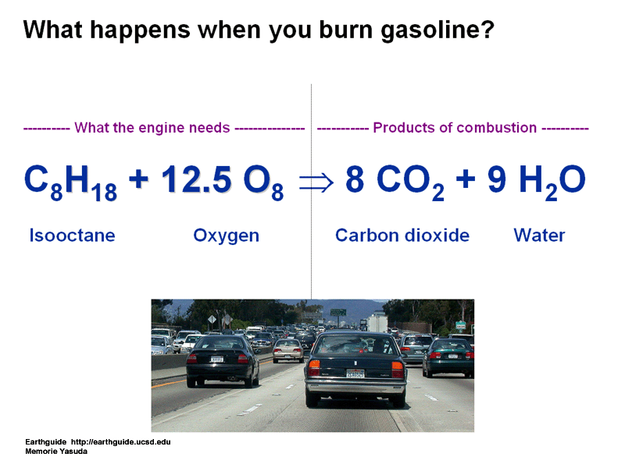
We Run a Combustion Reaction in Our Motors

Slide 19
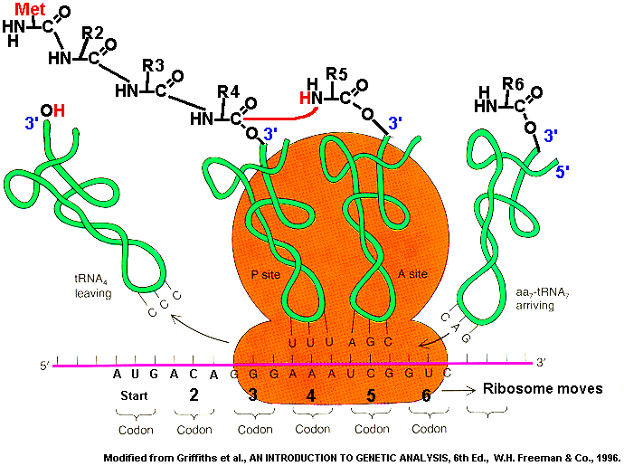
Enzymes create environments that maximize the efficiency/specificity of chemical reactions by applying appropriate forces to reactant molecules
Notes:
Mention that enzymes: Speed reaction rate by holding molecules in an orientation that facilitates electronic forces leading to bond formation, guarantee correct stereochemistry by holding molecules in position favoring correct isomer, apply forces to molecules etc.

Slide 20
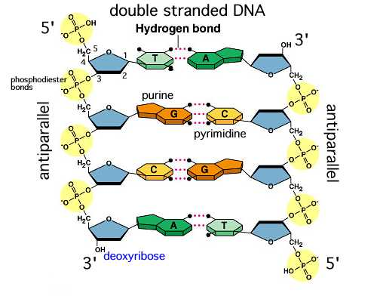
Biology uses chemical reactivity/energy to reliably store information

Slide 21
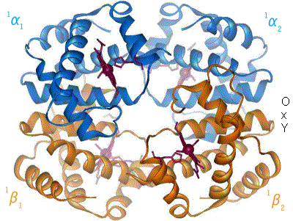
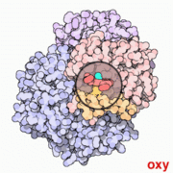
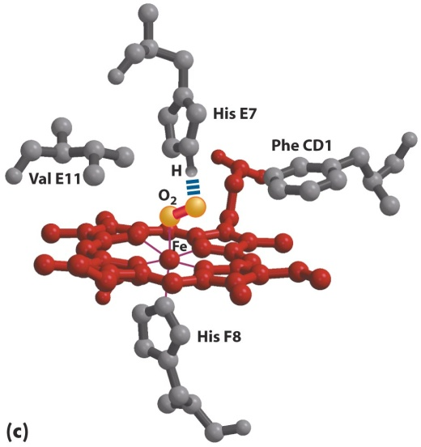
Hemoglobin is a transport enzyme that creates “perfect” conditions for picking oxygen up from regions of high concentration and dropping it off in regions of low concentration
X-ray spectroscopy provides detailed information about the Hemoglobin 3D structure
Thermodynamic and kinetic studies of oxygen binding to Hb have brought insight as to how it functions and malfunctions
Notes:
Mention that tightness of binding critical… too loose, won’t carry. Too tight, won’t drop off. Carbon Monoxide poisoning and genetic malfunction.

Slide 22
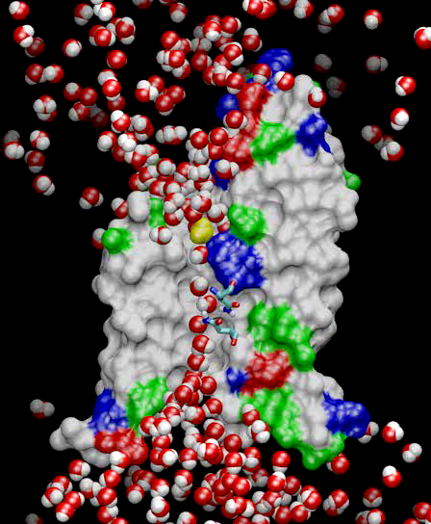
Water transport through channels
Aquaporins are membrane water channels that play critical roles in controlling the water contents of cells.
Notes:
Creating Hydrophilic environment across hydrophobic cell membrane. Polar amino acids.

Slide 23
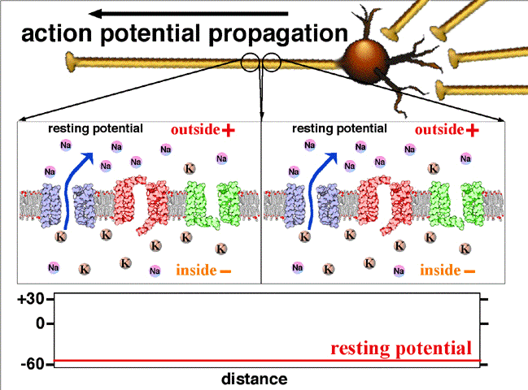
Energy stored in ion concentration gradients is used to send signals in our neurons
Notes:
Mechanism used in learning

Slide 24
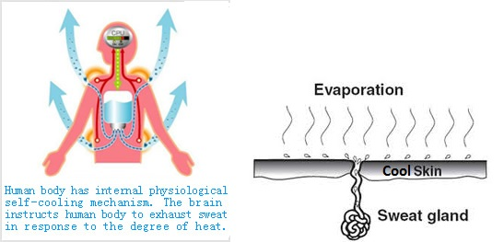
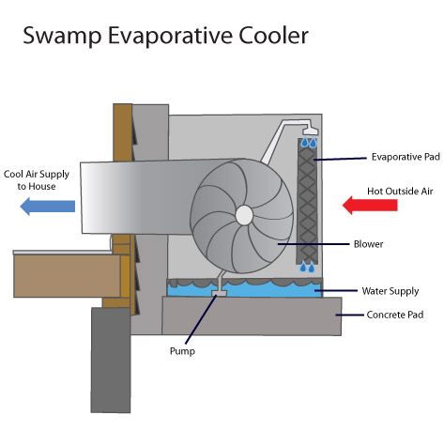
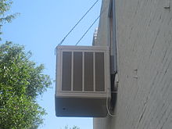
Evaporative Cooling

Slide 25
Early Course Goals
Remind ourselves of the different forms that energy can take in systems of matter and the different ways that matter stores energy in the different forms.
Observe simplified systems of matter as they go through changes and learn to follow the energy as it moves into and out of systems and changes form.
Define the Internal Energy U of a system of matter.
Define Heat q and Work w as modes of energy transfer between systems of matter
Define the Temperature T as it relates to the Internal Energy of a system and the tendency of energy to flow (as Heat and Work) between two systems.
Define the Enthalpy H of a system as the heat evolved or consumed as a system transitions between two states at constant pressure.
Define the Entropy S of a system as a measure of the dispersion of energy throughout the system. Learn how the total Entropy change of the universe is used to predict reaction spontaneity.
Define the Gibbs Free Energy G as a measure of the total Entropy change of the Universe and learn to use it to predict reaction spontaneity.
Extend principles derived from simplified systems to more complex systems.
Learn how these defined quantities relate to chemical equilibrium and reaction rates.

Slide 26
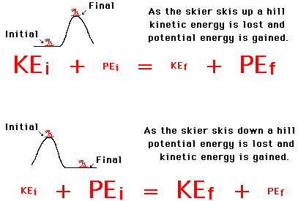
Quick Review on Energy
Energy exists in two basic forms: Kinetic Energy and Potential Energy
Kinetic Energy is the energy associated with the motion of a particle having mass
KE = 1/2mV²
Potential Energy is the energy associated with a particles position in a force field. It is the energy that will be released or absorbed when the particle changes its position in the field. For a conservative field (like a gravitational field or an electric field) the difference in the potential energy between two positions in the field is the integral of the dot product of the force vector and the vector in the direction of travel along a path between two places in the field.
Potential E = ʃF·ds
We are familiar with conversions between kinetic and gravitational potential energy…

Slide 27
Of the field forces acting on chemical systems, we are primarily concerned with electromagnetic forces
The Gravitational Force acts between two objects having mass pulling them toward each other. It is far weaker than electromagnetic forces and so is seldom a consideration in chemical systems.
F_{Gr} = Gm₁m₂/r²
The Nuclear Binding Force or Strong Force is responsible for holding nuclear particles (protons/neutrons/etc) together. It acts only at short distances and while it is much stronger than electromagnetic forces, it is only involved in nuclear changes and so is not a consideration in most chemical reactions.
The Electrostatic Force between two charged particles is given by the Inverse Square Force Law
F_{El} = kq₁q₂/r²
While the very mobile electrons confined to orbital's in atoms/molecules cannot be simply described by electrostatics, this equation does provide a framework in which to think of the forces between positive protons and negative electrons. These electronic forces give rise to the potential energies relevant in most reactions.
The Magnetic Force is due to magnetic fields generated by charges in motion. The motion of an electron its orbital generates a magnetic field that interacts with magnetic fields of other moving electrons in the area. These forces are what cause two electrons in the same orbital to “spin” in opposite directions.
F_{mag} = q(E + v x B)

Slide 28
How is Energy Stored in Matter/Chemical Systems?
In matter (individual atoms or atoms bound by chemical bonds) energy is stored as a combination of Kinetic and Potential energies.
For simplification we will ignore gravitational/magnetic/nuclear energies.
If the particles have any motion at all there will be a kinetic energy associated with that motion. Electrons are always in motion. Not true for nuclei.
All atoms/molecules contain protons and electrons and so can possess electrical potential energy associated with the forces acting between these charged particles.
Electrical potential energy is not limited to forces between protons/electrons bound to the same atom/molecule. Electric forces can exist between protons and electrons on separate atoms/molecules and so there is potential energy associated with the positions of these atoms/molecules with respect to each other.

Slide 29
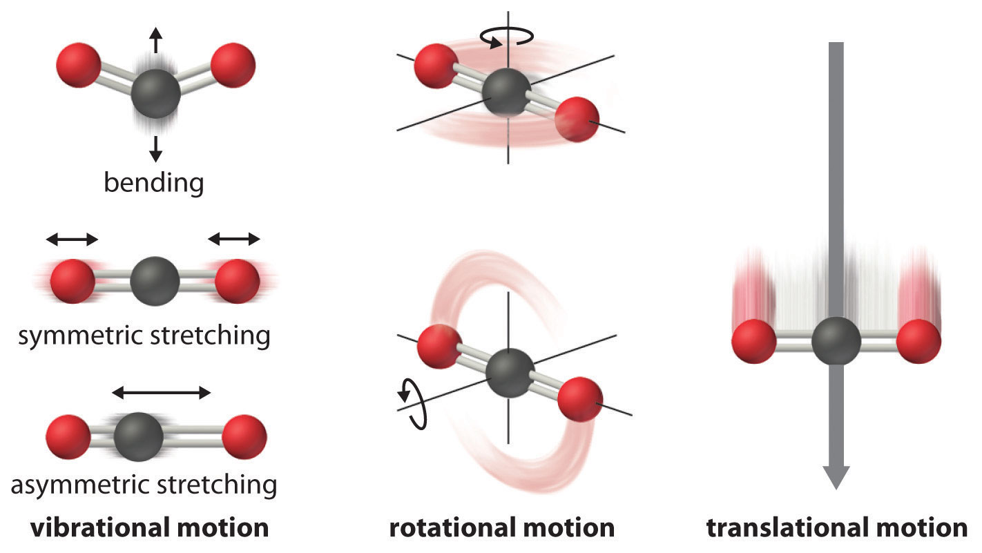
Kinetic Energy takes a variety of forms
Atoms/Molecules can have kinetic energy associated with the translation of their centers of mass
Molecules can rotate about their center of mass and so can store kinetic energy in the motion of rotation
Molecules can vibrate along/about their bonds and so can store kinetic energy in the motion of vibration
Notes:
Mention vibrational modes of bulk matter

Slide 30
Electric Potential Energy can be stored in different ways
Electrons in any orbital on an atom/molecule other than the lowest energy orbital available are at a high electrical potential. Such electrons are known to fall spontaneously to the lowest energy orbital converting electric potential energy into energy of another kind (light usually).
Electrons bound to less electronegative atoms that hold them more loosely than they would be held if associated with a more electronegative atom in the system are at a high electrical potential. If these electrons were to somehow leave their high potential orbital and enter the lower potential orbital on the more electronegative atom, electrical potential energy would be released and converted into energy of another kind (light/heat/other).
Polar molecules have charged regions that attract oppositely charged regions in other molecules. The lowest potential configuration is usually when these oppositely charged areas are allowed to approach each other closely. A configuration that separates these charged areas is at a higher relative electrical potential. The same logic applies to oppositely charged ions in a salt and the orientation of polar molecules around charged ions in a solution.
Electron clouds of nonpolar molecules can repel one another temporarily exposing the positive charge of one molecules nuclei to the negative charge of the others electrons. This creates attractive “Van der Waals” forces between them. When these forces are allowed to bring molecules together they are at a lower potential than if the molecules are separated. There is an optimal distance for these forces. If the molecules are pushed closer together than this, their negative electron clouds and positive nuclei will repel each other increasing the electric potential.

Slide 31
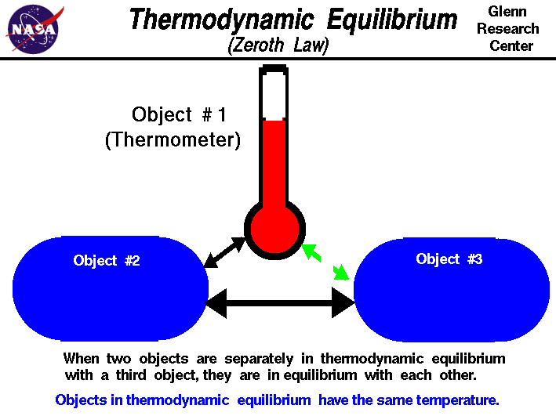
The Zeroth Law of Thermodynamics and Temperature
“If two thermodynamic systems are each in thermal equilibrium with a third, then all three are in thermal equilibrium with each other.”

Slide 32
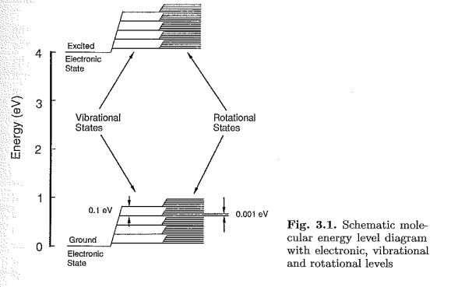
The amount of energy stored in these different “degrees of freedom” varies with each mode.

