Slide 1

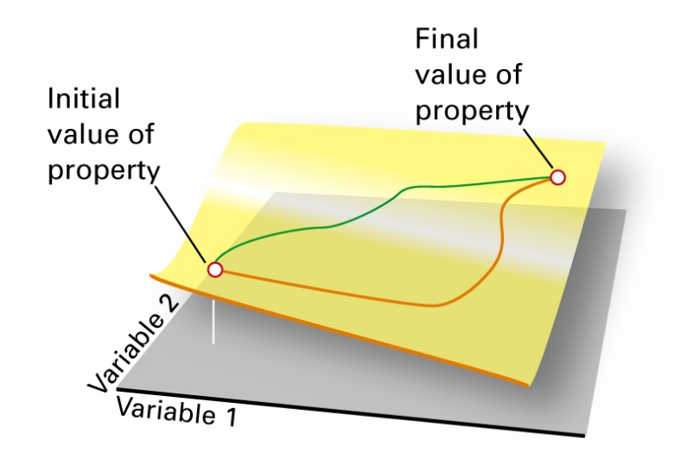
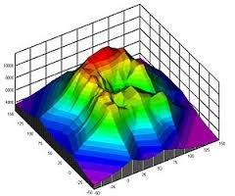
Review First Law
Notes:
U is state function, independent of path. Systems do not possess heat and work, they are modes of energy transfer.

Slide 2

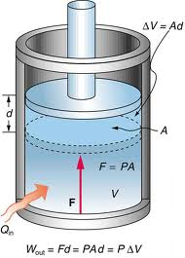

Work
Work is energy transferred when directed motion is achieved against an external force. There are many types of forces available for doing work against. Work done against non-conservative forces dissipates energy (generally as heat). Work done against conservative forces converts mechanical energy into potential energy that can later be released. Most of our discussion will be limited to work done against conservative forces. Expansion work or “PV work” is conservative work done when a system changes its volume while under the influence of an external pressure. Most of the systems we consider will be restricted to this kind of work. We will look at work associated with electric fields (also conservative) later in the course.

Slide 3




Heat and Heat Capacities
Heat is energy transferred as the result of a temperature difference. When two bodies at different temperatures are in thermal contact energy will flow from the higher temperature body to the lower temperature body. The energy transfer is generally the result of inelastic collisions between fast moving particles in the hot body and slow moving particles in the cold body, but heat can also be transferred when radiation leaves a hot body and enters a cold body.
Heat Capacity is a measure of the differential amount of energy needed for a differential increase in the temperature of a system.
The heat capacity of a system depends on the specific conditions of the energy transfer. In addition to varying with temperature, it takes on different values for constant volume and constant pressure processes.
Generally heat capacity is a function of Temperature since certain degrees of freedom are “frozen out” until some minimum temperature is reached. For a narrow range of temperatures however, it can usually be considered to be constant.
Notes:
Mention that because “heat” is generally transferred through collisions it/and temperature tend to be thought of in terms of translational kinetic energy of molecules but “heat” is also associated with energy transferred when rotational/vibrational/electronic states are populated/depopulated and radiation is emitted, so that must also be included in “heat” Temperature is not simply a measure of translational kinetic energy.

Slide 4


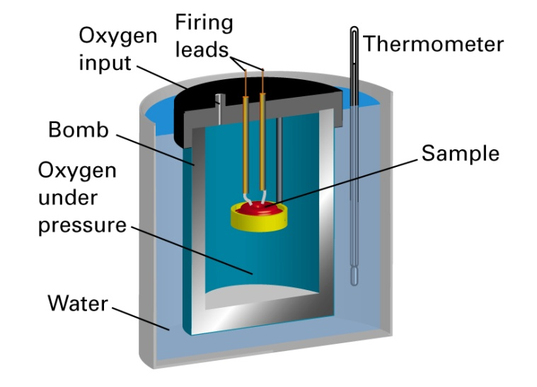
C_{v} and ∆U
For a reaction that happens at constant volume, no expansion work can be done (∆V=0). All energetic changes are due to population or depopulation of energetic degrees of freedom in the system. In such a process any change in the internal energy of the system is due to heat flow.
We can measure the constant volume heat capacity and using a bomb calorimeter.
Simply place a sample in a constant volume calorimeter and inject a known amount of heat while monitoring the change in temperature of the sample

Slide 5




Ideal Gases and ∆U
For an ideal gas the internal energy depends only on Temperature
Because U is a State Function its differential is exact
The term (dU/dV)_{T} is called the internal pressure. Because molecules of an ideal gas exert no attractive or repulsive forces on each other, there is no potential energy absorbed or released when their separation distance changes. For an ideal gas then the internal pressure is zero.
The Second Law of Thermodynamics (which we have not yet covered) allows another mathematical statement of the internal pressure.
Evaluate this term for an Ideal Gas
Take home message is that, for an ideal gas, the internal energy of the gas is only a function of T
Notes:
Evaluate Internal Pressure dV for solids/liquids small making internal pressure term negligible for those processes

Slide 6
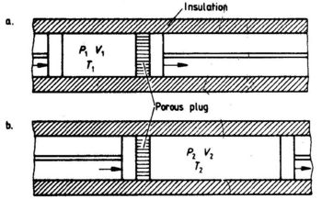
∆U and Real Gases
In general the internal pressure is non-zero for real gases. In many gases attractive forces resist separation of the molecules in an expansion. In this case for an expansion to occur at constant temperature energy would have to be put into the gas as it expands to keep the temperature from dropping as kinetic energy is converted to potential energy as the molecules separate. If such an expansion were carried out adiabatically the gas would cool as it expands. This is the phenomena utilized in the liquefaction of gases referred to at the end of chapter 1.
For some gases repulsive forces cause a gas to heat up during an expansion as potential energy is converted to kinetic energy as the molecules separate.

Slide 7


Enthalpy and q_{P}
In a constant pressure process energy released or absorbed goes to two places. In addition to being related to population/depopulation of energetic degrees of freedom in the system, energetic changes are also associated with work done in any volume change that the system undergoes against the constant external pressure. This inspired the concept of Enthalpy H.
Enthalpy is a function generated by adding the term PV to the Internal Energy U. Since U is a state function and d(PV) is an exact differential, Enthalpy is also a state function and is independent of path.
For a constant pressure process dP=0. Also, since enthalpy is a state function only the initial and final states are important and not the path between them so we are free to use a reversible process where P_{ext} = P_{int}. As heat of a constant volume process was equal to ∆U, heat of a constant pressure process is equal to ∆H.

Slide 8



Enthalpy
Ideal and Real Gases
Because Enthalpy is a State Function
The second term in this expression asks what enthalpy is involved in changing the pressure of the system at constant temperature. Increasing the pressure at constant temperature requires decreasing the volume since at constant temperature the speed of the molecules does not change. Again for real gases any change in the separation of the molecules will result in conversion between potential and kinetic energies and so this term is non-zero. This term is analogous to the term (dU/dV)_{T} dV in the differential of the internal energy.
For Ideal Gases no forces are exerted between molecules and so this term is zero.

Slide 9
Ideal Gas C_{P} and C_{v}

Slide 10
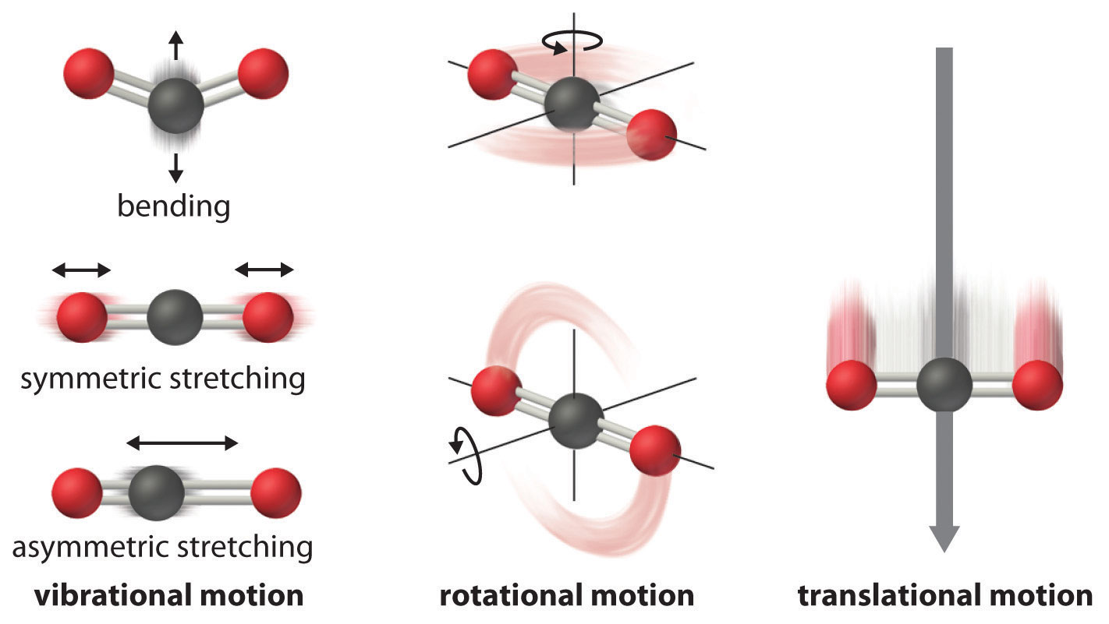
Kinetic Energy takes a variety of forms
Atoms/Molecules can have kinetic energy associated with the translation of their centers of mass
Molecules can rotate about their center of mass and so can store kinetic energy in the motion of rotation
Molecules can vibrate along/about their bonds and so can store kinetic energy in the motion of vibration
Notes:
Mention vibrational modes of bulk matter

Slide 11
Kinetic Energy takes a variety of forms
Atoms/Molecules can have kinetic energy associated with the translation of their centers of mass
Molecules can rotate about their center of mass and so can store kinetic energy in the motion of rotation
Molecules can vibrate along/about their bonds and so can store kinetic energy in the motion of vibration
Notes:
Mention vibrational modes of bulk matter

Slide 13
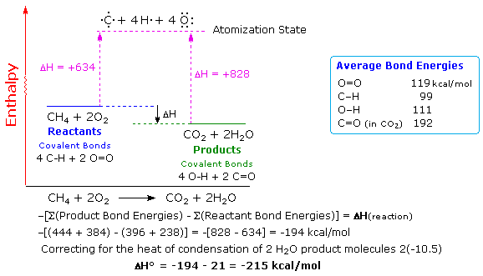
A system composed of hydrocarbon molecules and oxygen molecules possesses a potential energy because the atoms could potentially re-arrange to form the lower energy carbon dioxide and water molecules

