Slide 2
How is Energy Stored in Matter/Chemical Systems?
In matter (individual atoms or atoms bound by chemical bonds) energy is stored as a combination of Kinetic and Potential energies.
For simplification we will ignore gravitational/magnetic/nuclear energies.
If the particles have any motion at all there will be a kinetic energy associated with that motion.
All atoms/molecules contain protons and electrons and so can possess electrical potential energy associated with the forces acting between these charged particles.
Electrical potential energy is not limited to forces between protons/electrons bound to the same atom/molecule. Electric forces can exist between protons and electrons on separate atoms/molecules and so there is potential energy associated with the positions/configurations of these atoms/molecules with respect to each other.
If a system is in any electrical configuration other than the lowest energy configuration possible, then it possesses an electric potential.

Slide 3
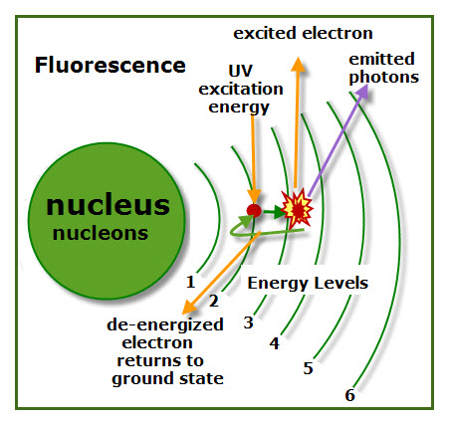
Atoms and molecules can possess potential energy in the form of an electron that has absorbed energy and moved to an excited state (an orbital other than the lowest energy orbital available).

Slide 4
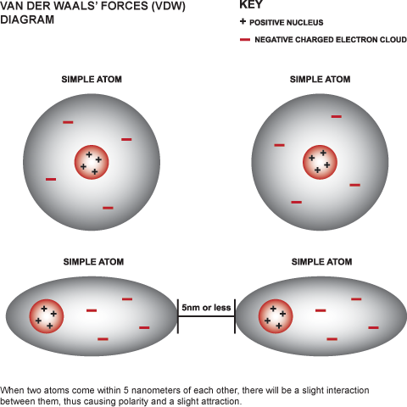
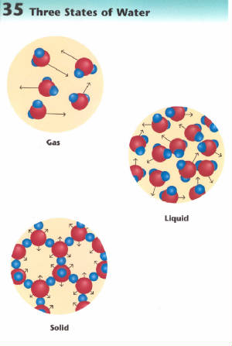
Groups of molecules (bulk matter) can possess an electric potential energy based on their configurations. States with positive and negative charges close together are lower in energy than states where they are separated..

Slide 5
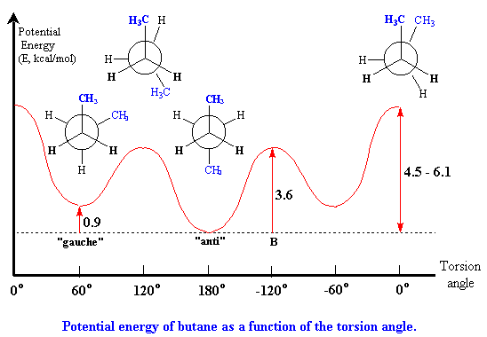
A molecule may possess a potential energy due to the proximity of charged groups/electron clouds with respect to one another.

Slide 6
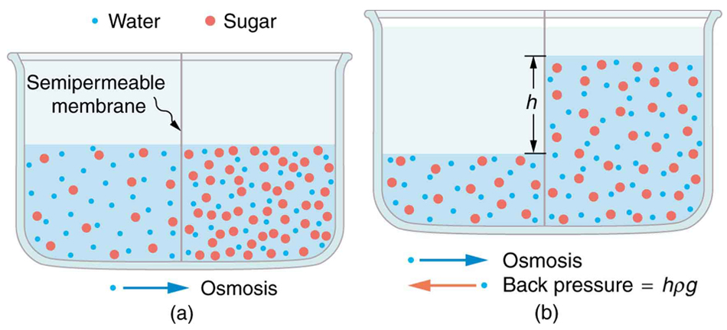
Osmotic pressure is due to a difference in potential between two solutions

Slide 7
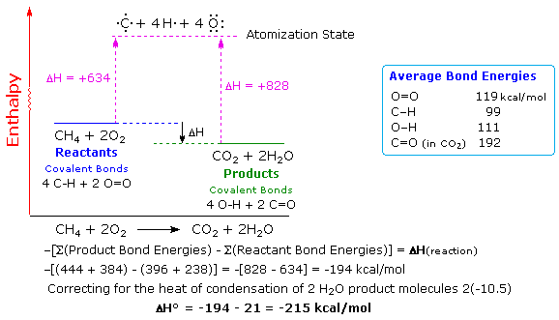
A system composed of hydrocarbon molecules and oxygen molecules possesses a potential energy because the atoms could potentially re-arrange to form the lower energy carbon dioxide and water molecules

Slide 8
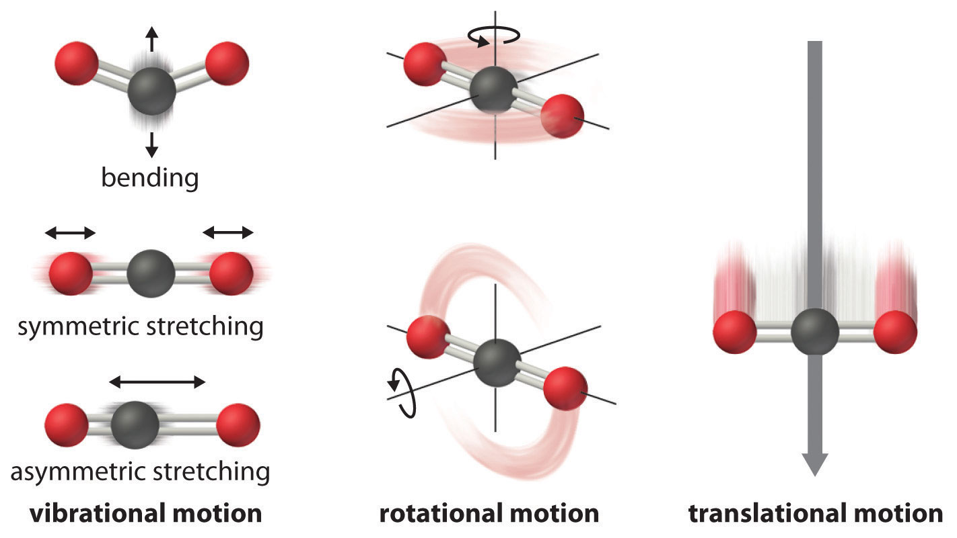
Kinetic Energy takes a variety of forms
Atoms/Molecules can have kinetic energy associated with the translation of their centers of mass
Molecules can rotate about their center of mass and so can store kinetic energy in the motion of rotation
Molecules can vibrate along/about their bonds and so can store kinetic energy in the motion of vibration
Notes:
Mention vibrational modes of bulk matter

Slide 9
The Internal Energy of a System is the sum of the Kinetic and Potential Energies
U = Kinetic + Potential

Slide 10
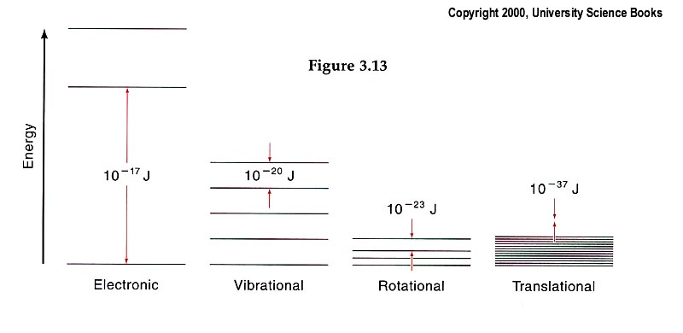
Quantization of energy
The heat capacity represent the capacity of the system to store energy

Slide 11
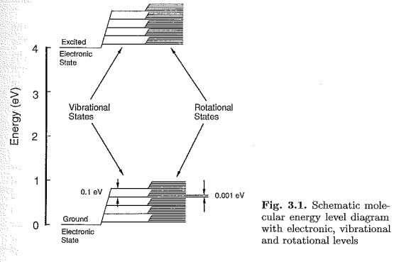
The amount of energy stored in these different “degrees of freedom” varies with each mode.

Slide 12
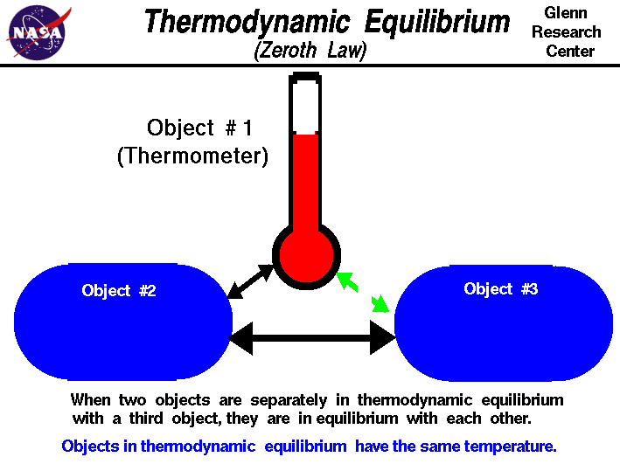
The Zeroth Law of Thermodynamics and Temperature
“If two thermodynamic systems are each in thermal equilibrium with a third, then all three are in thermal equilibrium with each other.”

Slide 13
The Ideal Gas Law

Slide 14
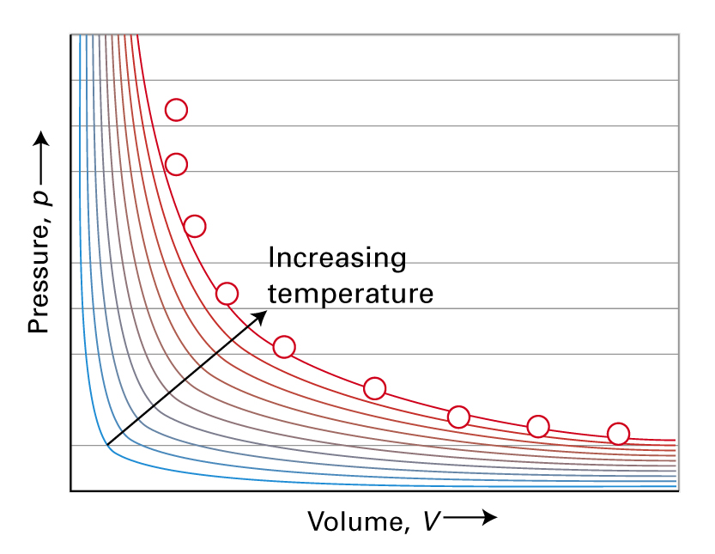
Volume vs. Pressure
Boyle’s Law:
at constant T and n
P_{i}V_{i} = P_{f}V_{f}
Notes:
Boyle law (1662): Volume (V) of a given amount of gas at const T is inversely proportional to its pressure (PV constant) (amount of gas and T remain the same (n # of moles). P vs V plot is a isotherm we saw before. That law is used to determine P when V changes. For an initial and final values for the gas we can write down P₁V₁=P₂V₂ (constant n and T) n – number of moles
Hyperbola

Slide 15
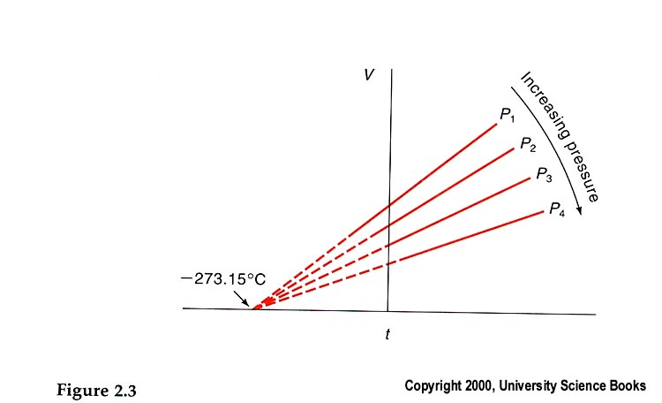

Volume vs. Temperature
Charles’ Law:
at constant P and n (V/T constant)
P const. V increases with T
Note that at -273.15 ºC (0 Kelvin) the volume of the gas is zero.
Notes:
Now assumed the temperature is changing!
Relationship between V and T at constant P (V/T constant)(1800). It was observed when the T goes up V expands at constant pressure. This graph (isobar)
Kelvin identified -273.15 C as an absolute zero. (T/K=t/C + 273.15K). Using of K defined by the International system of units (SI) based on thermodynamic (absolute) temperature scale as the temperature with the theoretical absence of all thermal energy. (0 entropy). Close to absolute zero – superconductivity (no resistance). Background temperature of the universe is 2.7 K
Dashed lines indicate that gas might not exist (phase diagram). Gas condenses to a liquid.

Slide 16
Avogadro’s Hypothesis
the volume of a gas is proportional to the number of molecules in the gas
Constant (constant T & P)
Equal volumes of gases at the same pressure and temperature contain the same number of molecules (Avogadro law).
Notes:
(1811) Equal volumes of gases at the same T and P contain the same number of molecules. The concept means that V/n= constant at constant T and P

Slide 17
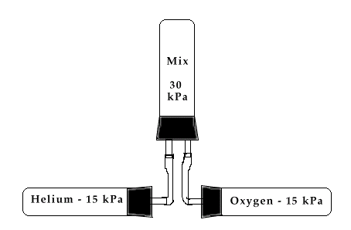
Dalton’s law
The total pressure of a gas mixture is equal to the sum of the partial pressure of each gas
  P_{T} = P₁ + P₂ + P₃ + … P_{n}
http://library.thinkquest.org/12596/index.html
The mole fraction of a gas is the ratio of the number of moles of one gas to the total number of moles of all the gases present
Notes:
So far we talked about the single gas. However, in most cases we work with mixture of gases. The total pressure of the gas would be equal the sum of the all the individual gases or partial pressures of the component 1, 2, 3,.
Dalton law is 1844 after Boyle law and Charles law.
System has 2 gases at T and V and their partial pressures will be defined as P1 and P2, So Pt = P1 + P2
P₁ = n₁RT/V and P₂ = n₂RT/V
P_{T} = P₁ + P₂ = n₁RT/V + n₂RT/V = (n₁ + n₂)RT/V
Divide the partial pressure by the total P₁= n_{1 /}(n₁ + n₂)Pt=X₂Pt
X1 and X2 is the mole fractions of gases.
Now this leads to how the partial pressures determined; A manomenter can measure only the total pressure of a gaseos mixuters. To obtain the partial pressures we need to know the mole fractions of the components. Partial pressures can be measured with mass spectrometry

Slide 18

Relationship between P, V and T
As the volume of a gas decreases, the pressure increases
As the pressure increases, the temperature increases.
Notes:
PV=nRT

Slide 19
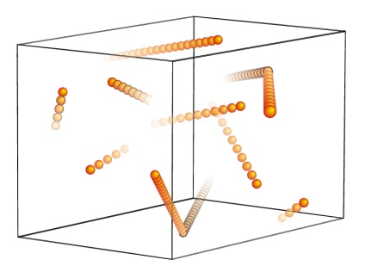
Model for the kinetic theory of gases
A gas is made up of a great number of atoms or molecules, separated by distances that are large compared to their size.
The molecules have mass but negligible volume, compared to avg. distance traveled
Molecules are in random motion.
There is no interaction between molecules or atoms (attractive or repulsive), except collisions
Collisions are elastic, i.e. Kinetic Energy is conserved.

Slide 20
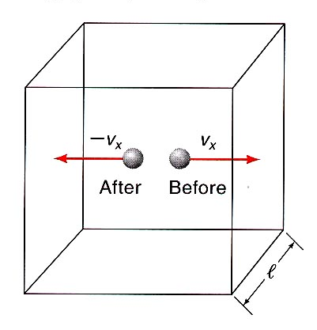



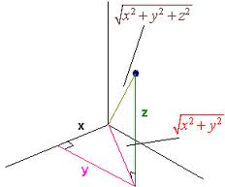


Kinetic Theory helps to explain Ideal Gas Law
When a gas molecule collides elastically with the surface of a container there is a momentum (p) change and this exerts a force on the wall.
According to classical mechanics F = dp/dT and p = mv.
The time between collisions is related to the size of the container
The force exerted on the wall by a single particle is then:
For a system with N gas particles, the total force on the wall is
The average velocity in the x-direction is related to the total average velocity.
The force in terms of the average total velocity can then be written as
Pressure is force/area. For our model A = L² so…

Slide 21
Kinetic Energy and Pressure
Pressure is directly proportional to the average kinetic energy and the mean-square velocity
The larger the velocity the more frequent the collisions and the greater the change in momentum.

Slide 22
Kinetic energy and Temperature
Equating the kinetic and IDG expressions for pressure we can relate kinetic energy to temperature
If two ideal gases are at the same temperature they must have the same average kinetic energy.
1.381 x 10⁻²³ J K⁻¹
Notes:
n=N (number of molecules)/N_{A} where N_{A} = (6.022 x 10²³ molecules/mol) (R 8.134 J K⁻¹ mol ⁻¹ = 0.08206 L atm K⁻¹ mol ⁻¹ )
Where R=k_{B}N_{A} and k_{B} is the Boltzman constant.
Significance of last equation: provides an explanation for the temperature of a gas in terms of molecular motion. For this reason random molecular motion is sometimes referred to as thermal motion.
Note that this is a statistical treatment of the model. Can’t associate temp with a few molecules. Don’t have to worry about size, molar mass or amount of the gas present as long as N is large.
We’ll see later that the mean kinetic energy of one molecule is proportional to absolute temperature.

Slide 23
Root-mean square velocity
ν²-difficult to measure, however it can be obtained from E and T
ν_{rms} is the root-mean-square velocity
  ν_{rms} ∝ square root of temperature
  ν_{rms} ∝ square root of the molar mass of the molecule⁻¹
Notes:
The relationship between the E and T allows to calculate the mean square velocity (V²).
W/o it we have to measure all the velocities, than square it and than take an average (V²=(V²1+V²2+V²2…V²N )/N
Taking the square root gives you rms. RMS – statistical measure of the magnitude of a varying quantity. (especially useful when variates are positive and negative)
M = mN_{A} (molar mass in kg/mol⁻¹). We are talking about single molecule, however it is still n/m
Vrms is directly proportional to a square root of molar mass of the molecules and also related to an energy of the gas. So Vrms can represent the mean kinetic energy of the gas. THE HEAVIER THE MOLECULE THE SLOWER ITS MOTION.
Ask them to predict whether He or O₂ would move faster? He b/c its lighter.
So if we wanted to find two temps at which they were moving at the same speed, which molecule would need to be colder? (He because it’s smaller and therefore will move faster).
v_{rms} is scalar: magnitude but no direction
Note that velocity is a vector quantity (magnitude and direction) and so the average molecular velocity must be zero (just as many going in the positive direction as the negative).

Slide 24
Group Quiz:
A mixture of 2 moles of Oxygen gas and 4 moles of Hydrogen gas are in a container at 300K and 1 atm of pressure. Assume the gasses behave ideally.
R = 0.08206 L atm/mol K
  What is the volume of the container?
  What is the pressure exerted by each gas in atmospheres?
  What is the ratio of the average speed of an Hydrogen molecule to the average speed of an Oxygen molecule?
  If temperature increases to 1200K by what factor do the speeds change?
  Consider an individual oxygen molecule and an individual hydrogen molecule in this mixture. Which possesses more translational kinetic energy?
  Calculate the average change in momentum when an oxygen molecule hits the wall of the container and when a hydrogen molecule hits the wall of the container. Do these numbers make sense considering your answer to part D? Is there anything else we need to consider?

